Slide 1
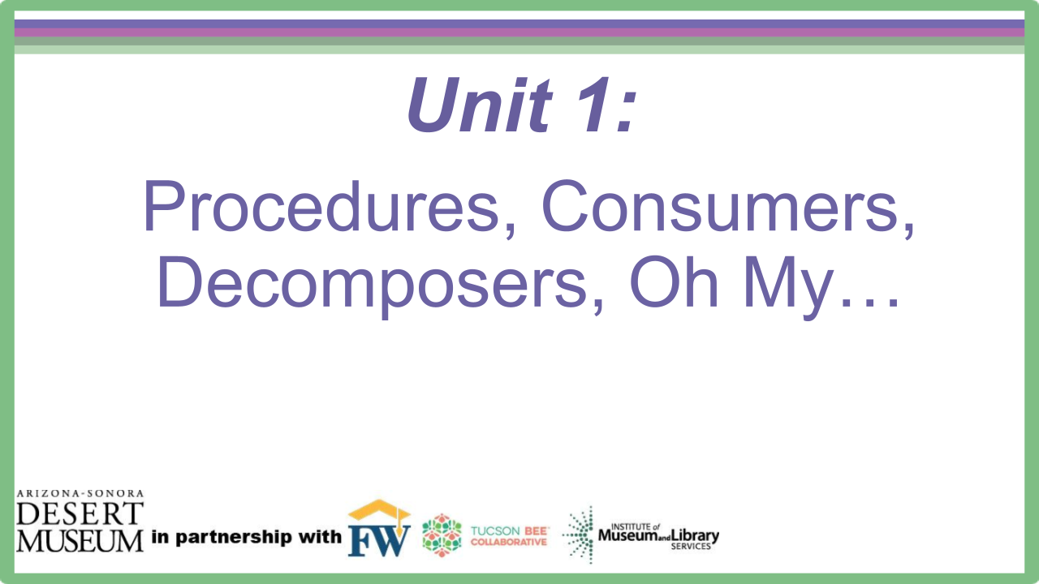
Producers, Consumers, Decomposers, Oh My…
Notes:
Introduce the driving questions for the next 3 weeks.

Slide 2
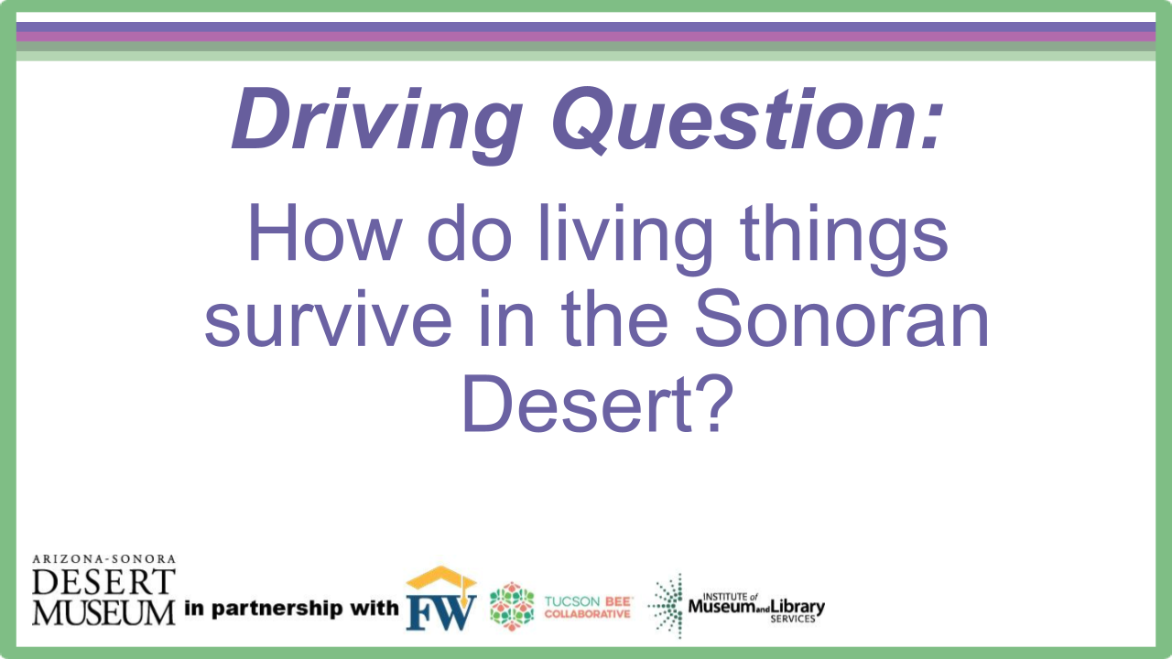
Notes:
Introduce the driving questions for the next 3 weeks.

Slide 3

Probe
What do you know about the Sonoran Desert?
Draw a picture of what you think the Sonoran Desert looks like.
Include:
Plants
Animals
Landscape
Labels of what you draw
You can use colored pencils or crayons to complete your drawing.
Notes:
Give students a blank piece of paper and ask them to create a drawing of the Sonoran Desert, including the plants and animals they know live there. Have them include labels in the drawing. Collect this and save it for the end of unit 3. Students will be adding to or creating a new drawing of their understanding.

Slide 4



Biodiversity Video Link
https://us-east-2.protection.sophos.com/?d=youtu.be&u=aHR0cHM6Ly95b3V0dS5iZS92Xy1ucW8yNVZvWQ==&i=NjE1YjcxMmU5ZTMxNGEwZjUyYmZiZjI3&t=cnNoZU5FelRpbmZnY2FHeTl3d0ExdGpDQ3M5bjFJc0NWekdtaXFIVTRqND0=&h=a5311c76853b449c98f3198f01123344
Engage
Photograph by Jay Pierstorff
Notes:
Introduce the two vocabulary words before watching the video.

Slide 5
What are some of the things you noticed in the video?
What are some of the things you are wondering about?
Engage
Notes:
After the video ask the questions in the lesson plan to elicit a conversation about the stats seen in the video. Students can write any wonders onto a post-it and add it to the wonder wall.

Slide 6

Engage
Read the mini graphic novel and think about any new information you learned and more things you notice and wonder about the Sonoran Desert.
Notes:
Give each student a copy of the graphic novel and allow students to read on own or in pairs. Some students may need help reading some of the vocabulary. Discuss any new notices or wonders and add wonders to the wonder wall.

Slide 7

Inductive Sort
Explore-Part 1
An inductive sort is using reasoning and drawing conclusions from what you observe before learning specific content.
Rules for the sort:
Minimum of three categories
At least 2 pictures in each category
  No groups of 1
Reason why you grouped pictures together
Each table group will receive an envelope containing pictures.
Your job:
  With your tablemates, sort the pictures into groups based on similar attributes.
Notes:
Give each group an envelope with group #1 of photos. While groups are working, walk around and facilitate discussions, question why they made certain placements, give suggestions for a group they could start, and encourage them to try categorizing them in a new and different way after they have completed it one way. Acknowledge that there will be more than one way to group them. Have a class discussion about some of the ways they grouped the pictures.

Slide 8
Inductive Sort Continued
Explore-Part 2
Producers | Consumers | Decomposers
Get a poster board and label the three categories.
Decide where each group of pictures should go.
Tape each picture to the poster board.
Work with your group to come up with a definition for each category. What do you think producers, consumers, and decomposers are? Write your definition on a post-it.
Definition
Notes:
Give each group a poster board and have them label the three categories with Producer, Consumer, and Decomposer. Have students look at the pictures again in their groups and decide which pictures will go under each group. While students are working, go to each group and facilitate discussions and ideas. After they have decided, students should tape the pictures down.
Give each group 3 post-its. They will write what they think the definition of each category is based on the attributes and criteria each picture in the group fits. Make sure all teammates can explain and provide different examples that could fit in each group.

Slide 9
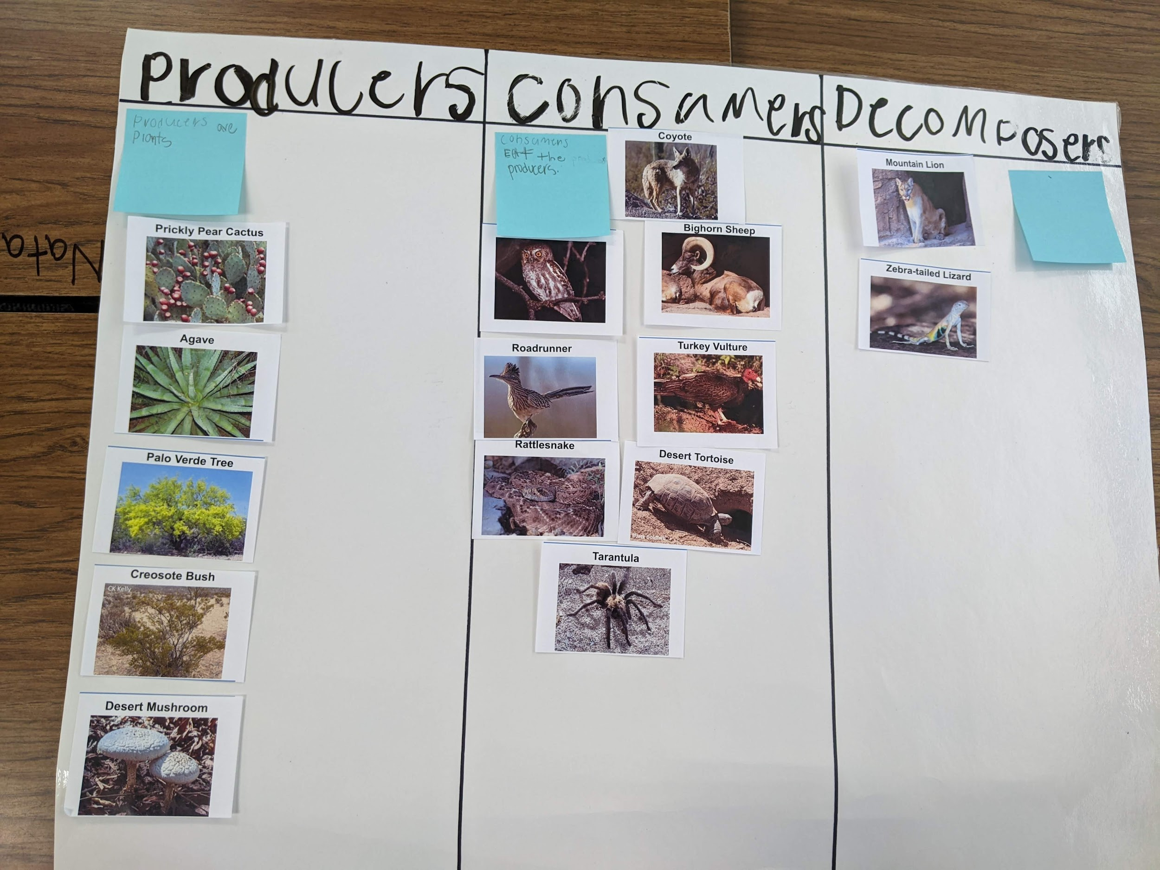
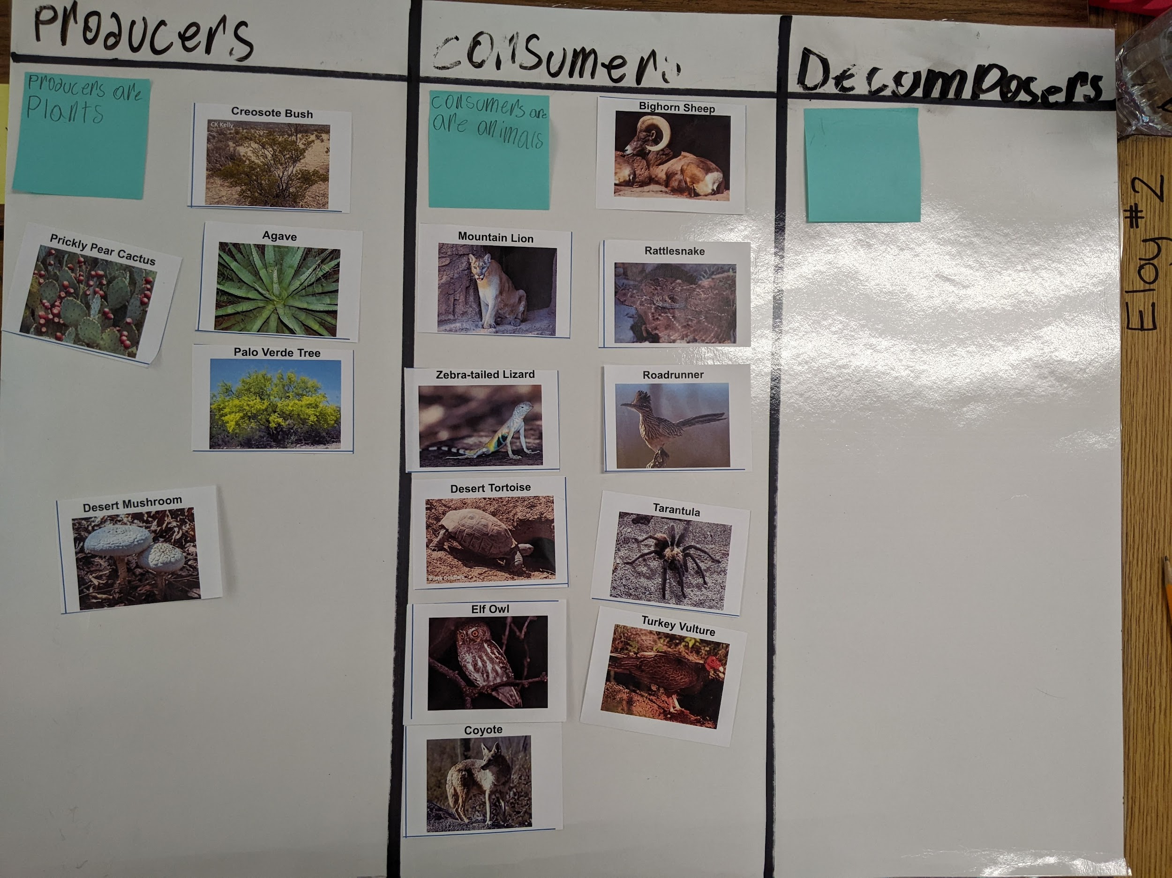
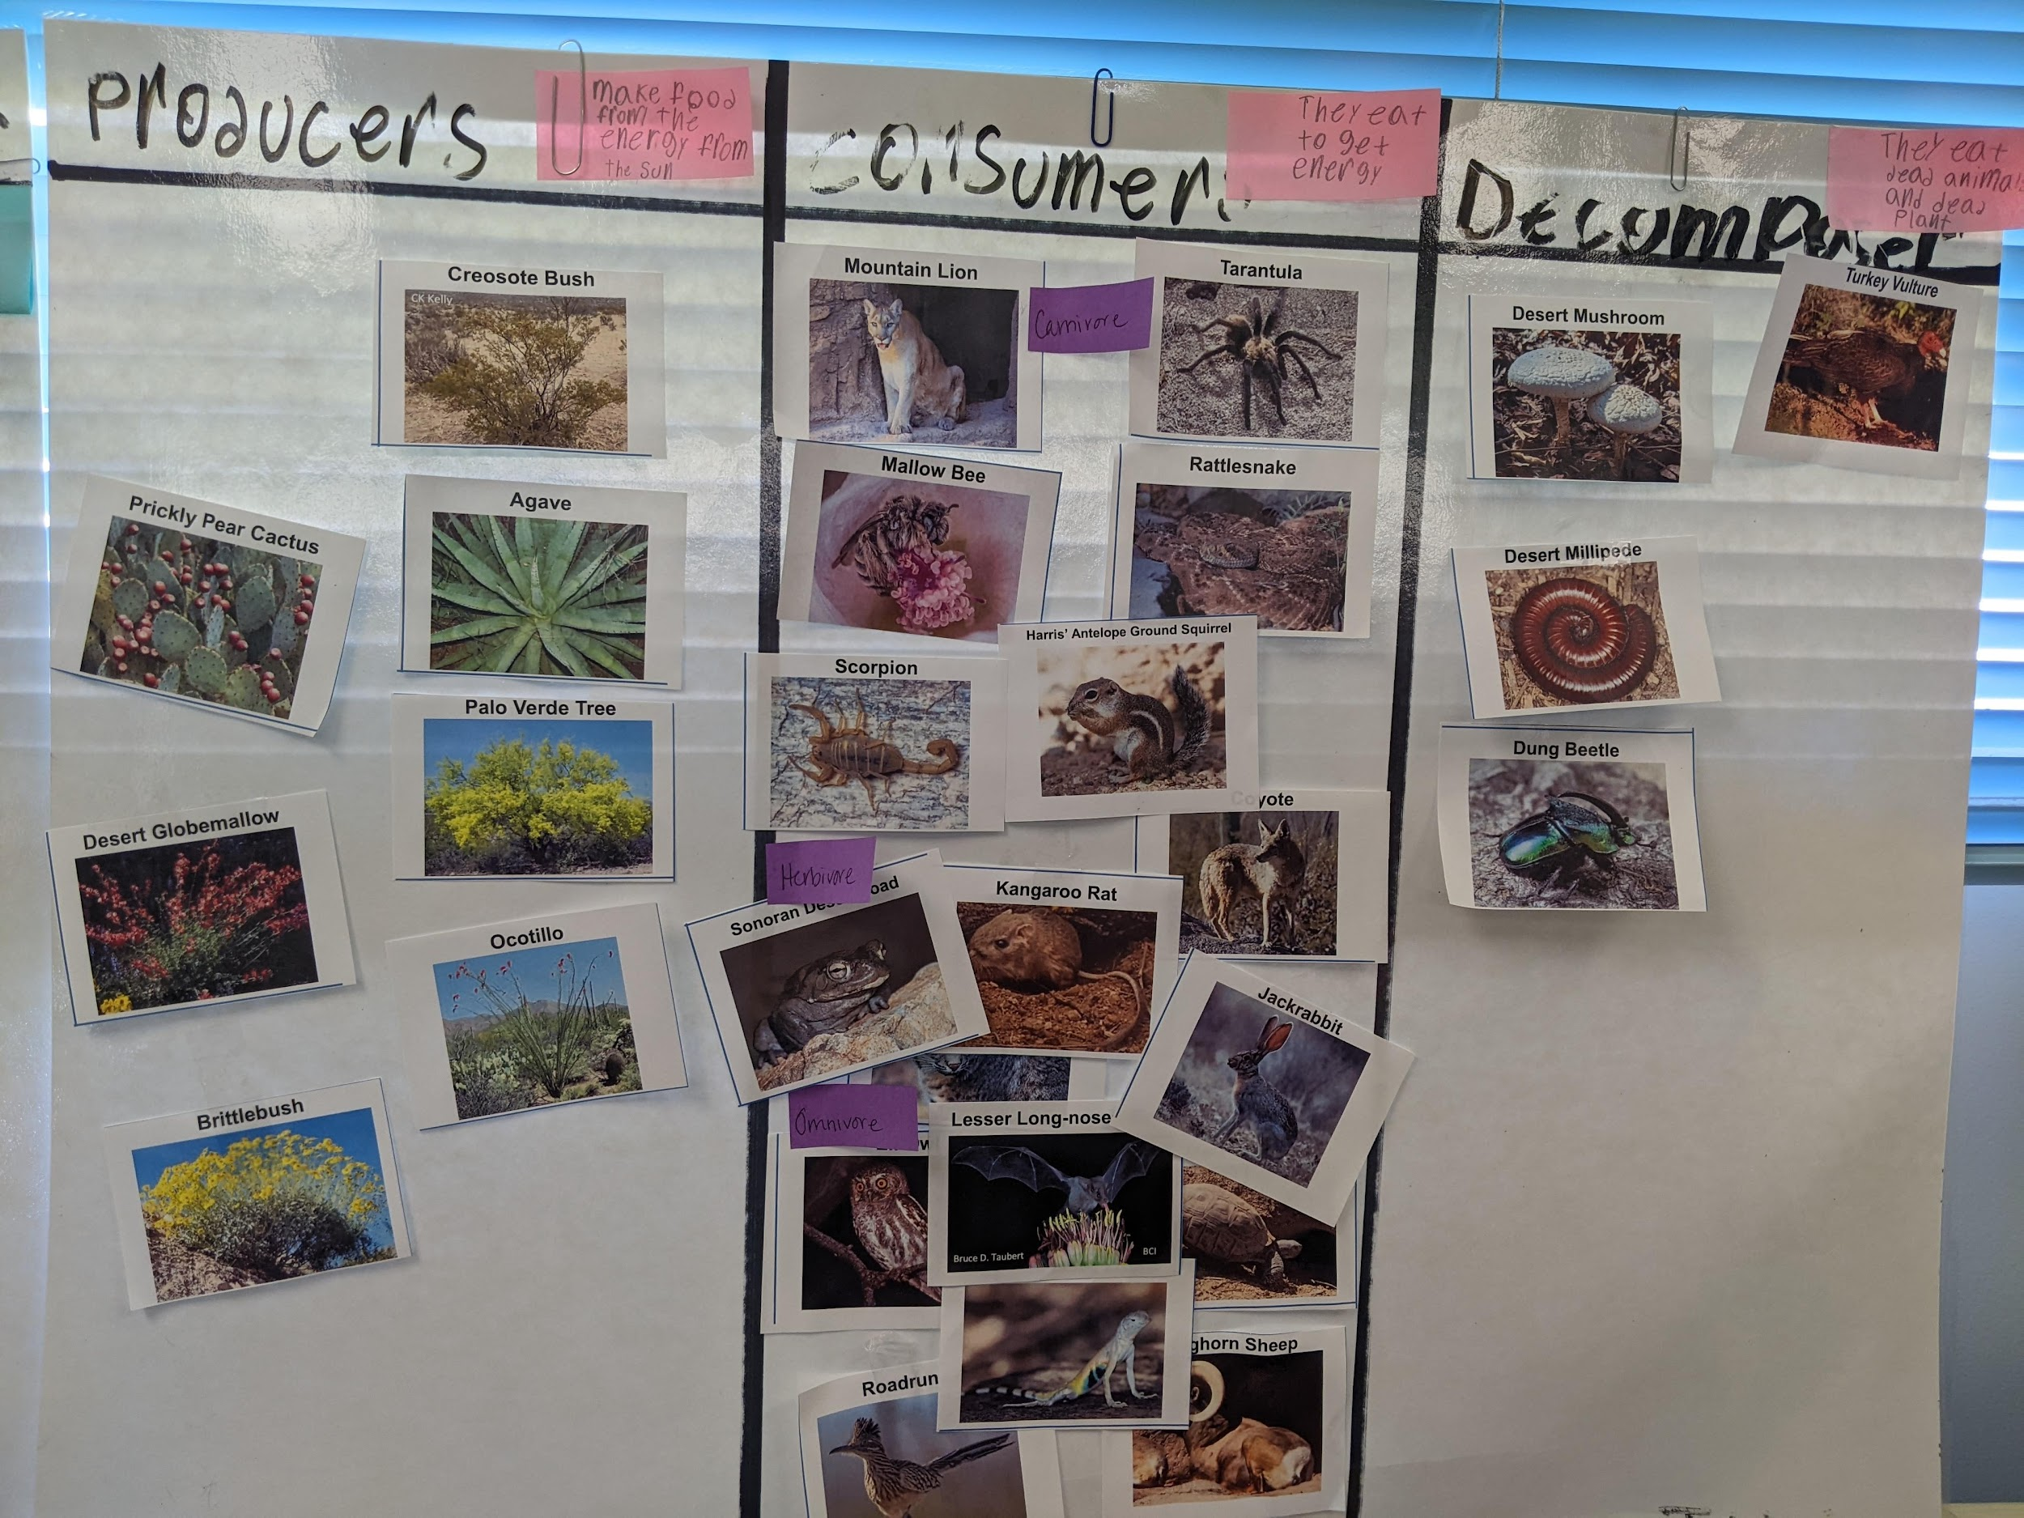
Carousel Walk
Explore-Part 2
Leave your poster board at your group table.
As a group, walk around the room and look at the other posters.
Be thinking about: What similarities in definitions did you notice? What differences? How did other groups place their pictures?
3. When back at your seat, be ready to share one of the ideas your group discussed from your carousel walk.
Notes:
Have each group leave their poster boards at their group work space and allow students to do a carousel walk. This is where they will walk as a group to observe how other students grouped their pictures and the definitions they came up with for each category. When students return to their desks, have a class discussion with think-pair-share.

Slide 10
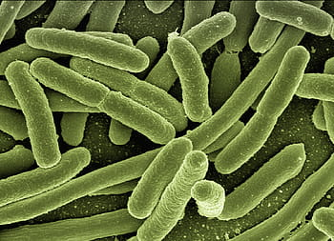
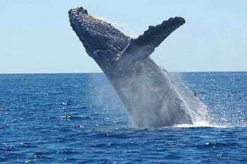
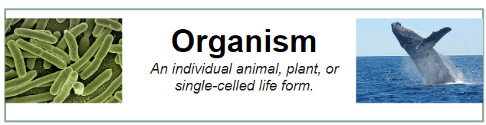
An organism …..
Explain
An individual animal, plant, or single-celled life form.
Can be as small as a
single-celled bacteria.
Can be as large as a whale!
Notes:
Put up vocabulary words when introduced throughout the next few slides.

Slide 11
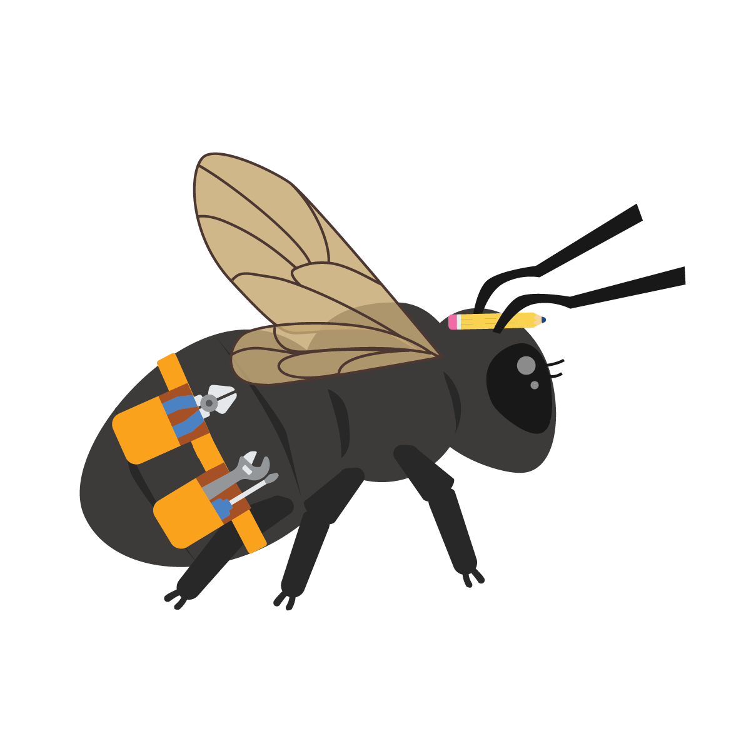
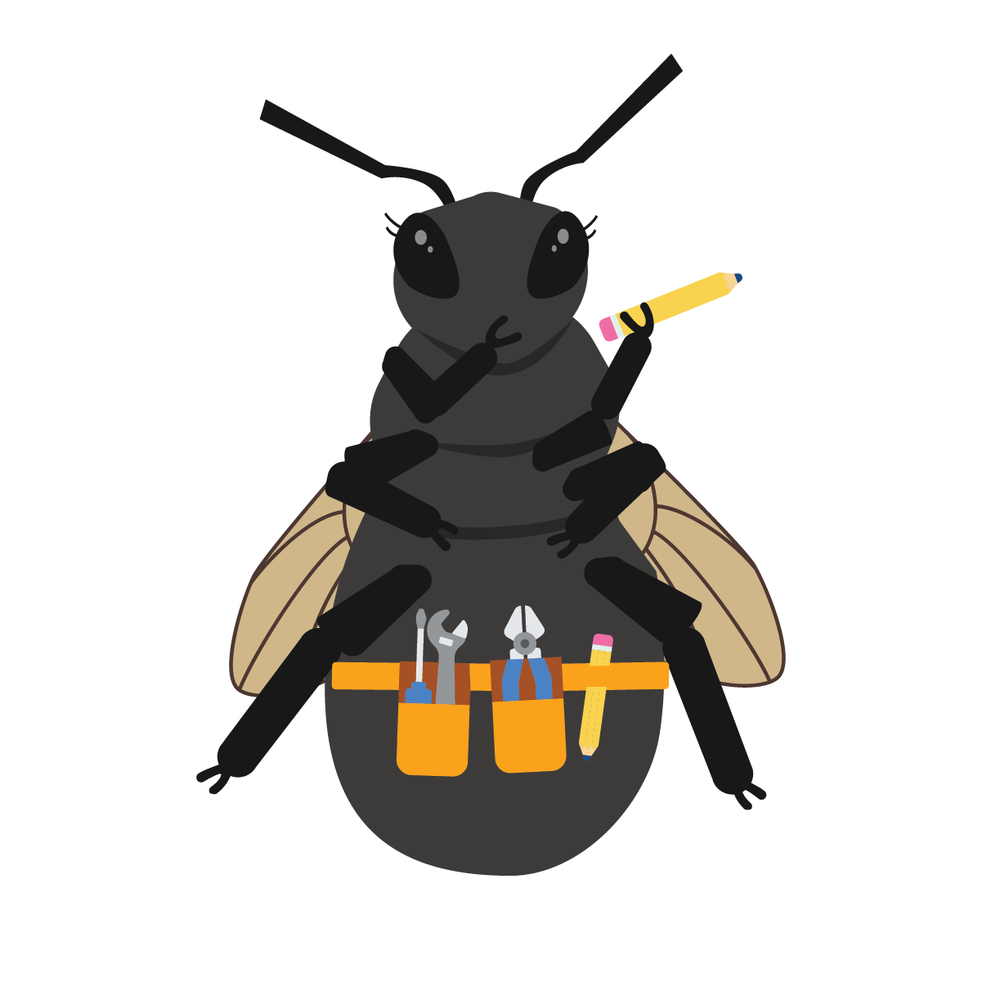
Scientists have divided living things into groups according to the job they do in nature.
Explain
Producers
Consumers
Decomposers
They are all dependent on each other.

Slide 12
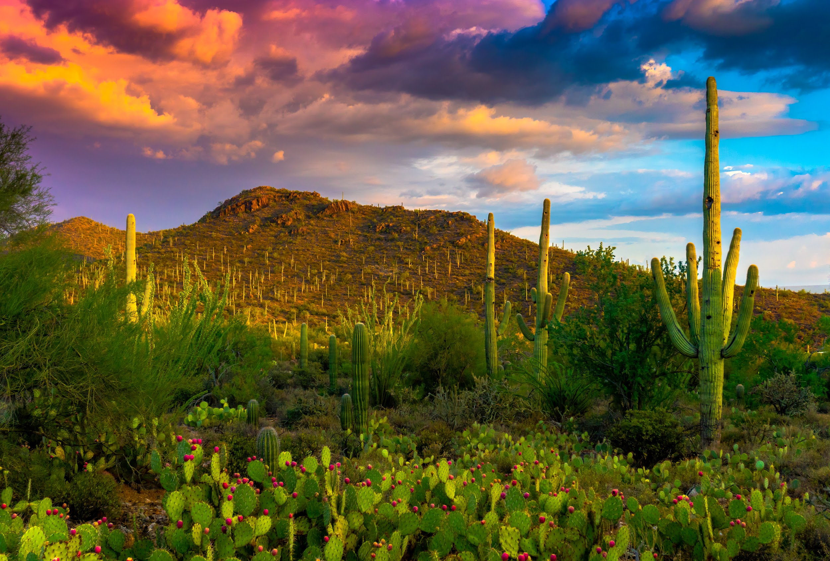
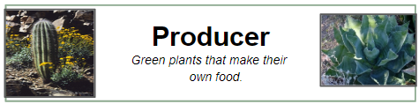
Producers
Explain
Producers are green plants that make their own food with energy from the sun.
Photograph by Jay Pierstorff

Slide 13
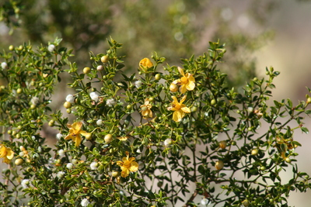
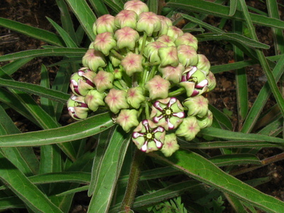
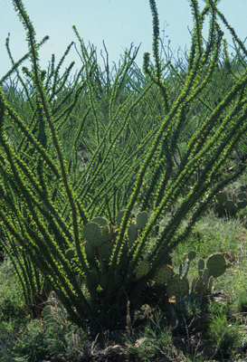
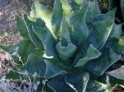
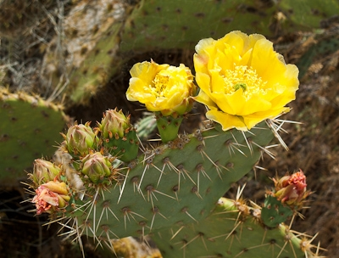
Explain
Creosote Bush
Milkweed
Ocotillo
Agave
Prickly Pear

Slide 14

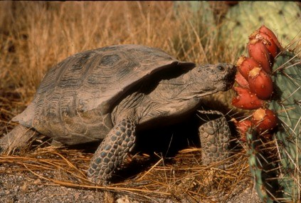
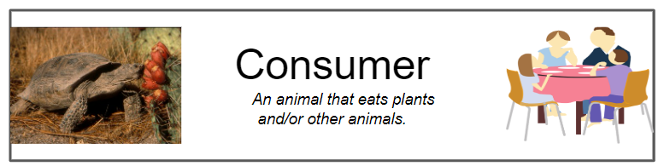
Consumers
Explain
Animals that eat plants and/or other animals.
Consumers need to eat their food to get energy.
Desert Tortoise

Slide 15
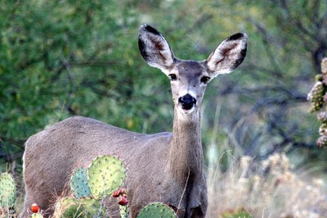
Types of consumers
Explain
There are THREE types of Consumers:
  Carnivores
  Herbivores
  Omnivores
It’s still all about what you eat!
Mule Deer

Slide 16
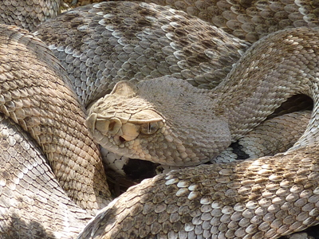
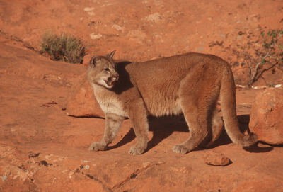
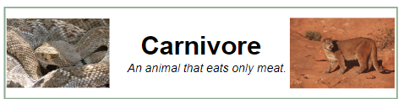
Carnivores only eat meat (other animals).
Explain
Rattlesnake
Mountain Lion

Slide 17
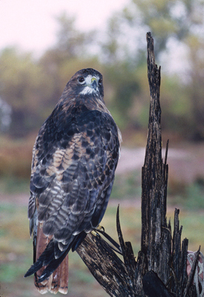
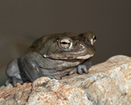
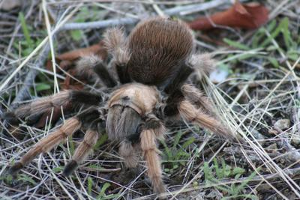
Explain
Sonoran Desert Toad
Red-Tailed Hawk
Tarantula

Slide 18
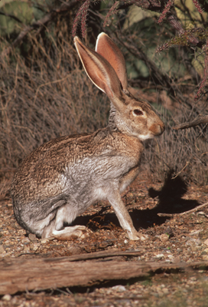
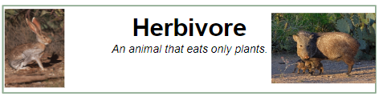
Herbivores eat only plants.
Explain
Jackrabbit

Slide 19
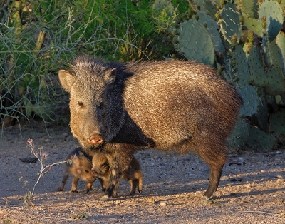
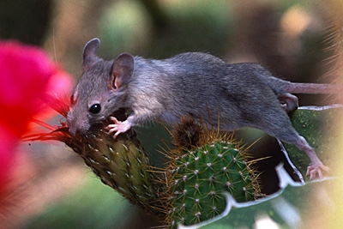
Explain
Desert Tortoise
Packrat
Javelina

Slide 20
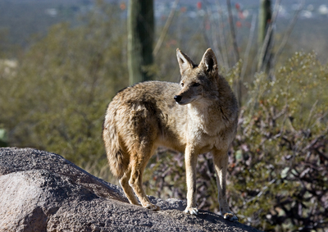
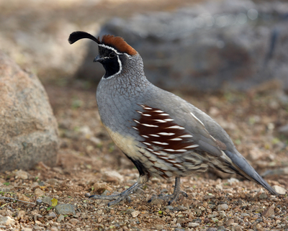
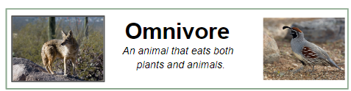
Omnivores eat both meat (animals) and plants.
Explain
Coyote
Gambel’s Quail

Slide 21
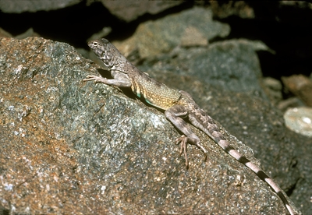
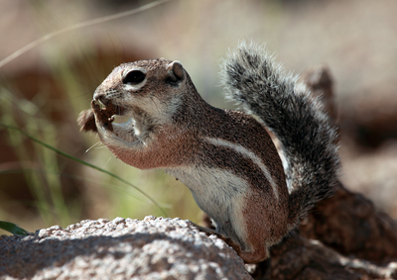
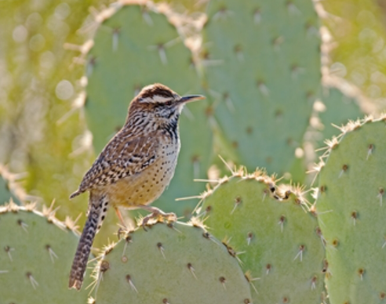
Explain
Zebra-Tailed Lizard
Harris’ Antelope Ground Squirrel
Cactus Wren

Slide 22
Stop…Review…Check…
Turn to your partner and tell them the meaning of each word. Also give two examples of each.
Explain
Carnivore:
Herbivore:
Omnivore:
Notes:
Have students think, pair, share to do a quick check for understanding of the three types of consumers.

Slide 23
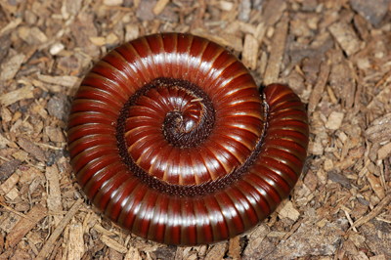
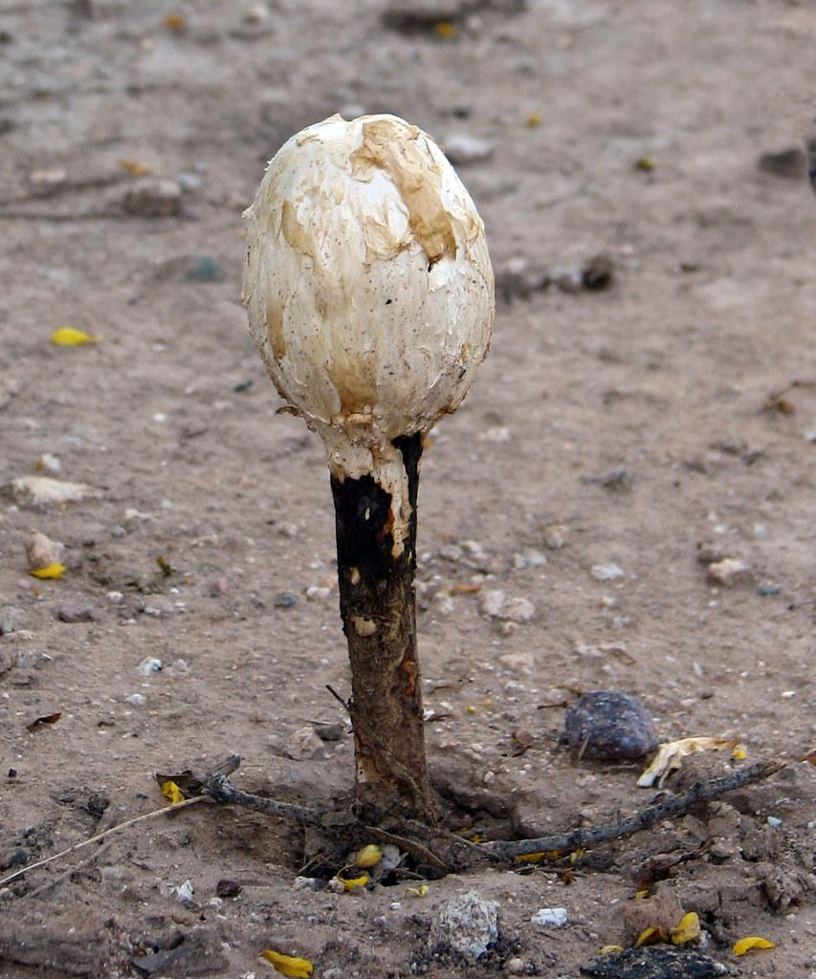
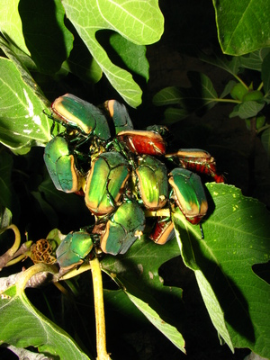
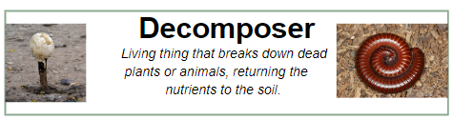
Decomposers
Explain
Decomposers are living things that break down dead plants or animals, returning the nutrients to the soil.
Examples:
  Mushrooms
  Worms
  Bugs
Millipede
Desert Mushroom
Fig Beetle

Slide 24
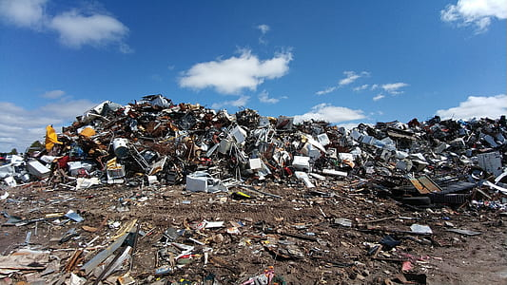
What would the world look like without decomposers?
Explain

Slide 25
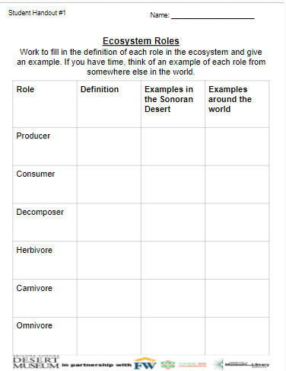
Explain
What did I learn?
Work in pairs to write:
The definition of each role
An example from the Sonoran Desert
An example from somewhere else around the world.
Extension: If you have time, add more examples to each role and start thinking about how these roles work together in the Sonoran Desert Ecosystem.
Notes:
Have students think-pair-share about the relationship between all the different types of living things and connect back to the groups they made on their boards since you will revisit them the next lesson. Pass out student handout #1. Have students work in pairs to fill in the definitions of each role and an example from the lesson. This can help them in future activities in the module.

Slide 26
Revisit your poster
Elaborate-Part 1
Now that we know what producers, consumers, and decomposers are, we will revisit our initial sort.
You will have a chance to:
Revise your original definitions
Move pictures if needed
Add new pictures
Create three new categories under consumers and place pictures where you think they belong.
Notes:
Students will go back to their posters to revise their definitions, add the types of consumers (omnivore, herbivore, carnivore) and move any needed pictures. Give the students the next set of pictures to have them add to their charts. These posters should be kept for future units to reference and add to. Ideally find a space to hang them up so students can easily see what they have done.

Slide 27
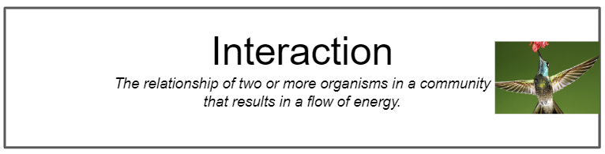
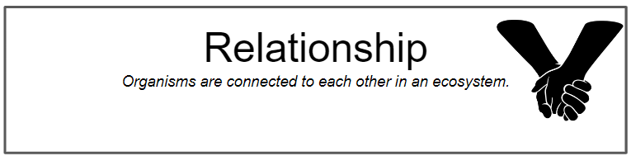
How are organisms connected
in an ecosystem?
Elaborate-Part 2
All living things in an ecosystem interact with other living things.
The interaction is the relationship between the living things.
Interaction is the relationship of two or more organisms in a community that results in the flow of energy.
The relationship is how organisms are connected to each other in an ecosystem.
Notes:
Go over the vocabulary words and discuss what some examples would be.

Slide 28
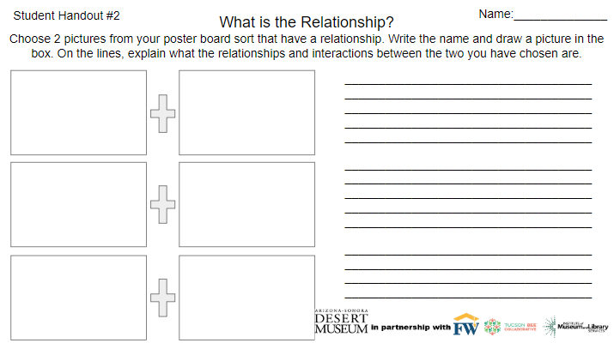
Elaborate-Part 2
What is the relationship?
Choose 2 pictures from your poster board sort that have a relationship.
Write the name of each one and draw a picture in each box.
On the lines, explain what the relationships and interactions between the two you have chosen are.
Do this for three pairs.
Notes:
Pass out student handout #2 and have students choose two to three sets of animals and/or plant combinations and have them explain the relationship between them. Introduce the meaning of the word relationship and interaction so they can think about how the combinations interact with each other. They can work through the relationships using the team-pair-solo cooperative structure. When completing their written response to the relationships, they should work on their own. If there is time, students can write a story about the relationship between one of the pairs.

Slide 29
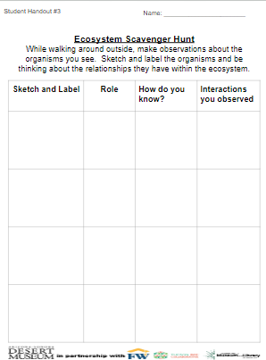
Evaluate-Part 1
Ecosystem Scavenger Hunt
We are going on a hunt for organisms around our campus.
While we are on the hunt pay close attention to what you are seeing.
When you see a living organism, sketch it on your paper and label it.
When we return to the classroom, you will be writing the role of each living organism, how you know it fits this role, and any interactions you observed.
Notes:
Students will be using student handout #3. They will be taking what they have learned about producers, consumers, and decomposers and will go on a scavenger hunt. Take students outside to the schoolyard, garden, or any outside space. In new small groups, have students look for evidence of producers, consumers, and decomposers and draw the organisms or signs of the organism on their worksheet. When they return to class, they can write an explanation about each organism they saw and why it fits into the specific role.

Slide 30
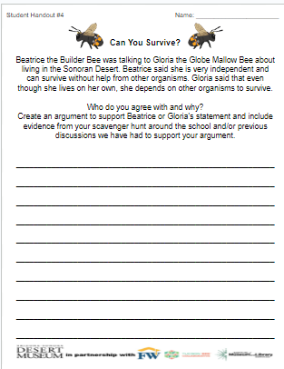
Evaluate-Part 2
Beatrice and Gloria disagree!
Who do you agree with and why?
Use evidence to support your argument about who you agree with.
Sentence Starters:
I agree with……
She thinks……….
I know this because……
Evidence can come from:
Your scavenger hunt
Class discussions
Observations from our posters
Notes:
Students will be using student handout #4. Read the argument from the handout about Beatrice and Marisol. The bees are arguing about whether you need other organisms to survive. Have students choose a side and argue why that side is correct. Students should use evidence from the scavenger hunt the session before to support their argument and/or what they have learned from previous discussions.

