Slide 1
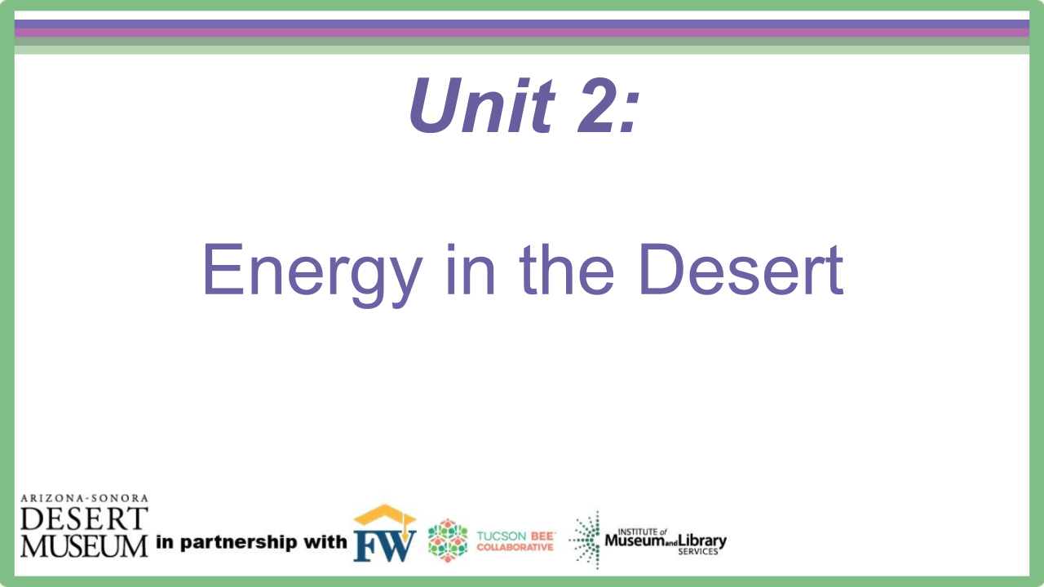
Notes:
Introduce the driving questions for the next 3 weeks.

Slide 2
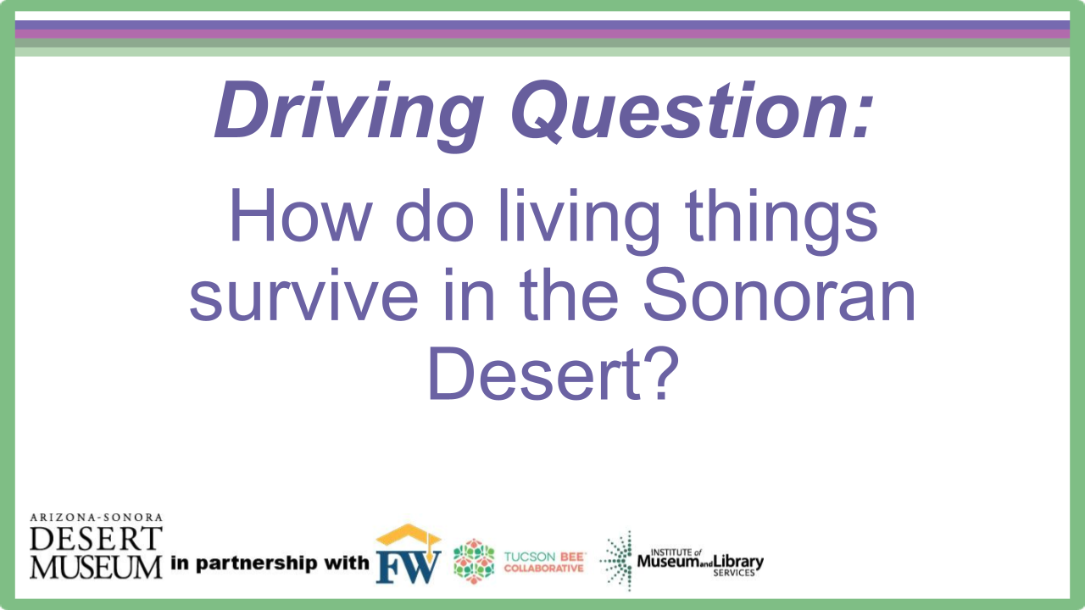
Notes:
Introduce the driving questions for the next 3 weeks.

Slide 3

Engage
What do you like to eat for breakfast in the morning?
Does anyone eat sunlight?
Notes:
Prior to the start of the lesson draw a sun on the whiteboard or use one of the suns from the print out. Ask students to think-pair-share what they ate for breakfast that morning or what their favorite thing to eat for breakfast is. Make a list of their answers on the board. Ask students, ‘Did anyone eat sunlight for breakfast?’ Tell students that the energy in everyone’s food can be traced back to the sun. They will be exploring how energy is transferred within the Sonoran Desert.

Slide 4
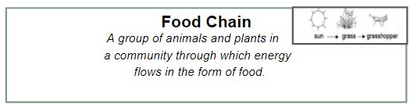
Food Chains
Explore
Food chain- a group of plants and animals in a community through which energy flows in the form of food.
Food chains have 3 levels:
  Level 1 – Producers
  Level 2 – Consumers
  Level 3 – Decomposers
Notes:
Students can use their note sheet from unit 1 to remind them what the different roles in an ecosystem are. Be sure to review producer, consumer, and decomposer with the students as well as carnivore, omnivore, and herbivore.

Slide 5


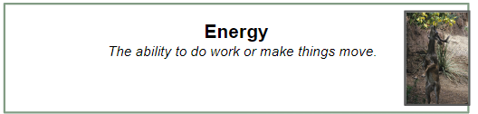
Food Chains
Explore
All food chains start with the sun… plants need to get their energy from somewhere!
Energy is the ability to do work or make things move.

Slide 6

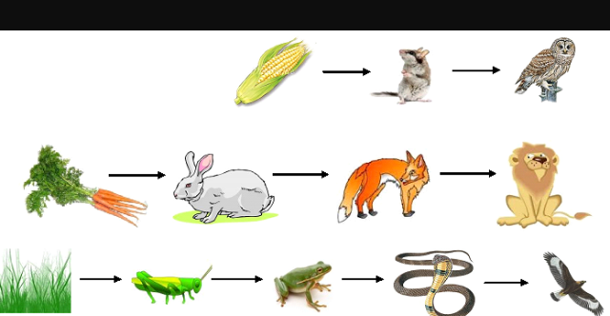
What do you notice?
Explore
Notes:
Have a discussion with the students about the three different food chains shown here. Ask what they all started with, what do they notice about the direction of the arrows, what do they notice about the last living organism in each food chain.

Slide 7
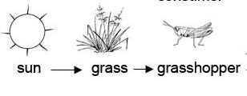
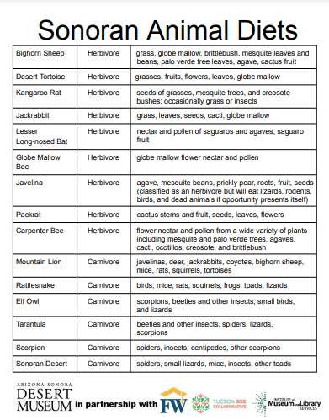
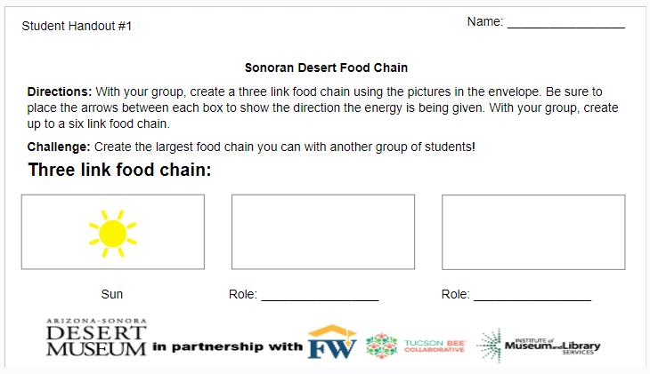
Sonoran Desert Food Chain
Explore
With your table group, empty the envelope in the middle of your table. Work together to create a food chain using only three of your picture cards.
Use two slates and draw an arrow on each one to show where the energy is going. For example:
When you have decided on a three link food chain, fill in your worksheet.
Notes:
Students will need student handouts #1 and #2. Student handout #2 will be useful when students are trying to figure out animals eat specifically in Sonoran Desert. Please take a moment to explain how to use student handout #2. You can have students first work on a three link food chain and then come back whole group to discuss before moving on to the six link food chain. Students will need to draw their own arrows to show where the energy is going on all the food chains. You will want them to write the names of the living organisms in the boxes. They will be filling in the roles later.

Slide 8
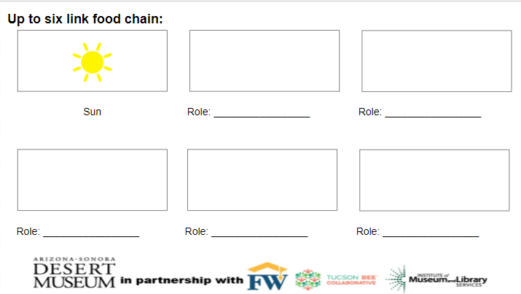
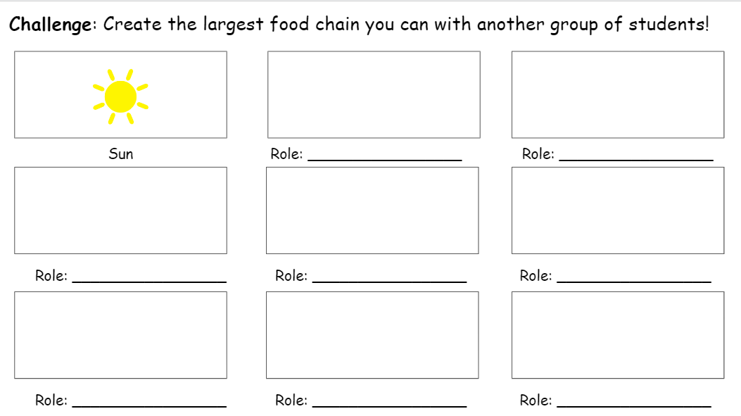
Sonoran Desert Food Chain
Explore
Next, work together to create up to a six link food chain. You will continue to use slates and arrows to show directions of where the energy is going. Complete your handout with your group.
Extension: Work together with another table to combine pictures to create the largest food chain. Be sure to use slates and arrows before committing it to your handout.
Notes:
The challenge is for 2 groups to work together to see if they can make a longer food chain. They could add in a decomposer as well. Remind them to write the names of the living organisms in the boxes and add arrows. They can add pictures if they have time as an extension.

Slide 9
Continued...
Explore
Return back to your table group and work together to label the role of each living thing.
Challenge: Identify the specific consumer (herbivore, omnivore, carnivore).
Additional challenge: Add a decomposer to one of your food chains!
Energy source Producer Consumer
Notes:
Whole group discuss the different food chains they made. Have them talk about what they noticed and ask if they have any new wonders. If they do, add to the wonder wall.

Slide 10
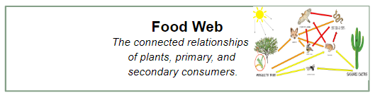
Food Webs
Explain
A food chain shows one pathway for energy from organism to organism in an ecosystem, but most animals get energy from more than one source.
A Food web shows the connected relationships of plants, primary, and secondary consumers.
Notes:
Discuss why students think the arrows are different colors.
Yellow-energy to an herbivore
Orange- energy to an omnivore
Red- energy to a carnivore

Slide 11
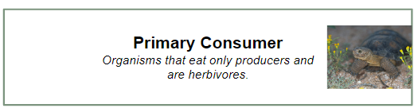
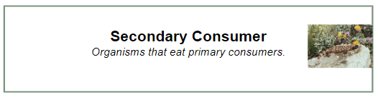
Consumers
Explain
In a food chain and food web there are primary and secondary consumers.
A Primary consumer is an organism that eats only producers. They are herbivores.
A Secondary consumer is an organism that eats primary consumers.
Notes:
Point out where the different consumers are in the web.

Slide 12
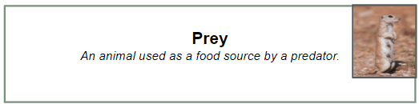
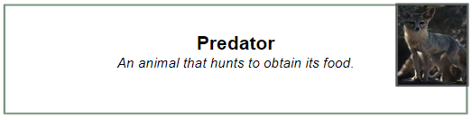
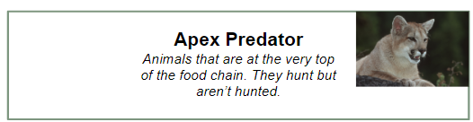
Prey and Predator
Explain
Prey is an animal used as a food source by a predator.
A predator is an animal that hunts to obtain its food.
An apex predator is an animal found at the top of a food chain or web. They hunt but aren’t hunted.
Notes:
Discuss with students the different types of prey in the sonoran desert and the different predators. Which can be prey and a predator? Which animals in the Sonoran Desert are apex predators? They can use their poster boards to find examples.

Slide 13
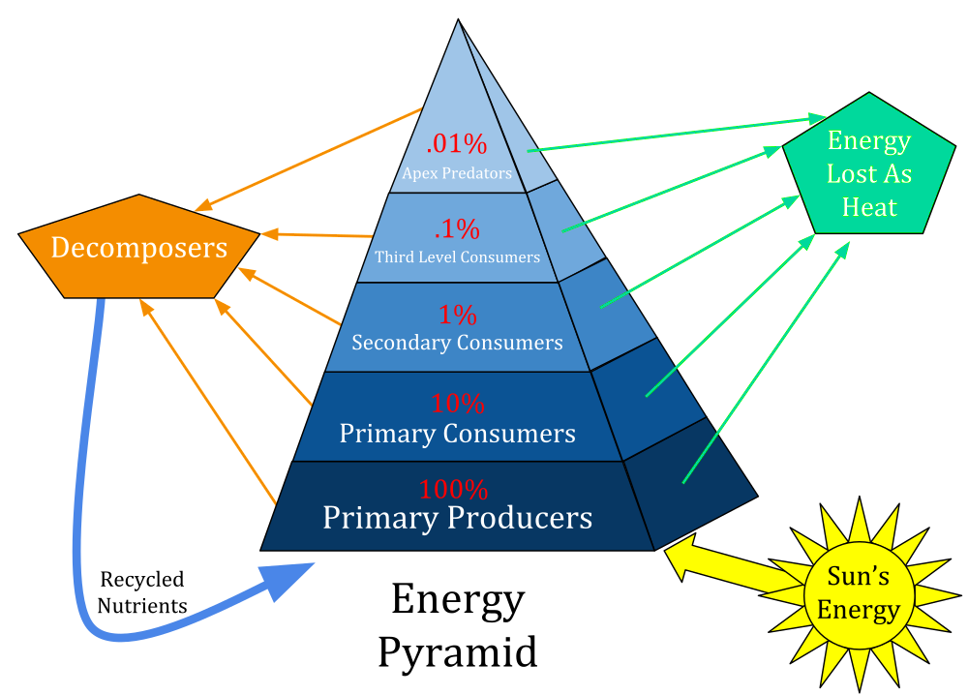
Transfer of Energy
Explain
In a food web, you will have multiple arrows pointing to different animals to show the transfer of energy.
There are usually only about 4 steps on any part of the food web because each time one organism eats another, some of that energy is used up and released as heat.
Since some energy gets used up in each step of the food chain, there can only be a few steps, otherwise there is not enough energy left for the animal at the top.

Slide 14
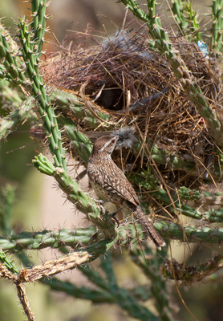
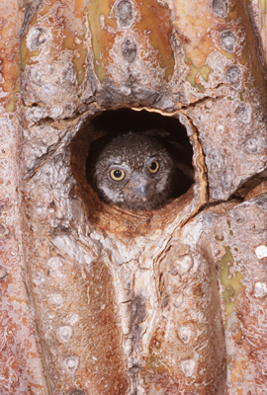
Are plants only important to animals as an energy source?
Explain
Animals depend on plants for more than just food.
  Animals use plants as shelter.
  Animals use plants as a place to lay their eggs or use to build a nest.
  Animals can use plants as a source of water.
  Animals use plants as protection from predators and from the heat.
Cactus Wren
Elf Owl
Notes:
Go over the examples on the slide:
The Cactus Wren builds a nest out of desert plants and builds the nest in a Cholla cactus.
The Elf Owl makes a home in the trunk of an old Saguaro to keep it safe from the heat during the day.

Slide 15
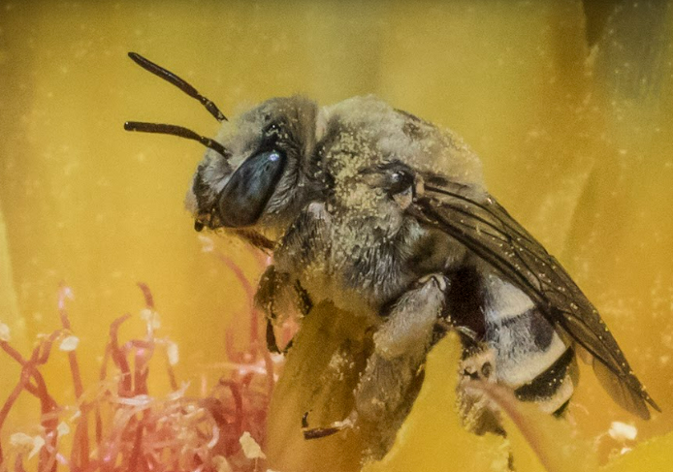
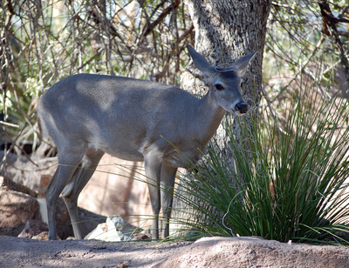
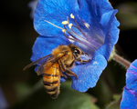
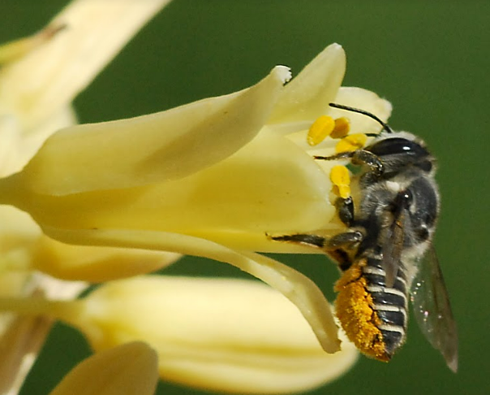
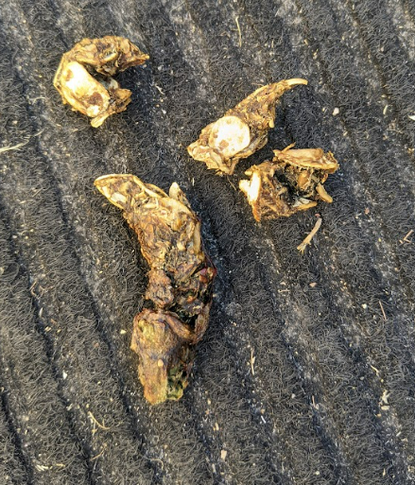
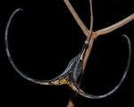
Plants depend on animals too!
Explain
Plants also depend on animals for many different things.
  Animals can carry their seeds on their fur or in their scat.
  Different animals pollinate plants, which allows them to reproduce and grow.
Notes:
Go over some examples from the pictures above:
Bees collecting pollen on their bodies and transferring it when they go to other plants.
Spreading mesquite seeds in their scat
Deer spreading seed when the devil’s claw seed pod gets stuck in their hoof. As they walk, it grinds the seed pod and releases the seeds.

Slide 16
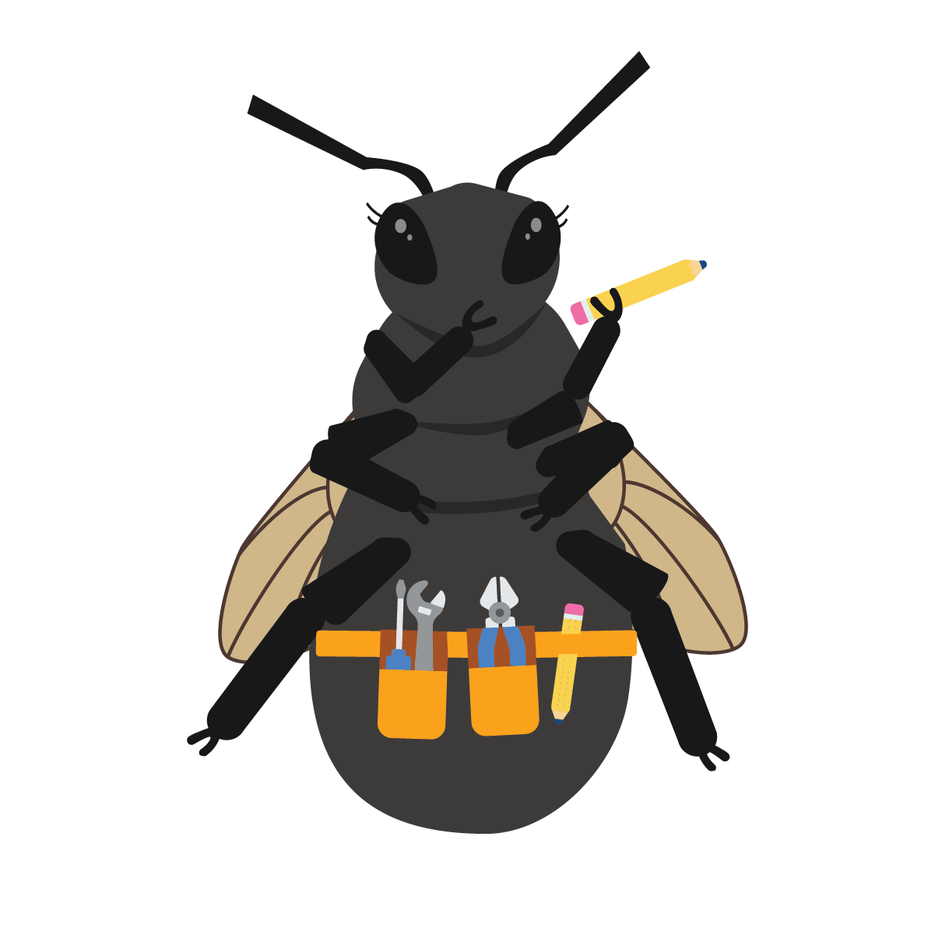
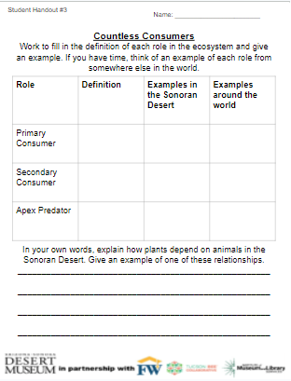
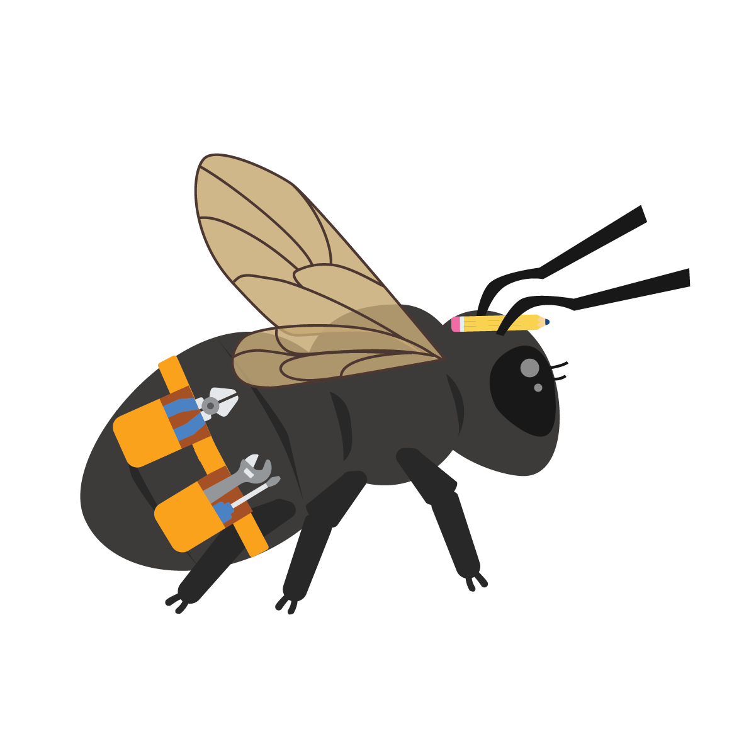
Explain
What did I learn?
Work in pairs to write:
The definition of each role
An example from the Sonoran Desert
An example from somewhere else around the world
In your own words, explain how plants depend on animals in the Sonoran Desert and give an example.
Notes:
Have students think-pair-share about the relationship between all the different types of living things and connect back to the groups they made on their boards since you will revisit them the next lesson. Pass out student handout #3. Have students work in pairs to fill in the definitions of each role and an example from the lesson. They will also explain the way plants depend on animals in the Sonoran Desert.

Slide 17
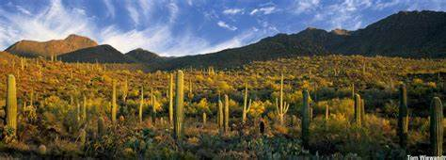
Weaving a Web
Elaborate
Now that we have created many different food chains, we are going to make a physical food web.
Before leaving your table:
Choose a picture
Decide what role in the food chain the picture plays
Clip the picture to the front of your clothing
Be thinking about who you could give energy to and who you could get energy from.
Notes:
You can use the same envelopes with pictures for this class activity. Be sure each group has at least one producer when they are picking roles. They can label the roles on the picture if you laminated the pictures. If they are not laminated, then you can just have them discuss the role and be sure they know what it is. Be sure to choose one student to be the sun and stand in the middle.

Slide 18
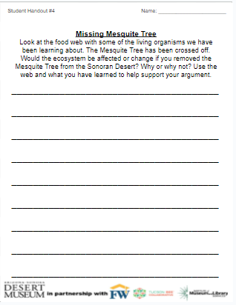
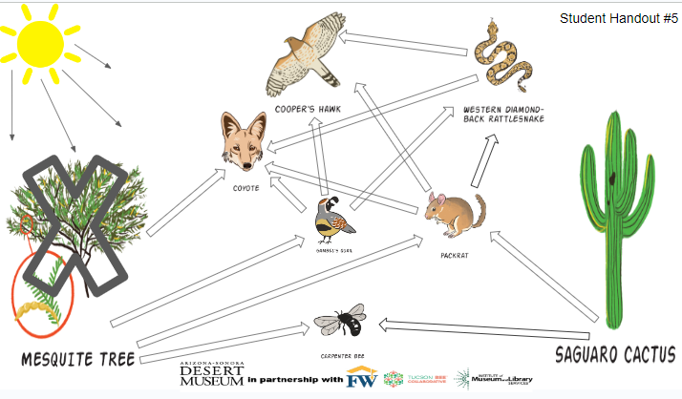
Evaluate
Missing Mesquite Tree
Look at the food web with some of the living organisms we have been learning about. The Mesquite Tree has been crossed off. Would the ecosystem be affected or change if you removed the Mesquite Tree from the Sonoran Desert? Why or why not? Use the web and what you have learned to help support your argument.
Notes:
Pass out student handout #4 and #5. Explain that one of the plants has been removed from the food web, and they need to make an argument for whether or not the ecosystem would be affected. After students have answered the prompt, they can color in the arrows for energy going to herbivores (yellow), omnivores (orange), and carnivores (red). Bigger image is on the next slide.

Slide 19
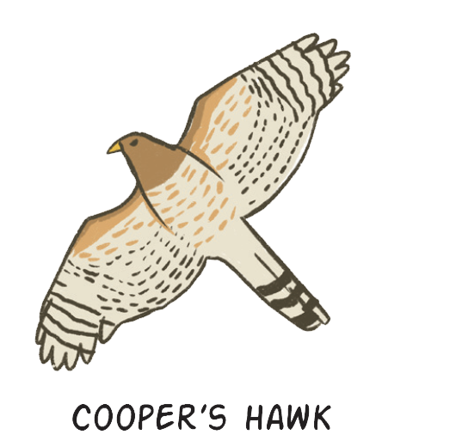
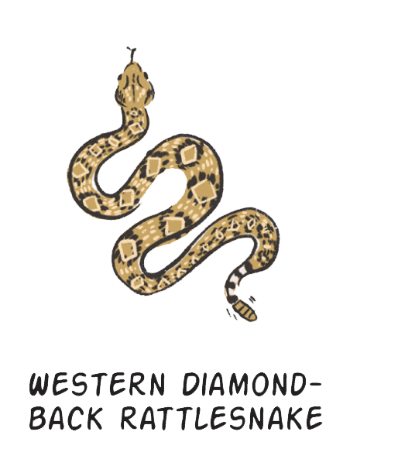
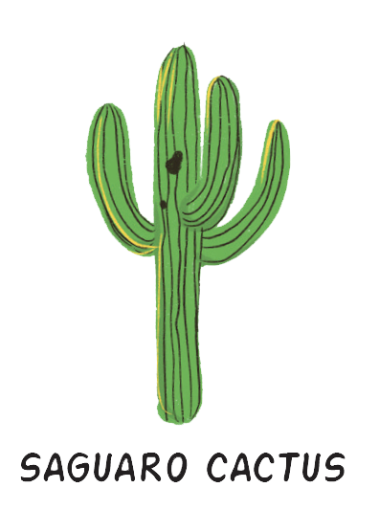
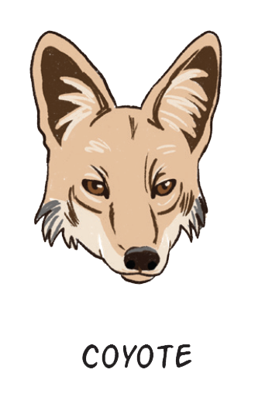
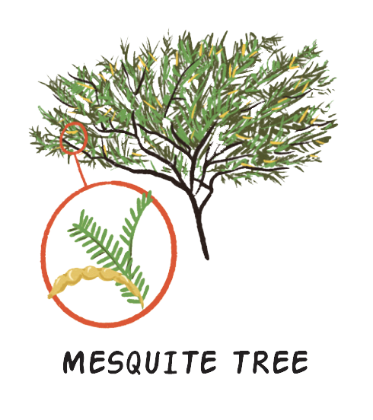
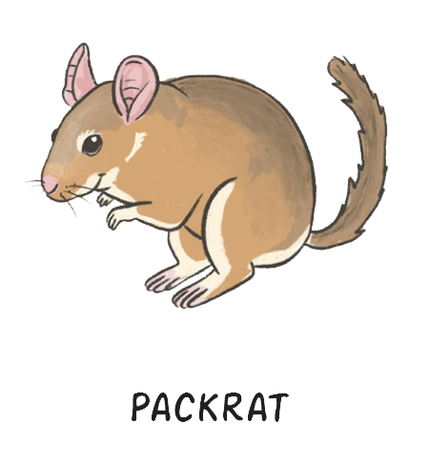
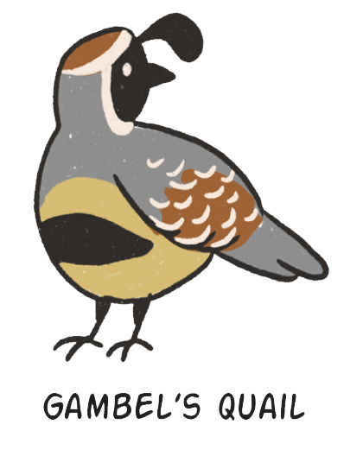
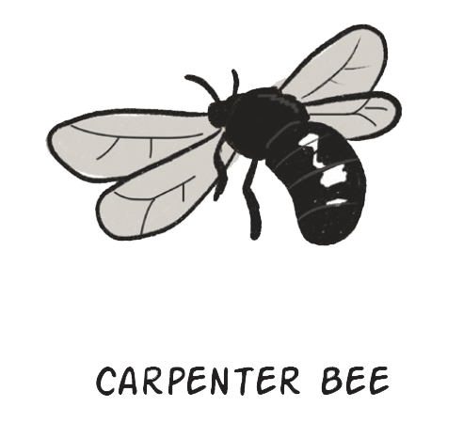

Student Handout #5
Notes:
Bigger slide to display for students.

