Slide 1
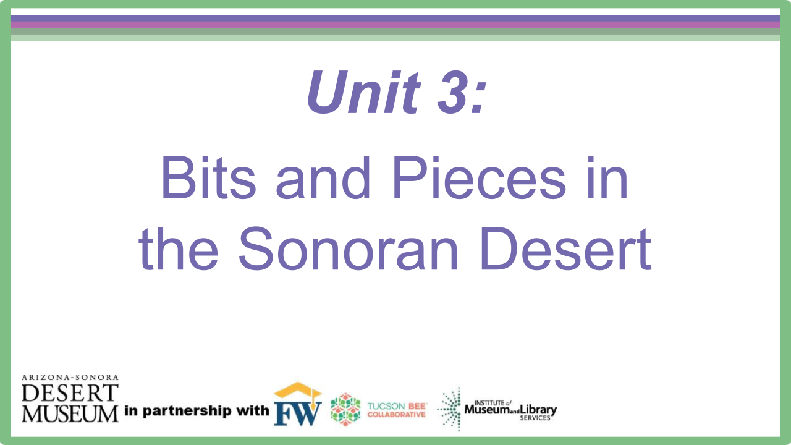
Notes:
Introduce the driving questions for the next 3 weeks.

Slide 2
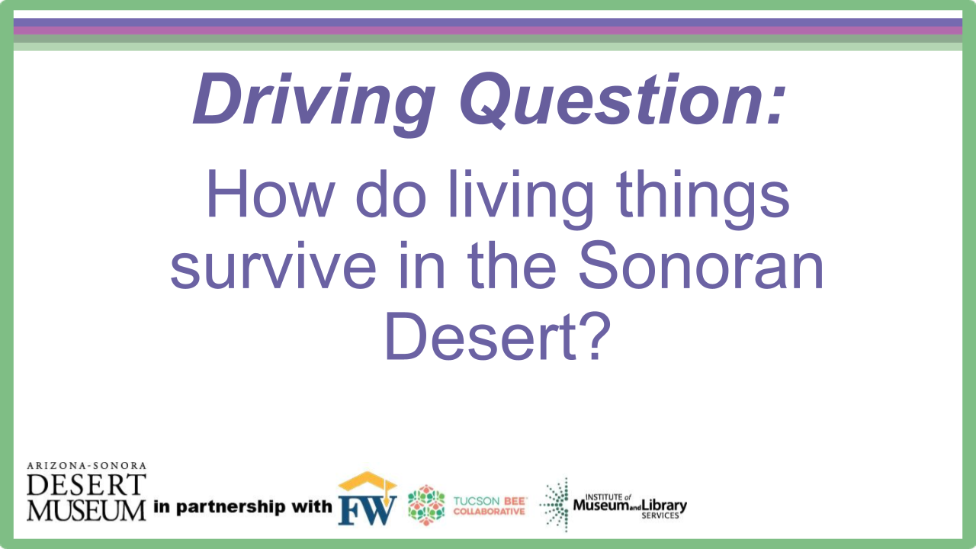
Notes:
Introduce the driving questions for the next 3 weeks.

Slide 3
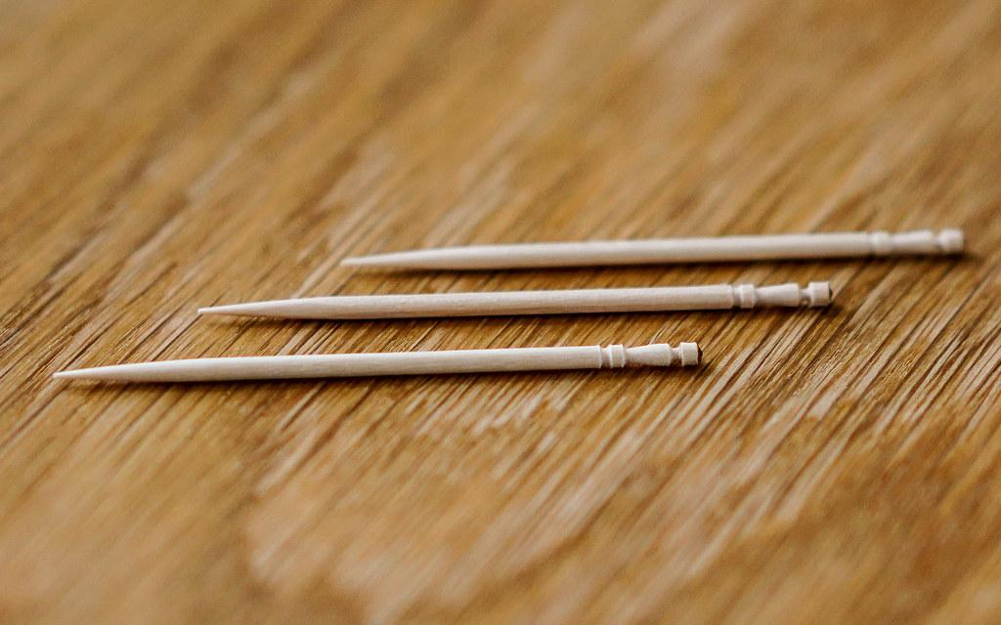
Look at the toothpicks in front of you.
Think about the following questions.
Engage
What do you notice about these toothpicks?
Do they look different from other toothpicks you have used?
Why do you think they have the grooves at the top?
Notes:
Give each student a toothpick with grooves. Allow them to make some observations, discuss if they look similar or different from other toothpicks they have seen, and why they think they may look this way.

Slide 4
Watch the video and think about how the way the toothpick is made changes the way you can use it.
Engage
https://www.youtube.com/watch?v=GiuMooDxaMg
Notes:
Show the video to describe how the structure helps the function of this toothpick. You will teach the students the definition of structure and function after the video so they understand what those words mean. You can then let students play with the toothpicks and break off the end like in the video.

Slide 5
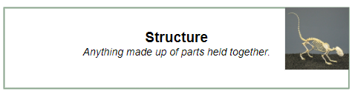
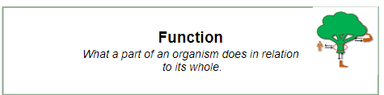
Engage
In the video it said toothpicks have functions hidden in plain sight.
The structure of the toothpick is what helps with the function.

Slide 6
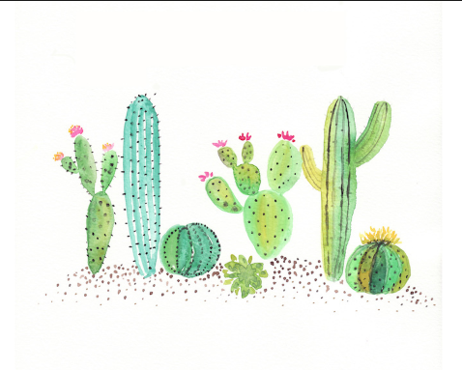
BITS AND PIECES OF THE SONORAN DESERT
Structures and Functions

Slide 7
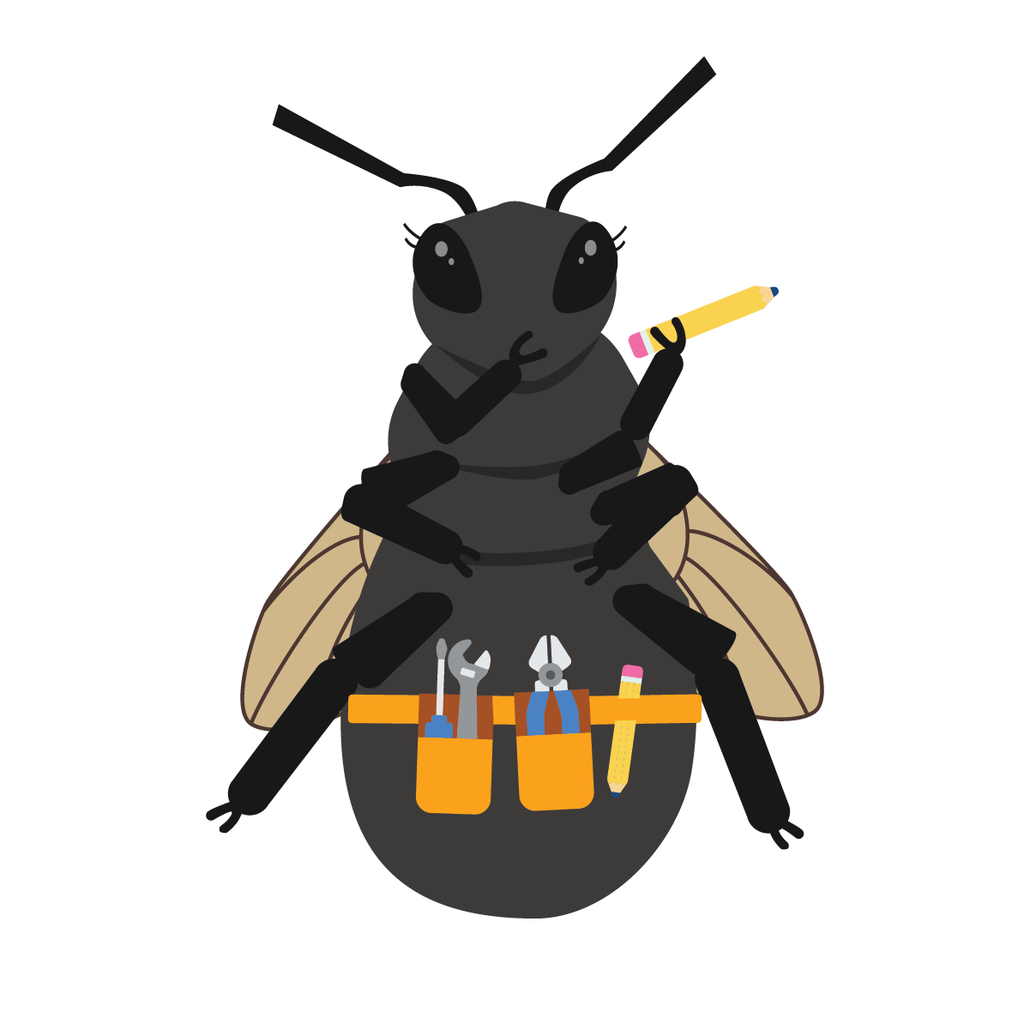
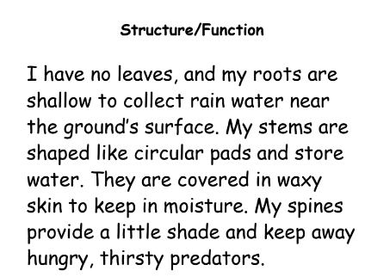
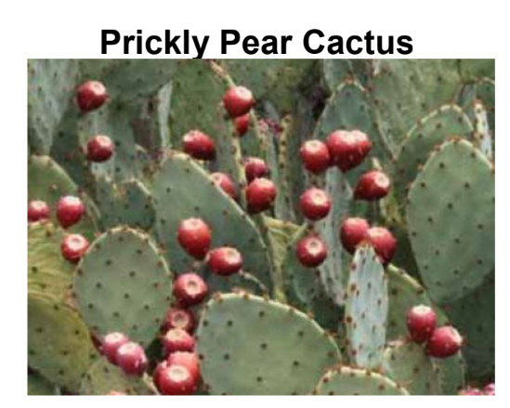
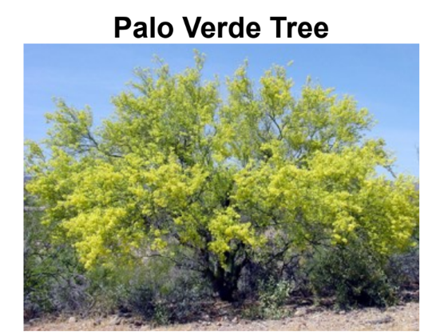
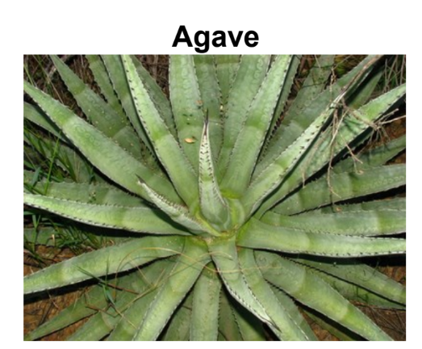
Bits and Pieces
Explore
You will each get a card.
It will either be words (structures and functions of a plant or animal) or a picture of a Sonoran desert plant or animal.
You will be working to find the structures and functions that match the particular plant or animal.
Notes:
Be sure to match up the pictures with their structure and function card ahead of time so you have the correct amount of pairs for how many students you have.

Slide 8
Activity
Explore
Everyone with an animal or plant card will line up in the front of the classroom.
Everyone with a structure/function card will line up facing the animal or plant card line.
Once in lines, work with the partner across from you to decide if you are a structure/function match.
When I say ‘switch’ you will move down the line.
Once you find your match, head to a table, grab a slate and list the structures and functions of your living thing.
Finished early?
Brainstorm other plants/animals that have the same or similar structures of your living thing.
Notes:
You can set up this activity in different ways, the two lines facing each other seems to keep things more organized. Because you will have extra plant and animal and structure and function cards, you can do a second round of this.

Slide 9
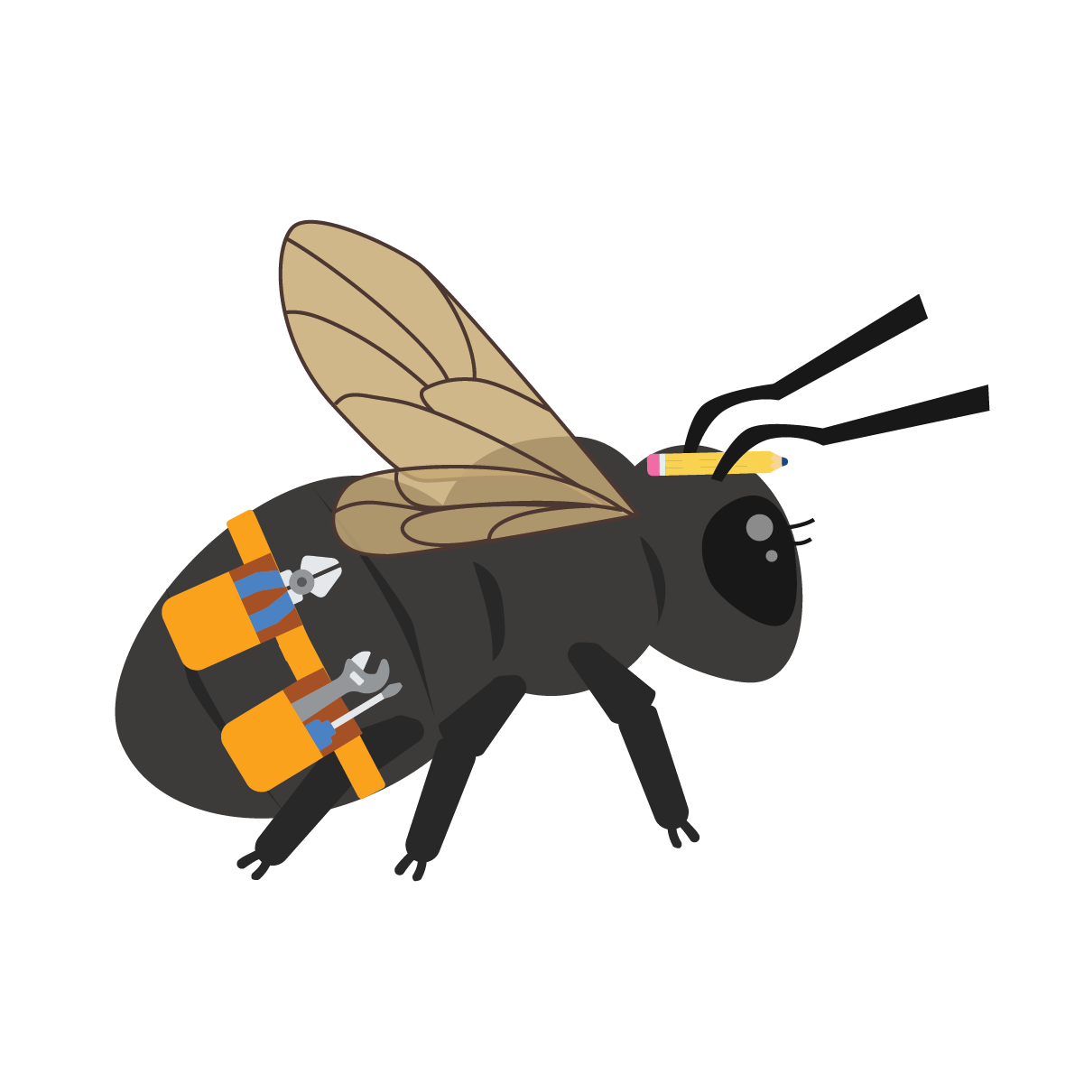
Discuss it
Explore
What were the special structures and functions of your plant or animal?
Did anyone else have a plant or animal with the same specific structures and functions?
Do you think there is any other way we could organize the animals and plants on our posters now that we have this information?
Notes:
This could be a good time to have students add the last group of pictures to their poster board. They could then regroup producers by similar structures as well as some of the consumers.

Slide 10
ANIMAL STRUCTURES AND FUNCTIONS
In the Sonoran Desert

Slide 11
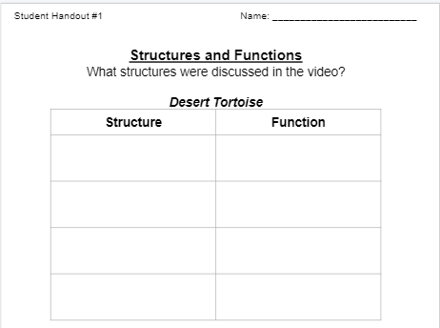
Watch this video and be ready to discuss what structures the desert tortoise has and how they function to help them survive in the Sonoran Desert.
Explain
Notes:
Pass out student handout #1 and students can list the structures they see in the video while watching.

Slide 12
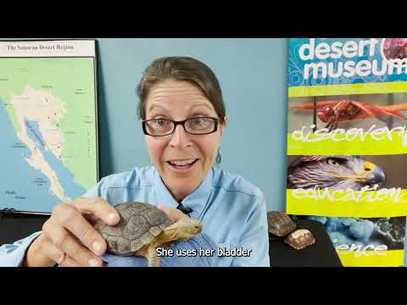
Explain

Slide 13
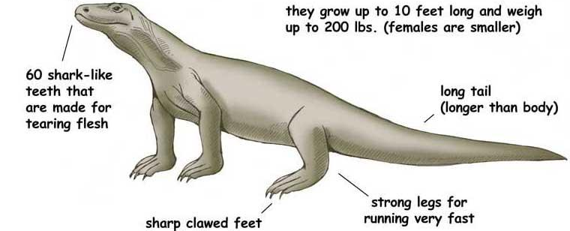
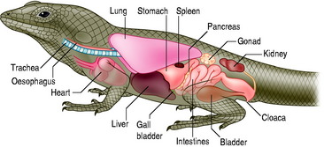
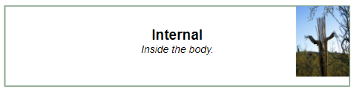
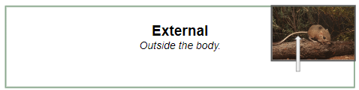
Structures
Every living thing has internal and external structures.
Explain
Internal
External
Internal structures are on the inside of living things.
Examples are:
  Heart
  Lungs
  Brain
External structures are on the outside of living things.
Examples are:
  Skin
  Eyes
  Claws
  Fur
Each structure of an animal has an important function.

Slide 14
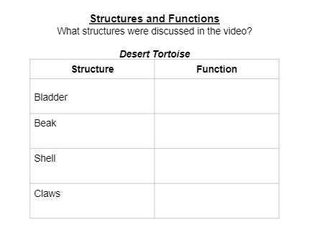
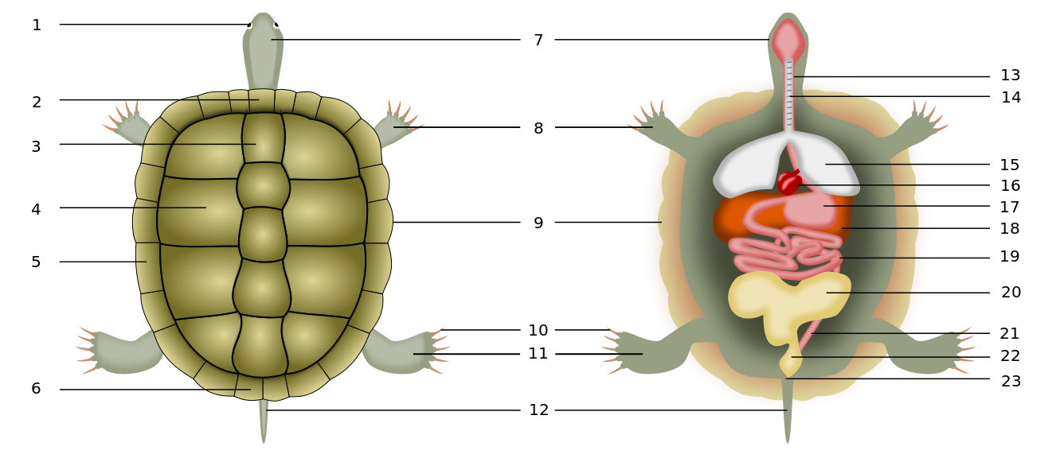
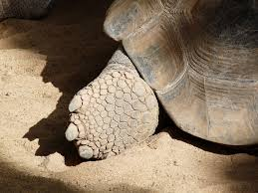
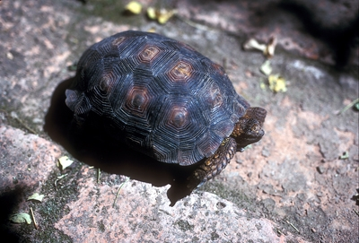
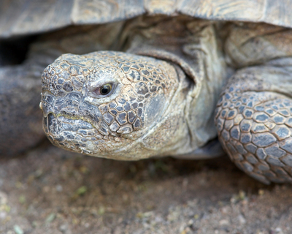
What were some of the internal and external structures of the desert tortoise?
Explain
Internal
External
Bladder
Beak
Shell
Claws
Notes:
Have students check their student handout sheet to be sure they have these structures. Ask if they noticed any other structures that were mentioned during the video.

Slide 15
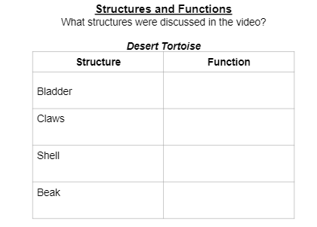
What were some of the functions of the external structures of the desert tortoise?
Explain
Structure
Function
Bladder
Beak
Shell
Claws
They have large bladders that can store water for long periods of time and reabsorb the water during dry periods.
Their beak helps them eat cactus fruits and other desert plants.
Their shell is for protection from predators and it works like a bulldozer when digging underground.
Their claws help them burrow underground and grip the ground.
Notes:
Students will fill in the function next to each structure on their handout.

Slide 16
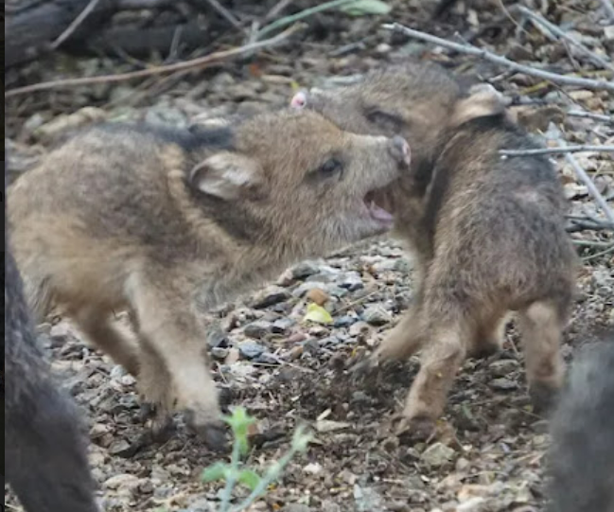
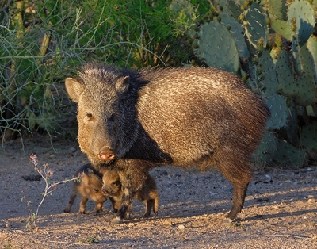
What are the structures of a javelina?
Explain
What are some of the structures of a javelina?
Let’s match them with their function. Be ready to tell what structure and function match.
Structure
Function
Scent glands
Coarse and bristly brownish fur
Long and sharp teeth
Protects them from desert plants and helps them blend in the with desert
Help them tear and shred plants, and also defend themselves.
Allow them to mark their territory and recognize others in their herd

Slide 17
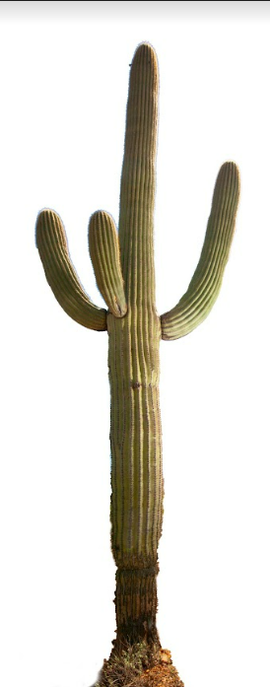
Every plant also has structures that have important functions.
Explain
Structure
Function
Allows saguaro to gather water when it rains.
Helps keep the water inside the plant from drying out.
Protect the saguaro from hungry animals and shade the plant like sun screen.
Waxy skin
Spines
Roots that spread out far underground

Slide 18
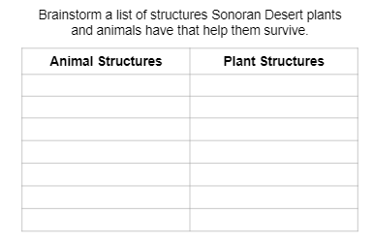
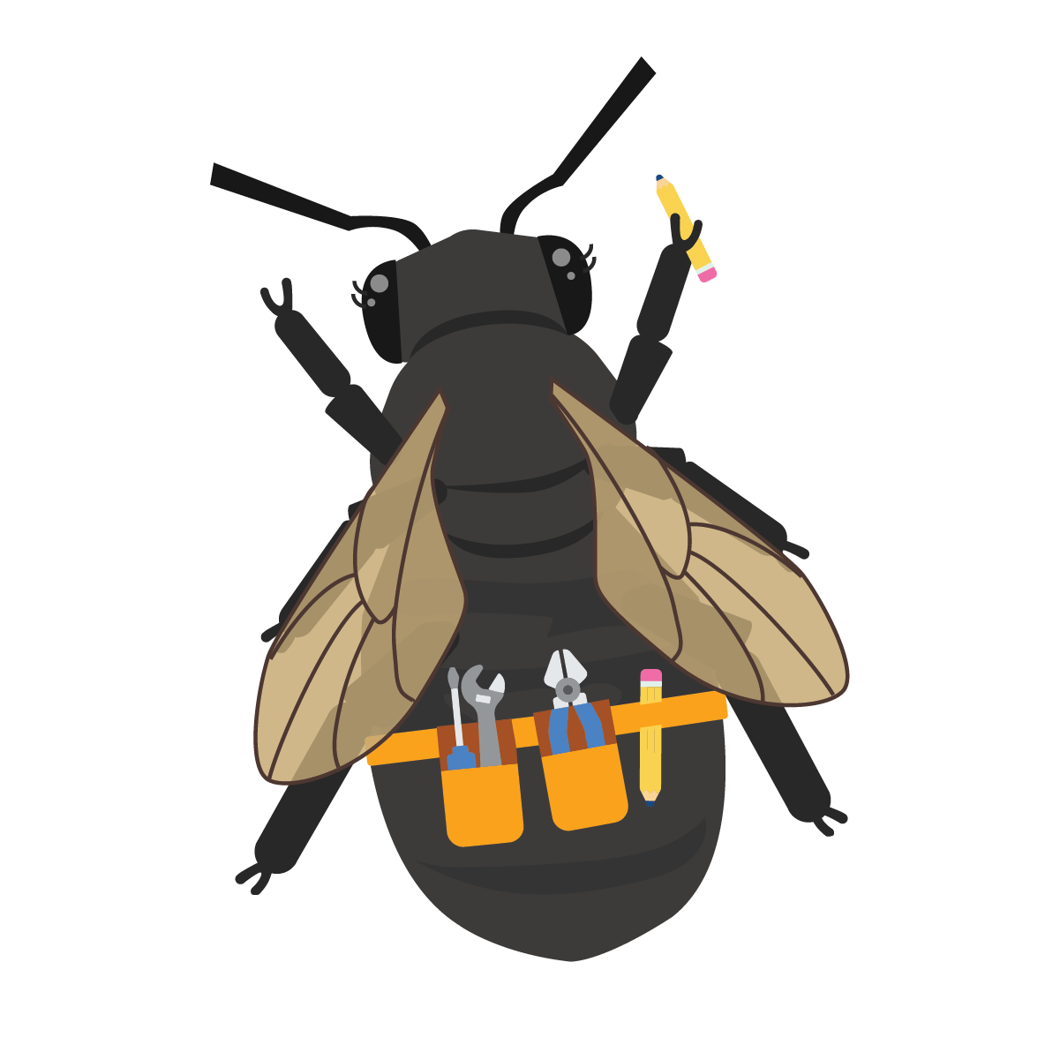
Brainstorm
Explain
Think about the plants and animals we discussed during Bits and Pieces.
Come up with a list of plant and animal structures with your group!
What desert plant and animal structures can you think of?
How do they help the animal or plant?
Notes:
In their group, students can work on the bottom part of their student handout #1 to come up with different structures of plants and animals in the Sonoran Desert. They can use the structure function cards from the explore session to help them with their brainstorm. When they have come up with a list, come back to whole group to share. Students can add any they did not have yet.

Slide 19
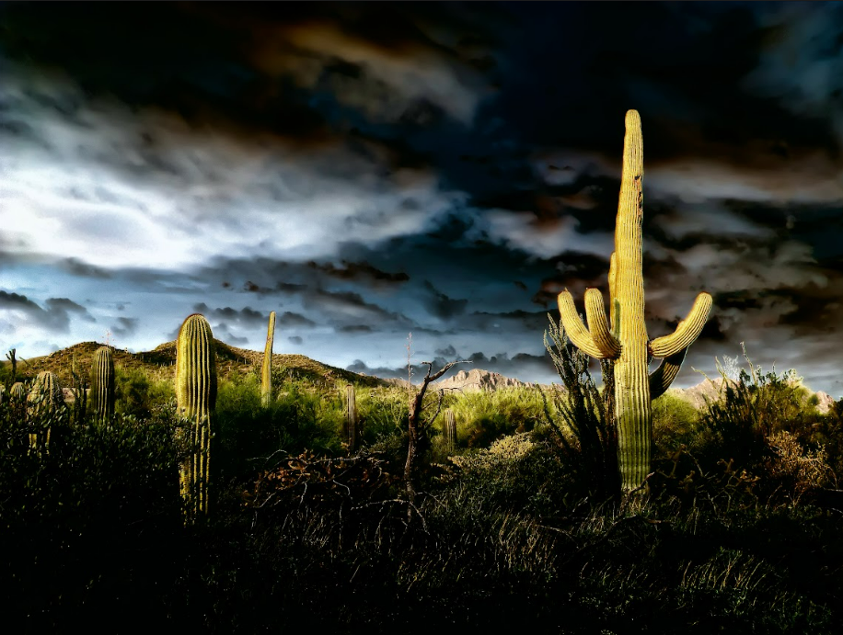
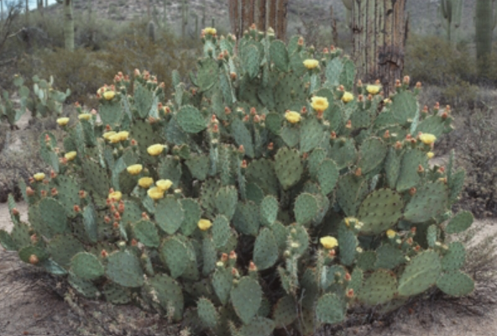
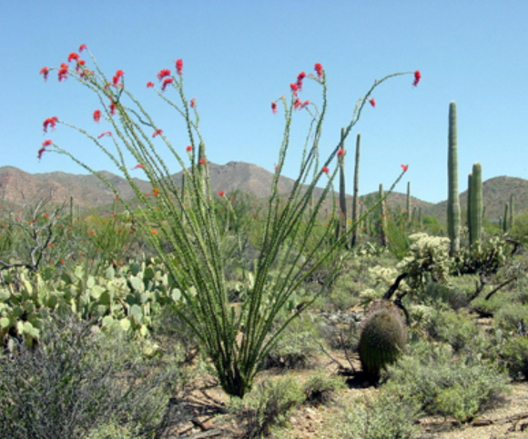
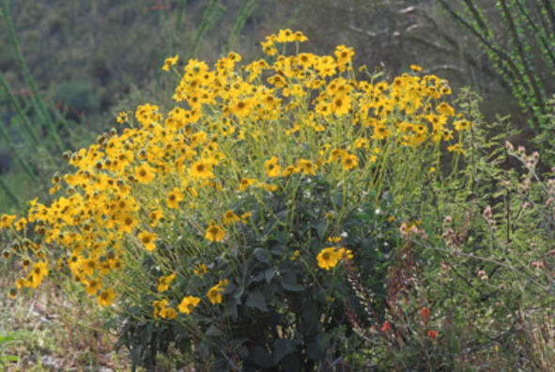
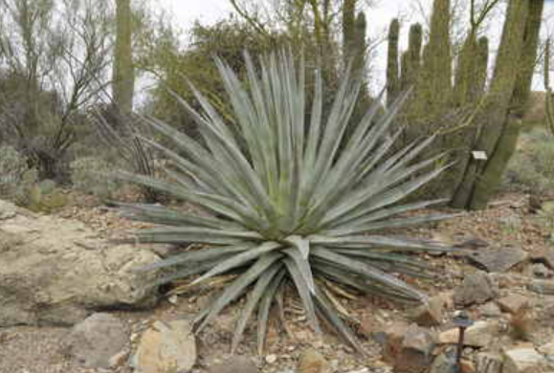
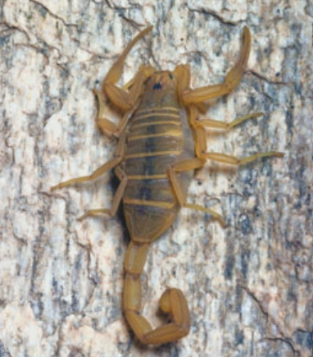
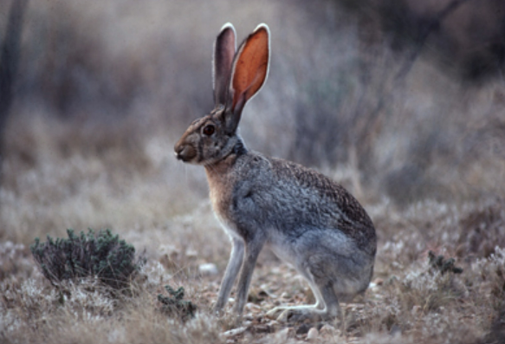
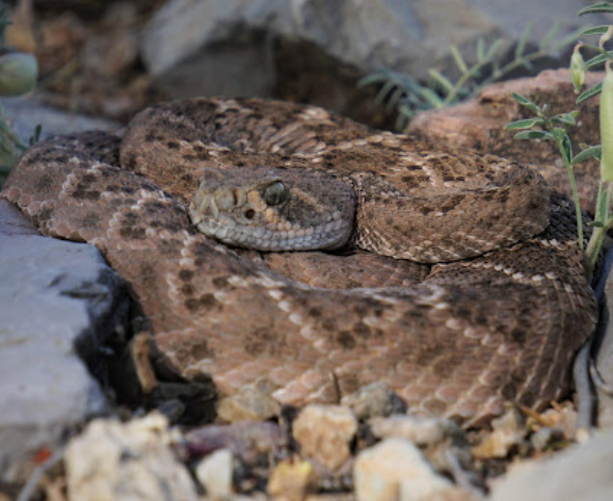
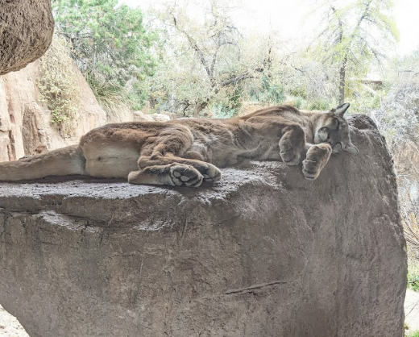
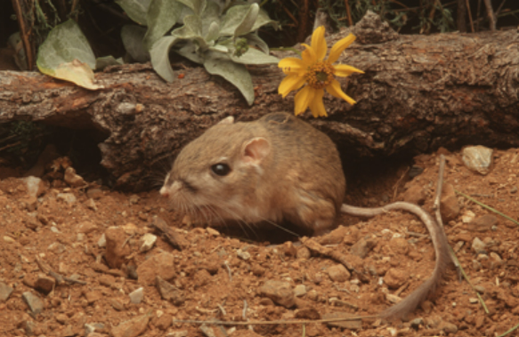
Think about it…
Explain
Finish this sentence:
Every structure of a living thing has an important _____________.
What are internal structures?
What are external structures?

Slide 20
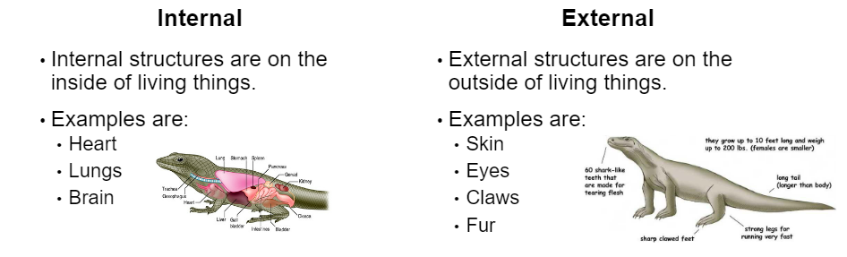
Elaborate
How are the structures of plants and animals different in other ecosystems?
What are some of the specific structures we have learned about in animals in the Sonoran Desert?
What are some of the specific structures we have learned about in plants in the Sonoran Desert?
Pick a Sonoran Desert plant or animal to compare and contrast with a plant or animal from a different ecosystem.
Notes:
Students will brainstorm some of the animals and plants in the Sonoran Desert and the specific structures that help them survive. They can use Student Handout #1 to reference. If students have a hard time picking two animals or plants to compare, you may need to help them. Students may not have a hard time picking a Sonoran Desert animal or plant but may need guidance on picking another similar plant or animal from another ecosystem.

Slide 21
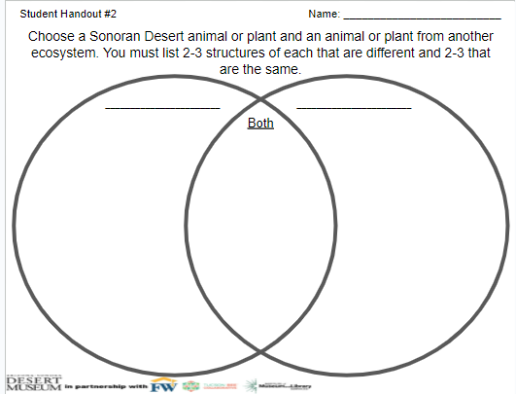
Elaborate
2-3 Structures that are different
2-3 Structures that are different.
2-3 Structures that are the same.
Finished Early?
Complete a second Venn Diagram on two different living things.
Notes:
Go over directions for assignment using the Venn Diagram. If you have an early finisher, they could complete another Venn Diagram comparing a different species set than the first time. (ie. if they compared plants the first time, they could compare plants the second time or if they compared two different birds the first time, they could compare two reptiles the second time.)

Slide 22
ULTIMATE SONORAN DESERT
Plant/Animal
Evaluate

Slide 23
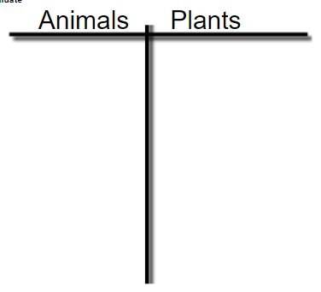
Evaluate
BRAINSTORM
What are some of the structures the plants or animals in the Sonoran desert have that help them survive? Look back at student handout #1 for ideas.
Notes:
Have students discuss structures of animals and plants. Record these on the board for students to reference later. Be sure to talk about how each of these structures help them survive in their environment. This will help set them up for later when they are designing their own plant or animal.

Slide 24
Ultimate Sonoran Desert Plant/Animal
Evaluate
You get to come up with your own Ultimate Sonoran Desert plant or animal, combining multiple structures.
You will make a sketch, create a model using various materials, draw and label a diagram, and write a paragraph about your made up plant or animal.

Slide 25

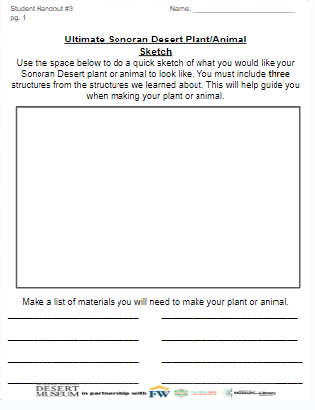
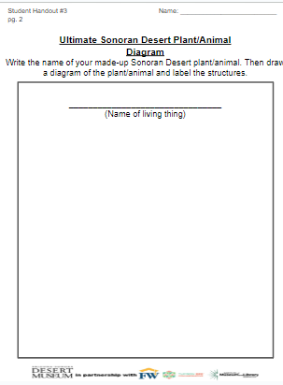

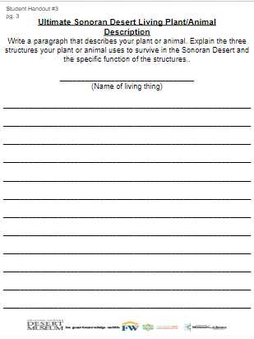
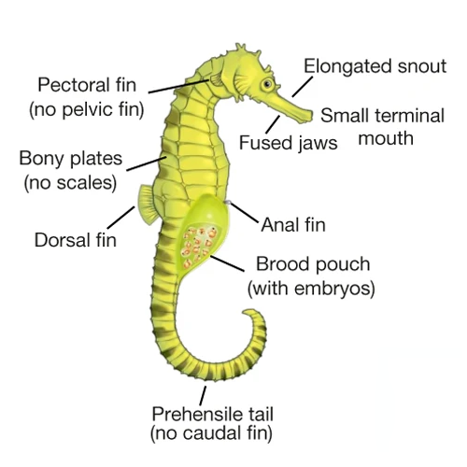

Ultimate Sonoran Desert Living Thing
Evaluate
1. Quick sketch
2. Create
3. Diagram with labels
4. Write
Notes:
When going through the next few slides you will be getting into the specifics of the project. Use this slide to introduce the different parts of the project. Each slide goes into more detail about each part. You can decide how much to accomplish during each session.

Slide 26
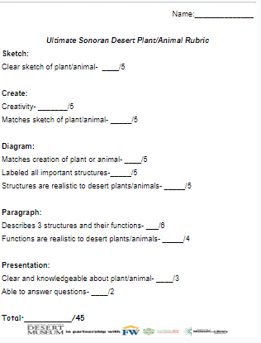
Criteria
Evaluate
This is the criteria you will be graded on for each section of your project.
While working through the parts of your project, check back to be sure you are meeting all the requirements.

Slide 27
Quick Sketch
Evaluate
Decide how you want to create your own desert plant or animal.
Draw a quick sketch of what you would like it to look like, considering the structures you will include and the functions they serve.
Make a list of materials you will need to make your plant or animal.
Notes:
Students will use the first page of student handout #3 for the sketch.

Slide 28
Create
Evaluate
Use the supplies to create your animal or plant.
Be creative! Decide which materials will be best to create what you have sketched.
You can choose from pipe cleaners, toothpicks, straws, clay, cups, tissue paper, etc.
Notes:
Get out all crafting supplies before the create phase. Show students what they will have available to them to use. If you don’t have these exact materials you can use what you have. You want students to be able to mimic some of the animal and plant structures on their made-up plant or animal with the crafting materials.

Slide 29
Diagram with Labels
Evaluate
Draw a detailed diagram of your plant or animal.
Label all the structures.
Give your animal or plant a name!
Notes:
Students will use the second page of student handout #3 for the diagram with labels. Encourage them to be very detailed and specific with their structures.

Slide 30
Write about it!
Evaluate
Write a paragraph that describes your plant or animal.
Explain the three structures your plant or animal uses to survive in the Sonoran Desert.
Notes:
Students will use the third page of student handout #3 for the paragraph. You can remind students what a complete paragraph would look like and really stress the importance of including what function the structures serve for their plant or animal.

Slide 31

Probe-Revisit
What do you know about the Sonoran Desert?
At the beginning of our Sonoran Desert learning, you drew a picture of what you think the Sonoran Desert looks like.
Now that you have more knowledge about the Sonoran Desert, I would like you to draw a new picture of what the Sonoran Desert looks like.
Include:
Plants
Animals
Landscape
Labels of what you draw
You can use colored pencils or crayons to complete your drawing.
Optional:
You can add arrows for where energy is going in your drawing.
Notes:
You can either have students add to their first drawing or they can make a new drawing. Use the first drawing and this drawing to assess how some of their understanding of what lives in the Sonoran Desert has changed.

