Slide 1

The Thirsty Desert: Conservation and Ecology in the Sonoran Desert

Slide 2
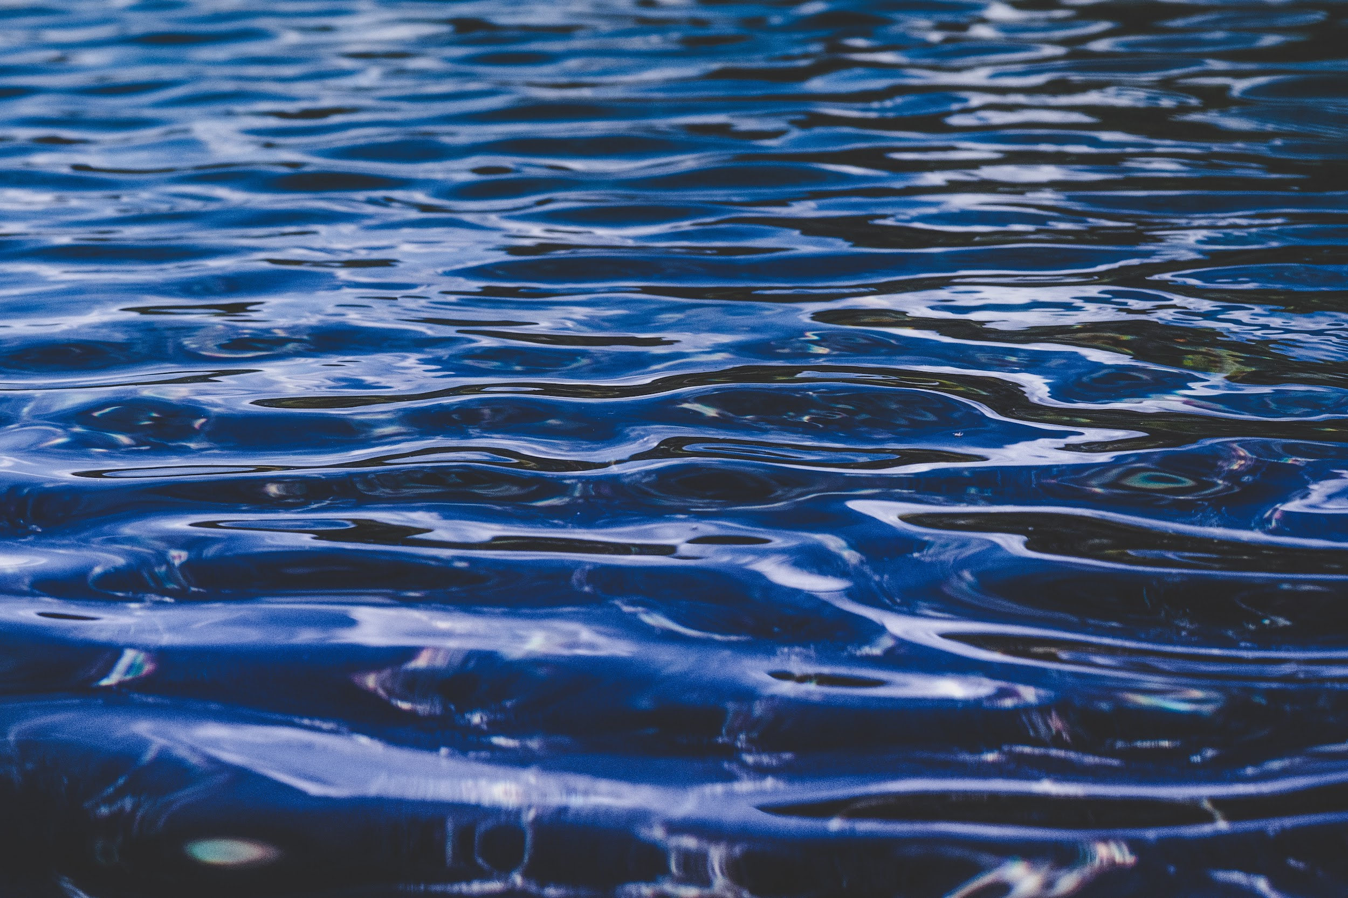
Driving Question:
How has water availability influenced living things in Tucson?

Slide 3

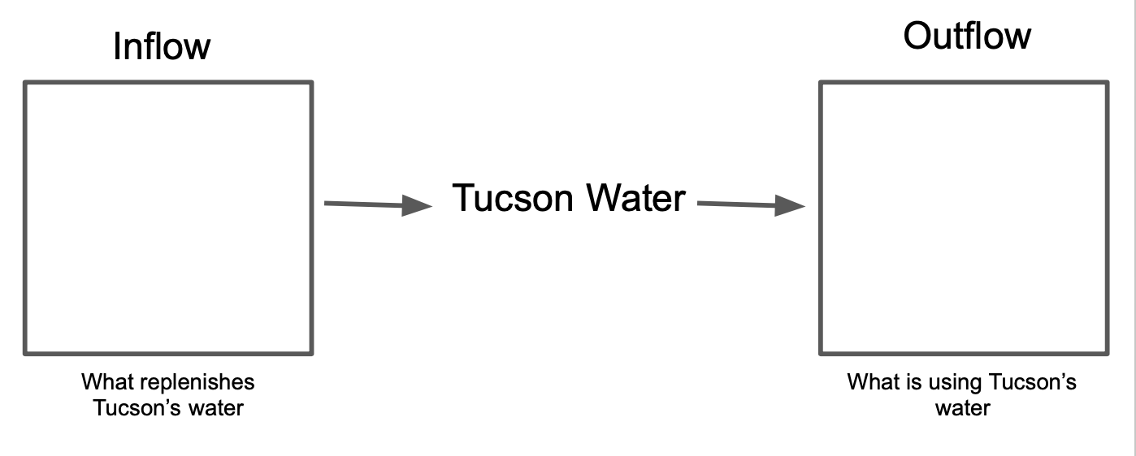
Probe
Where does Tucson get their water?
What replenishes Tucson’s water?
Where does Tucson’s water go?
Notes:
Give students the probe. Have them identify inflow water sources (CAP, rain, snow melt, groundwater, surface water, effluent water). Create a larger scale version of this stock model as an anchor chart to add information throughout the unit.

Slide 4
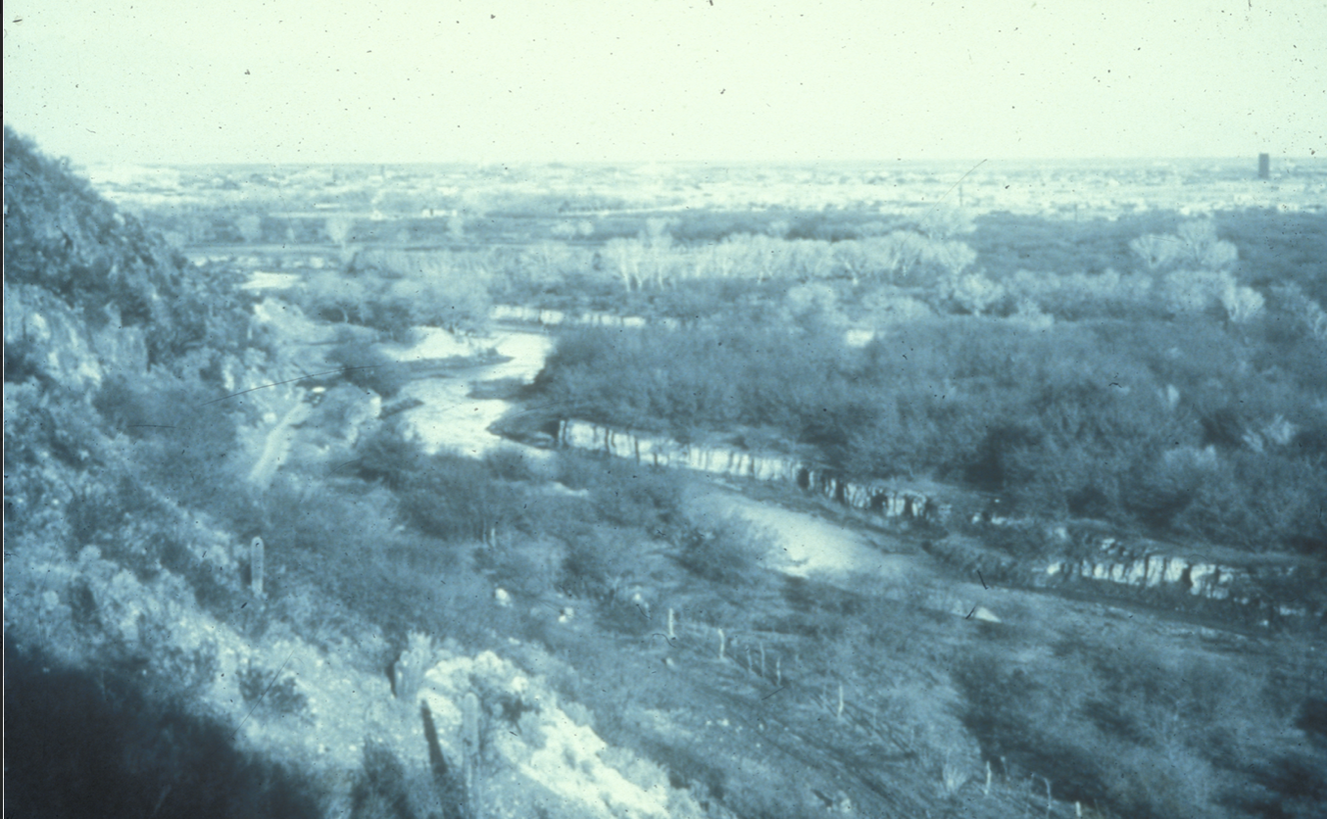
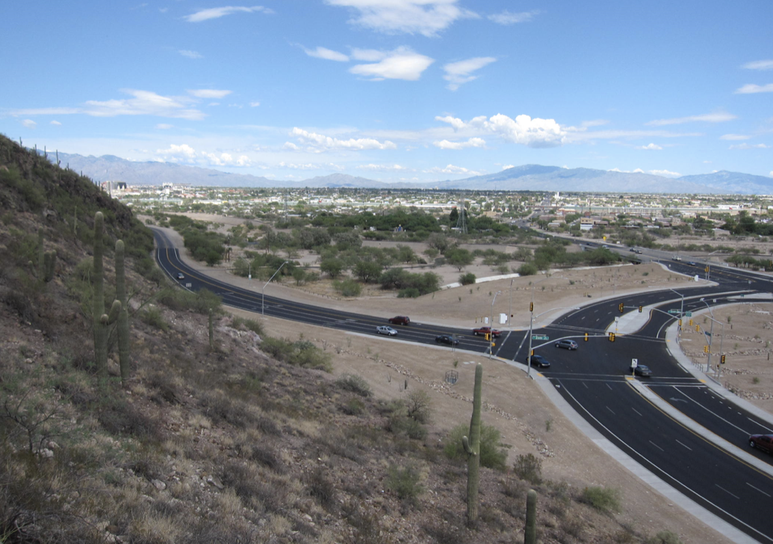
Phenomena
The Santa Cruz River 1890
The Santa Cruz River 2010
What do you notice?
What do you wonder?

Slide 5
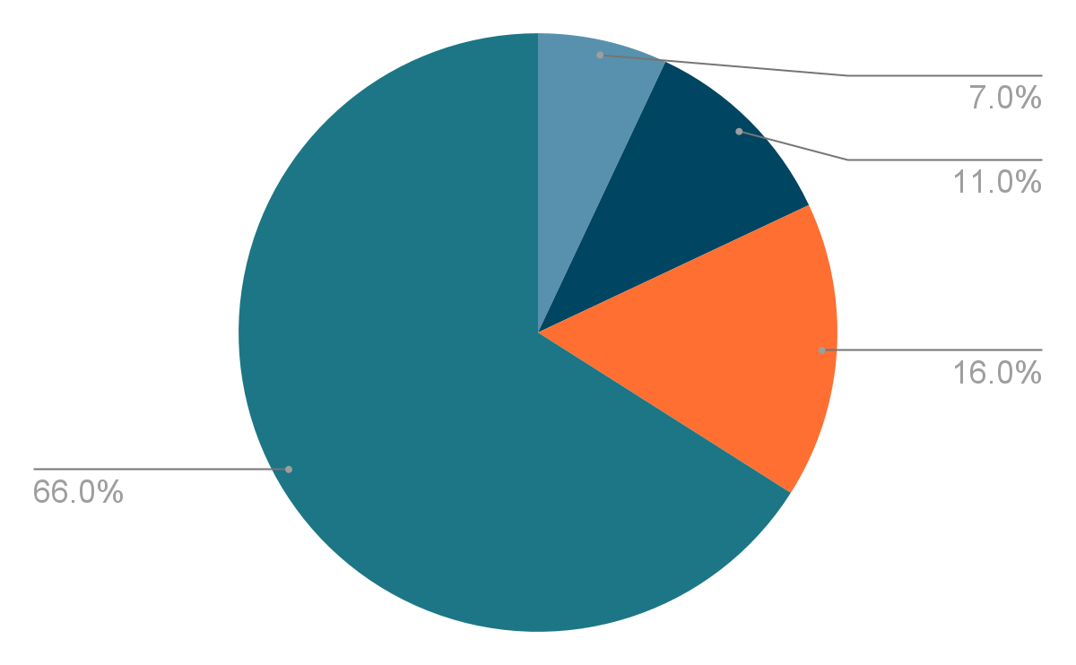
Engage
Notes:
What do you notice? What do you wonder? Encourage students to compare the sizes of the different pie slices. Which is the largest, smallest, etc? What might this chart represent?

Slide 6
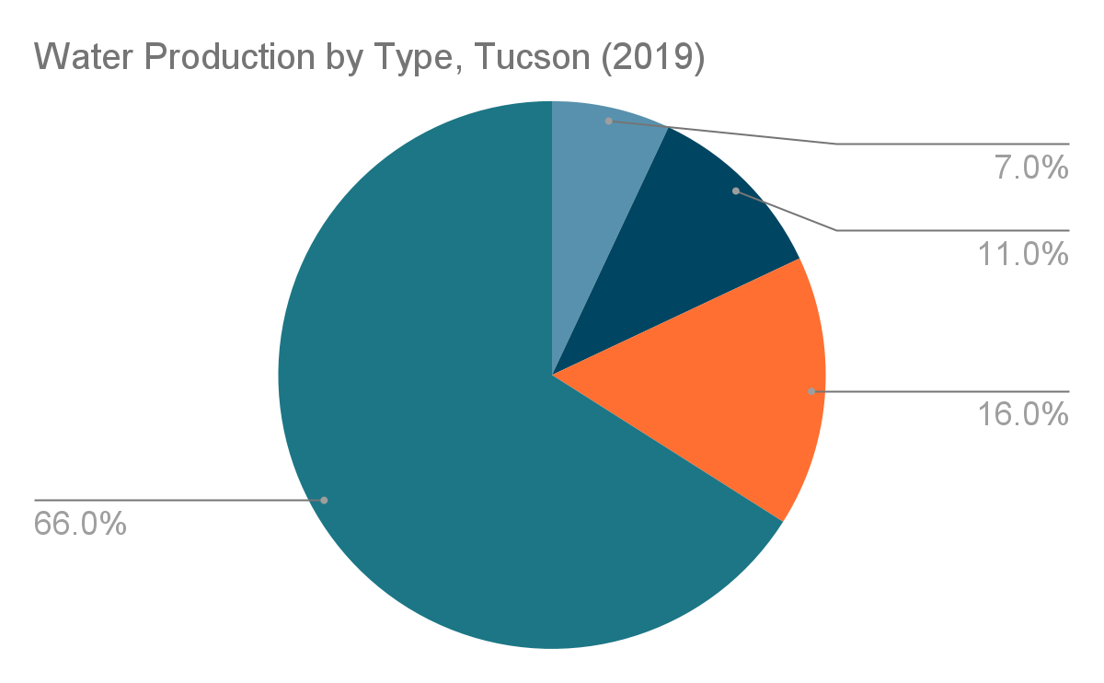
Engage
Notes:
What might the slice labels be? Students might guess things like pool water, rain

Slide 7
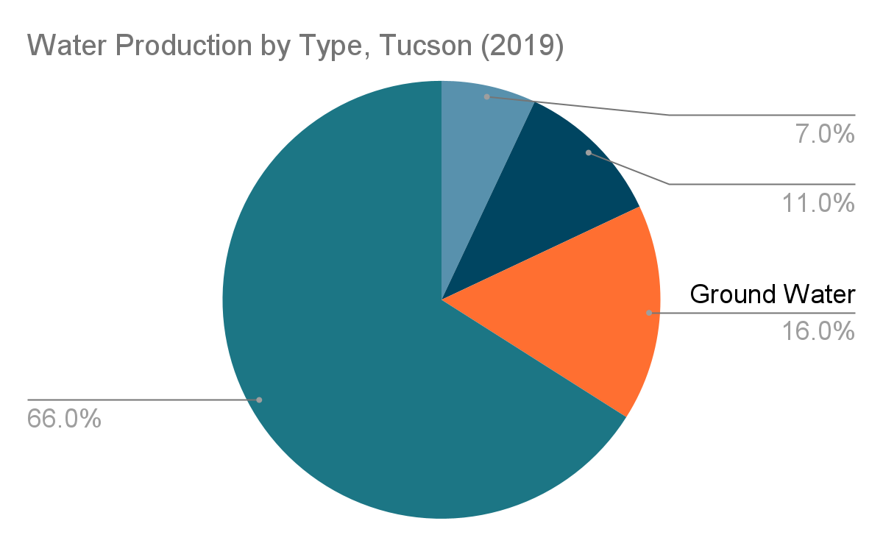
Engage
Notes:
How does this change your thinking? What might the other slices represent?

Slide 8
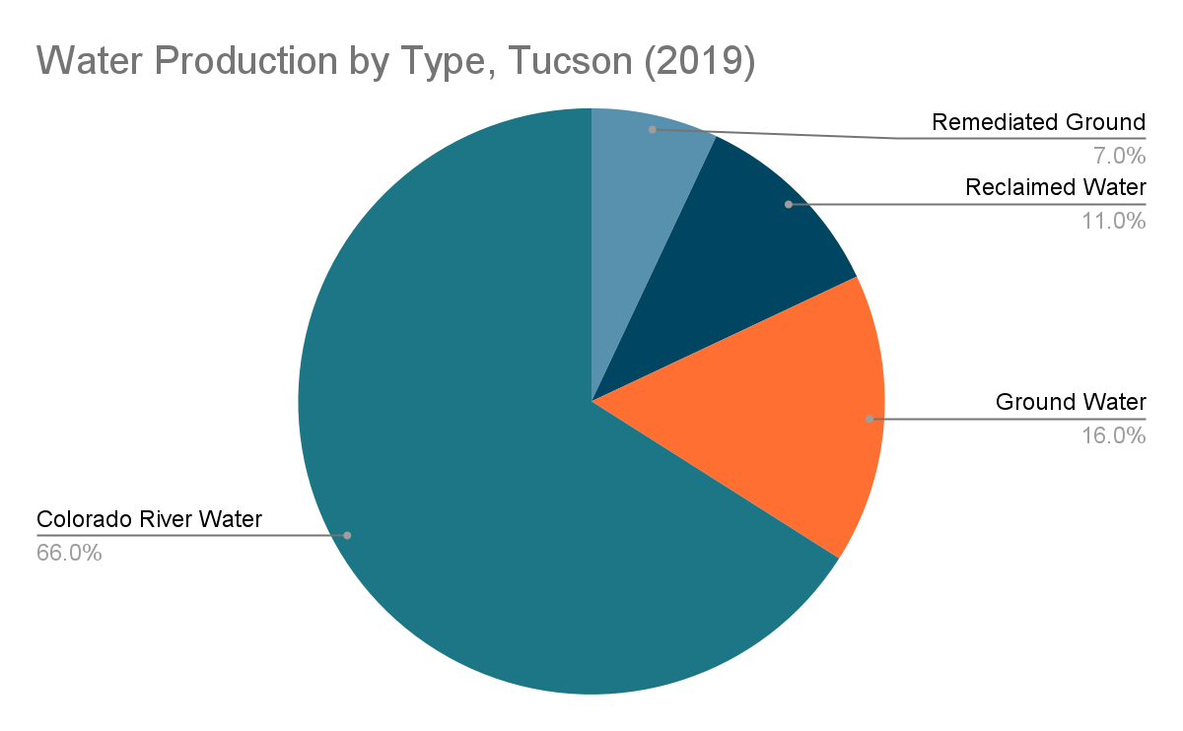
Engage
Remediated Ground Water
Notes:
What might reclaimed mean? What about remediated? Allow students to make guesses based on background knowledge or root words.
Reclaimed water refers to water that has been reused or recycled. This happens in water treatment plants or even in homes where grey water is utilized. Remediated refers to water that has been treated for pollution.

Slide 9

Engage
Remediated
Ground Water
Notes:
What new information was added? What does this new information tell us?

Slide 10
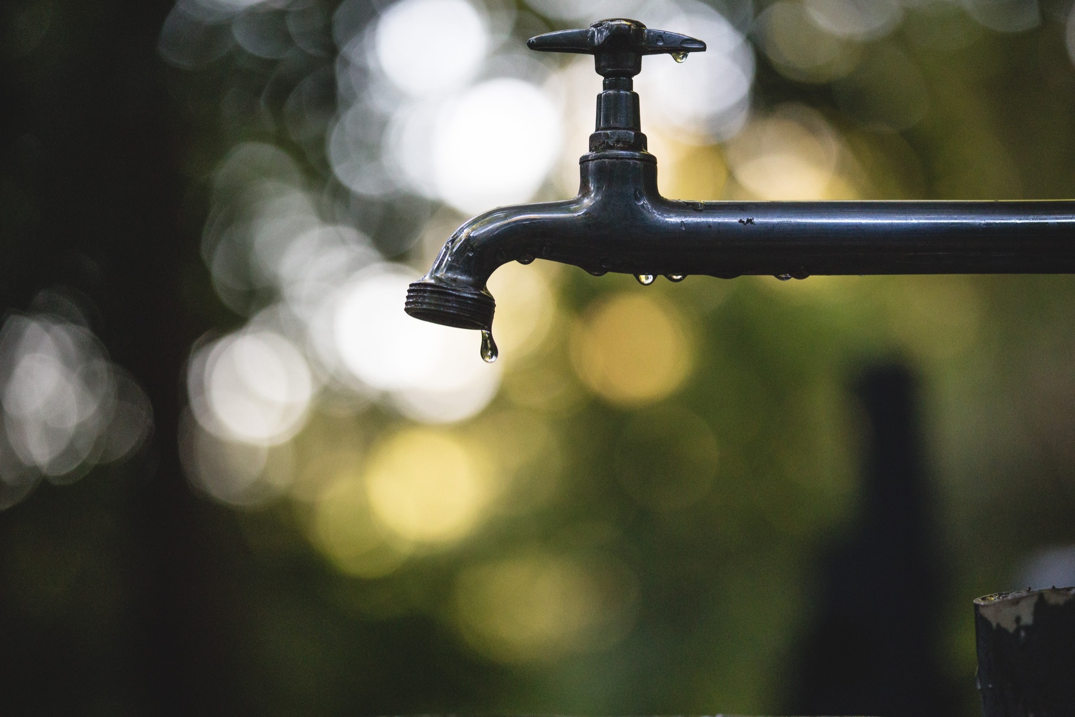
Engage
What questions do you have about Tucson’s water usage?
Notes:
Students can write any question onto a post-it or sentence strip and add it to the wonder wall.

Slide 11

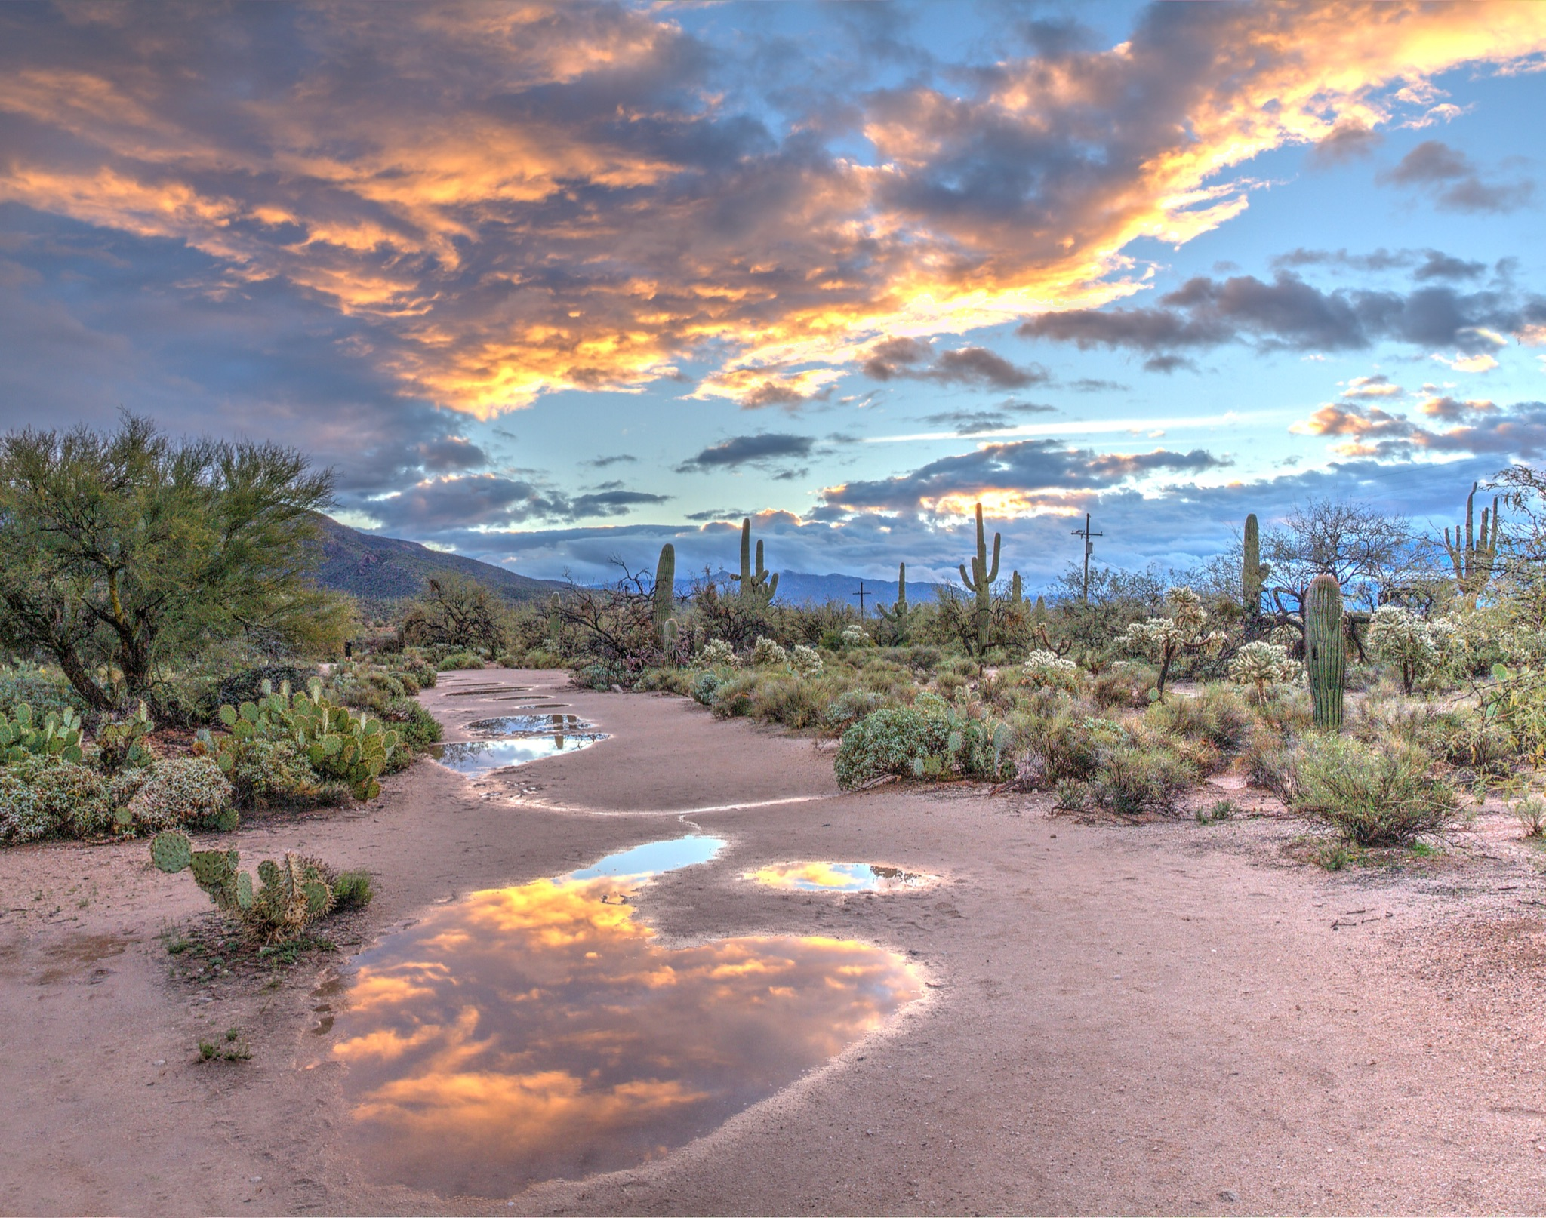
Explore
What is surface water?
What is groundwater?
What is the relationship between the two?

Slide 12
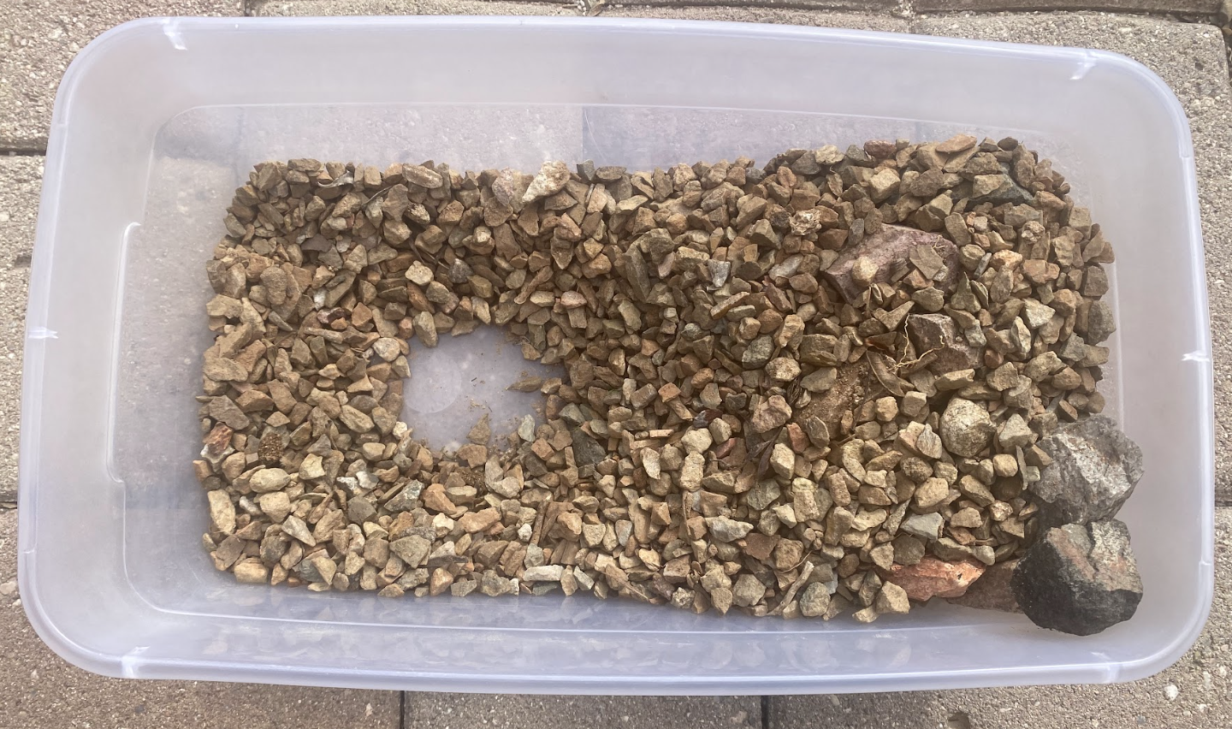
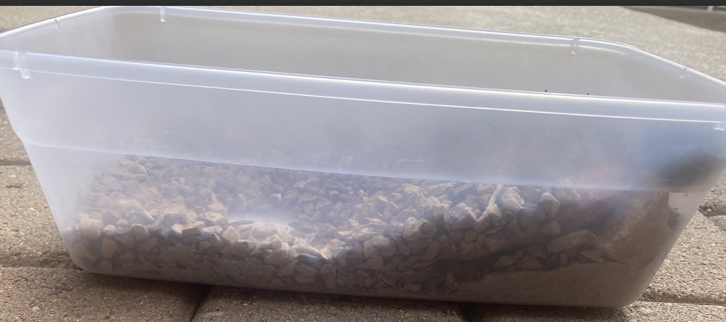
Explore
Using a transparent plastic shoe box container and rocks, create a model to represent the layers of the water table.
Include:
-A slope to represent a hill or mountain
-A low spot where water can collect.
When ready, slowly pour water on the top of the mountain/hill. Notice what happens to the water.

Slide 13
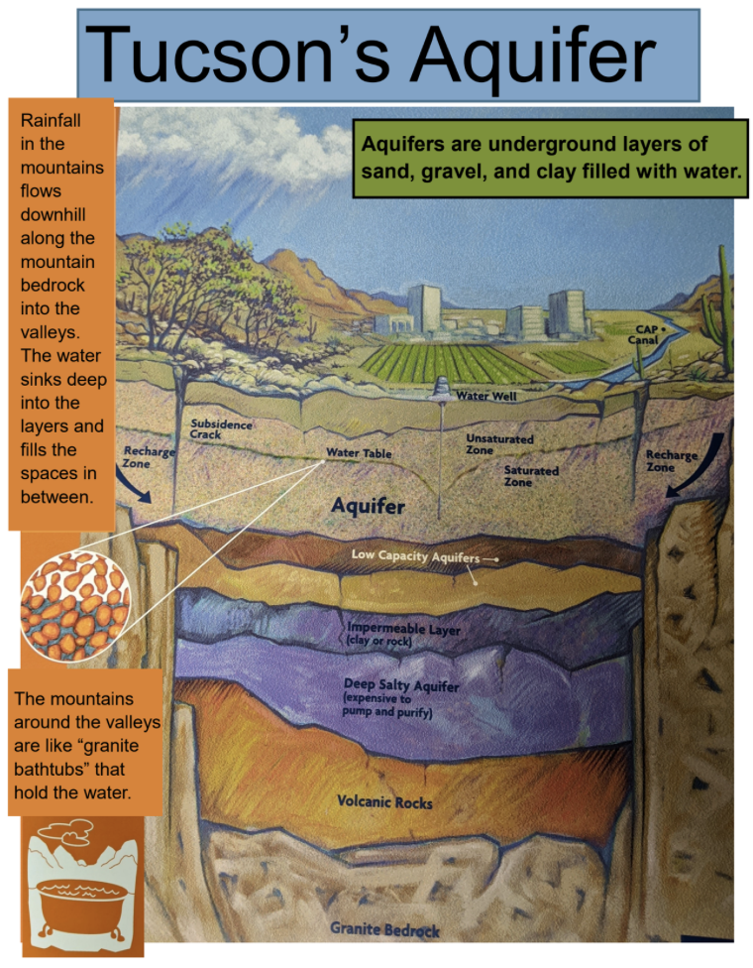
Explore
Discussion:
What causes the surface water runoff to move down into the ground?
What happens when the water table crosses the surface?
Notes:
Teacher will lead a discussion after building and using the model. Gravity causes the water to run off and move into the ground. As surface runoff slows it infiltrates into underground layers of sand, gravel, and clay (the aquifer.) When the water table (the top level of the groundwater accumulated between sediments in the aquifer) crosses the surface it becomes surface water. Surface water and groundwater are connected.

Slide 14
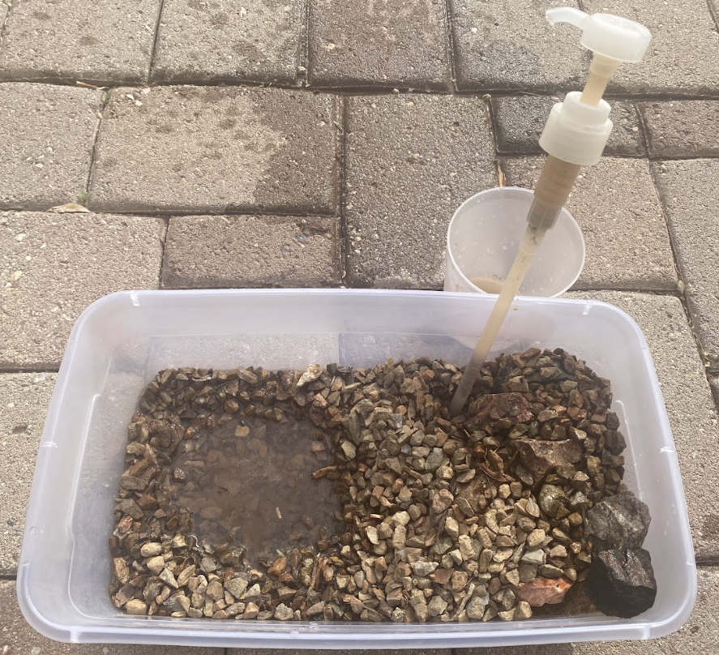
Explore
Add a well to your water table model.
Use your pump to collect groundwater from your model.
What happens to the water table when groundwater is pumped?
Notes:
Consider having student pump 5 times every thirty seconds to simulate 5 years time passing. This will help to simulate that the water table reduces slowly over time.

Slide 15
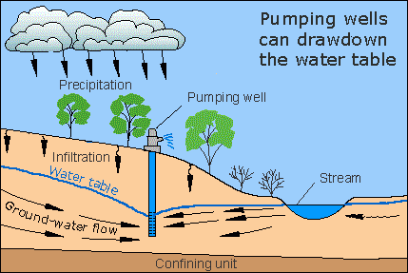
Explore
Discussion:
What would happen if we added more
wells?
How does drought, which is a natural occurrence in the desert, affect surface water and groundwater?
Source: USGS
Notes:
Teacher will lead a discussion after using the model. If groundwater is pumped, there is less available. If groundwater is over pumped, it would affect both the availability of surface water and groundwater, resulting in less for human consumption, loss of habitats and impacts to wildlife.

Slide 16
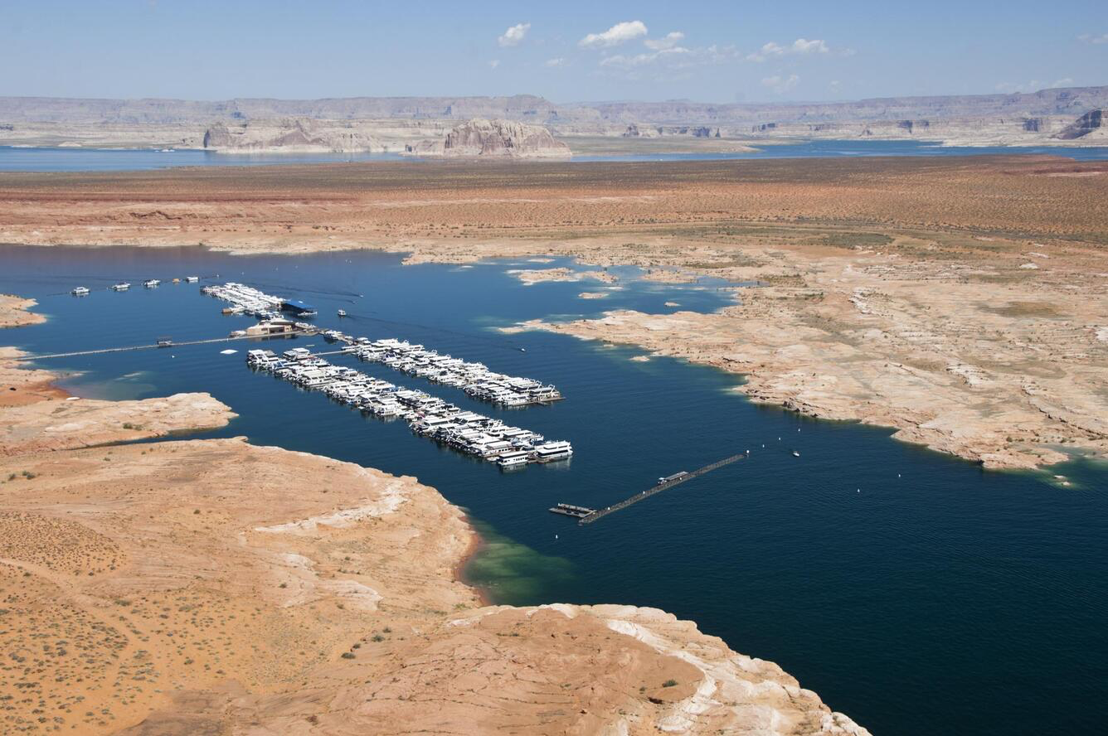
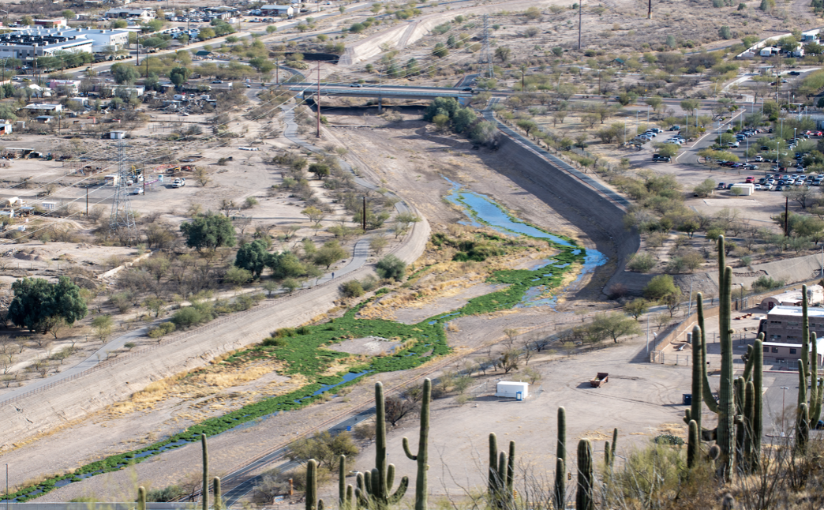
Explore
Discussion:
Based on this experiment, what do you think has happened to the Santa Cruz River and Lake Powell?
Source: The Water Desk
Source: USGS
Notes:
Teacher will lead a discussion after using the model. If groundwater is pumped, there is less available. If groundwater is over pumped, it would affect both the availability of surface water and groundwater, resulting in less for human consumption, loss of habitats and impacts wildlife. Lake Powell’s water levels are impacted by drought, since it is fed by snowmelt and rainfall in the mountains of the Colorado River watershed. Since the CAP’s source of water is the Colorado River, fluctuations in water availability will affect how much of the CAP water we can receive. Banking it now through recharge is important for our future water supply.

Slide 17
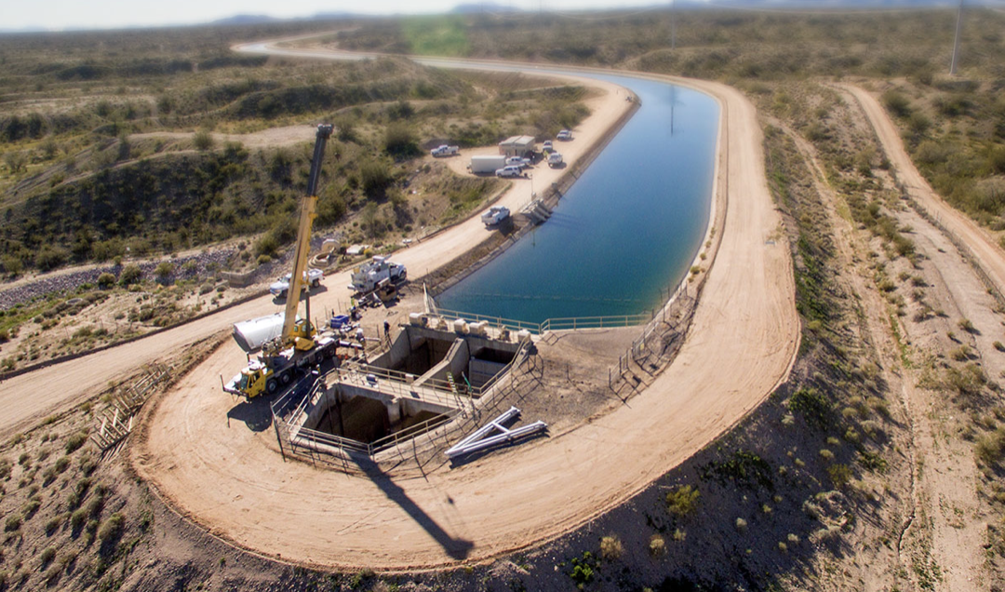
Explain
Three main water sources in Tucson:
Central Arizona Project
Groundwater
Effluent (remediated and reclaimed water)
Source: Central Arizona Project

Slide 18
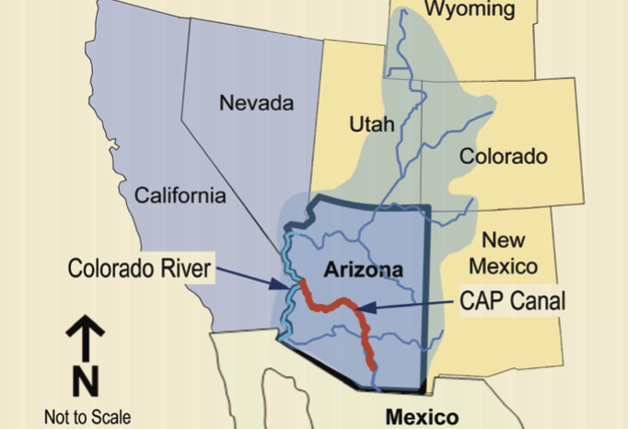
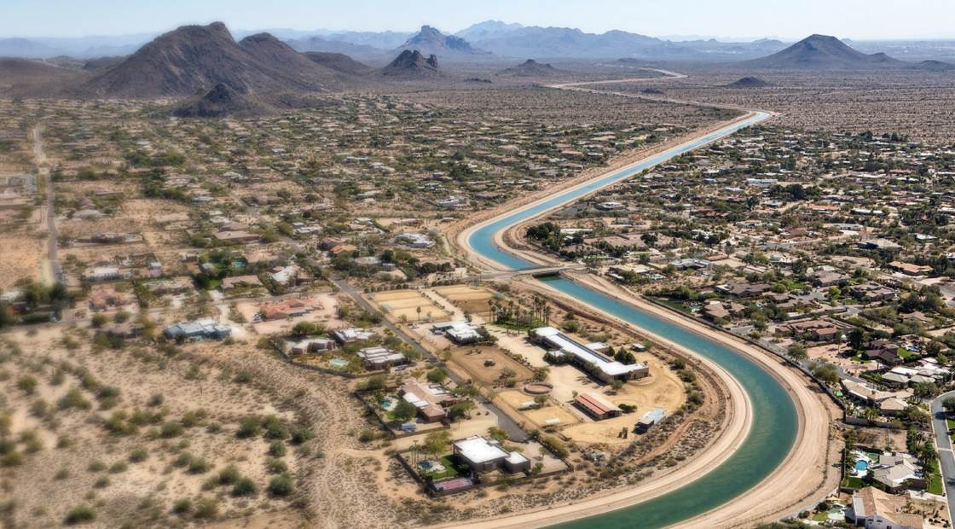
Explain
Central Arizona Project (CAP)
Colorado River Water is delivered to different parts of Arizona, including Tucson, through a series of canals.
CAP system starts at Lake Havasu along the western edge of Arizona.
CAP moves 1.3 billion gallons of water each day.
Source: Tucson Water
Source: Central Arizona Project

Slide 19
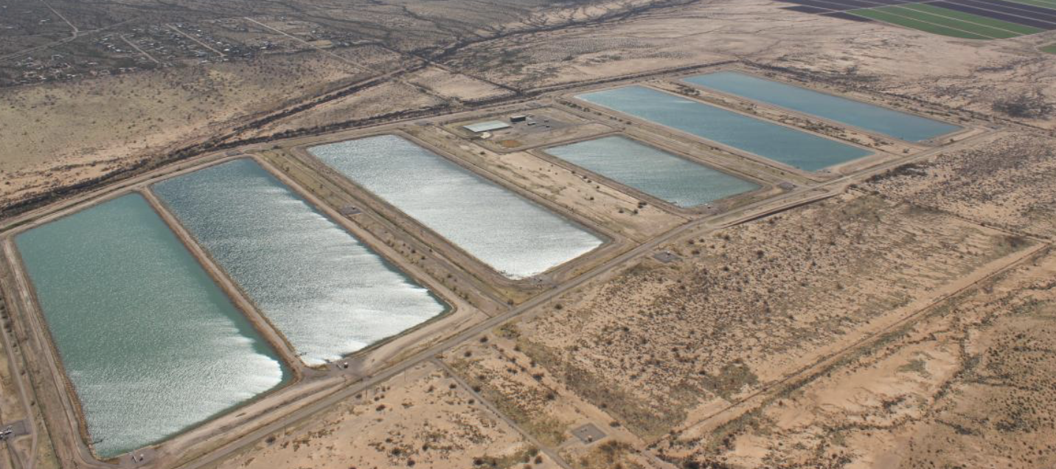
Explain
Central Arizona Project (CAP)
Tucson’s share of water is piped from the CAP canal to Avra Valley’s three large recharge basins.
Recharge basins allow surface water to be stored underground until needed.
Eliminates the need to build costly surface reservoirs which are prone to evaporation.
Source: Central Arizona Project

Slide 20
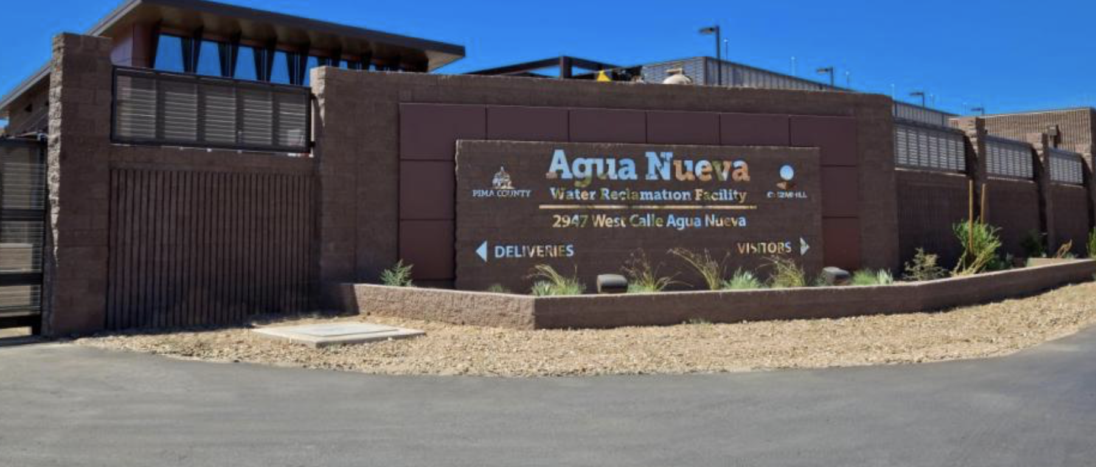
Explain
Remediated vs. Reclaimed Water
Reclaimed Water:
Recycled water typically used for irrigation, crops, dust control, fire fighting, supporting wildlife habitats.
Reclaimed Water Facility
Remediated Water:
Water that contains contaminants (pollution) that is cleaned for later use.
Source: Jacobs
Notes:
Introduce vocabulary cards and display in the classroom.

Slide 21
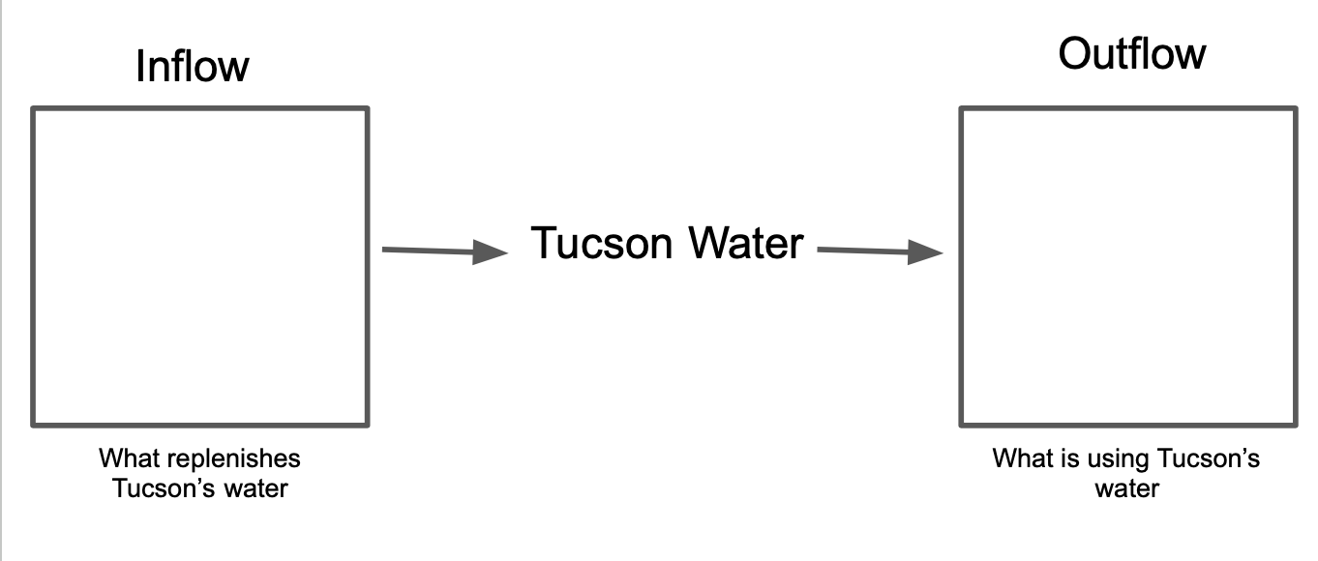
Explain
Notes:
Teachers should revisit their class stock inflow/outflow diagram. You should be able to add CAP water as an inflow. Reclaimed water and remediated water would be added from the outflow to the Tucson water at the backloop arrow.

Slide 22
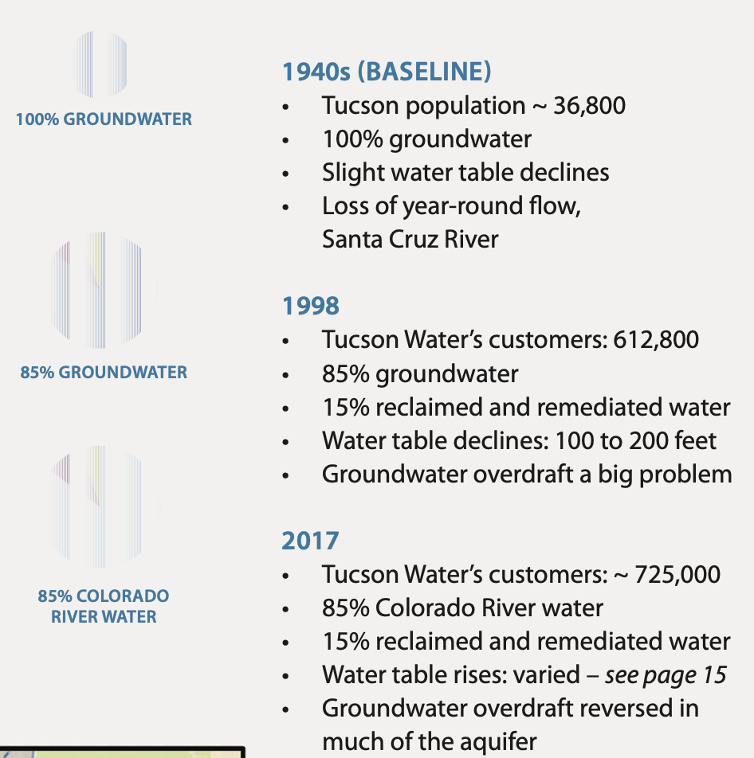
Explain
What patterns do you see?
What is changing?
Source: City of Tucson, Tucson Water
Notes:
Pass out handout #2 containing the infographic and map. Have students independently read through the infographic and respond on their worksheet. Then pull them together for a class discussion.

Slide 23
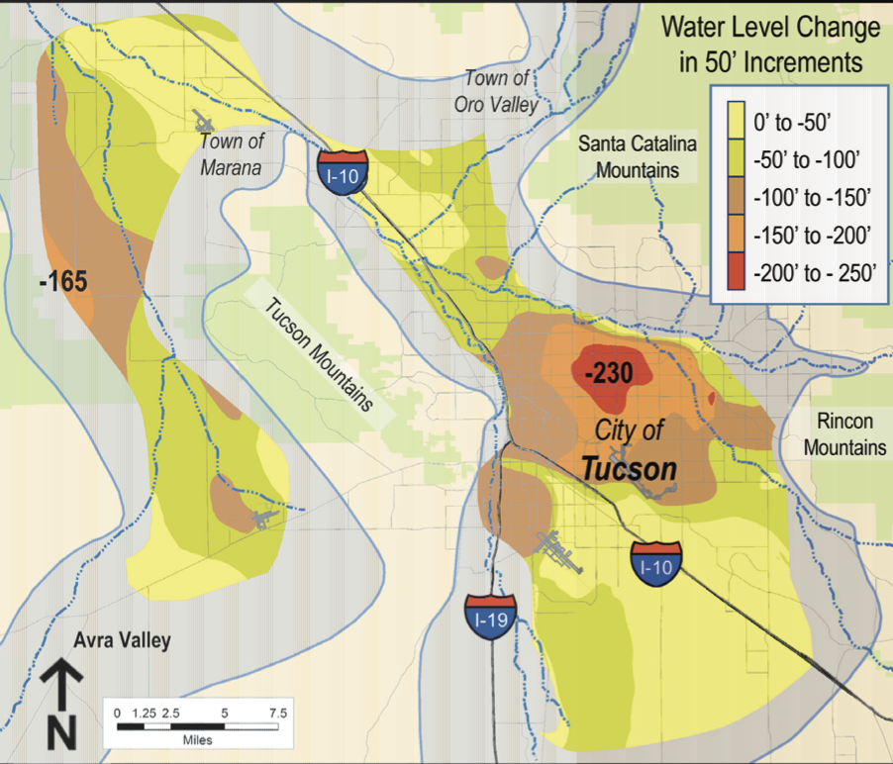
Explain
Water Level Declines 1940-1998
What do you notice?
What do the different colors tell us?
Where are we approximately?
Source: City of Tucson, Tucson Water

Slide 24
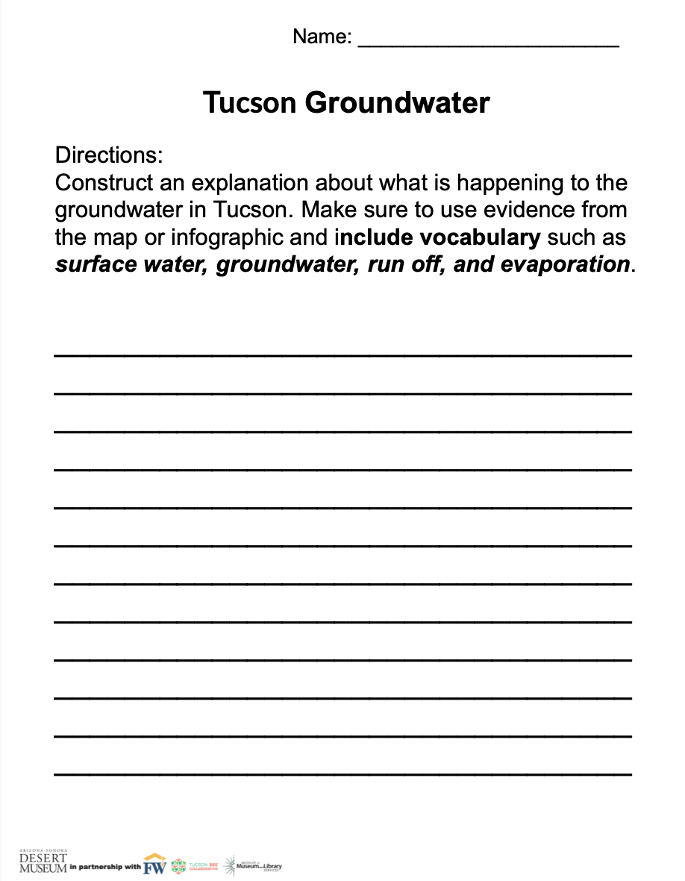
Explain
Your Task:
Construct an explanation about what is happening to the groundwater in Tucson. Make sure to use evidence from the map or infographic and include vocabulary such as surface water, groundwater, runoff, and evaporation.
Notes:
Handout #3 students should complete independently. Make sure to review expectation of integrating vocabulary.

Slide 25
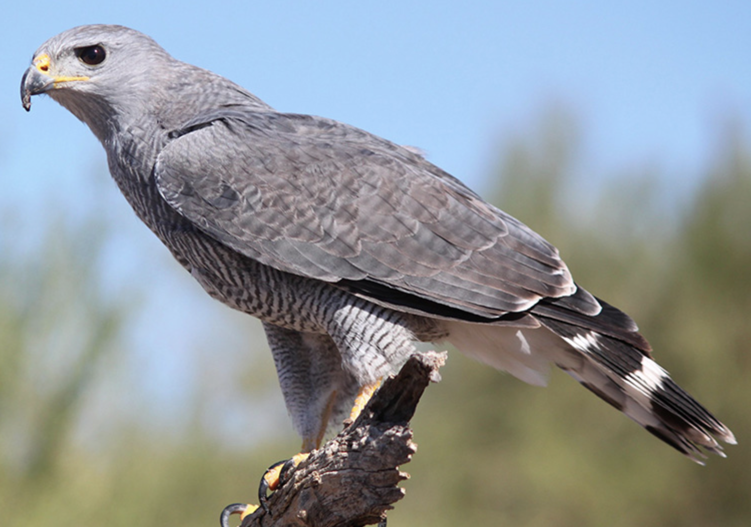
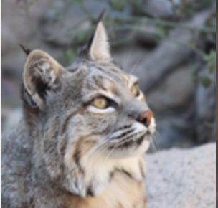
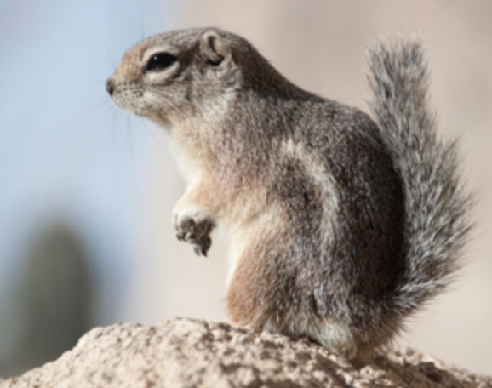
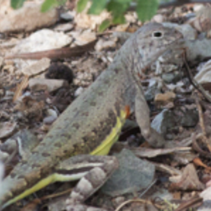
Explore
How do you think surface water and groundwater scarcity affects animals in Tucson?

Slide 26
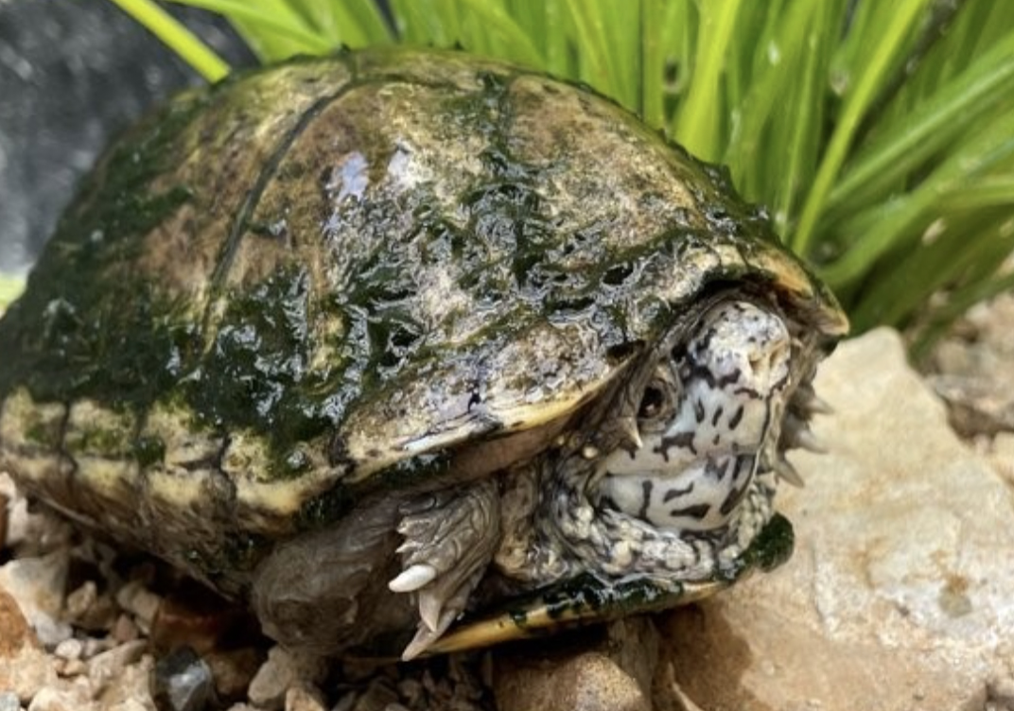
Explore
Breakout Groups
Read the fact sheets to learn about your animal.
As you read, think about how lack of availability of water affects your animal.
Be ready to share two interesting things
about your animal.
Notes:
Break up your class into 3 groups. Each group will become experts on one of the three species. They will then use the information from the facts sheets (found online or can be printed) to make a claim about the impact of water on their survival.

Slide 27
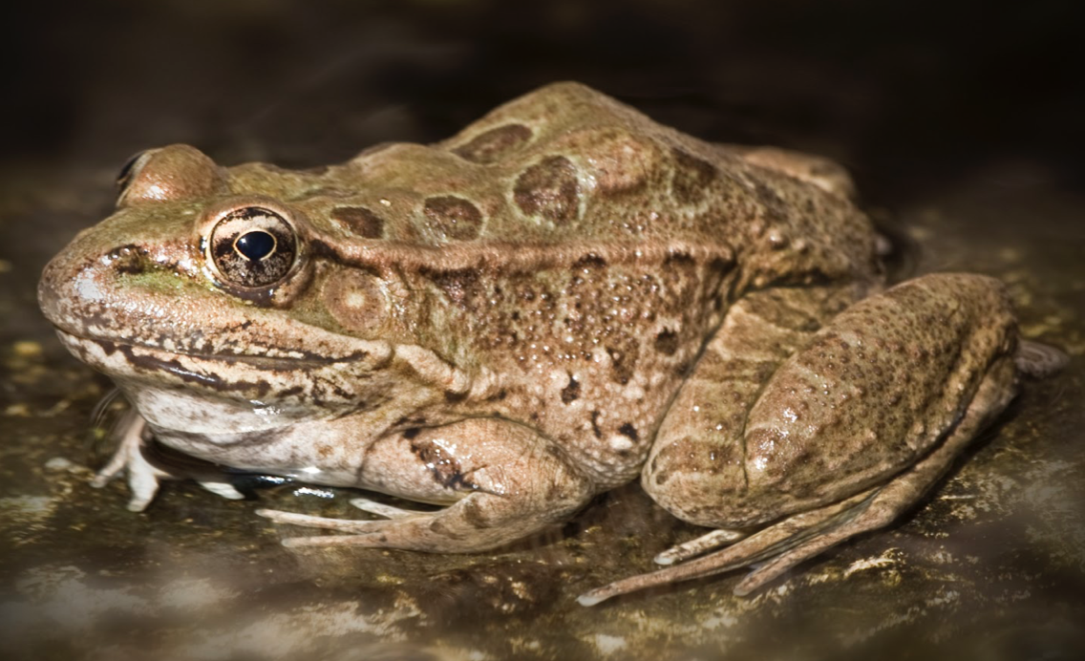
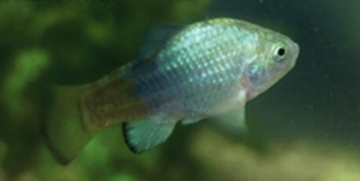
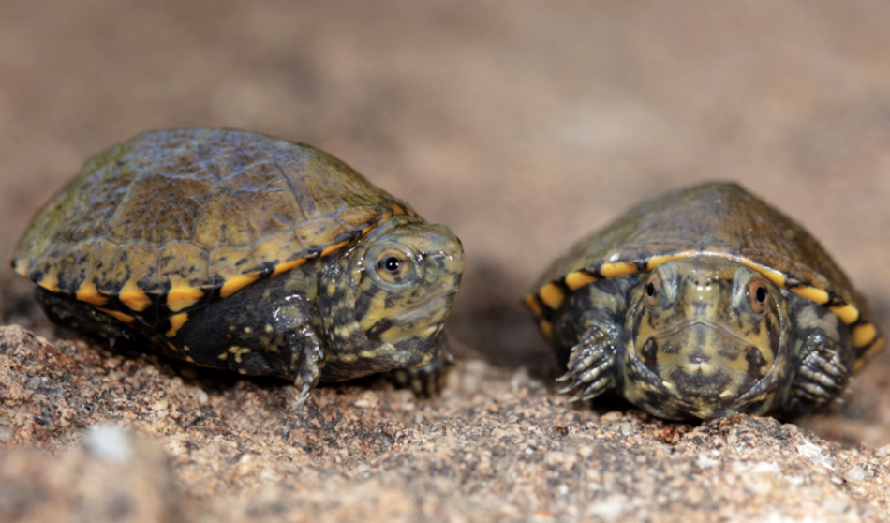
Explore
Breakout Groups
In your group, share one thing you learned about your animal and one way that water affects it.
Chiricahua Leopard Frog
Desert Pupfish
Sonoyta Mud Turtle

Slide 28
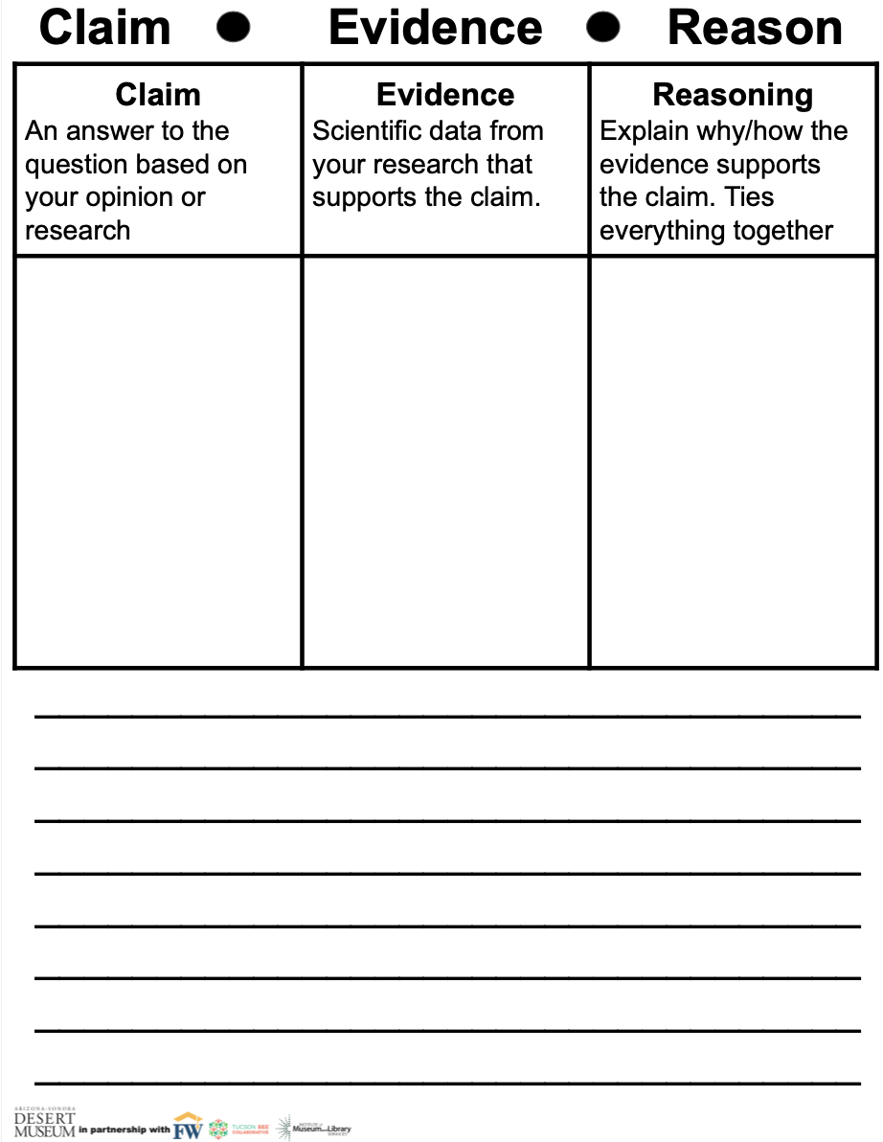
Explain
Your Task:
Make a claim about the impact and survival on your native species.
How has water usage affected it?
What can we do to help?

Slide 29
Explore
Think about all the how you use water at home.
What are some of the ways you use water both indoors and outdoors?

Slide 30
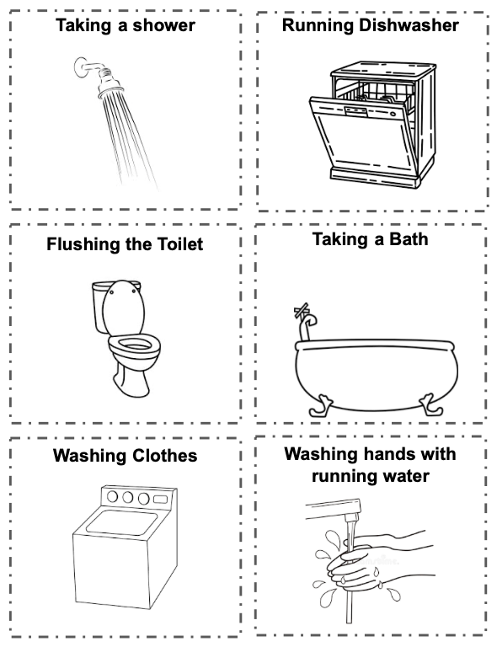
Explore
Water Usage Card Sort
Everyone uses water to shower, brush their teeth, and wash their hands. But thinking about these activities, which ones do you think use the most water, which one uses the least?
With your group, order these cards from the least amount of water used to the most amount of water used to perform these activities.
Notes:
Least to greatest: Hand washing, teeth brushing, dishwasher, washing machine, shower, bath, toilets, lawn.

Slide 31
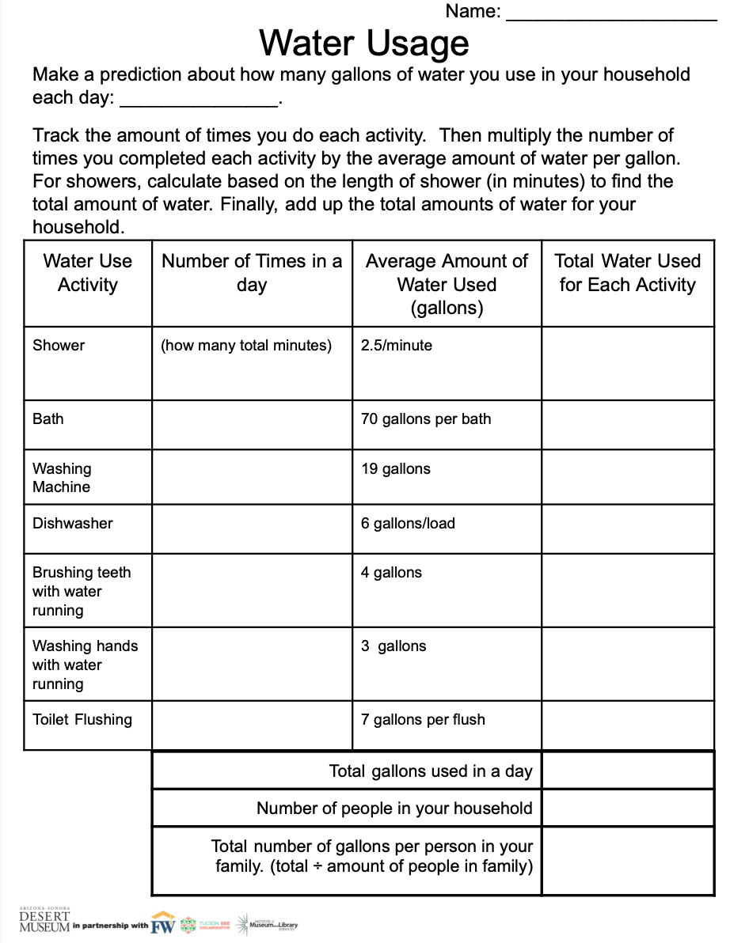
Explore
At home water tracking activity
Track your water usage over a 24 hour period of time.
For showers, you will have to track how many minutes you shower to figure out how many total gallons you use.
Notes:
Pass out to students. Ideally students should be completing on a weekend day so they can track a full day’s water use. Explain that the shower calculation is different because it is based on length of shower.

Slide 32
Explore
Make a prediction about how much water your household uses in each day.
Be ready to share your reasoning behind your prediction.

Slide 33
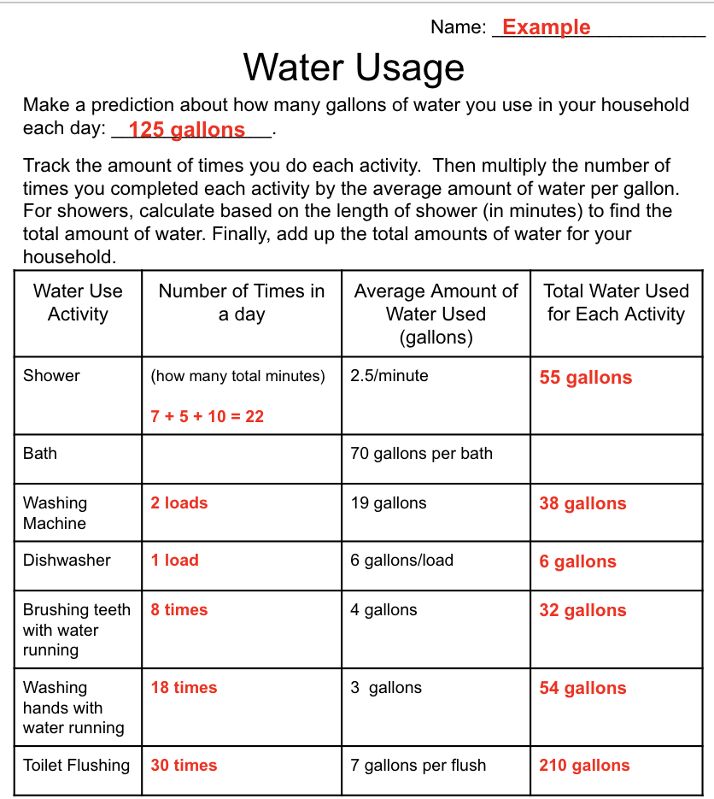
Explore
What information can you gather from this example water usage tracking?
How did they calculate the amount of gallons used to take showers?

Slide 34
Explain
Discussion:
How did your prediction compare to your actual usage?
What surprised you about your water usage?
What activity used the most amount of water?
What used the least amount?
Notes:
WIth a partner or group, have students share their ideas.

Slide 35
Explain
Water Hogger Activity
Amount of Households
Teeth brushing
Hand
washing
Shower
Toilet flushing
Bath
Washing Machine
Dishwasher
Notes:
Ask students to look at the last column of their water usage. Have students write the name of that activity (shower, tooth brushing, etc.) on a post-it. Teachers could draw a graph on the whiteboard or use one in the slide deck and then invite students to place their post it on the graph under the appropriate category.

Slide 36
Explain
Discussion
What was the biggest water hogging activity as a class?
How could we reduce or conserve the amount of water used for this activity?
Which activity used the least amount of water? Why do you think that is?

Slide 37
Elaborate
What is something your household is doing well when it comes to conserving or using less water?
What is something they could do better to use less water?

Slide 38
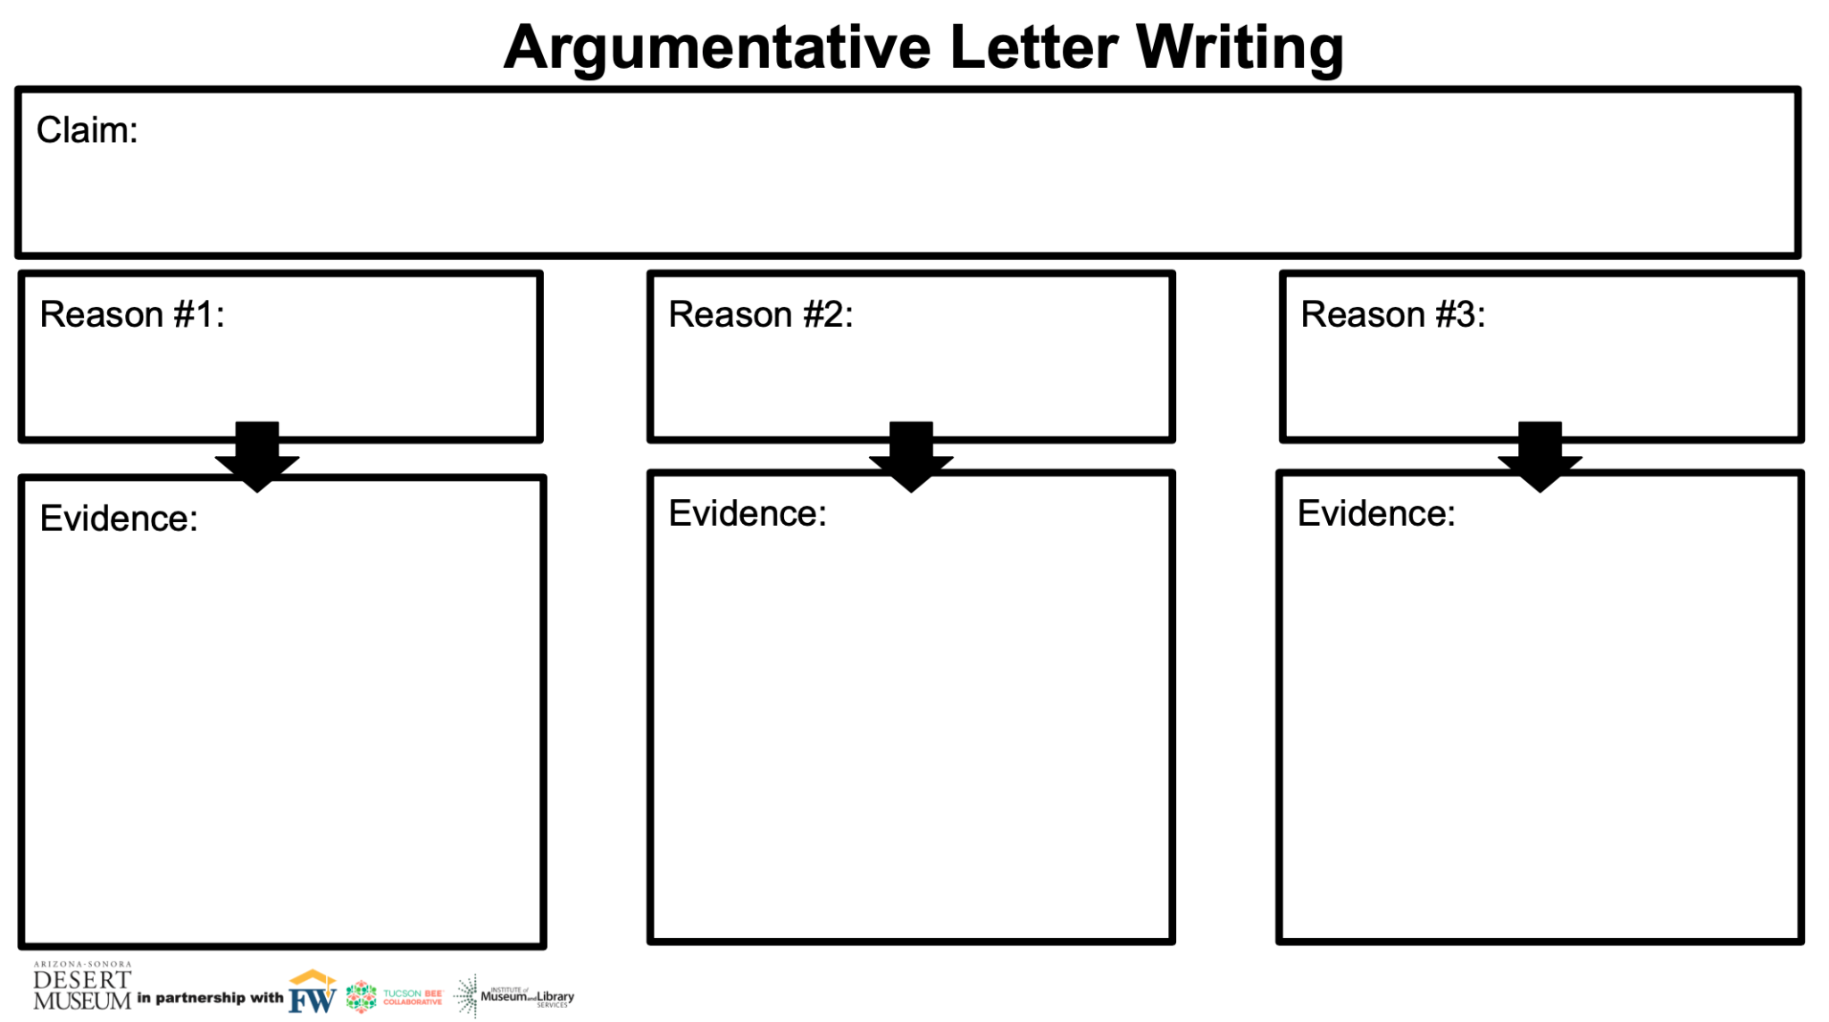
Elaborate
Write an argumentative letter to your parent or guardian about how you can work together to use less water as a household and why that is important.
Make sure to include evidence from your water usage recording sheet or things you have learned in this unit to support your argument.

Slide 39
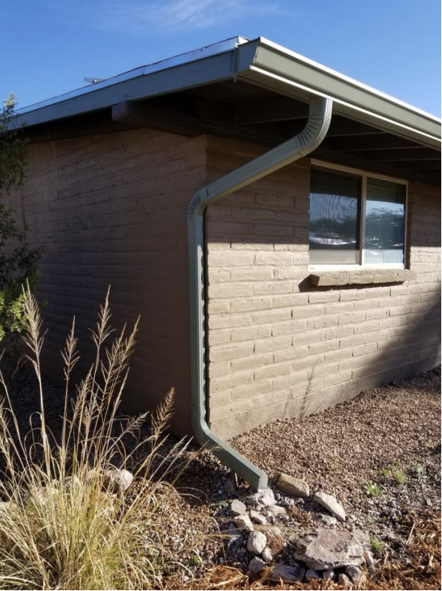
Evaluate
In this unit we learned about the importance of water in the desert and how the scarcity of this natural resource impacts Tucson.
How could we use features, such as gutters to catch or capture rainwater to use around our homes?
City of Tucson

Slide 40
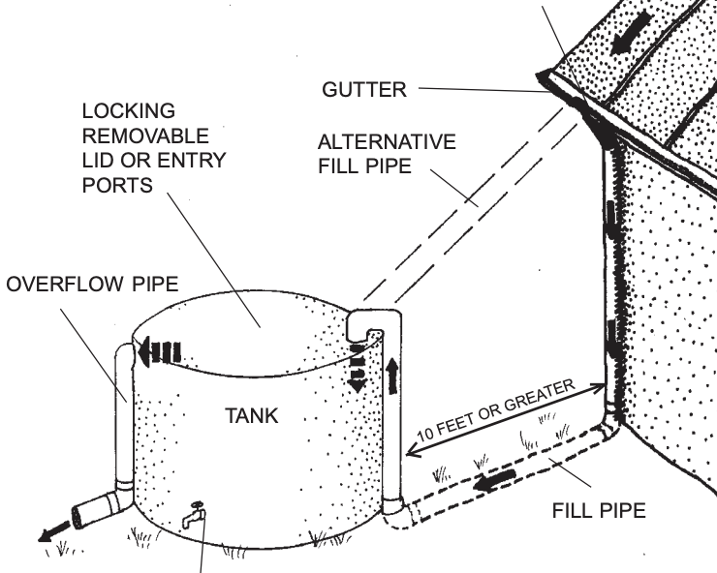
Evaluate
Rain Harvesting Design Challenge
Your task: Create a model home that maximizes water harvesting.
Possible features could include a cistern, gutter system, a recharge basin, rooftop rainwater harvesting, etc.
AZ Department of Water Resources

Slide 41
Evaluate
Constraints
You will be creating a model home using milk cartons.
Use a tray with a ½” lip as the landscape around your home.
Use natural materials such as mulch, sand, rocks, twigs to model natural landscape outside of your home.
You will have 30 minutes to build your home and landscape.
Your home and rainwater harvesting system must collect, retain, or reroute water for later use.

Slide 42
Evaluate
Materials
Natural materials (sticks, gravel, leaf, mulch, rocks)
Milk Cartons
Cardstock
Straws
Plastic Tray
Ziplock bag
Foil
Dixie cup
Clay
Notes:
Feel free to use other possible materials for your class as you see fit.

Slide 43
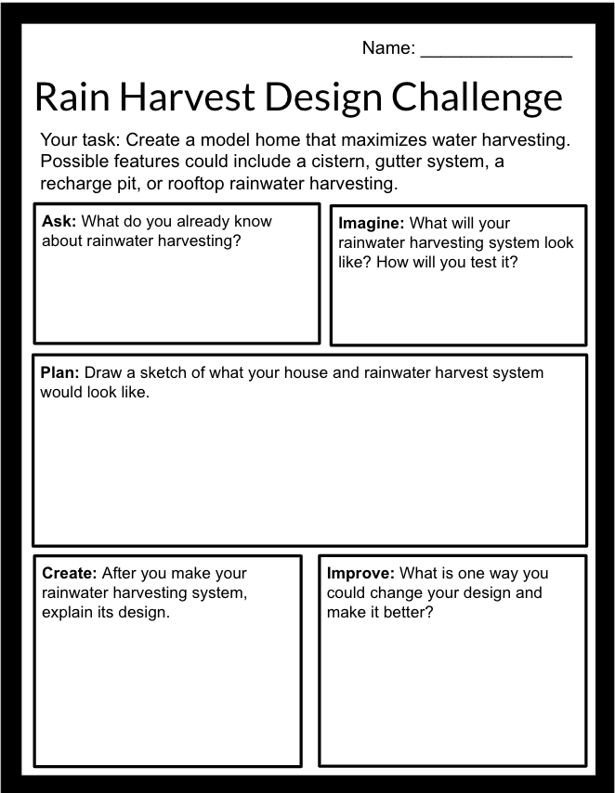
Design Challenge
Complete the “ask” and “imagine” sections of the planning page independently. Then in your group, share your ideas of what you envision your rainwater harvesting design to look like and how you plan to use your natural materials in water collection or diversion.
After everyone had a chance to share, draw what your group’s house and rainwater harvesting system will look like in the “plan” section. Then begin building.
Notes:
As you discuss their rainwater harvesting systems, reiterate that they don’t have to just be cisterns for storage. They can be as simple as basins that slow runoff to let it infiltrate into the ground to naturally water vegetation so that groundwater doesn’t need to be pumped to water their landscapes.

Slide 44
Evaluate
Redesign
Today you will have an opportunity to redesign your home and rainwater harvesting system.
What was an effective part of your design?
What area would you like to improve?
What materials will you need to make these improvements?
Will you get rid of any of your design completely?

Slide 45
Evaluate
Reflection
What rainwater harvesting feature captured the most water for later use?
What would you do differently in the future?
Why do you think it is critical for more homes to incorporate rainwater harvesting?

