Slide 1
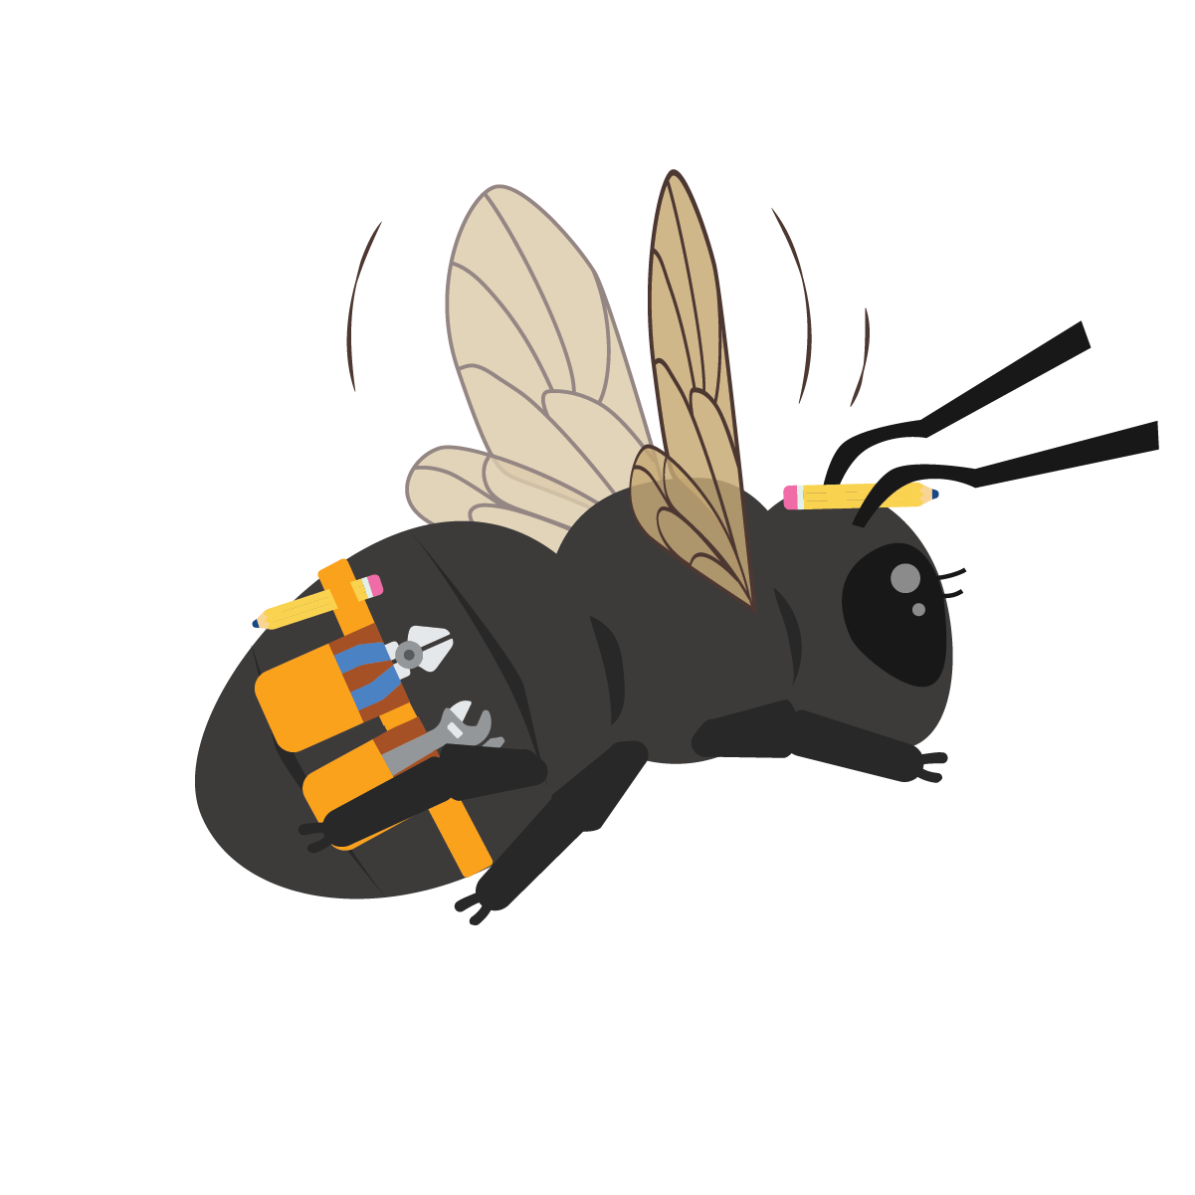

2nd Grade:
Bee Heroes

Slide 2
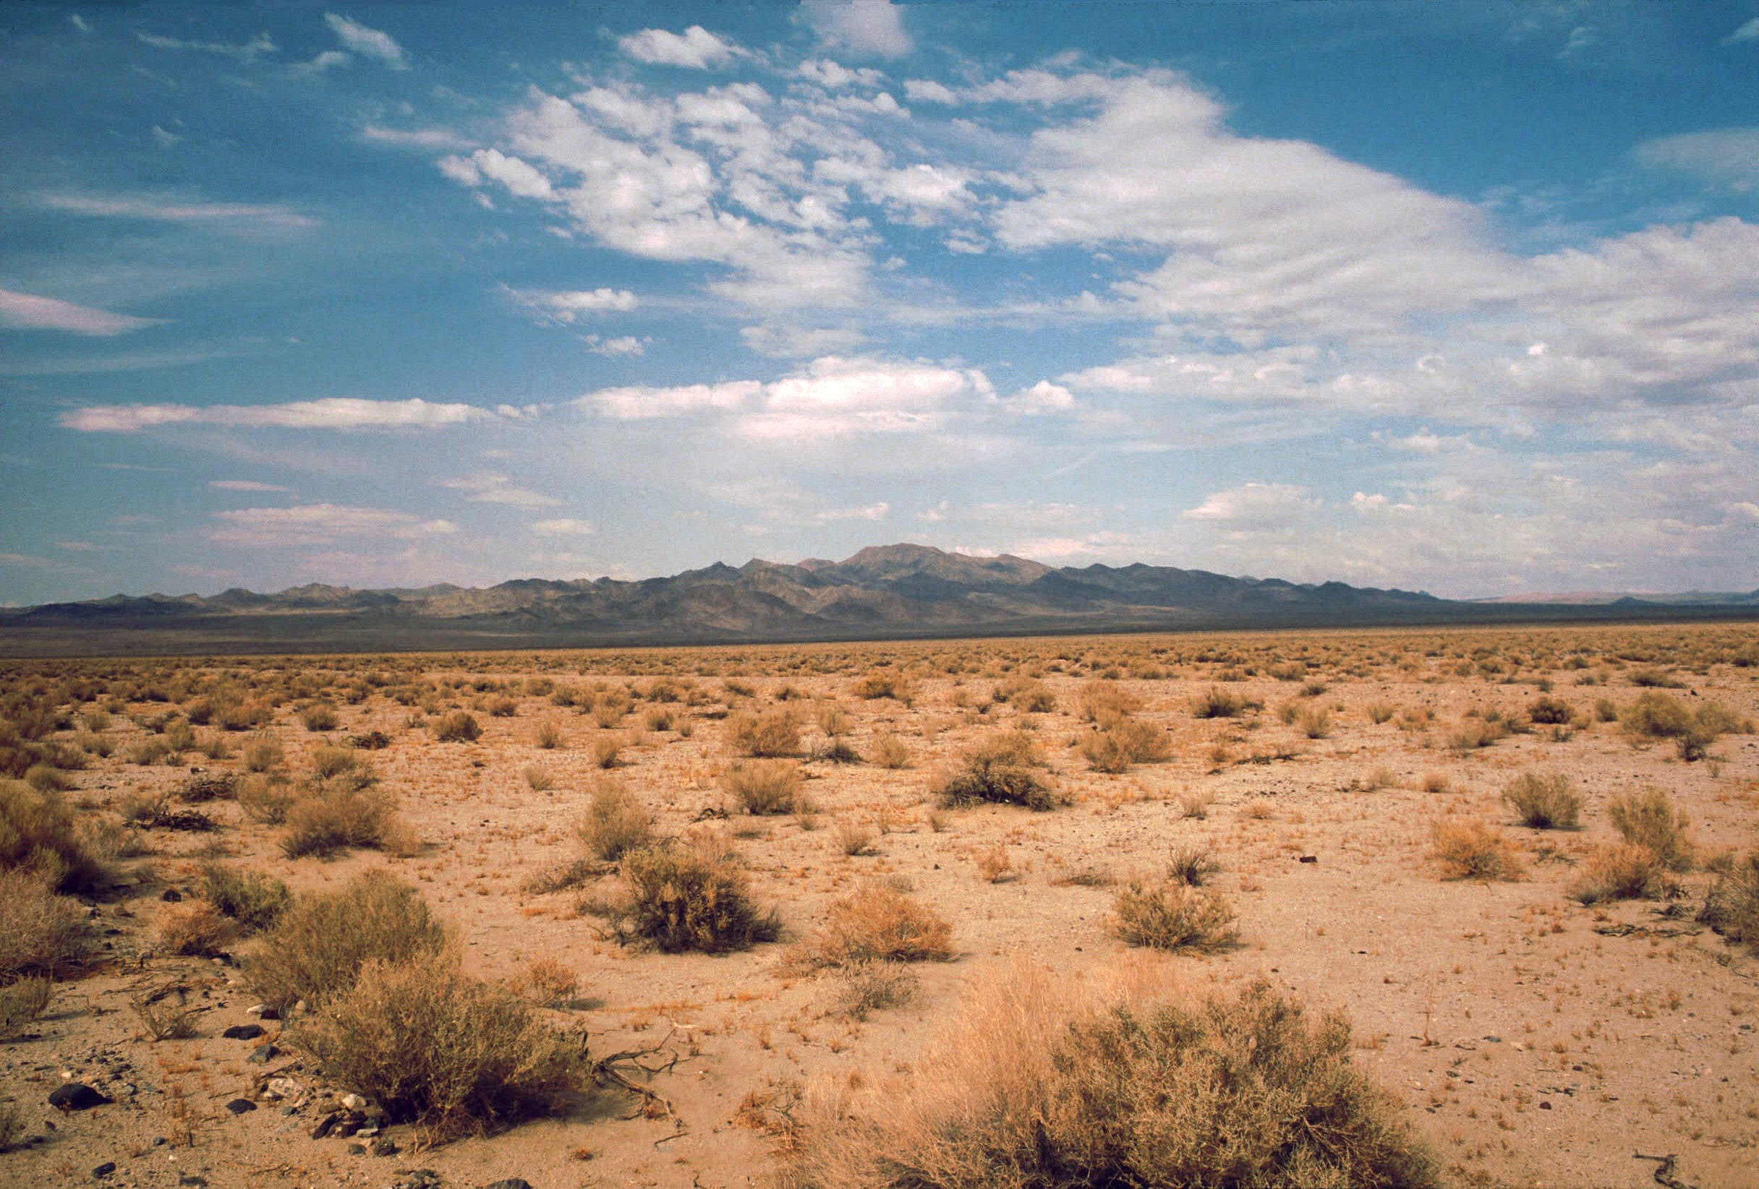
Driving Question:
What do desert bees need to survive, why are they essential and how can humans protect them?
Notes:
Introduce the driving questions for the next 3 weeks.

Slide 3
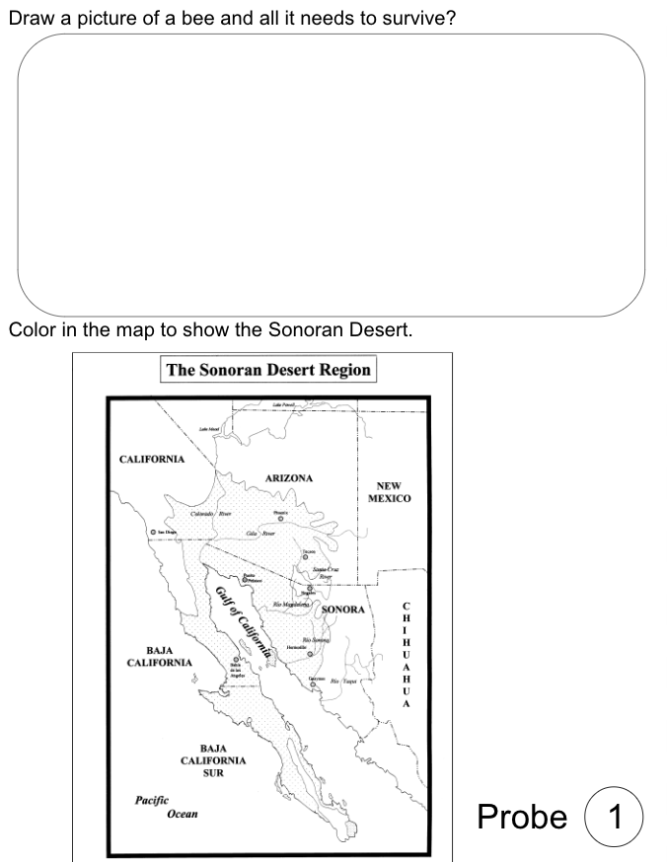
Probe
What do you know about bees in the
Sonoran Desert?
Draw a detailed picture of a bee in the
Sonoran Desert and what it needs to
survive on page 1 of your bee journal.
Include:
Plants/food source
Animals
Landscape
Labels of what you draw
You can use colored pencils or crayons to complete your drawing.
Notes:
Pass out the students’ Bee Journal and ask them to draw a picture of a bee in the desert. Have them include plant life, animals, a desert landscape as well as labels for their drawing. Crayons, color pencils, or markers can be used to help add details to their picture. The purpose is to see what prior knowledge they already have and to start identifying misconceptions about bees.

Slide 4
Probe
Where is the Sonoran Desert located?
On page 1 of your bee journal, color in the shaded area of the map to identify where the Sonoran Desert is located.
Circle where you are located on the map.
Notes:
Pass out the students’ Bee Journal and have them color in the shaded area of the map to indicate where the Sonoran Desert is located.
AP Structure Suggested: Turn and Talk
Have students talk with a partner to try and identify the location of their city on the map.
Then help students determine where they are located on the map and mark it with a star or circle it.

Slide 5
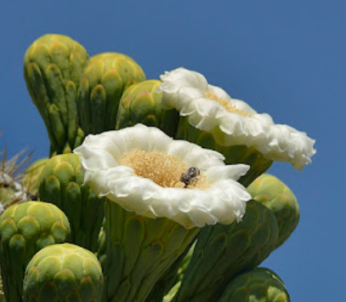
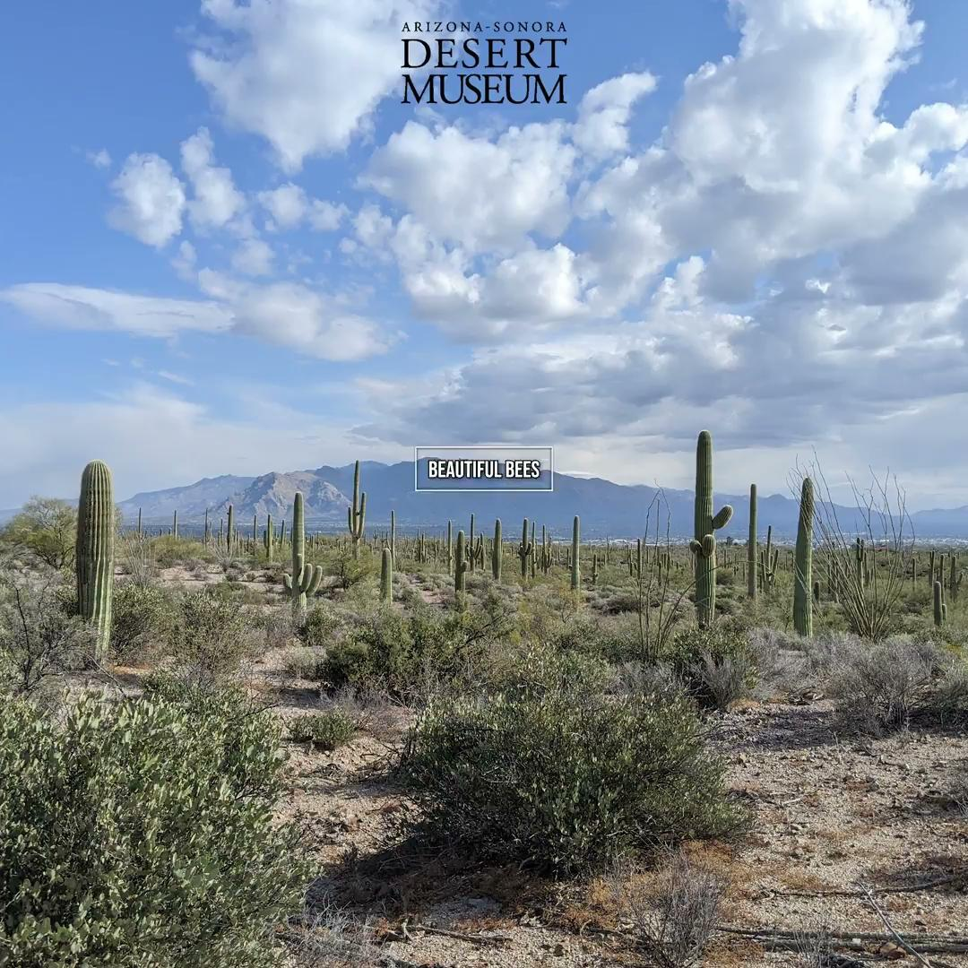
Bee Video link
Phenomena
Watch the link to see bees in the desert.
Be thinking about what you notice, what do you see the bees doing, and what questions do you have?
Notes:
Show the students the video of bees in the desert. Encourage them to be thinking about what they notice, what they see the bees doing, where the bees are going, what they look like, and what questions they have. You can also access the video from these links:
YouTube: https://youtu.be/4D916gRjvfM
Vimeo: https://vimeo.com/916786959
AP Structure Suggested: Solo-Pair-Team
Students think about their noticing and wonderings on their own first, then share with a partner or group and last, you come together as a group to share ideas.
Then have students use post its to write their ideas and questions, then transfer that to the page 3 of their Bee Journal. You can also use their post its afterwards to create a class wondering/noticing wall.

Slide 6
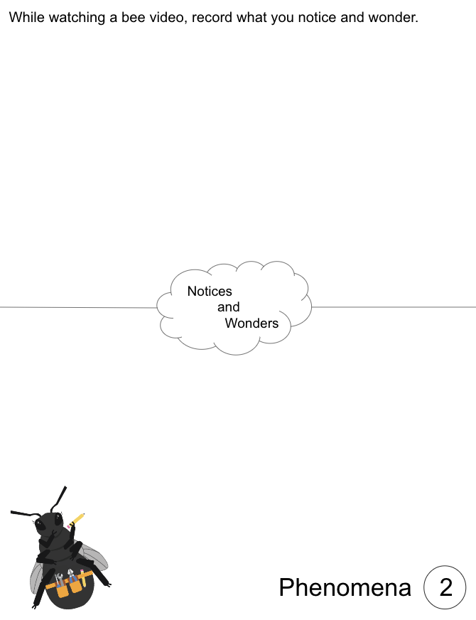
What are some things you noticed and wondered during the video?
Phenomena
Fill in page 2 in your bee journal with what you notice and wonder!
Notes:
This will be the page they transfer their post it note ideas to.

Slide 7
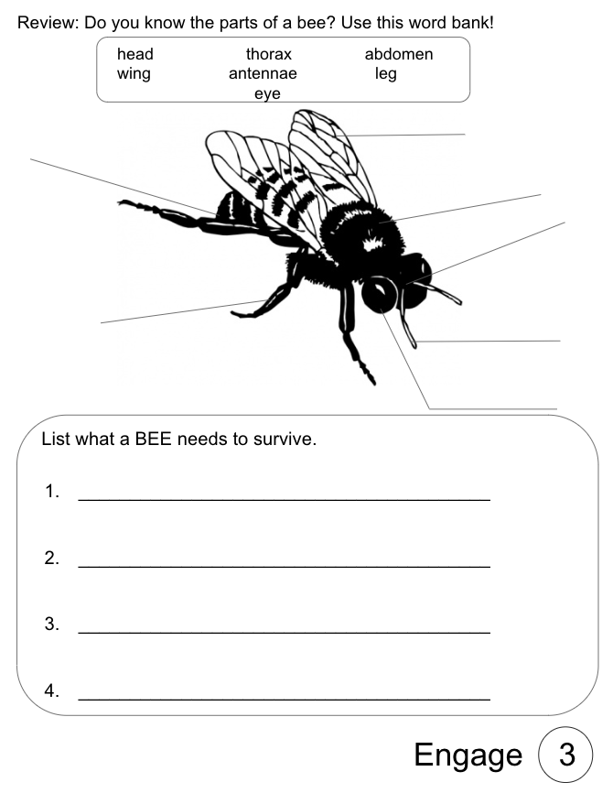
Engage
Look at the image of the bee on page 3 of your bee journal.
Use the word bank to label the parts of a bee.
Notes:
Students in prior grades should have exposure to the parts of an insect- this allows students to review their prior knowledge and apply that information to a diagram of a bee. See the “Answer Key for Bee Journal” for the correct labels.
**Do not complete the bottom portion of this page until after the Engage Activity has students look at different pictures of bees and discuss what they need to survive.

Slide 8
Engage
Let’s look at some pictures of bees. What are some things bees need to survive in the Sonoran Desert?
Notes:
Use the following slides to encourage discussion about what bees need to survive in the desert. (Air, food source, water, temperature control - provided by nest)

Slide 9
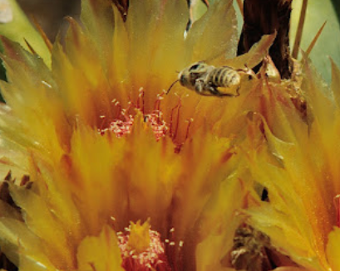
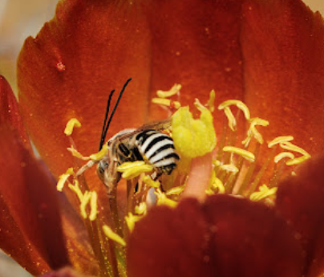
Engage
Notes:
Images of bees pollinating flowers, visiting flowers for pollen and nectar (food source), top left image of bee flying in air (air to survive),

Slide 10
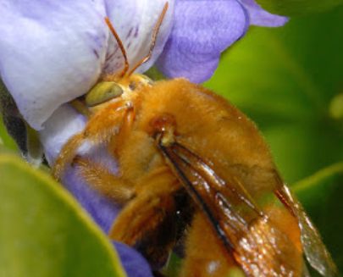
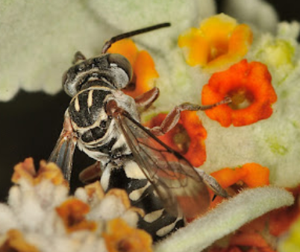
Engage
Notes:
Images of bees pollinating flowers, visiting flowers for pollen and nectar (food source)

Slide 11
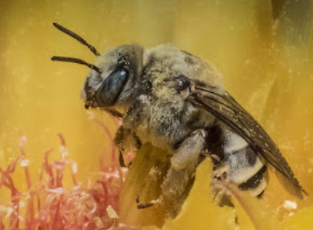
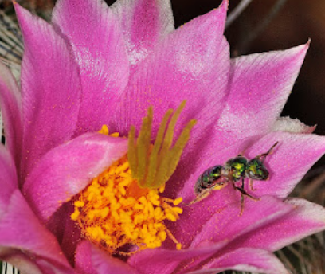
Engage
Notes:
Images of bees pollinating flowers, visiting flowers for pollen and nectar (food source)

Slide 12
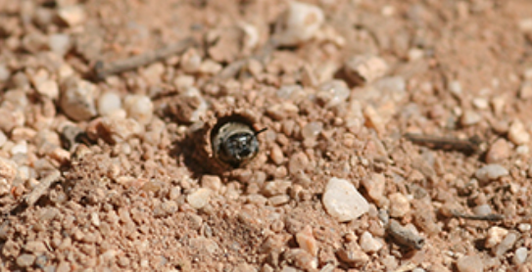
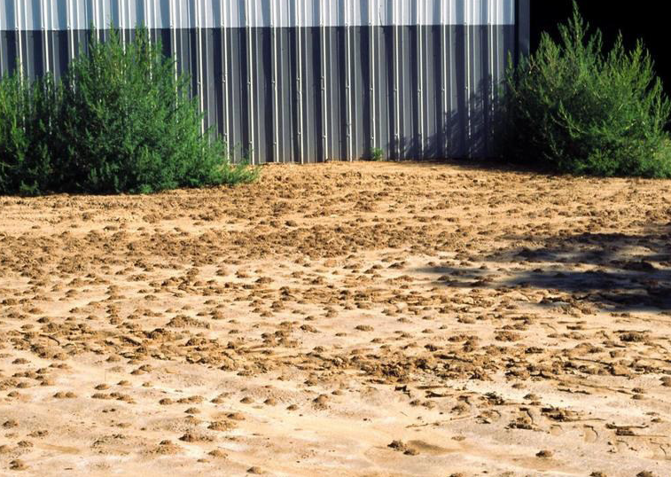
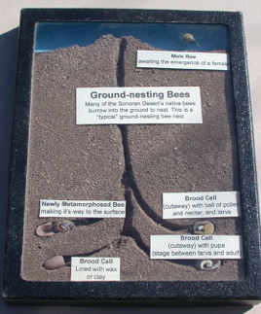
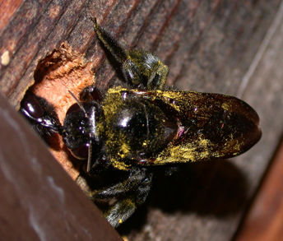
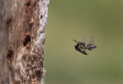
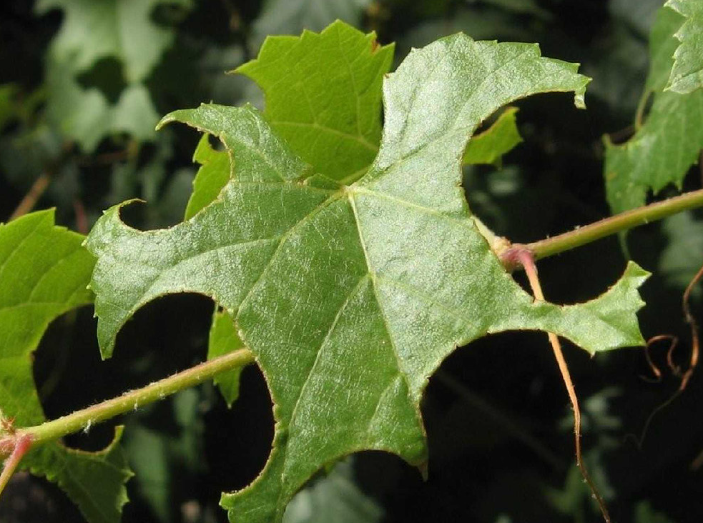
Engage
Notes:
Images of bees nesting in the ground and wood to show how they control the temperature

Slide 13
Engage
After looking at the pictures of bees, what are some things bees need to survive in the Sonoran Desert?
Notes:
AP Structure Suggested: Look-Pause-Partner
After students look at the pictures, they will pause to consider the question on their own, then share with a partner or group before discussing with the whole class. This participation structure can help students come up with answers to the questions at the bottom of page 3 in their bee journal.

Slide 14
Engage
What are 4 things bees need to survive in the Sonoran Desert? Write your answers on page 3 in your bee journal.
Notes:
After looking at the pictures of bee food sources and shelters, have kids fill in the answers to page 3 in their Bee Journal.
**See answer key: air, water, food, right temperature/shelter.

Slide 15
Gallery Walk Around Matching Activity
Explore
Posted around the classroom are pictures of Sonoran Desert plants, flowers, and landscape.
Match the different bees to their food source and shelter.
Use the clues on the bee cards to help you.
Notes:
**Before lesson, print 1 set of picture of plants/flowers/landscapes from Materials folder AND print the bee cards with names of bees on the back (Enough for each small group to have TWO of each bee- one with yellow highlighted and one with green highlighted.) Then post the Gallery Walk pictures of the plants/flowers/landscape around your classroom on the walls.
Activity: groups match one card at a time from the set first by matching the bees to the food source (yellow highlight first). Then have the students match their second cards (of the same bee with green highlighter) to the shelter source. Students will work in partnerships or groups to match the bee cards to their food source and then their nesting locations. Each partner pair/group will need 2 cards for each bee (2 carpenter bees/2 Leafcutter bees/2 Cactus bees/2 Globe Mallow bees)
**See the answer key in Bee Heroes Journal Answer Key for the possible places the students could place the bees. Note that there could be more than one place for them to put their bee cards. (Ex: Carpenter bees are considered “generalists” meaning they visit more than one type of flower like a saguaro flower and a palo verde tree.)
**Leave the Gallery Walk matches up on the wall to revisit during explain portion.

Slide 16
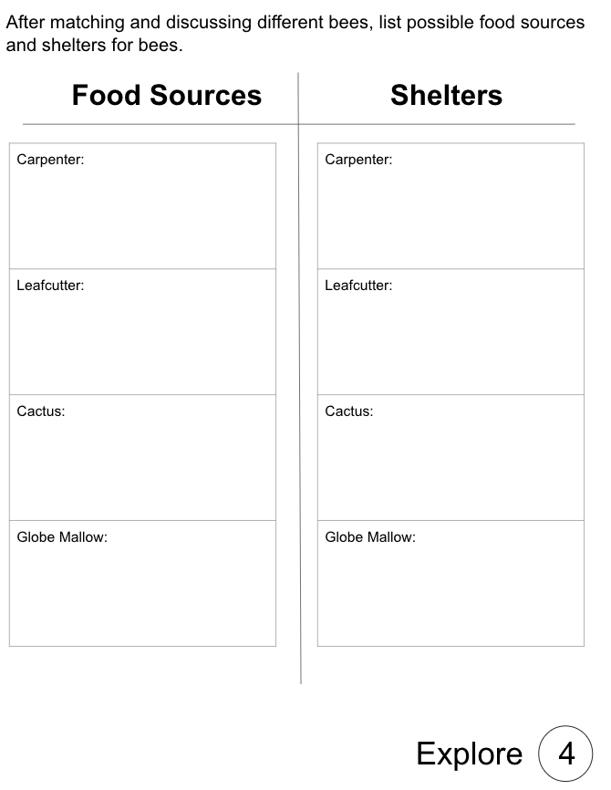
Gallery Walk Around Matching Activity
Explore
Discussion: Where can bees live and what are their food sources?
On page 4 of your bee journal, list food sources and shelters available to each bee in the Sonoran Desert.
Notes:
After the Gallery Walk have students discuss where the bees can live, make the homes, why they need to do that (to control temperature and weather conditions) and what they visit to get their food. They will fill in these pieces of information on page 4 of their bee journal.

Slide 17
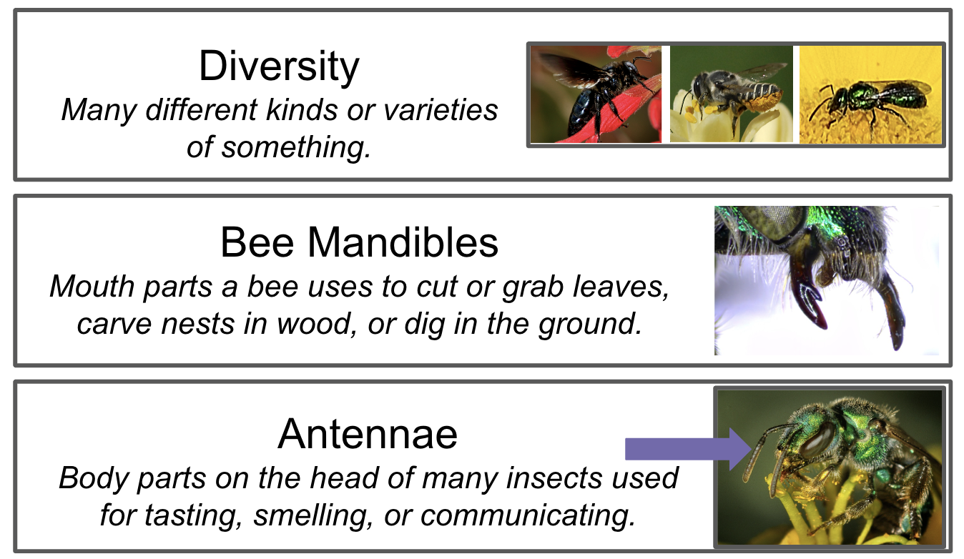
Explain - Vocab Cards
Notes:
Put up vocabulary words when introduced throughout the next few slides.

Slide 18
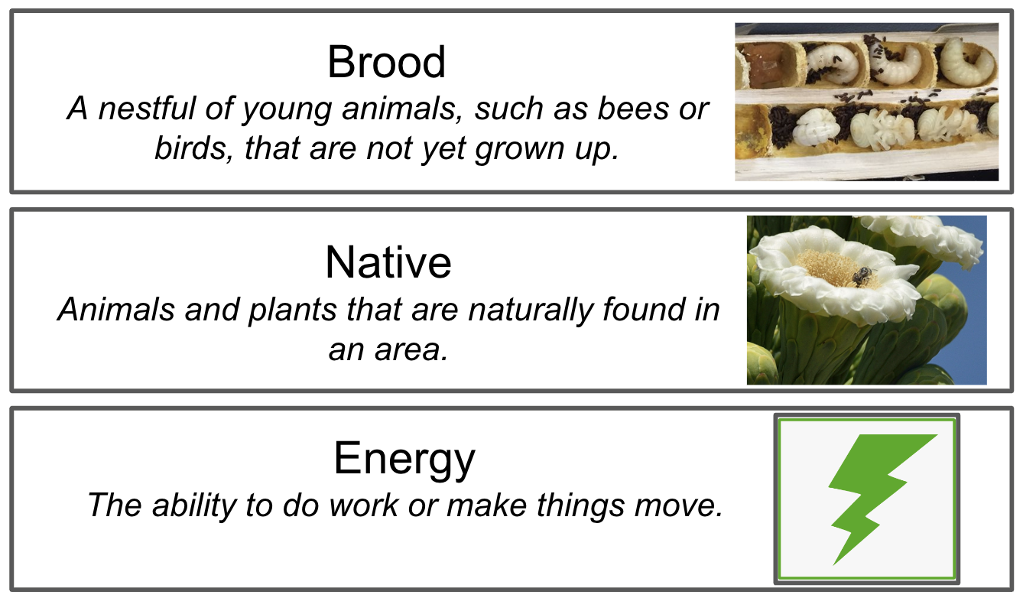
Explain - Vocab Cards
Notes:
Put up vocabulary words when introduced throughout the next few slides.

Slide 19
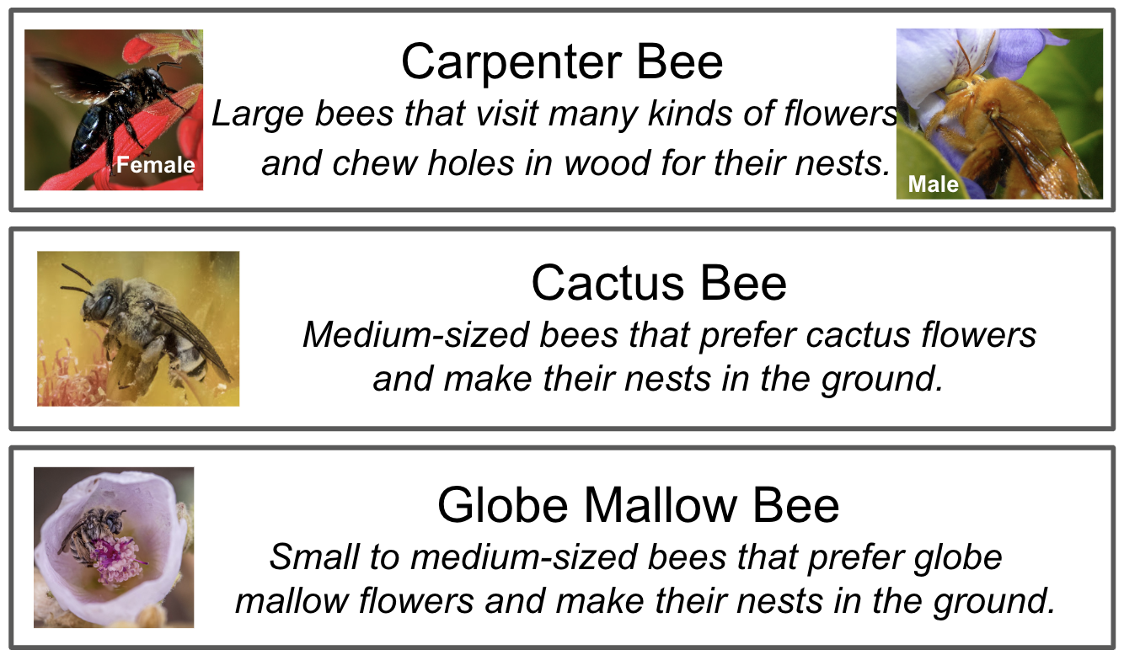
Explain - Vocab Cards
Notes:
Put up vocabulary words when introduced throughout the next few slides.

Slide 20
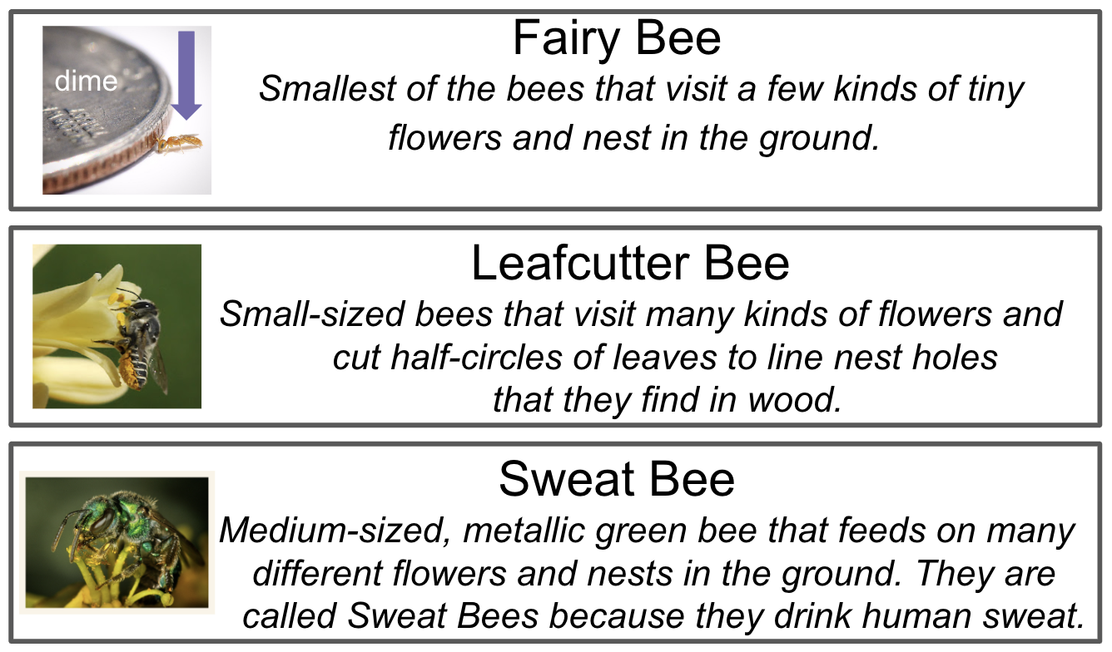
Explain - Vocab Cards
Notes:
Put up vocabulary words when introduced throughout the next few slides.

Slide 21
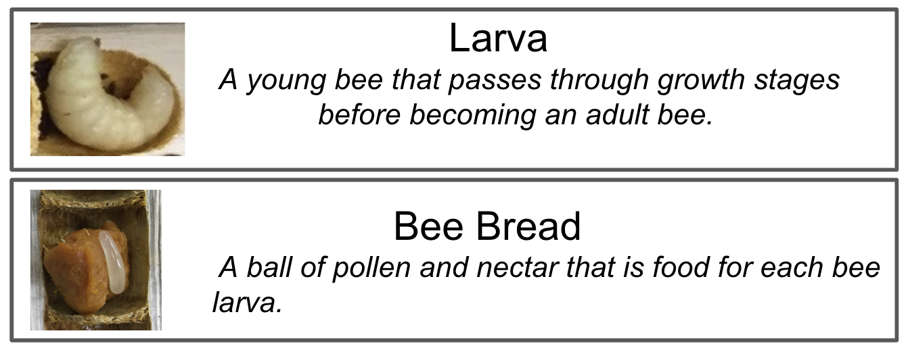
Explain - Vocab Cards
Notes:
Put up vocabulary words when introduced throughout the next few slides.

Slide 22
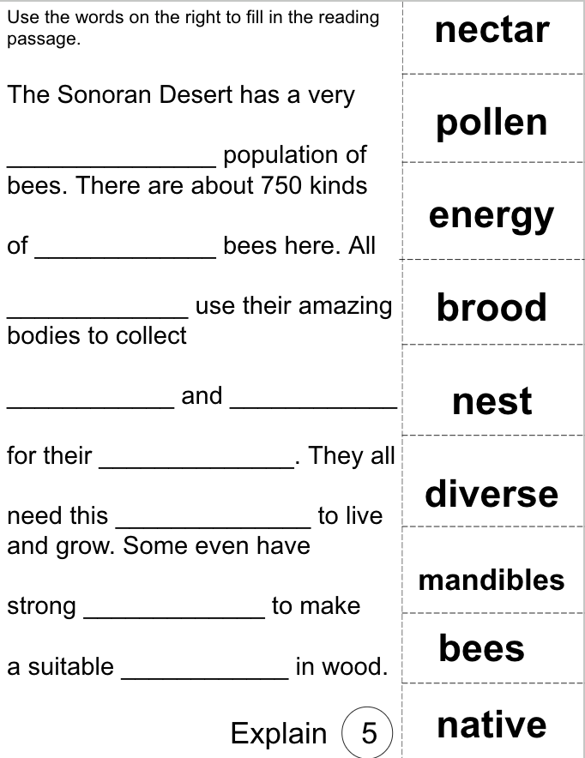
Explain - Vocab Cards
Check what I learned
Use the vocab cards to help fill in the missing words in the passage.
Cut and paste the words cards or write in the answers.
Then check in with a partner and compare your answers.
Discuss and read together as a class.
Notes:
After students learn about the vocabulary word cards, they will test their knowledge by filling in the missing blanks on page 5 of their bee journal. If you have printed the bee journal single-sided, you could have students cut and paste if desired.
AP structure suggested: Think-Pair-Share
Have students work on their own first, then check in with a partner. Lastly, share with the group before finalizing their answers.
Students can cut and paste the word cards into the correct spots or they can write in the answers on the appropriate line.

Slide 23
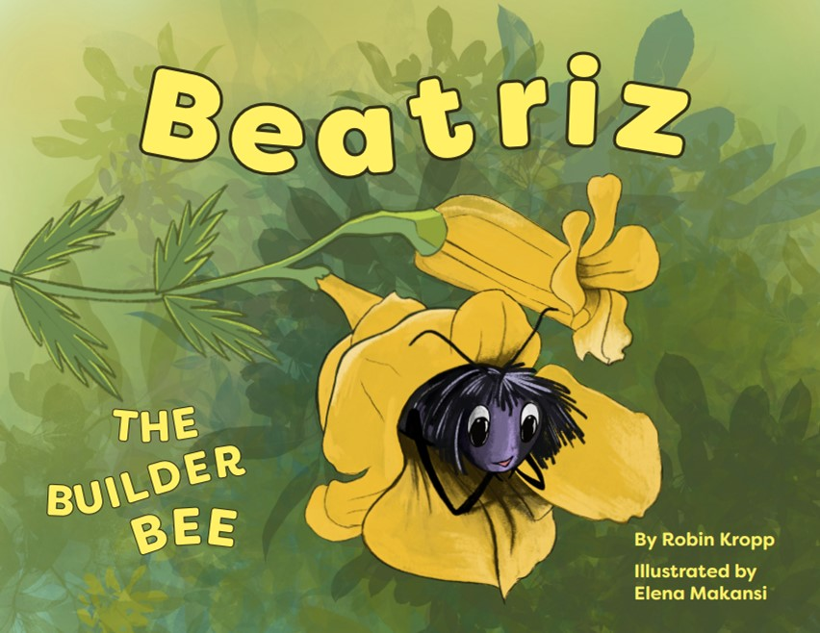
Explain - Read Aloud
Teachers: Click here to access a copy of Beatriz the Builder Bee (as a PDF) to read to your students on screen. For classroom copies, contact rkropp@desertmuseum.org. We will have a video link to a read-aloud here as well.
Notes:
Play the video of the read aloud if you don’t have access to the book. Link is here **insert link to read aloud

Slide 24
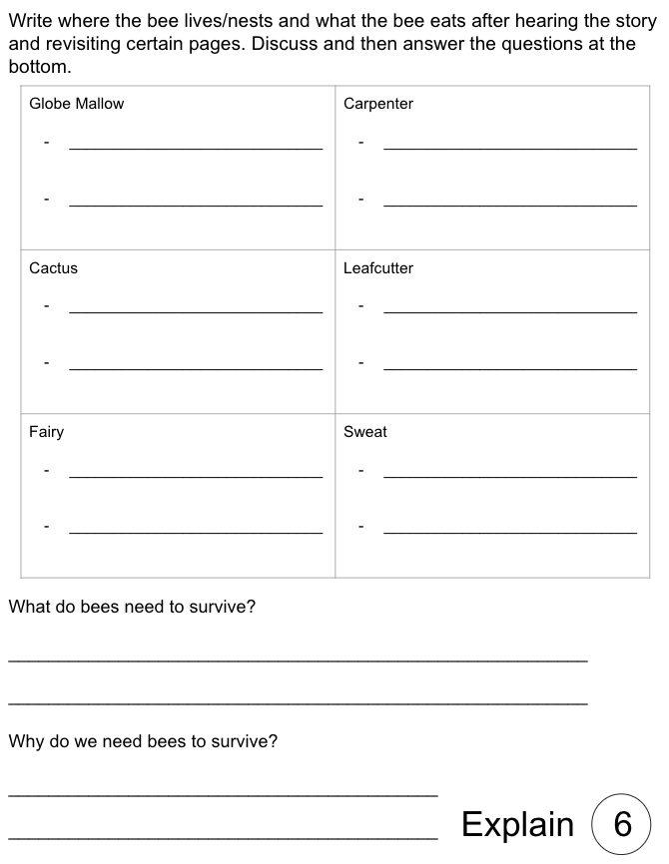
Explain- Read Aloud
What are some facts about the different bees in our story?
Think about the following bees and write down
facts about each one (where they live and what
they eat) on page 5 of your bee journal:
Carpenter bee
Leafcutter bee
Globe Mallow bee
Cactus bee
Sweat bee
Fairy bee
What do bees need to survive? Why do
humans need bees to survive?
Notes:
Reread these pages to help students remember the 6 different bees! Carpenter Bee page 6, 7 & 10, Leaf-cutter page 13 & 14, Globe Mallow page 12 & 14, Cactus page 12 & 14, Sweat Bee page 12 & 14 and Fairy Bee page 12 & 14.

Slide 25
Classroom Walk Around Matching Activity
Explain- Revisit Explore Activity
Discussion:
After listening to the read aloud Beatriz the Builder Bee, would we need to make changes to our bee matches from around the room? Why or why not?
Notes:
Hold a quick classroom discussion after listening to Beatriz the Builder Bee about what changes might need to be made to their matching cards from the gallery walk. If students don’t feel they need to make any changes, have them defend their answers.
AP Structure Suggested: Team-Pair-Solo
Students discuss their matches first as a whole class, then decide with a partner if they were correct, and lastly, make a decision on their own if they need to make changes or keep the same answers for their Gallery Walk matches.

Slide 26
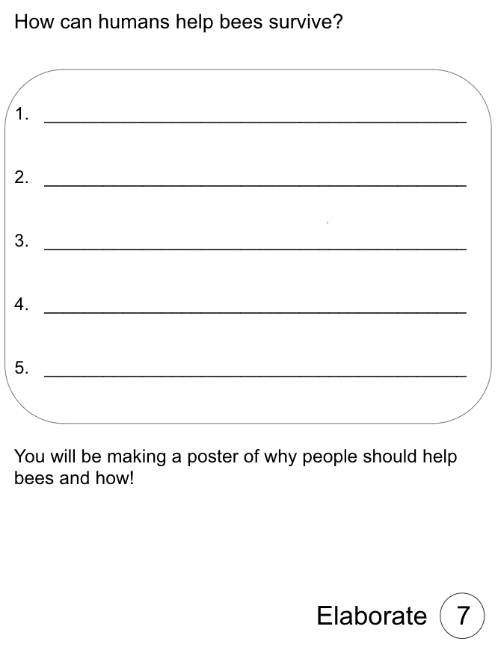
Bee A Hero! Save the Bees!
Elaborate - Part 1
Brainstorm
Now that we know how important bees are to the Sonoran Desert, let’s tell everyone!
Brainstorm ideas on how humans can save the bees and help them survive in the desert.
Think about what they need to survive and how humans can provide that to them.
How can we help to keep our native friends here?
Think about their food sources, their nests, and helping people understand that they are important to everyone.
Tell people what might happen if bees didn’t survive. How would life be different?
Notes:
AP Structure Suggestion: Sticky Sort
Have students come up with 3 ideas on sticky notes and then ask the students to sort their sticky notes with other ideas that are similar on the whiteboard or wall to construct a whole-class sticky board.
Ways to Save/Help Bees: provide habitat for them, Make a bee house, go chemical free- no pesticides, no herbicides,no bug spray (use natural remedies), plant native plants b/c that’s their food, don’t use heavy gravel/rocks b/c many nest underground in sand/dirt, let yucca stalks grow (this is where some carpenter bees nest), keep dead branches and tree stems-these are homes for many bees, make pollinator pools/bee baths, talk to your family and friends about bees- tell them why and how to help them

Slide 27
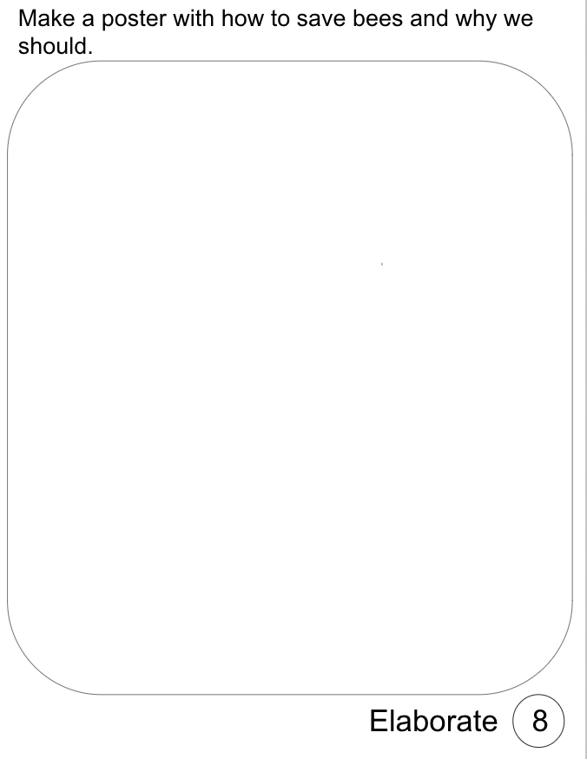
Bee A Hero! Save the Bees! Poster
Elaborate- Part 2
Use the brainstorm page in your bee journal to create a poster to help save the bees!
Include:
At least 3 ways humans can help keep bees alive in the Sonoran Desert and
Why humans should save the bees
Use color pencils, crayons or markers to make your poster eye-catching and colorful.
The bees need you!
Notes:
Students will use their brainstorm page (pg. 7) to create a poster to show people that we need to save the bees. Some ideas that should be included on the poster are reasons why bees are important, what bees do for us and what we can do for bees to help them survive in the desert.

Slide 28
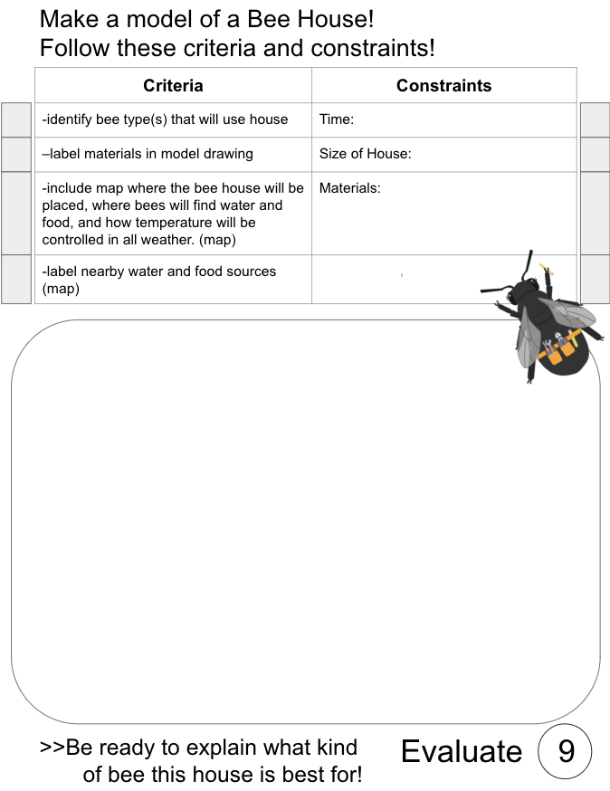
Evaluate
Can you make a bee house that bees could actually use?
Create a drawing of a bee house with labeled materials and details about where it will be located to attract bees:
Think about:
temperature control
water source
food source
length of tubing
size of house
location of house
Notes:
Allow students to draw a model of a bee house on page 9 of their bee journal. Encourage them to think about where their water source will be, what their food source will be, how big the house will be, what it will be made up of, and where in the yard they would place it. Use the back of the page to draw a location map of their bee house. They also need to think about temperature and how they will control that. (Ex. place the house in the shade.)
**If time allows, have the students build a model of their bee house using the drawing to help them design it. Possible constraints to provide can be: no glue, no plastic, must hang 3-feet or higher, unable to move, out of direct sunlight and protected from the rain. A sample bee house is located in the materials folder for reference.

