Slide 1
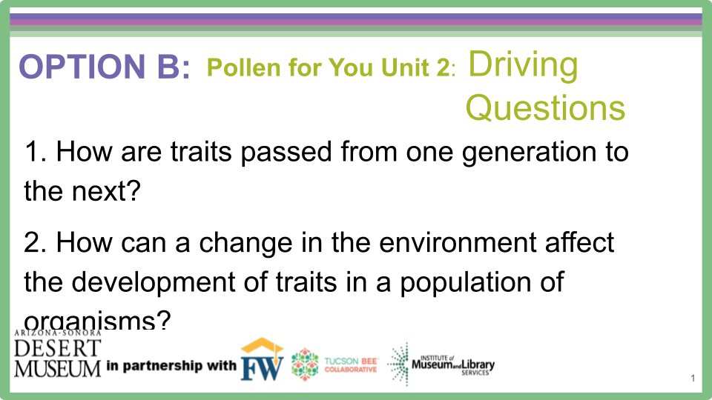
Option B, Unit 2, Pollen for You:
Driving Questions
How are traits passed from one generation to the next?
How can a change in the environment affect the development of traits in a population of organisms?

Slide 2
FOR THE TEACHER: IF PLANTS DIE BEFORE CROSS POLLINATION
Unfortunately the reality is that many variables often lead to the classroom plants dying before students can manually pollinate plants and grow another generation. If you are able to cross pollinate a couple of the plants as a whole class, the class could then work as a whole to continue observing and monitoring the growth of the next generation. But, if the plants have gone as far as they can go, the following simulation/game will help students understand that humans can select traits, but that variation of traits and time are variables that humans must patiently cope with as they try to grow the crop with the traits they desire.

Slide 3
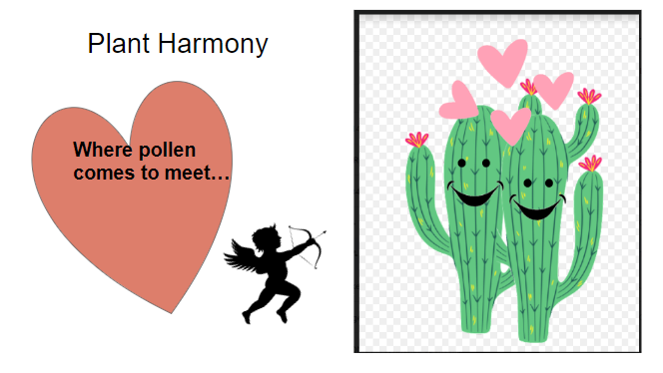
OPTION B
Explore 2
Couldn’t we be pollinators?
Couldn’t we also select parental plants and have a future generation of plants we want to see with traits we selected? If so…how?
THINK PAIR SHARE
Notes:
After discussing with Students how humans could move pollen from plant to plant. Teacher then guides students to realize humans have selected the traits they want in future crops for centuries. Humans select the parent plants they want, based on the traits those plants have. Then humans manually pollinate the 2 parent plants. Humans have been “ matchmaking” , so to speak for thousands of years. Our ancestors saved the seeds of the best plants so they could plant those seeds the next season. Explain that IF the class plants had survived, students would have actually cross pollinated 2 plants they choose based on traits they liked .

Slide 4
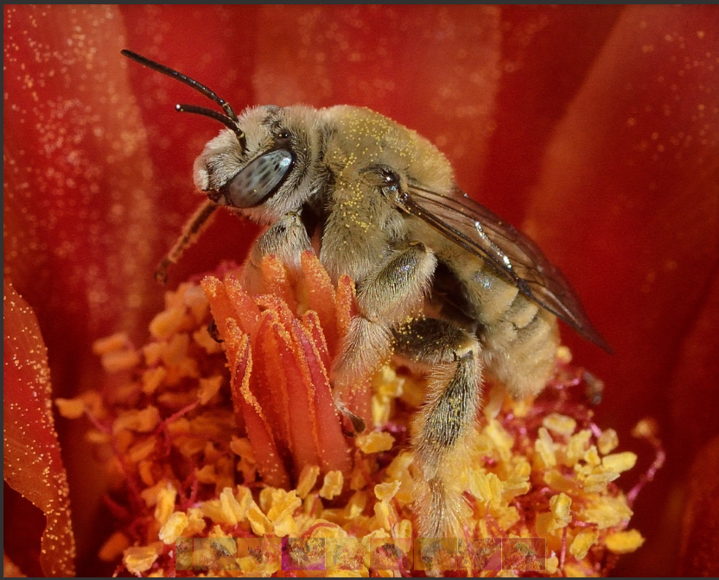
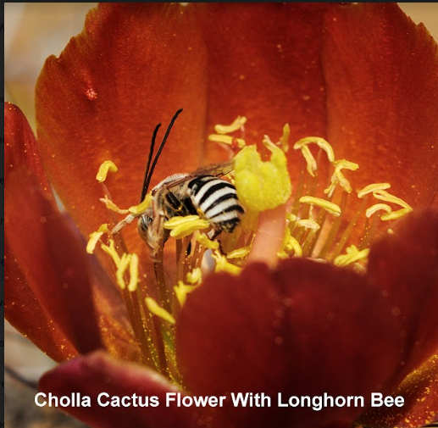
Since we don’t have bees to help us, how will we transfer the pollen?
THINK - PAIR- SHARE
Notes:
Teacher asks students how man can pollinate plants. If bees and other creatures usually do the pollinating, how do humans transfer pollen? Have students share their thinking.

Slide 5
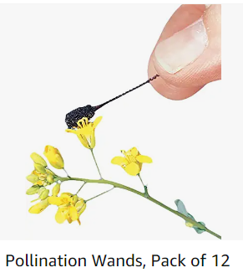
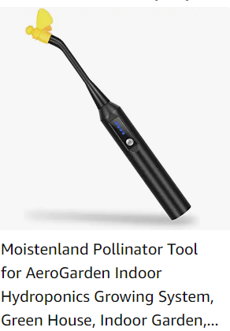
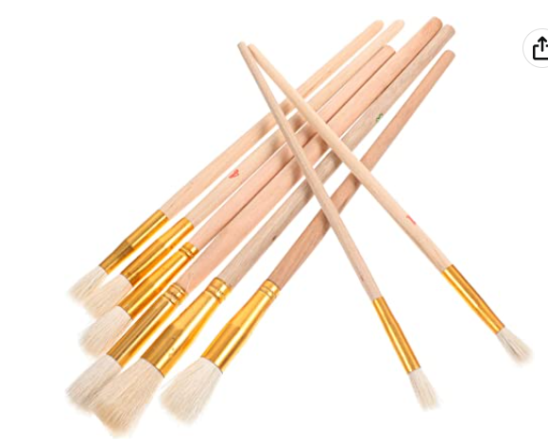
Some tools humans could use
Qtips
Pipe cleaner
Physically having flower parts touch another flower’s parts
Notes:
Share various tools humans use to pollinate plants.

Slide 6
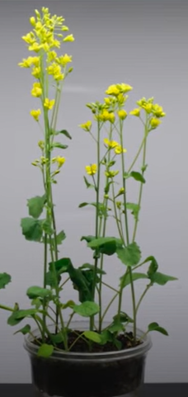
What about our flowers?
Things You Should Know By Now:
Due to trait variation, every individual plant and animal is unique in some way (except identical twins)
Humans have selected for desirable plant traits for hundreds of years
Notes:
To wrap up unit, revisit that due to trait variation, all individual plants and animals are unique (excluding identical twins). Humans have selected for desirable plant traits for years

Slide 7
If we had more time…
We would have to have our flowers die, collect the seeds, and plant the seeds to see if we were successful.
What if we wanted the flowers to have 6 petals, how would we do that?
If you selected two plants with purple, hairless stems, how would you know if the traits you had selected for actually emerge?
Notes:
Ask students how we would ensure the traits they selected their next generation to have actually were passed on? Ask how if they wanted flowers to have 6 petals, how would they go about doing that? Students would need to find 2 plants with a 6 -petaled flower and cross pollinate those 2 flowers. Wild roses have 4-6 petals. Humans selected traits over the years and the domestic roses now have more like 45 petals.

Slide 8
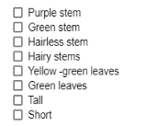
If our plants had survived, we would have been able to manually pollinate the plants, while selecting the traits we wanted to grow in our next generation of plants.
Your Turn!!! Time to be a matchmaker…
What traits do you want your next generation of plants to have???
Notes:
Explain that if the plants had survived, Students would have have acted as Matchmakers and chosen 2 of their plants- or worked with another student group and chosen 1 Parent from another group- to become the parent plants of the next generation. They would have chosen the 2 parent plants based on the traits they wanted to see in their next generation of plants. Using the Bee Stick, students would have moved pollen from the anthers in a flower on one plant to the stigma of a flower on a different plant.. Students would have also drawn predictions of what the offspring would have looked like

Slide 9

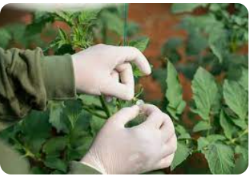
If we cannot manually pollinate…let’s do what scientists
often do…let’s move to Plan B to gather data and draw
conclusions….
Notes:
Explain that since the plants have died, students will participate in a simulation/game. The simulation will allow students the ability to gather data and draw conclusions about the selecting of traits and the actual passing on of traits. Discuss how scientists must often use models and simulations in real life to gather data. For example, scientists cannot make volcanoes erupt in order to study what happens during an eruption. Scientists cannot try new surgeries or medicines on humans. Scientists often must rely on models or simulations to gather data for their theories.

Slide 10

CHILICRAFT
YOUR MISSION:
Build your Dream Pepper
COLOR
SIZE
SHAPE
HEAT LEVEL
Notes:
Explain that after some learning about chiltepines, students will be working with a Partner to build a Dream Pepper. The traits they will be selecting for will be color, shape, size and heat level.

Slide 11
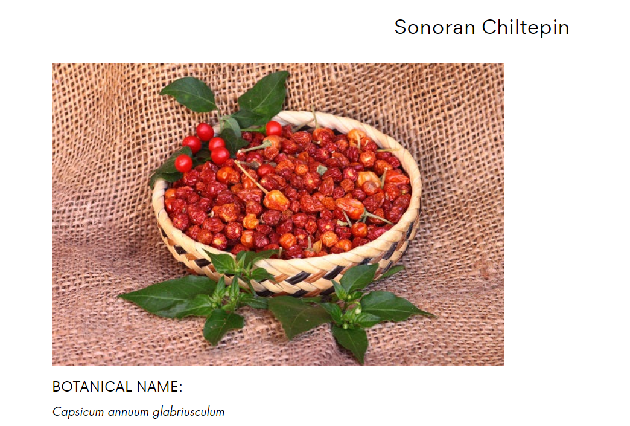

Before we actually play Chilicraft…we need some background information.
What do you know about chiltepines?
Notes:
Teacher explains that before students play Chilicraft to build their Dream Pepper, they need some background information. Teacher asks students what they already know about chiltepins.

Slide 12
The Who: Chiltepines
The What: Chiltepines are the wild ancestor of domesticated chilis in the Capsicum annuum species - including jalapeños and bell peppers.
The When: Wild chilis have been used by people for 10,000 years. Chili domestication started around 7,000 years ago in central-east Mexico.
The Where: They grow wild from southern Arizona and Texas through Mexico and Central America.
The How: People throughout Central America and Mexico have long used the wild plants as food and medicine. They are used to add heat to salsa and soups, and marinades. They are used in desserts too. They rank very high on the Scoville scale (50,000 to 100,000 Scoville units).
Notes:
Teacher teaches students about the chiltepin.

Slide 13
What is the Scoville Scale?
Wilbur Scoville was an American pharmacist that created the Scoville Scale. The Scoville Scale is a measurement of heat or spice of a chili pepper. The Scoville Heat Units (SHU) are based on the concentration of capsaicinoids.
Capsaicin is a chemical substance responsible for the sense of spiciness or hotness found in chili peppers.
Capsaicinoids are added to food to make it have a hot taste - but it can also be used as a painkiller.
Notes:
Teacher explains the Scoville Scale

Slide 14
The Why:
The mighty chiltepín has been used by people throughout Central America and Mexico as food and medicine because it is very resilient, hearty and adapted to the temperature extremes of our desert.
It was first domesticated around 6 - 7,000 years ago. It is known as the “Mother of All Peppers” because it is the wild ancestor to today’s domesticated peppers.
The wild chiltepín is a master adapter and survivor in the extremes of a desert environment. Like saguaros, wild chiltepín plants grow under the cover of nurse trees and shrubs like mesquite, ironwood, and hackberry. These nurse plant protects the chiltepín from the sun by providing shade in the summer. During the winter, the nurse plant protects the plant from frost and freeze damage.
Notes:
Teacher focuses on what an amazing desert survivor the chl tipene is. Chiltepines use a nurse plant for protection, just like a saguaro does.

Slide 15
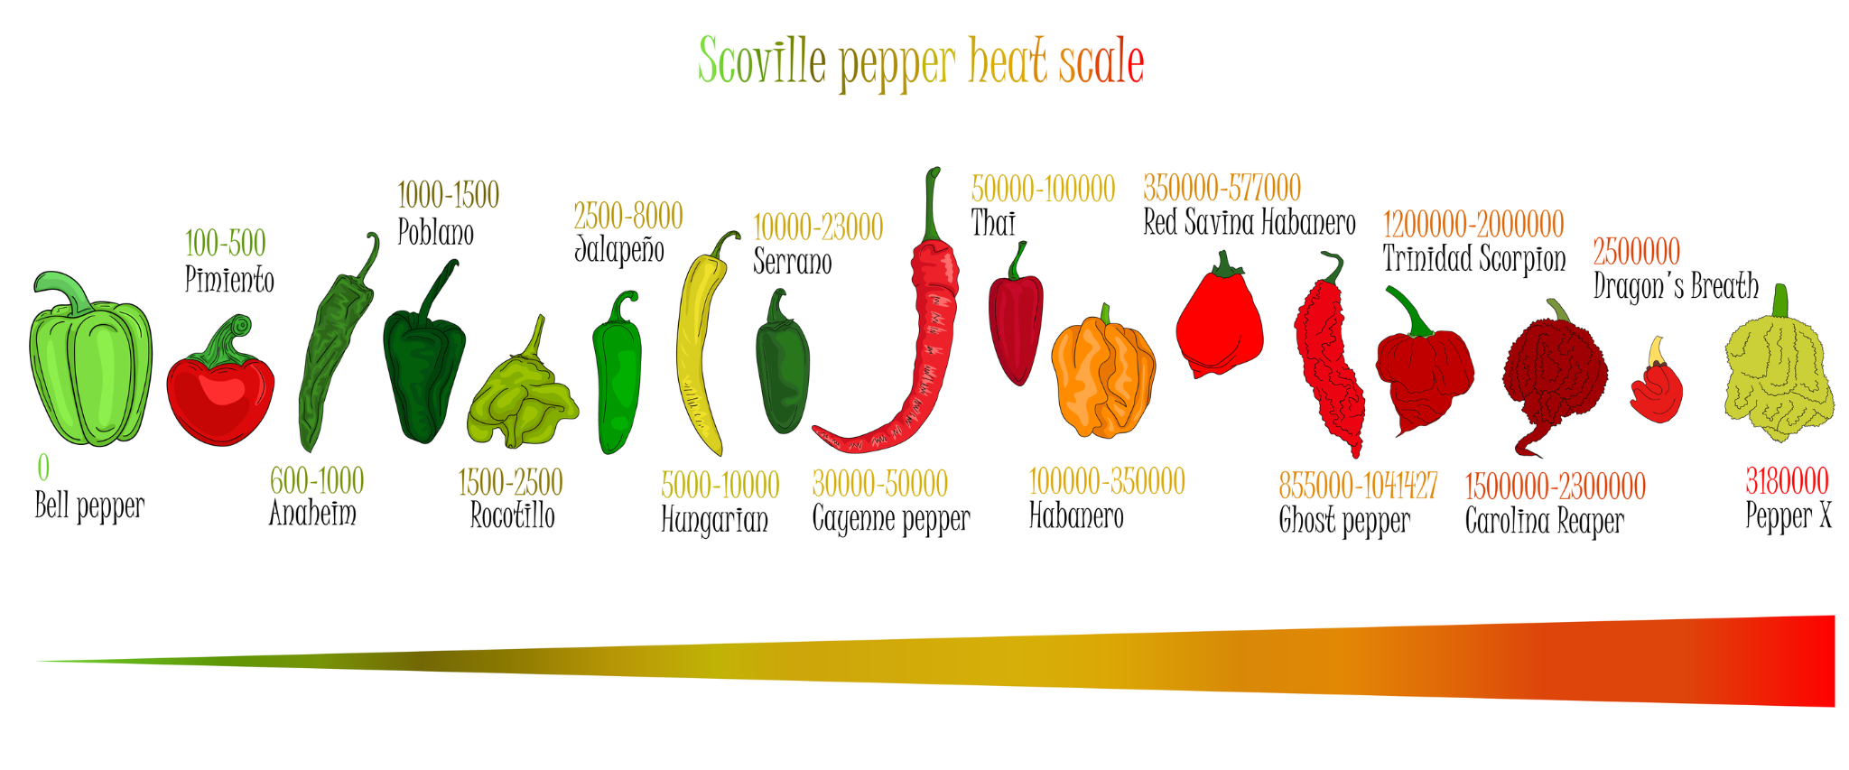
Bell Pepper = 0 SHU
Jalapeno = 2,000-8,000 SHU
Pepper X = 3,180,000 SHU

Slide 16
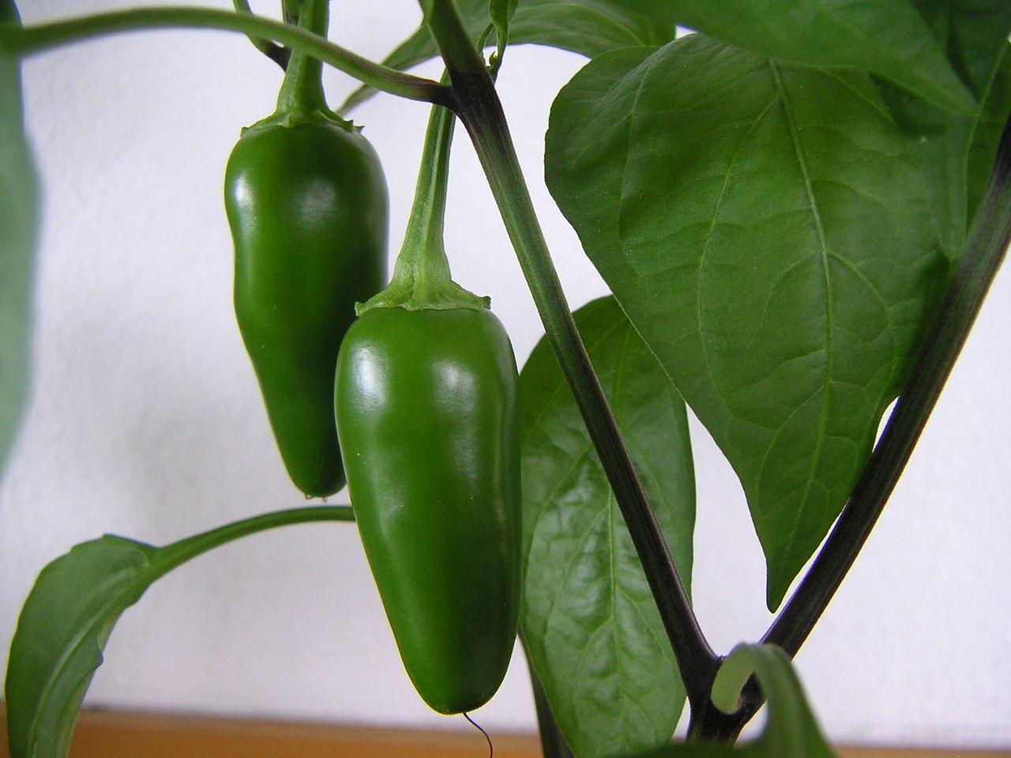
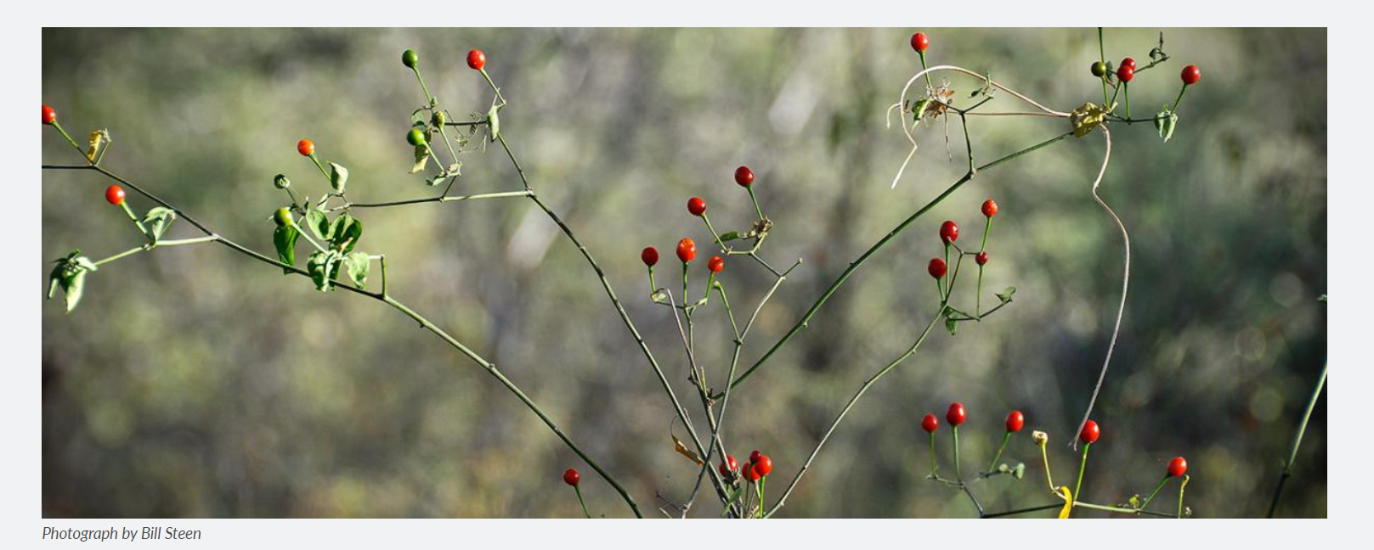
Talk with a neighbor…
Jalapeños are 2,500-8,000 SHU
Chiltepin = 50,000-100,000 SHU
Be ready to share your thinking
Notes:
After explaining the Scoville Scale, Teacher explains the SHUs of a jalapeno vs. a chiltepin. Students discuss with a Learning Buddy what conclusions they can draw about the heat of a chiltepin compared to a jalapeno.

Slide 17
CHILICRAFT
Notes:
Explain that in a few minutes, students will be working with a Partner to build a chiltepin.

Slide 18
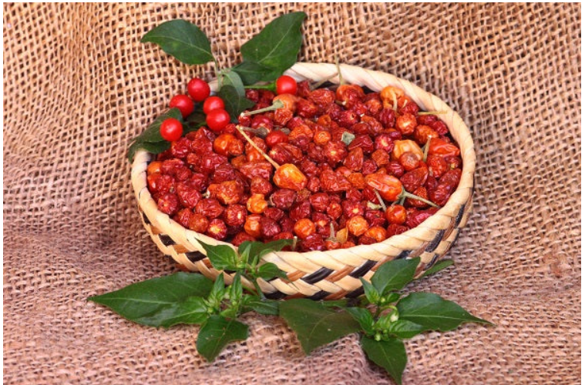
YOUR MISSION: Create & Build a CHILTEPIN
Trait Selection:
COLOR
SIZE
SHAPE
HEAT LEVEL

Slide 19
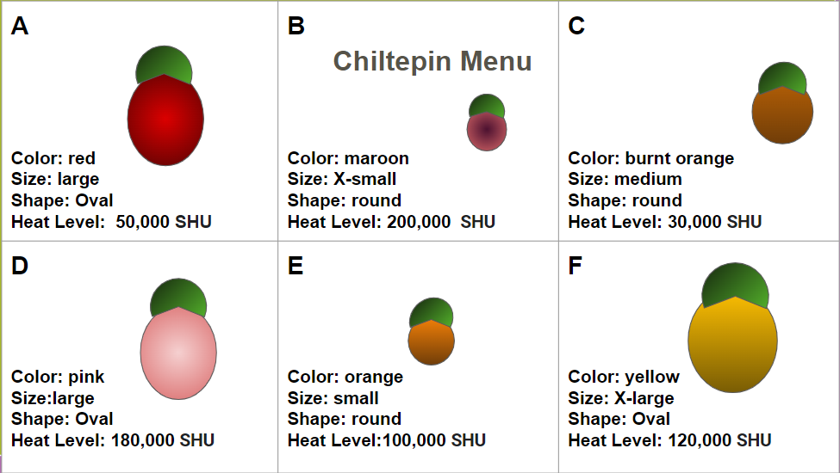

Slide 20
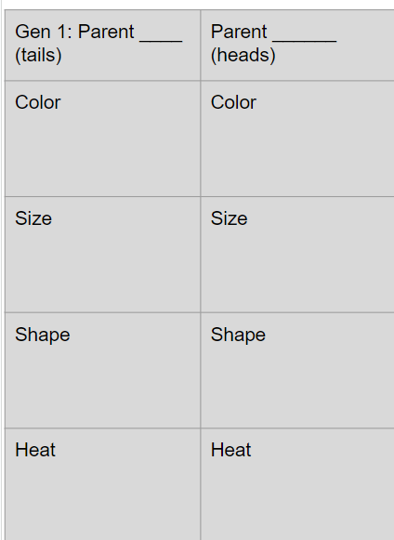
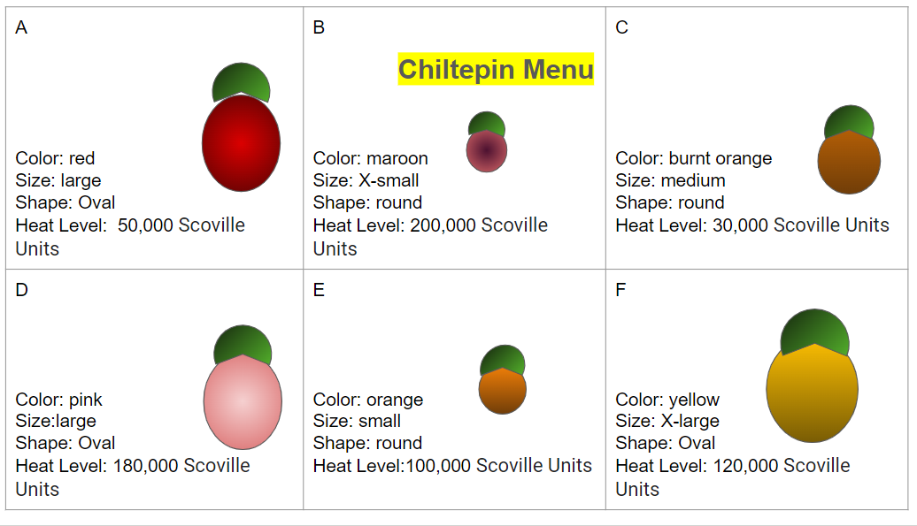
With a partner you will:
Select 2 parent plants from your Chiltepin Menu Choices A-F based on the traits of color, size, shape and heat level that you want/like for your Dream Pepper.
Record your Parent selection on your worksheet. Set Chiltepin Menu aside.You will not be using it again.
Notes:
Explain the directions written on the slide. Students are still acting as “Matchmakers” as they select 2 parent plants based on traits they like and want passed on in the next generation of plants. Students are to put Chiltepin Menu aside so that they do not try to select two new parents from that menu in Generation 2. They will use characteristics from one of the original parent plants and/or one of the first generations’ offspring.

Slide 21
Generation 1- Example:
What color did these partners choose?
Red
Size?
You do not have to agree on traits you select, but remember your Dream Pepper goal
General shape?
Roundish
Heat level? Hot?Medium?Mild?
hot
Parent 1 _A__ (tails) | Parent 2 _B__ (heads) | Seed Offspring 1 | Seed Offspring 2 | Seed Offspring 3
Color Red | Color Maroon | Color | Color | Color
Size large | Size X-Small | Size | Size | Size
Shape oval | Shape round | Shape | Shape | Shape
Heat 50,000 Scoville Units | Heat 200,000 Scoville Units | Heat | Heat | Heat
Notes:
Teacher shares example Slide and goes over answers to questions. Teacher should address the difference in the Partner’s choices on Heat and Size. Teacher should emphasize that although Partners are most definitely allowed to disagree on traits, they may change their mind as they move through the game. Explain to Students that when they decide upon their Dream Pepper, they cannot change their minds mid-game and decide upon a new Dream Pepper. Later talk about that in real life, of course a farmer or gardener could change their mind, but for the learning goal - this was not an option.

Slide 22
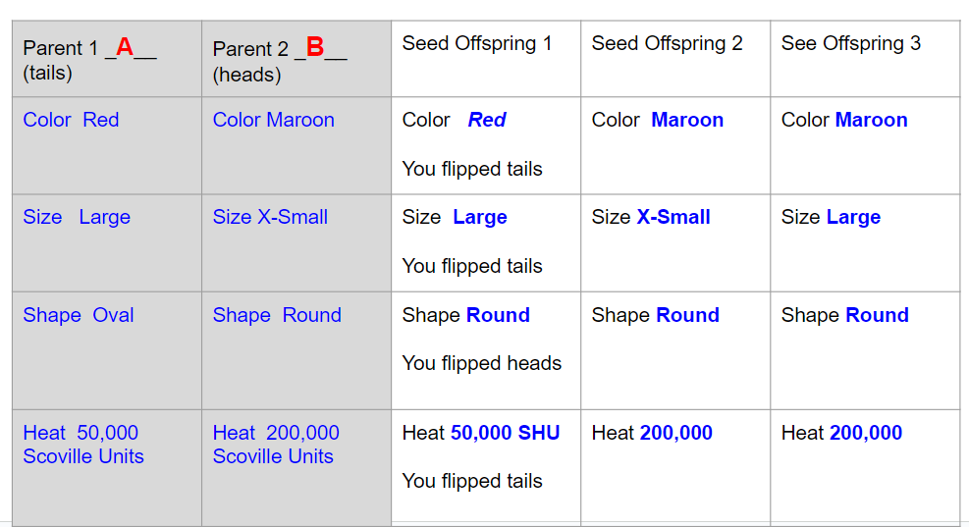
3. Take turns flipping a coin.
Tails = trait from Parent 1 wins.
Heads = trait from Parent 2 wins. Record Data
4. Repeat 3 Rounds.
Notes:
Teacher continues to explain directions and shows students where to record their data on Unit 2 Option B Worksheet

Slide 23
5. Now select the 2 plants (seed offspring or parent) for the next generation that are the closest to your Dream Pepper vision.
Parent 1 _A__ (tails) | Parent 2 _B__ (heads) | Seed Offspring 1 | Seed Offspring 2 | Seed Offspring 3
Color Red | Color Maroon | Color Red | Color Maroon | Color Maroon
Size Large | Size X-Small | Size Large | Size X-Small | Size Large
Shape Oval | Shape Round | Shape Round | Shape Round | Shape Round
Heat 50,000 | Heat 200,000 | Heat 50,000 | Heat 200,000 | Heat 200,000
With your Learning
Buddy,
which 2 Parents
should you choose
to match the Dream
Pepper these
Students chose?
Notes:
Have students work with their Learning Buddy to decide which 2 Parents they should select that meets the Example Students’ Dream Pepper. As teacher listens to students’ choices, teacher needs to direct students to the differences between the Size selections and the Heat selections. Teacher discusses with the class how with each new Parent selection, the Learning Buddies need to decide if they want to commit to the same Trait Choices, or keep selecting different choices. Emphasize that with every time they select for a Parent, they must revisit their original Dream Pepper. They may NOT change their Dream Pepper from their original pepper.

Slide 24
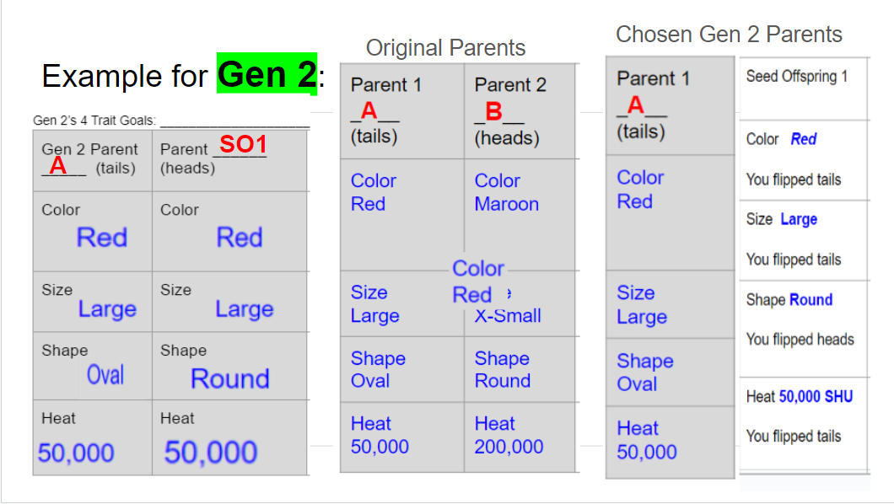
Notes:
Teacher shares Example on slide. Make sure Students understand the importance of choosing Parents based on the traits of the original Dream Pepper. They will flip a coin for each of the traits each time they cross a new generation of plants.

Slide 25
6. Repeat Steps 1- 5 until you have completed 3 generations of growing plants. Record data for each generation.
7. Complete Data Breakdown on page 4, then use it and your game experience to answer questions 1-3 on the last page.
Remember to always select the 2 new Parents based on the traits that best match your original Dream Pepper!
CHILICRAFT
Notes:
To ensure understanding of the game, the teacher can review the procedures with some quick questions: After filling up all of Generation 1’s data, how do you and your Learning Buddy decide which 2 plants should now be the Parents of the next generation? (Base Parent selection on the traits that most match your Dream Pepper) Are you to create a new Dream Pepper, or stick to the original one you crafted? (Stick to your original Dream Pepper) Are you to use the Chiltepin Menu to choose new Parents? (No)

Slide 26
Let’s Play!
Use your Chiltepin Menu and follow directions on your Chilicraft Student Handout.
CHILICRAFT
Notes:
Teacher walks around room and monitors students to ensure they are understanding and following directions. Once the Teacher sees Students are coming to an end of Generation 3, go over the Worksheet directions.

Slide 27
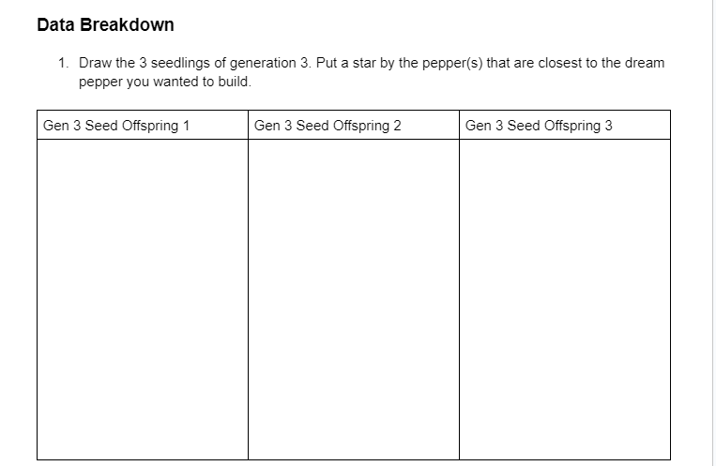
Time to draw your last 3 peppers!
Place a by the pepper that is closest to the Dream Pepper(s) you wanted to build/craft.
Notes:
Teacher reviews directions on Journal Worksheet. Students Draw the last 3 peppers from Generation 3, and marks a star closest to the Dream Pepper(s) they wanted to craft.

Slide 28
Now that you have been selecting for traits to build your Dream Pepper…..
3. Humans have selected traits they want plants to have for hundreds of years. What did Chilicraft teach you about trait selection and crafting or engineering the traits of a plant?
_____________________________________________________________________
________________________________________________________________________________
________________________________________________________________________________
________________________________________________________________________________
________________________________________________________________________________
________________________________________________________________________________
Notes:
Teacher reviews final question on worksheet. Encourage students to use vocabulary they have learned and to be specific in their answer. The Learning Buddies are allowed to put heads together and craft the answer together.

Slide 29
Let’s process…
Did the traits you selected for turn up in the first generation of chiltipines? Why or why not?
What did you learn about selecting for traits and the passing on of traits?
Notes:
Lead discussion with students about their results. Students selected the traits they wanted, but the traits did not show up immediately. Ask students why this did not happen.

Slide 30
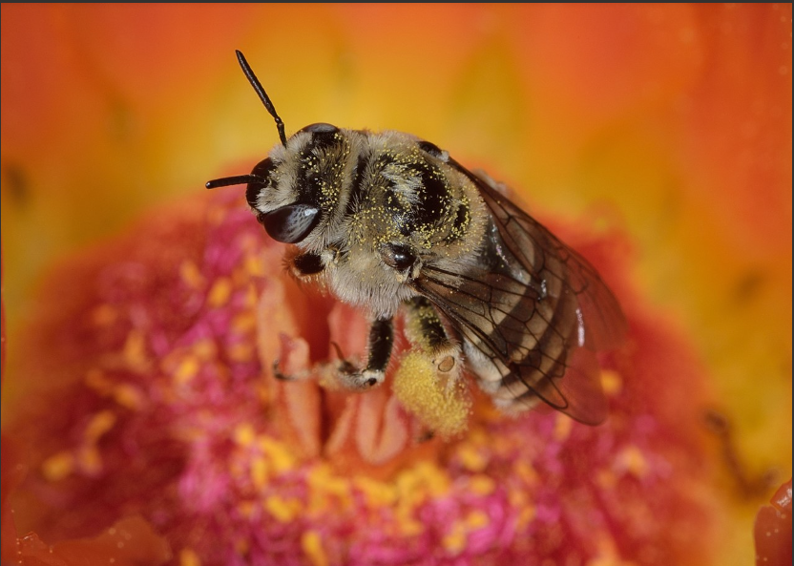
Elaborate
Let’s get back to pollinators moving pollen
around rather than humans…
Which animals are pollinators?
What’s in it for them?
Also be ready to share what forces, other than animals, help move pollen for plants.
Notes:
Teacher asks students which animals are pollinators and why animals want to pollinate plants. Why do insects visit flowers? Teacher asks if there are other forces that move pollen from plant to plant other than animals? Teacher may want to focus on word pollen - not seeds. Students may think of seeds that get stuck on clothing or seeds they see in their dog’s fur - remind students to think of pollen.

Slide 31
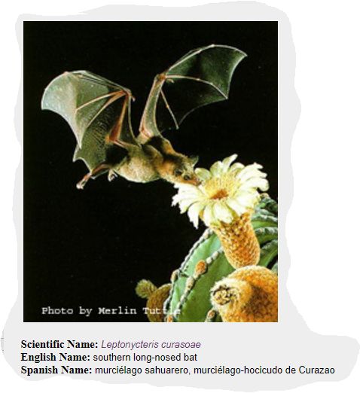
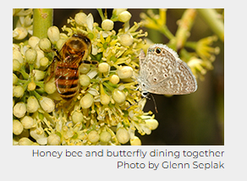
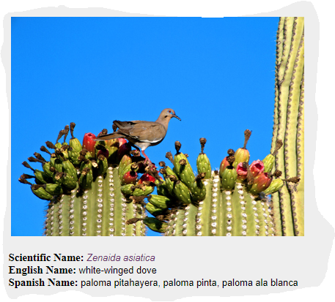
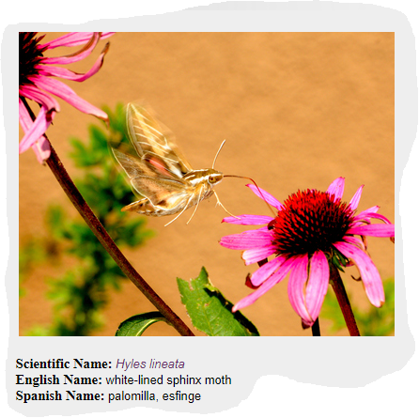
What pollinators are out there in the Sonoran Desert?
Bees
Butterflies
Beetles
Bats
Birds
Moths
Flies
Notes:
Bring students back to animal pollinators. The teacher asks students what they already know about Sonoran Desert pollinators and how many different kinds can they name.Teacher reveals many kinds of desert pollinators and asks what the pollinators get from flowers. Many different organisms pollinate plants, including bees, butterflies, beetles, bats, birds, moths, wasps, flies, and more. As they have seen, even humans can be pollinators, but it is a lot of work! Pollinators spread pollen when they make contact with flowers. We know this helps out the plants, but what is in it for the pollinators? Generally, flowers provide them with rewards such as nectar, pollen, perfumes, and oils. Teacher then leads a class discussion on the pollinators of the Sonoran Desert.

Slide 32
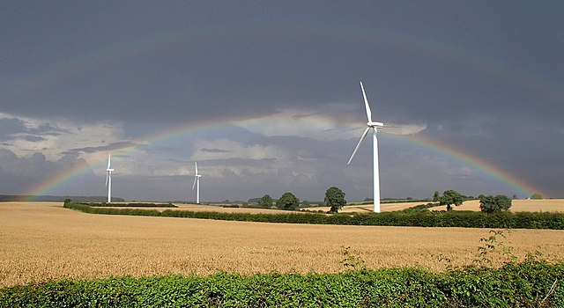
Other forces that move pollen…
Wind
Water
Notes:
Students may note that wind may spread pollen from plant to plant. Wind can spread pollen. Grasses are wind pollinated. Many of our grain crops (corn, wheat, barley, rice, rye, and oats) are wind-pollinated, as are some trees like pines. Pollen of Fast Plants (rapid cycling Brassica rapa) is relatively heavy and sticky. Fast Plants pollen is normally not carried in the air. For brassicas, bees are marvelously coevolved pollen-transferring devices. Students may think of water moving pollen if they have seen pollen collected on the surface of puddles, a stream, lake or a pool. However, the small percentage of plants pollinated by water are aquatic plants. Photo source: https://commons.wikimedia.org/wiki/File:Wheat_fields,_wind_farm_and_double_rainbow_-_geograph.org.uk_-_3098755.jpg

Slide 33
Evaluate Let’s watch the video again
Our Wild Food Ancestors
Be ready to share your thinking on why the plants of today look so different than their wild ancestors
Notes:
Students watch Phenomena video they saw at beginning of this unit. They then discuss how the crops of today look so different than their wild ancestors. Students should discuss that humans probably selected for traits over the years to yield the crops they wanted. Guide students to discuss traits people would select and why(color, size of fruit produced, taste, number of seeds or fruit produced,etc). Remind students that inherited traits and traits affected by the environment cause traits to change over time in populations.

Slide 34
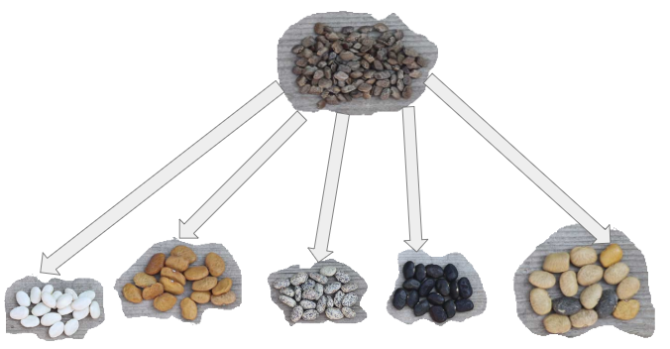
Let’s Revisit: Beatrice and her friends were discussing why today’s tepary beans look so different from the ancient, wild beans they are related to. The ancient, wild beans pictured at the top grew from 0 BCE to over 100 years ago - pre- Industrial Revolution. These were their ideas:
Beatrice: “Nature decides what the beans will look like. When I plant beans in my garden, the seeds that come from the plant don’t always look the same.”
Gloria: “Rising temperatures due to climate change have made the soil hotter so the colors of the seeds have changed over time.”
Cat: “Over time groups of people selected and bred the bean plants with variations they liked which led to the many different varieties we have today.”
Dan: “So many people have been using pesticides over the years, the seed color has changed.”
All of the tepary bean seeds in the bottom row came from their wild relative at the top that grew wild pre-Industrial Revolution.
Notes:
Need Wonderwall area ready, Student Handout #1, post its, names of students on Probe posted, Driving Questions posted
Students read probes in their groups or Teacher can lead this as a whole class. Students then discuss which student they agree with and why. Students write their name on a post-it note and place their post-it by the name they agree with on the Probe. Teacher leads discussion to hear the students’ thoughts. This Probe will become the Evaluation at the end of the unit.

Slide 35
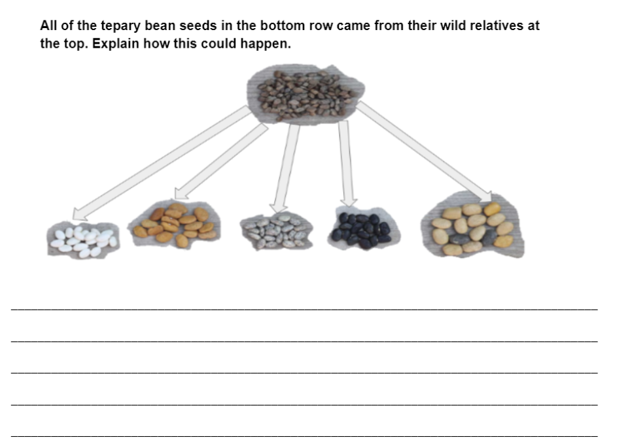
Look at your handout
Notes:
Teacher may want to keep this slide posted due to color of seeds since most students will have a black and white copy. Remind students of the vocabulary and the Big ?s as they write their response.

Slide 36
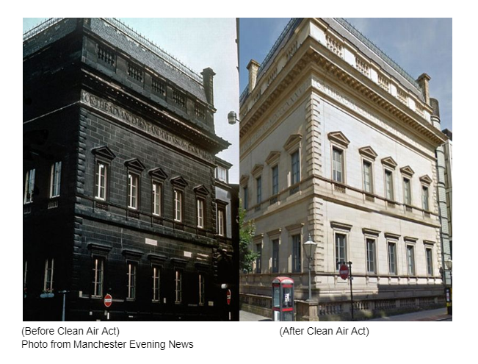
Final Evaluation
Coal fires and smoke from industrial chimneys turned many of the Victorian landmarks in Manchester, England a sooty black before the Clean Air Act of 1956 reduced pollution. The buildings and streets were covered in soot. Architectural historian Dr Andrew Crompton explained: "It's fair to say Manchester was the filthiest city in the world and the point of maximum blackness was in the late 1940s.” The picture above shows a building before the Clean Air Act was passed in 1956, and afterwards.
Notes:
Teacher goes over Evaluation

Slide 37
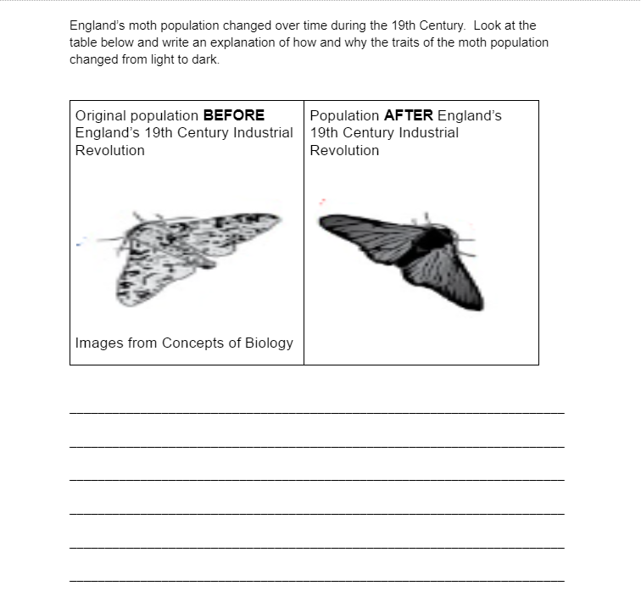
Hints:
Use content specific vocabulary
May include an example to strengthen defense of your thinking
Notes:
Remind students of the vocabulary and the Big ?s as they write their response. Suggest they include an example to strengthen their response (the Sort)

