Slide 1
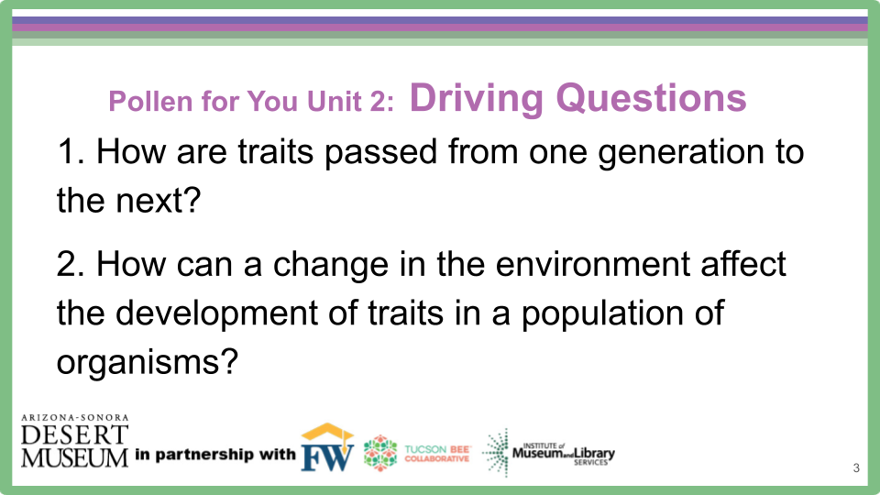

Unit 2, Pollen for You: Driving Questions
How are traits passed from one generation to the next?
How can a change in the environment affect the development of traits in a population of organisms?

Slide 2
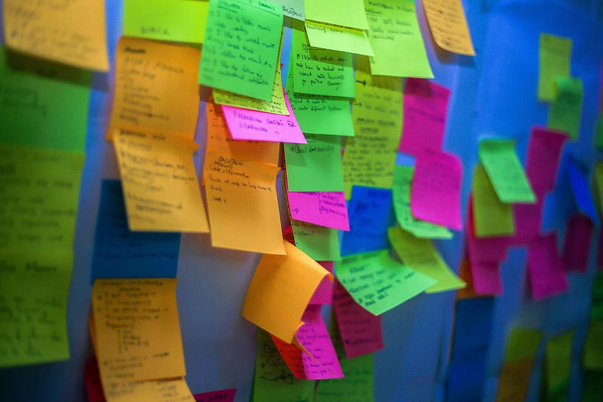

Engage
Watch the video.
Record your I Wonders on a post-it note.
Be ready to share what you notice and what you are wondering.
Phenomena
Our Wild Food Ancestors
Notes:
Need post-it notes and Wonder Wall area, Driving Questions remain posted, Students watch the Desert Museum video comparing corn, chilies, squash, and beans of today to their ancient, wild relatives. Click on link in slide show mode (it is for this link: https://www.youtube.com/watch?v=eJfp1fhNzOM) or the embedded video on the screen. Students write their wonderings on a post-it.

Slide 3

Share with a neighbor
What did you notice?
What are you wondering?
Put your wondering on a post-it and place it on our Wonder Wall.
Notes:
Students post I Wonders on a Wonder Wall. Teacher leads discussion on their wonderings and thinking. Teacher listens to Wonderings and students help organize Wonderings into groups.

Slide 4
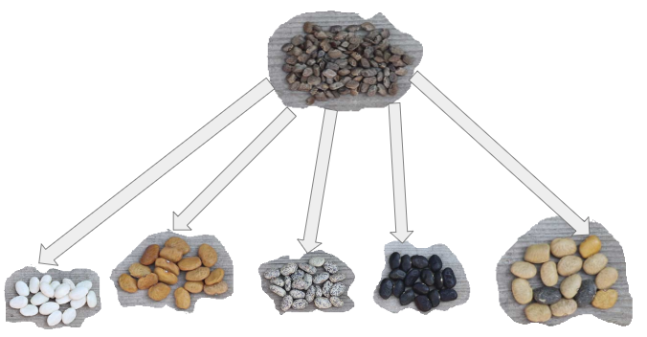
ENGAGE - PROBE Beatrice and her friends were discussing why today’s tepary beans look so different from the ancient, wild beans they are related to. The ancient, wild beans pictured at the top grew from 0 BCE to over 100 years ago - pre- Industrial Revolution. These were their ideas:
Beatrice: “Nature decides what the beans will look like. When I plant beans in my garden, the seeds that come from the plant don’t always look the same.”
Gloria: “Rising temperatures due to climate change have made the soil hotter so the colors of the seeds have changed over time.”
Cat: “Over time groups of people selected and bred the bean plants with variations they liked which led to the many different varieties we have today.”
Dan: “So many people have been using pesticides over the years, the seed color has changed.”
All of the tepary bean seeds in the bottom row came from their wild relative at the top that grew wild pre-Industrial Revolution.
Notes:
Need Wonder Wall area ready, Student Handout #1, post its, names of students on Probe posted, Driving Questions posted.
Students read probes in their groups or Teacher can lead this as a whole class. Students then discuss which student they agree with and why. Students write their name on a post-it note and place their post-it by the name they agree with on the Probe. Teacher leads discussion to hear the students’ thoughts. This Probe will become the Evaluation at the end of the unit.

Slide 5
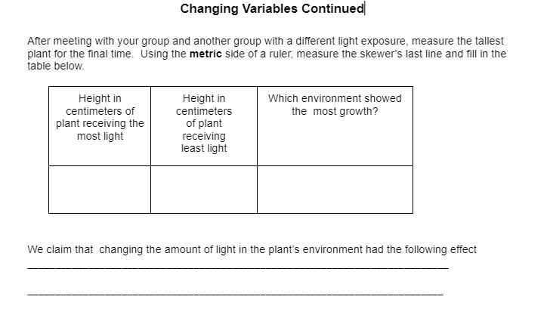
Explore 1 Let’s see how our seedlings are doing with their different light exposures
Get with another group that had different light exposure
Record measurements in METRIC
Discuss your findings & write your
Claim
Notes:
Students groups must get together with another group that had different lighting conditions. Students need rulers and Unit 2 Student Handout #1. Student record the tallest plant’s final measurement in metric and fills out their Unit 2 Student Handout #1 table. Teacher leads class in a discussion on their findings and how an environmental factor impacted the plant.

Slide 6
So we have explored:
Traits and what they are
How traits are passed on from parent to offspring
DNA and heredity
Environmental impacts on traits
So let’s focus back on our plants passing traits from one generation to the next…
Notes:
Teacher revisits objectives/Driving ?s and brings focus to passing traits from one generation to the next

Slide 7
Let’s focus in on the flower…
Science Sauce Flower Dissection
What is a flower?
Why do plants have flowers?
What do flowers do?
Why are they so colorful?
THINK - PAIR - SHARE
Notes:
Teacher has students think about flowers by asking questions posted on Slide Deck. Students then talk to a Learning Buddy about their thinking. Teacher leads class discussion in to what partners discussed.Students watch video. (Click on link in slide show mode of this video: https://www.youtube.com/watch?app=desktop&si=vBPMA7_2oaPp8I9-&t=3&v=493WeySyf-8&feature=youtu.be or watch from embedded video on screen.) Students can use the flowers on their plants OR the teacher can bring in lily’s like in the video (go to local flower shop and ask for dead flowers good for dissection) If there are no flowers available, just have students watch video. Students work together to dissect some flowers and take a closer look to find out where the pollen is exactly. You could also use a Document Camera to demonstrate flower dissection. Students examine, draw and label their flower and its parts on their Handout Unit 2 #1. If you are not using students’ Wisconsin Fast Plants’ flowers, adjust lesson and use of Student Handout accordingly.

Slide 8
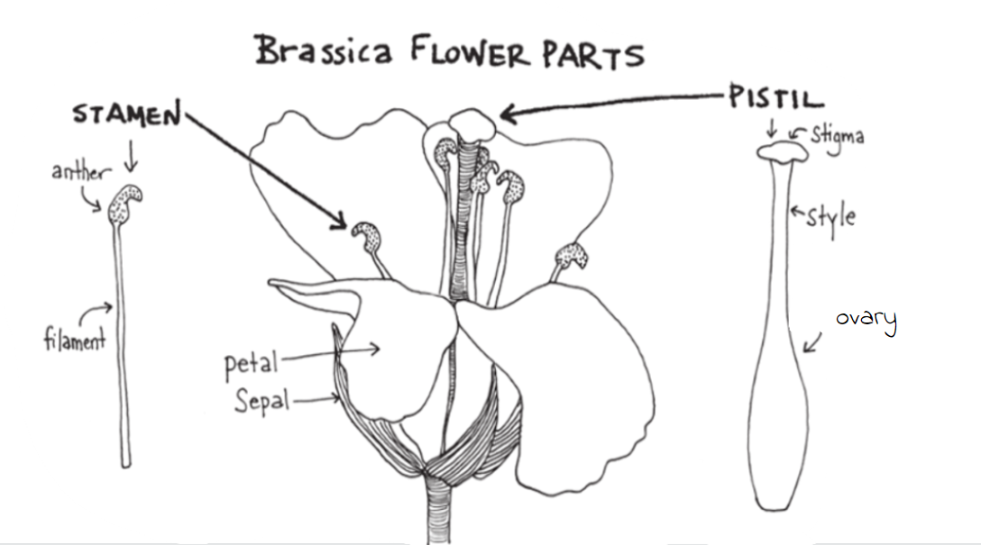
1. Take the top open flower of the first plant and carefully remove it with a forceps.
BRASSICA
(Wisconsin Fast Plants)
Notes:
Students use their Wisconsin Fast Plant flowers to dissect and identify parts of a flower. If you are not using Fast Plants or have limited time, teacher can bring in lily’s like in the video (go to local flower shop and ask for dead flowers good for dissection) If there are no flowers available, just have students watch video. Teacher can model dissection under a Document Camera (Teacher will need to modify Student Handout). Students work together to dissect some flowers and take a closer look to find where the pollen is exactly. Students examine, draw and label their flower and its parts on their Handout Unit 2 #1 if they are using Wisconsin Fast Plants

Slide 9
2. Using the drawing of “Brassica Flower Parts,” compare your flower to the drawing.
3. Work with a partner to draw and label the parts of the flower on your Lab Sheet.
Flower Parts to Include in Drawing | My Drawing of My Flower
Stamen - with anther & filament identified Pistil - with stigma, style, carpel identified Petal Sepal
Notes:
Students draw their flower and label the parts listed on Unit 2 Student Handout #1. If teacher leading a demonstration under a document camera or having students use some other flower than Wisconsin Fast Plants, adjust lesson accordingly and use of Student Handout.

Slide 10
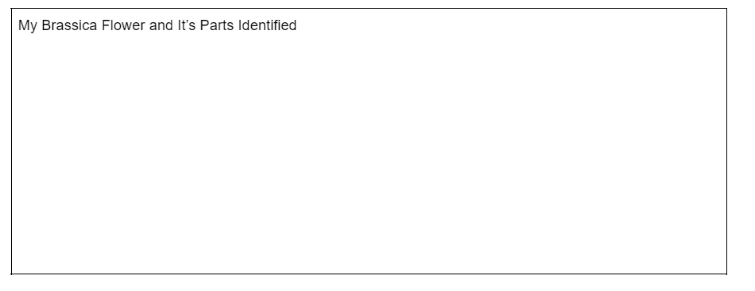
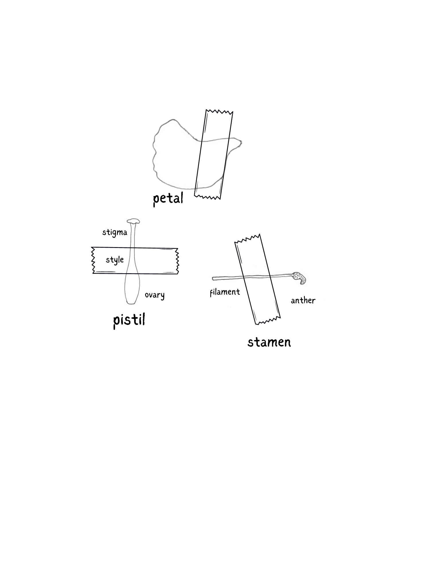
4. While observing with a hand lens or microscope, carefully remove the flower parts with fine tipped forceps, a dissecting needle, or a sharp-tipped toothpick.
5. Place each part on the sticky side of a piece of tape, and tape it onto your lab sheet as shown in the “My Brassica Flower Parts Identified”.
Notes:
Teacher guides students through dissection and taping it down to the lab sheet.

Slide 11
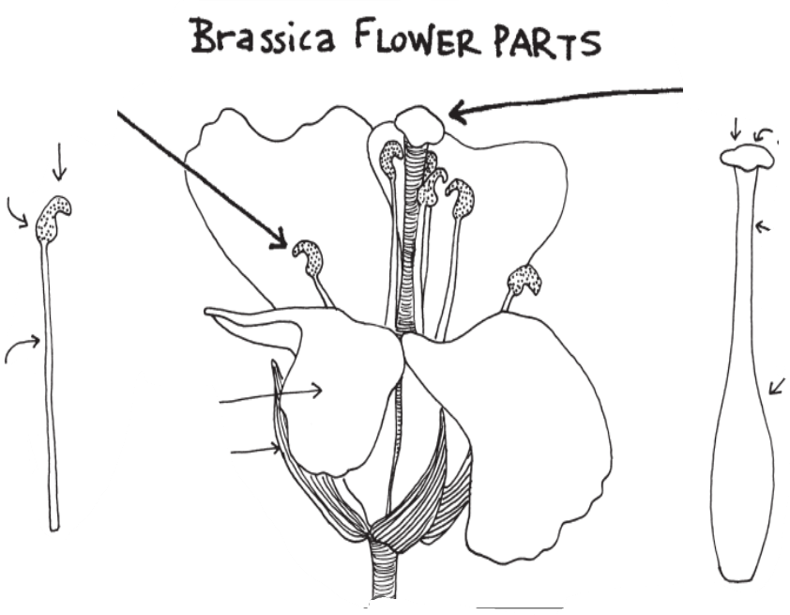
9
With a Learning Buddy, practice identifying the flower parts
Filament
Anther
Stamen
Petal
Sepal
Pistil
Stigma
Style
Ovary
6
3
7
2
8
1
4
5
Notes:
Teacher can quickly practice students identifying parts of a flower. Answers are animated. Students can work with their science group or a partner to practice identifying the flower parts.

Slide 12
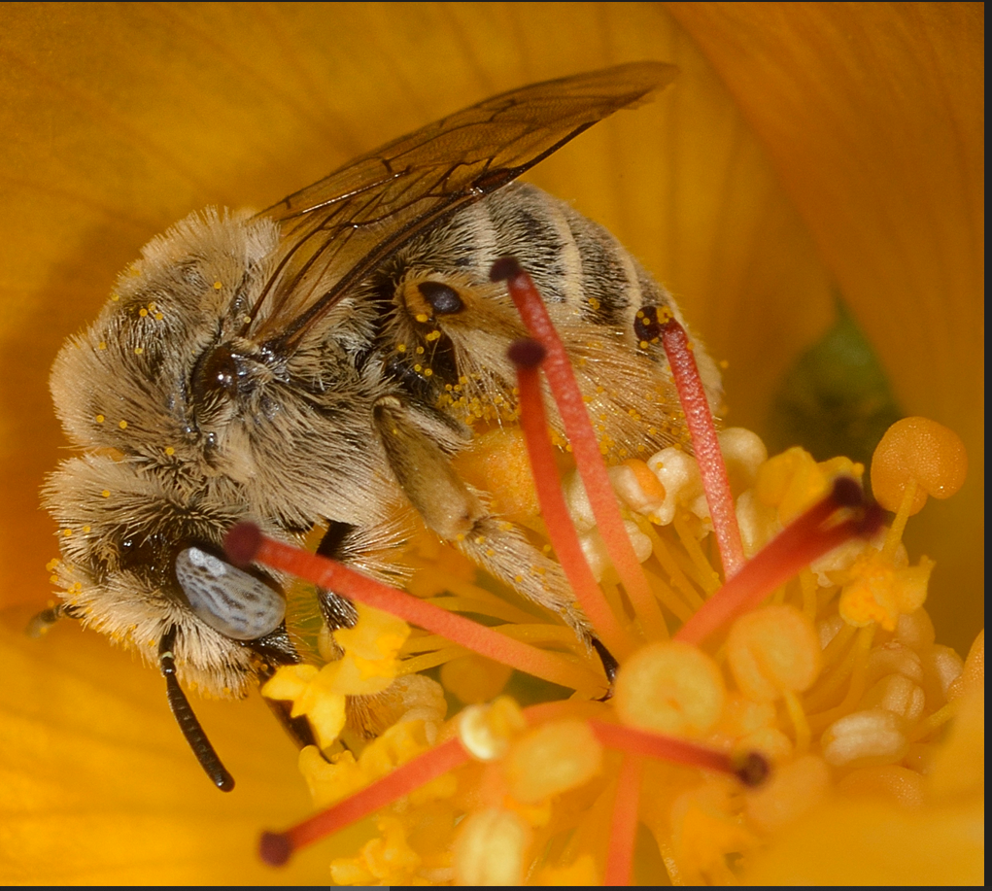
Can you identify?:
Stigma/style
Anther/filament
Petal
Stigma
Style
Anther
Filament
Notes:
Sometimes the parts are not very obvious. Some flowers have multiple pistils (stigma/style/ovary) along with their many stamens (anthers/filaments.)

Slide 13
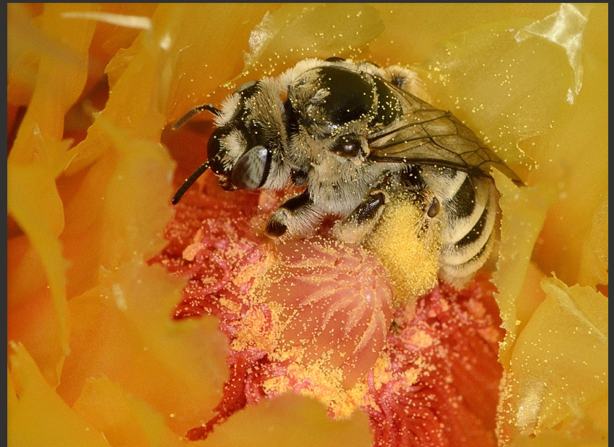
So let’s revisit our questions…
What is a flower?
Why do plants have flowers?
What do flowers do?
Why are they so colorful?
Notes:
Teacher revisits questions posted before video and leads class discussion on student responses

Slide 14
And why do bees go to flowers? Talk with your group…
bees depend on flowers for sugars in the nectar to provide the energy their body needs to function
pollen is the primary source of proteins, fats, vitamins and minerals to build muscular, glandular and skeletal tissues of bees
a colony of honey bees will collect as much as 44 to 110 pounds of pollen in a season because they need pollen, just like they need nectar.
Notes:
Bees depend on flowers for nectar and pollen, and in some cases, floral oils. Nectar provides energy, and pollen provides needed protein and nutrients. Bees move a lot of nectar and pollen around in their ecosystems.

Slide 15

Explain How do plants pass on traits???? How does their DNA get from one plant to another????
Pollination Explained video
Be ready to share what you notice and are wondering.
Notes:
Students watch video to learn about pollination (Click on embedded video in slide show mode or follow link from Pollination Explained to the You Tube link: https://www.youtube.com/watch?v=Dfvyoir_SCY&t=2s). Teacher leads class discussion about what students noticed and are wondering using vocabulary from next slide.

Slide 16
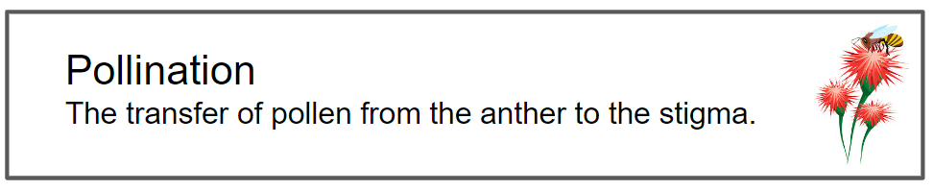
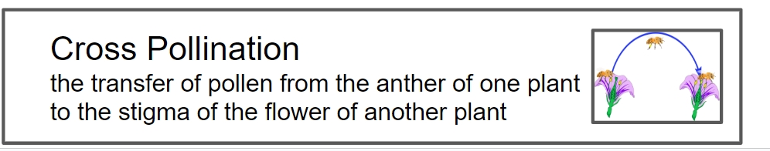
Explain How do plants pass on traits???? How does their DNA get from one plant to another????
Be ready to share what you notice and are wondering.
Notes:
Teacher introduces vocabulary words pollination and cross-pollination. Pollination, the transfer of pollen from an anther to a stigma, leads to seed production. Cross-pollination is the transfer of pollen from the anther of a plant to the stigma of the flower of another plant. Self-pollination is the transfer of pollen from the anther of a flower to the stigma of the same flower of another flower of the same plant. Wisconsin Fast Plants™ DO NOT self-pollinate, so they need to be cross-pollinated by pollinators or by hand. When pollen lands on the stigma, a pollen tube grows through the style to reach the egg and allows for fertilization and the development of fruit and seeds.

Slide 17
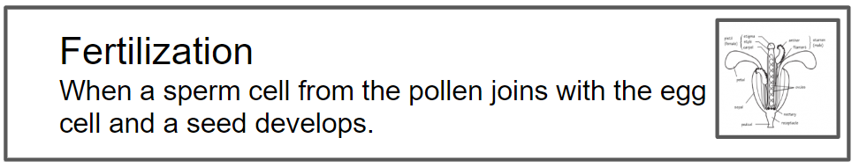
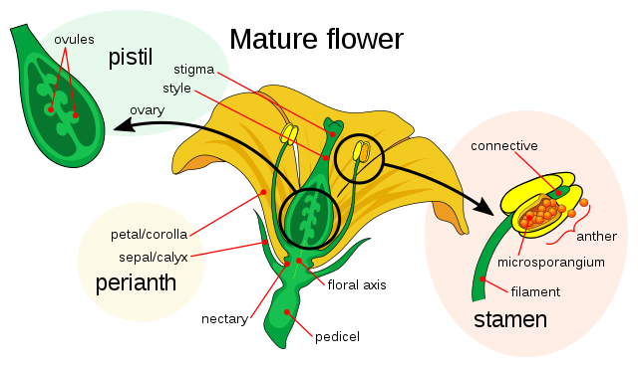
Let’s take a closer look at what happens to the pollen grains
Be ready to share what you notice and are wondering
Science Sauce Flower Fertilization
Notes:
Students watch video to learn about fertilization. Play in slide show mode by clicking Science Sauce Flower Fertilization Link (or follow this You Tube link: https://www.youtube.com/watch?app=desktop&si=mskRtJu0NySRpXHR&t=1&v=8Y5BRMCo-00&feature=youtu.be) Teacher leads class discussion about what students noticed and wondered and introduces vocabulary word Fertilization. (Fertilization is spelled with an “s” in British English.)

Slide 18
Now we know: Organisms look like their parents due to inherited traits
But why should we care about an organism’s traits and DNA???
Why should we care about species and grouping living things into species?
traits vary, so all individuals are unique, but they also share similar traits of their species
traits can be affected by the environment.
Notes:
Have students discuss why it is important to know the species on the planet.

Slide 19
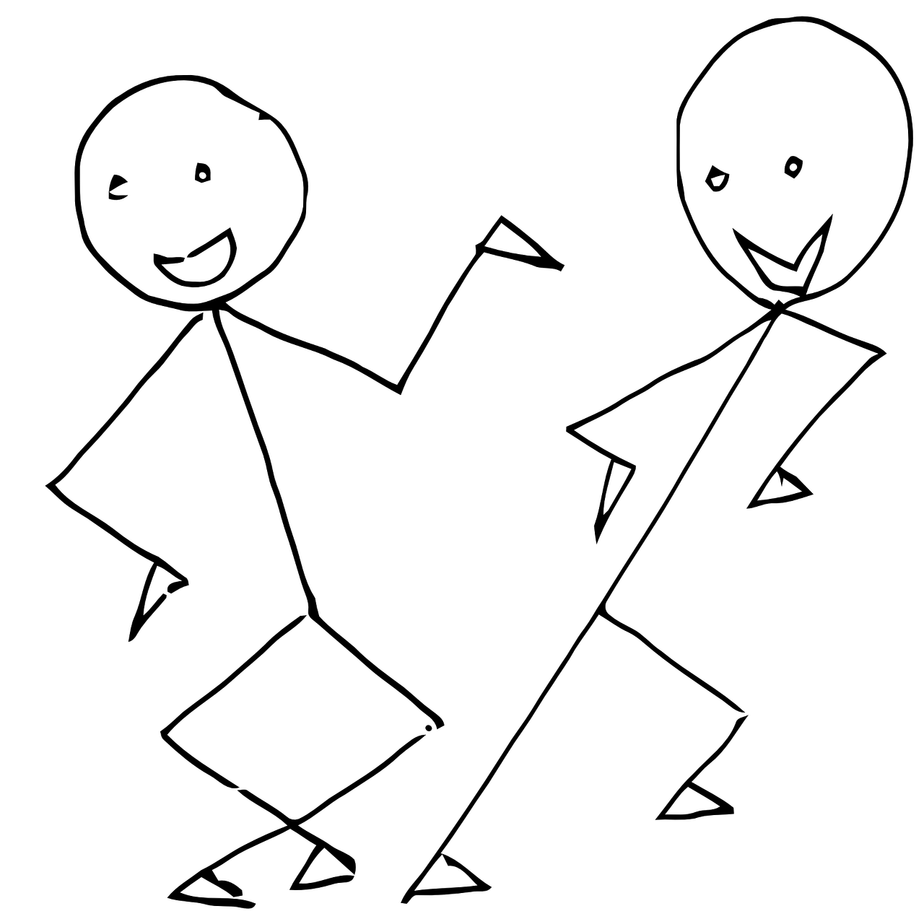
One reason we have to know species…
…we communicate about species everyday!!
Could you pick up some apples and carrots at the store?
Can you tell Beatrice to walk the dogs please?
And it’s Gloria’s turn to water the plants in the yard.
Notes:
Teacher explains we must know what species are on the planet because we talk about species all the time.

Slide 20
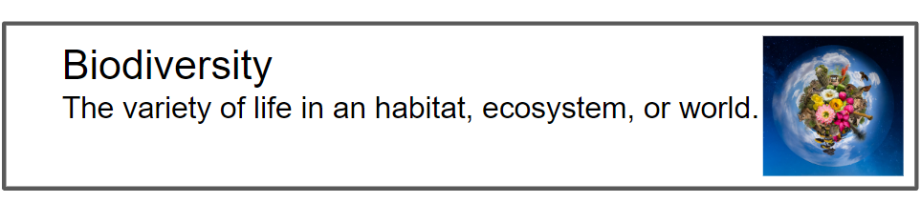
Biodiversity
We also need to know what species are out there because biodiversity is important.
We need a variety of life on the planet to keep ecosystems healthy.
Notes:
Teacher discusses what biodiversity is and its importance. Biodiversity - the varieties of living things - provides all kinds of services that we depend on (think of the oxygen you breathe or the soil aeration that ants provide so that plant roots can drink rain water more easily). And biodiversity is the source of so many products that we depend on, from food, to textiles, to shelter, to medicines. We need biodiversity! And having a diversity of traits within and among species is important. Teacher should again address that having a variety of traits within a species allows the species to survive under different environmental conditions and thus keep providing all of these services.

Slide 21
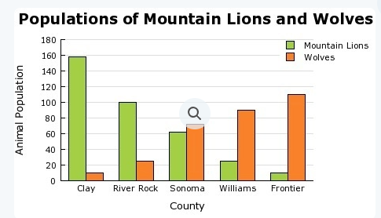
We also need to know what species are out there in order to prevent extinction!!! We need to know species’
numbers.
Notes:
Teacher leads class to see importance of knowing species for conservation efforts

Slide 22
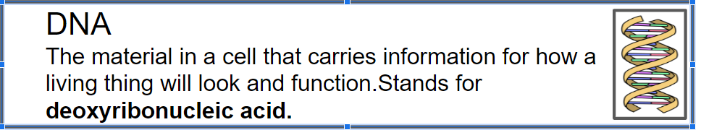
But how do scientists determine species other than traits since traits can vary so much within a species???
Notes:
Teacher then leads students to decide that if variation of traits makes it so difficult to identify species, scientists must rely on something other than traits. Have students brainstorm and think of other ways to identify species that would be scientifically reliable and accurate. If students don’t think of DNA - teacher will have to lead them there

Slide 23


Ever heard of the Tucson Bee Collaborative?
DNA is pretty important to the Tucson Bee Collaborative…
Notes:
Teacher introduces Tucson Bee Collaborative. Teacher may ask students what a “collaborative” is.

Slide 24
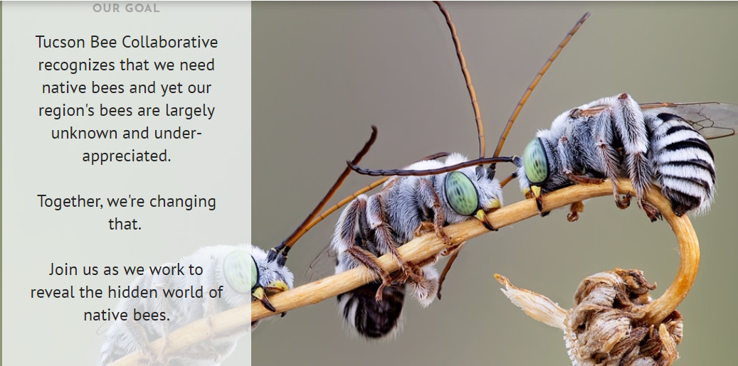
Notes:
Teacher shares Goal of TBC to better understand and identify our native bees.

Slide 25
Tucson Bee Collaborative
Tucson Bee Collaborative works with U of A, Pima Community College, and high school students by engaging students in research activities.
Scientists, teachers, students, artists, photographers, and community scientists are working together to understand, monitor, and document the native bees of the Sonoran Desert.
Documenting Biodiversity - Bee Diversity
Growing the University of Arizona insect collection by collecting at least one specimen of every bee known in our region
There are well over 700 species of native bees in the Sonoran Desert (we don’t know all the names or species yet)
Notes:
Teacher explains Tucson Bee Collaborative efforts to document the Sonoran Desert’s Bee Biodiversity. Most recent estimates indicate that there are more than 1000 native bee species in the Sonoran Desert Region. We are a bee hotspot! We don’t even know which species are all here! This is where the work on the Tucson Bee Collaborative comes in.

Slide 26
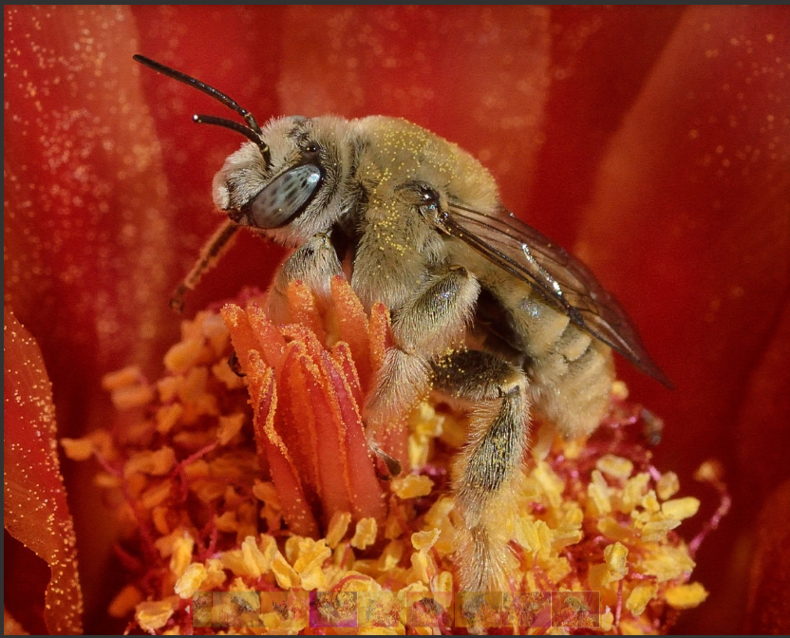
Tucson Bee Collaborative
Notes:
Take Students to Tucson Bee Collaborative website. Ensure students understand the “collaborative” partners are the UofA, ASDM, and PCC

Slide 27
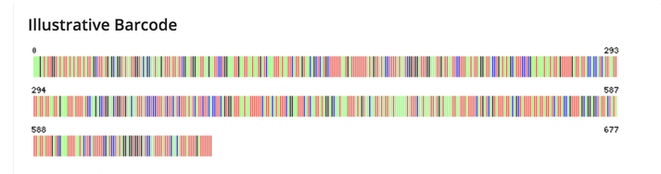
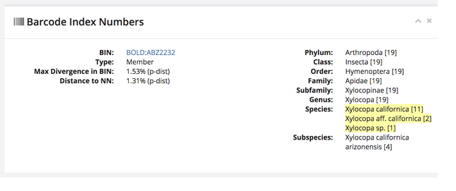
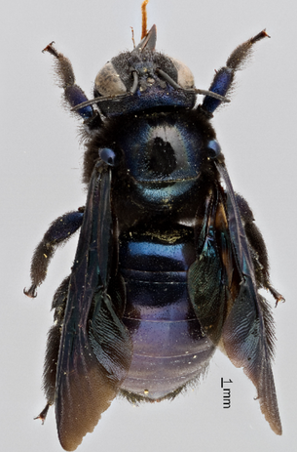
College and high school students help identify species through DNA Barcoding
Let's watch some students in action
Notes:
Click on link to students in action in slide show mode (or from this You Tube link: https://www.youtube.com/watch?app=desktop&si=ugNbxAIOzkFlEOz2&t=1&v=F7sN8gxkXiw&feature=youtu.be). Teacher explains that students capture bees (attract bees to soapy water in a cup, bee drowns), pin the bees, take a section of their leg, and put the leg through the DNA Barcoding process which requires special machinery.

Slide 28
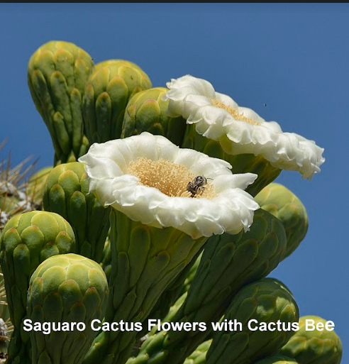
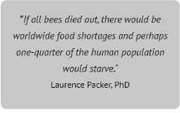
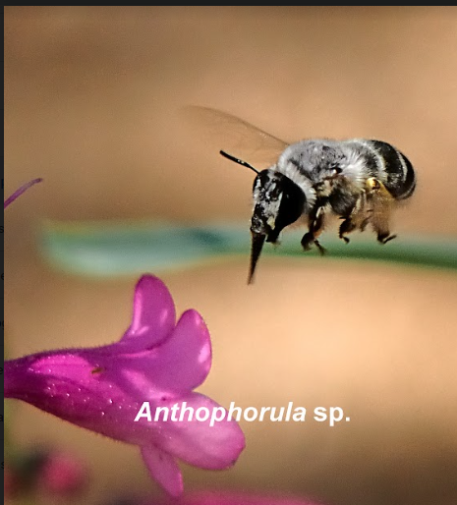
Consider the following the next time you see a bee..
Notes:
Teacher reads quotation aloud from Tucson Bee Collaborative Website. Teacher leads discussion on students’ thoughts, feelings, wonderings, etc. Discuss importance of pollination.

Slide 29
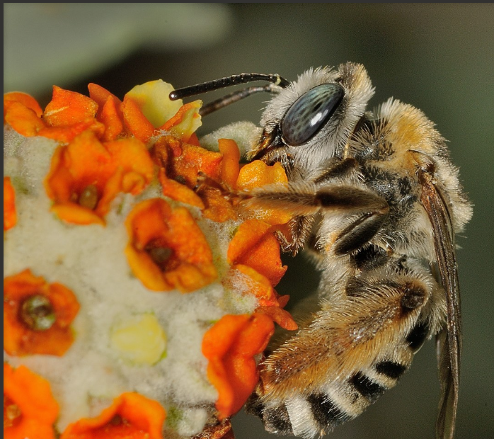
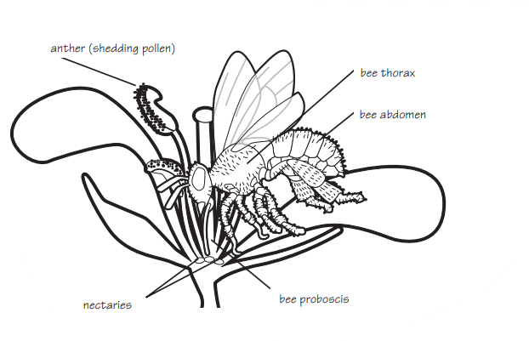
Taking a closer look
What does the bee use to reach the nectar?
Notes:
Teacher leads students in a closer look at exactly how bee pollinate and the body parts involved. Teacher goes over parts of the bee’s anatomy - thorax, abdomen, head. Bees, like butterflies, use a proboscis to reach nectar. Nectaries are strategically located in the flower and secrete sugar-rich nectar. Their location ensures that nectar-gathering insects and other animals will receive pollen from anthers and transmit it to its stigmas as they forage.

Slide 30
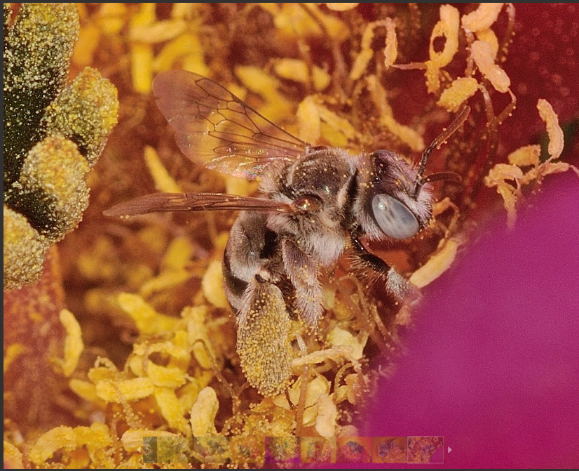
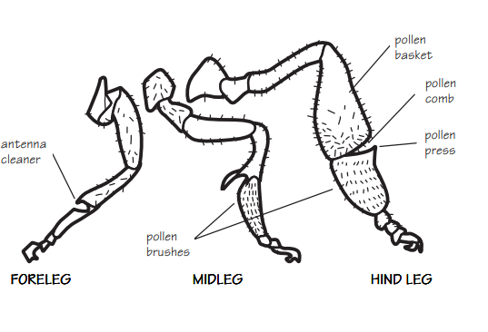
Do you see the pollen baskets?
Notes:
Teacher then focuses on the legs. Students identify the pollen basket on the bee.

Slide 31
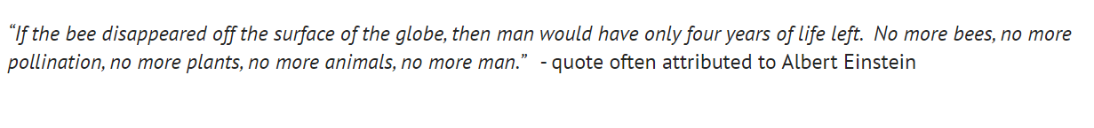
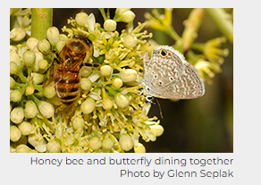
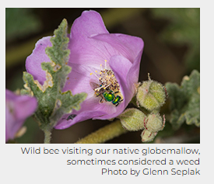
Notes:
Teacher reads quotation aloud taken from the Tucson Bee Collaborative Website. Teacher asks students to share any new thoughts, learnings or wonderings on pollination.

Slide 32
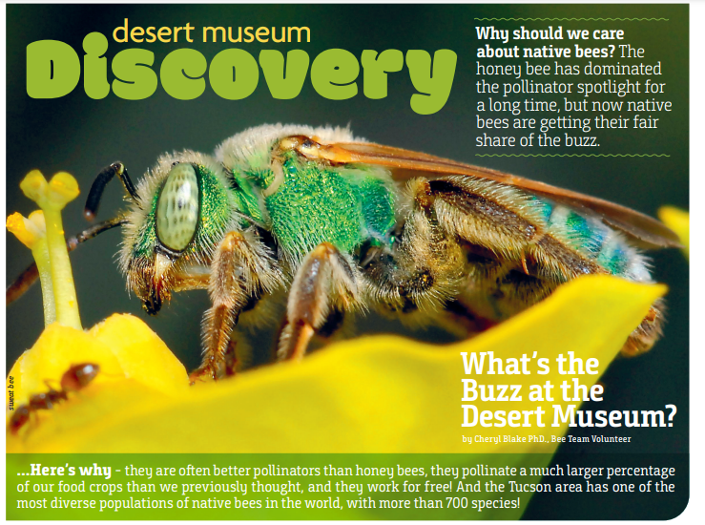
Notes:
This slide shows the Desert Museum’s teamwork with the TBC. The Desert Museum is one of the partners helping with the collection and identification of native bees.

Slide 33
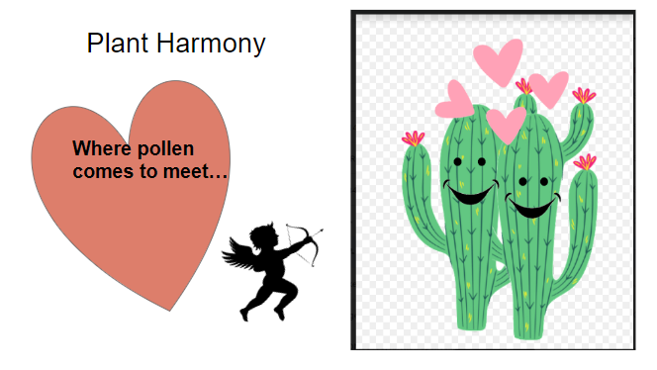
Explore 2
Couldn’t we be pollinators? If so, how?
Couldn’t we also select parental plants and have a future generation of plants we want to see with traits we selected? If so…how?
THINK PAIR SHARE
Notes:
Students discuss how humans could move pollen from plant to plant. Teacher then guides students to realize humans have selected the traits they want in future crops for centuries. Our ancestors saved the seeds of the best plants so they could plant those seeds the next season.

Slide 34
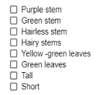
Your Turn!!! Time to be a matchmaker…
What traits do you want your next generation of plants to have???
Notes:
Student Groups decide the traits they will select for. They will select 2 parent plants that exhibit the traits they want in future generations

Slide 35
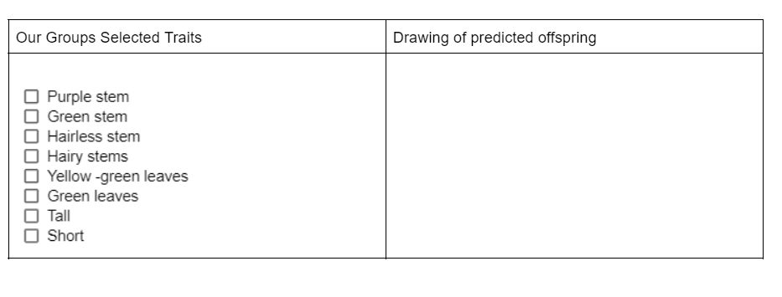
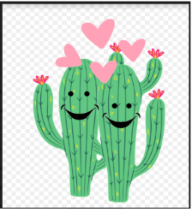
Choose 2 plants you want to “set up”
On your Handout
If you do not have 2 plants in your group you want to set up, you may work with another group.
Notes:
Students may need to go to another group if they do not have plants bearing the traits they want to select for. Using the Bee Stick, students pollinate their two parent plants. Using the Bee Stick, students move pollen from the anthers in a flower on one plant to the stigma of a flower on a different plant. Be sure to deposit a good amount of pollen on the stigma of each flower. Fast Plants are self incompatible: that is, each stigma prevents germination of its own pollen. Students draw predictions of what offspring will look like

Slide 36
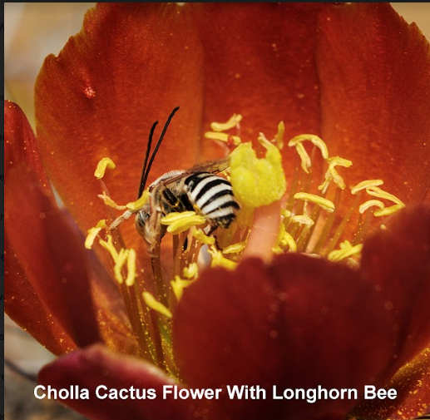
Since we don’t have bees to help us, how will we transfer the pollen?
Notes:
Teacher asks students if bees and other creatures usually do the pollinating, how do humans transfer pollen? Have students share their thinking.

Slide 37
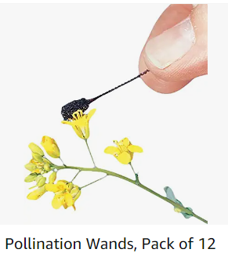
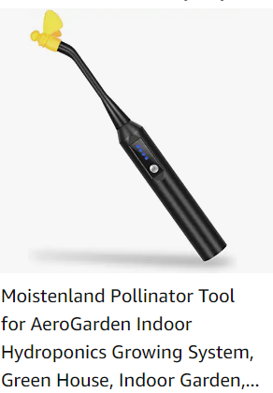
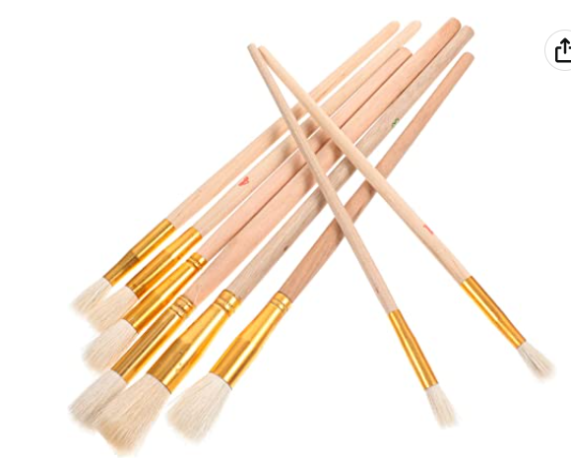
Some tools humans could use
Qtips
Pipe cleaner
Physically having flower parts touch another flower’s parts
Notes:
Share various tools humans use to pollinate plants.

Slide 38
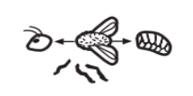
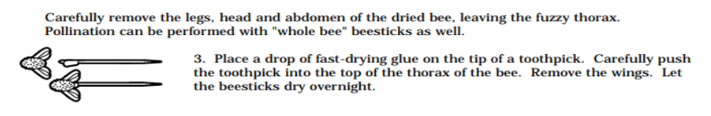
We will use Bee Sticks to manually pollinate!
When humans are the pollinators, we call it “manual pollination.”
Notes:
Teacher may have decided to already have assembled Bee Sticks. Bees are very delicate and fall apart easily. Teacher introduces manual pollination.

Slide 39
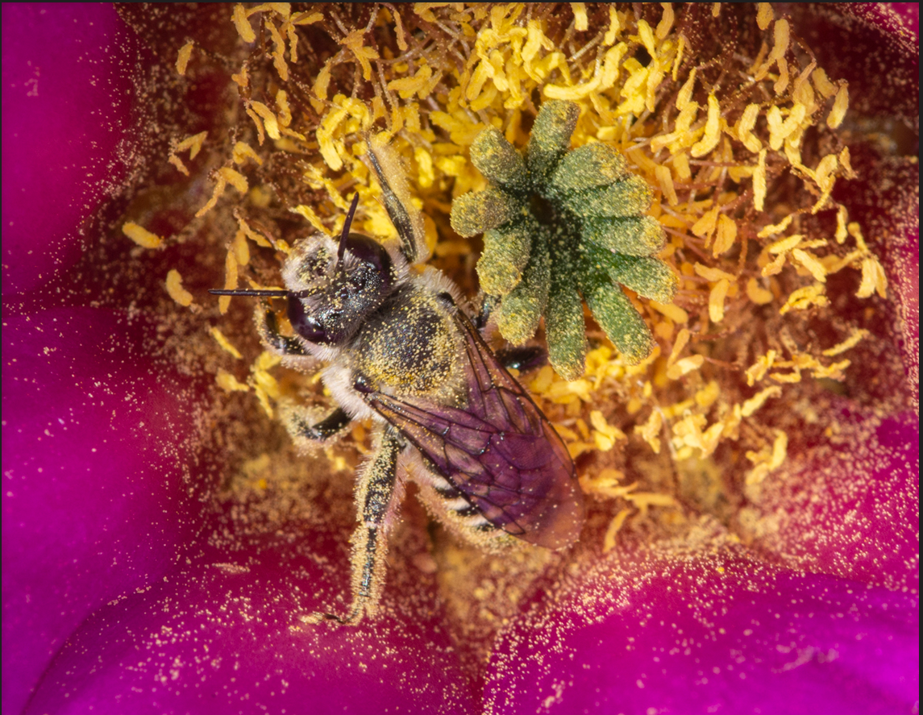
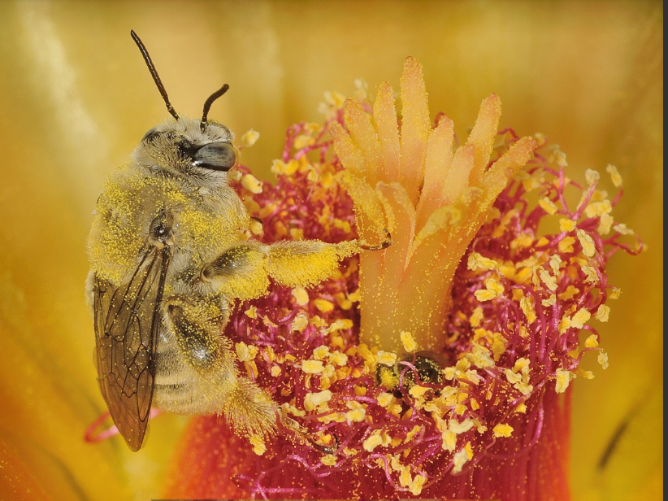
Appreciating the real thing…
Notes:
Teacher may want to point out pollen baskets on bees legs.

Slide 40
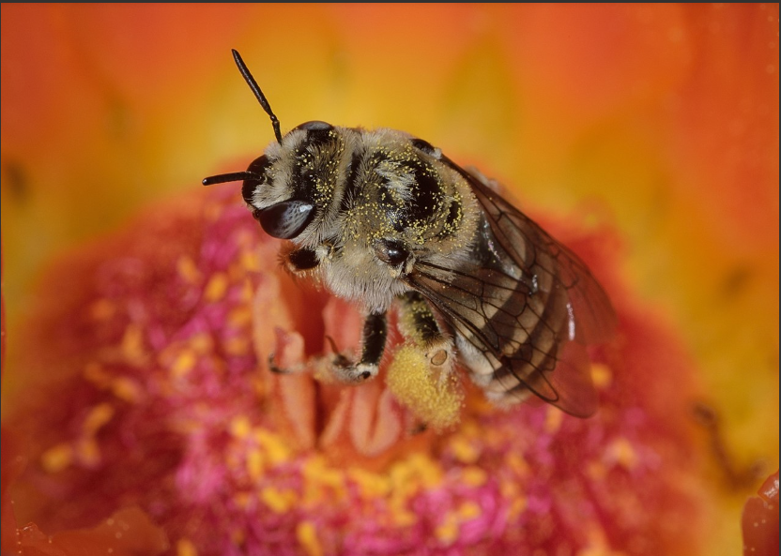
Elaborate
Get ready to share:
Which animals are pollinators?
What’s in it for them?
Also be ready to share what forces, other than animals, help move pollen for plants.
Notes:
Teacher asks students which animals are pollinators and why animals want to pollinate plants. Why do insects visit flowers? Teacher asks if there are other forces that move pollen from plant to plant other than animals? Teacher may want to focus on word pollen - not seeds. Students may think of seeds that get stuck on clothing or seeds they see in their dog’s fur - remind students to think of pollen.

Slide 41
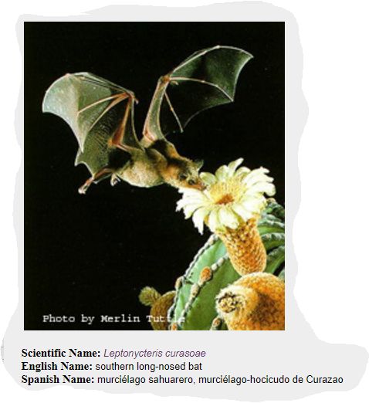
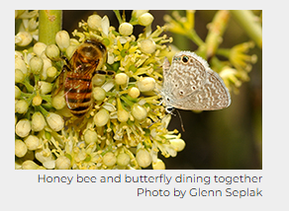
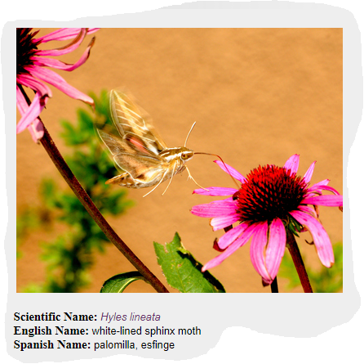

What pollinators are out there in the Sonoran Desert?
Bees
Butterflies
Beetles
Bats
Birds
Moths
Flies
Notes:
Teacher asks students what they already know about Sonoran Desert pollinators and how many different kinds can they name.Teacher reveals many kinds of desert pollinators and asks what the pollinators get from flowers. Many different organisms pollinate plants, including bees, butterflies, beetles, bats, birds, moths, wasps, flies, and more. As they have seen, even humans can be pollinators, but it is a lot of work! Pollinators spread pollen when they make contact with flowers. We know this helps out the plants, but what is in it for the pollinators? Generally, flowers provide them with rewards such as nectar, pollen, perfumes, and oils. Teacher then leads a class discussion on the pollinators of the Sonoran Desert.

Slide 42

Other forces that move pollen…
Wind
Water
Notes:
Students may note that wind may spread pollen from plant to plant. Wind can spread pollen. Grasses are wind pollinated. Many of our grain crops (corn, wheat, barley, rice, rye, and oats) are wind-pollinated, as are some trees like pines. Pollen of Fast Plants (rapid cycling Brassica rapa) is relatively heavy and sticky. Fast Plants pollen is normally not carried in the air. For brassicas, bees are marvelously coevolved pollen-transferring devices. Students may think of water moving pollen if they have seen pollen collected on the surface of puddles, a stream, lake or a pool. However, the small percentage of plants pollinated by water are aquatic plants. Photo source: https://commons.wikimedia.org/wiki/File:Wheat_fields,_wind_farm_and_double_rainbow_-_geograph.org.uk_-_3098755.jpg

Slide 43
EVALUATE Let’s watch the video again
Our Wild Food Ancestors
Be ready to share your thinking on why the plants of today look so different than their wild ancestors
Notes:
Students watch Phenomena video they saw at beginning of this unit (click on Our Wild Food Ancestors in slide show mode or follow this link: https://www.youtube.com/watch?app=desktop&v=eJfp1fhNzOM). They then discuss how the crops of today look so different than their wild ancestors. Students should discuss that humans probably selected for traits over the years to yield the crops they wanted. Guide students to discuss traits people would select and why(color, size of fruit produced, taste, number of seeds or fruit produced,etc). Remind students that inherited traits and traits affected by the environment cause traits to change over time in populations.

Slide 44
Let’s Revisit: Beatrice and her friends were discussing why today’s tepary beans look so different from the ancient, wild beans they are related to. The ancient, wild beans pictured at the top grew from 0 BCE to over 100 years ago - pre- Industrial Revolution. These were their ideas:
Beatrice: “Nature decides what the beans will look like. When I plant beans in my garden, the seeds that come from the plant don’t always look the same.”
Gloria: “Rising temperatures due to climate change have made the soil hotter so the colors of the seeds have changed over time.”
Cat: “Over time groups of people selected and bred the bean plants with variations they liked which led to the many different varieties we have today.”
Dan: “So many people have been using pesticides over the years, the seed color has changed.”
All of the tepary bean seeds in the bottom row came from their wild relative at the top that grew wild pre-Industrial Revolution.
Notes:
Need Wonderwall area ready, Student Handout #1, post its, names of students on Probe posted, Driving Questions posted
Students read probes in their groups or Teacher can lead this as a whole class. Students then discuss which student they agree with and why. Students write their name on a post-it note and place their post-it by the name they agree with on the Probe. Teacher leads discussion to hear the students’ thoughts. This Probe will become the Evaluation at the end of the unit.

Slide 45

Look at your handout
Notes:
Teacher may want to keep this slide posted due to color of seeds since most students will have a black and white copy. Remind students of the vocabulary and the Big ?s as they write their response.

Slide 46

Final Evaluation
Coal fires and smoke from industrial chimneys turned many of the Victorian landmarks in Manchester, England a sooty black before the Clean Air Act of 1956 reduced pollution. The buildings and streets were covered in soot. Architectural historian Dr Andrew Crompton explained: "It's fair to say Manchester was the filthiest city in the world and the point of maximum blackness was in the late 1940s.” The picture above shows a building before the Clean Air Act was passed in 1956, and afterwards.
Notes:
Teacher goes over Evaluation

Slide 47

Hints:
Use content specific vocabulary
May include an example to strengthen defense of your thinking
Notes:
Remind students of the vocabulary and the Big ?s as they write their response. Suggest that they include an example to strengthen their response (the Sort.)

