Slide 1
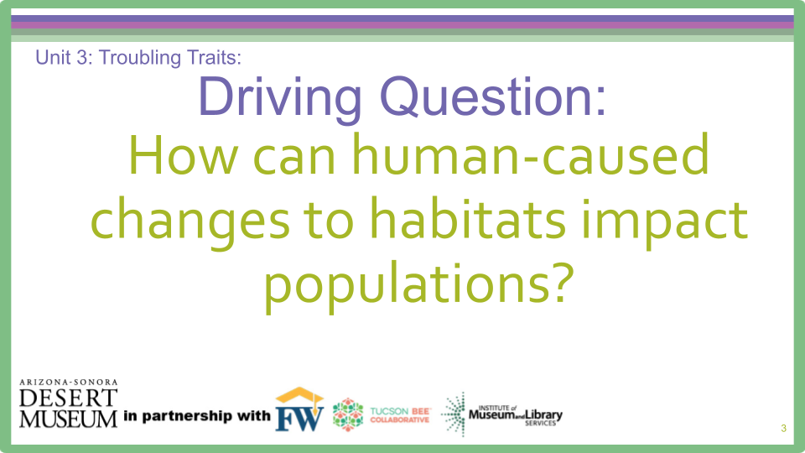

Unit 3, Troubling Traits: Driving Question
How can human-caused changes to habitats impact populations?

Slide 2

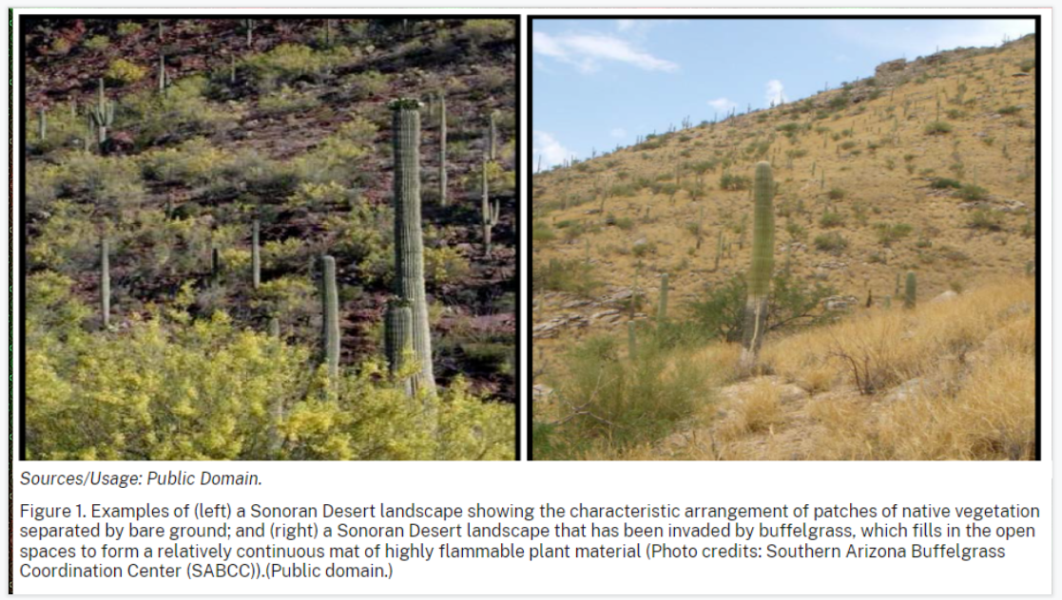
Engage
With your group, what do you notice about the photos? What do you wonder?
Write your wondering or your thinking on a post-it with your name.
Notes:
Have students look at photos. Teacher explains that the photo on the left shows a healthy Sonoran Desert landscape absent of buffelgrass. The photo on the right shows a Sonoran landscape invaded by buffelgrass. Students generate Wonder statements and place them on Wonder Wall

Slide 3
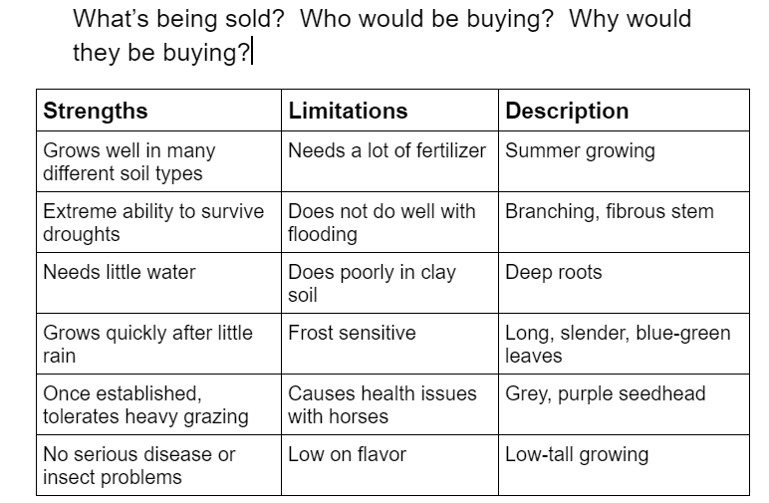
Engage cont. Check out the traits below with your group…
WHAT | WHO | WHY
Record conclusions on
Handout
Notes:
Have students put Heads Together in their groups to discuss what’s being sold in this product catalogue. Who would be buying the product and why would they be buying it? Students record their conclusions on Unit 3 Student Handout #1

Slide 4
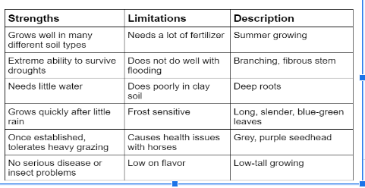
What did your group decide?
What is being sold?
Who would by buying?
Why would they be
buying?
Notes:
Students should determine that plants or seeds are being sold. Students should know a person growing something is purchasing the seeds. Teacher may have to lead students to think of farmers and ranchers. Targeted questions might include: Are there any people who may want these seeds for more than a garden? Who might grow lots and lots of plants? Who might grow plants for a living to make money?

Slide 5
Let’s think about what we already know so far…
Humans can select plant traits in order to grow future crops with traits we want.
Farmers, and those who raise crops, select for traits that make the plant a product that will sell.
They want to keep seeds of the plants that have the best traits (tastier fruit, bigger size, brighter colors.)
But what about ranchers?
What do they raise?
Notes:
Teacher reviews past learning in unit of how humans can and do select for traits. Teacher may need to lead students to realize ranchers raise cows. Depending upon student background knowledge, students may never have considered where the meat they eat comes from and the care and feeding of cows.

Slide 6
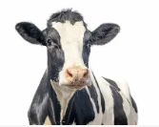
And what do cows need?
Notes:
Students will most likely say food. Discuss with students what cows eat - grass in pastures. If students are not knowledgeable about ranching or have never thought about ranching much, they will not think about feeding high numbers of cattle.

Slide 7
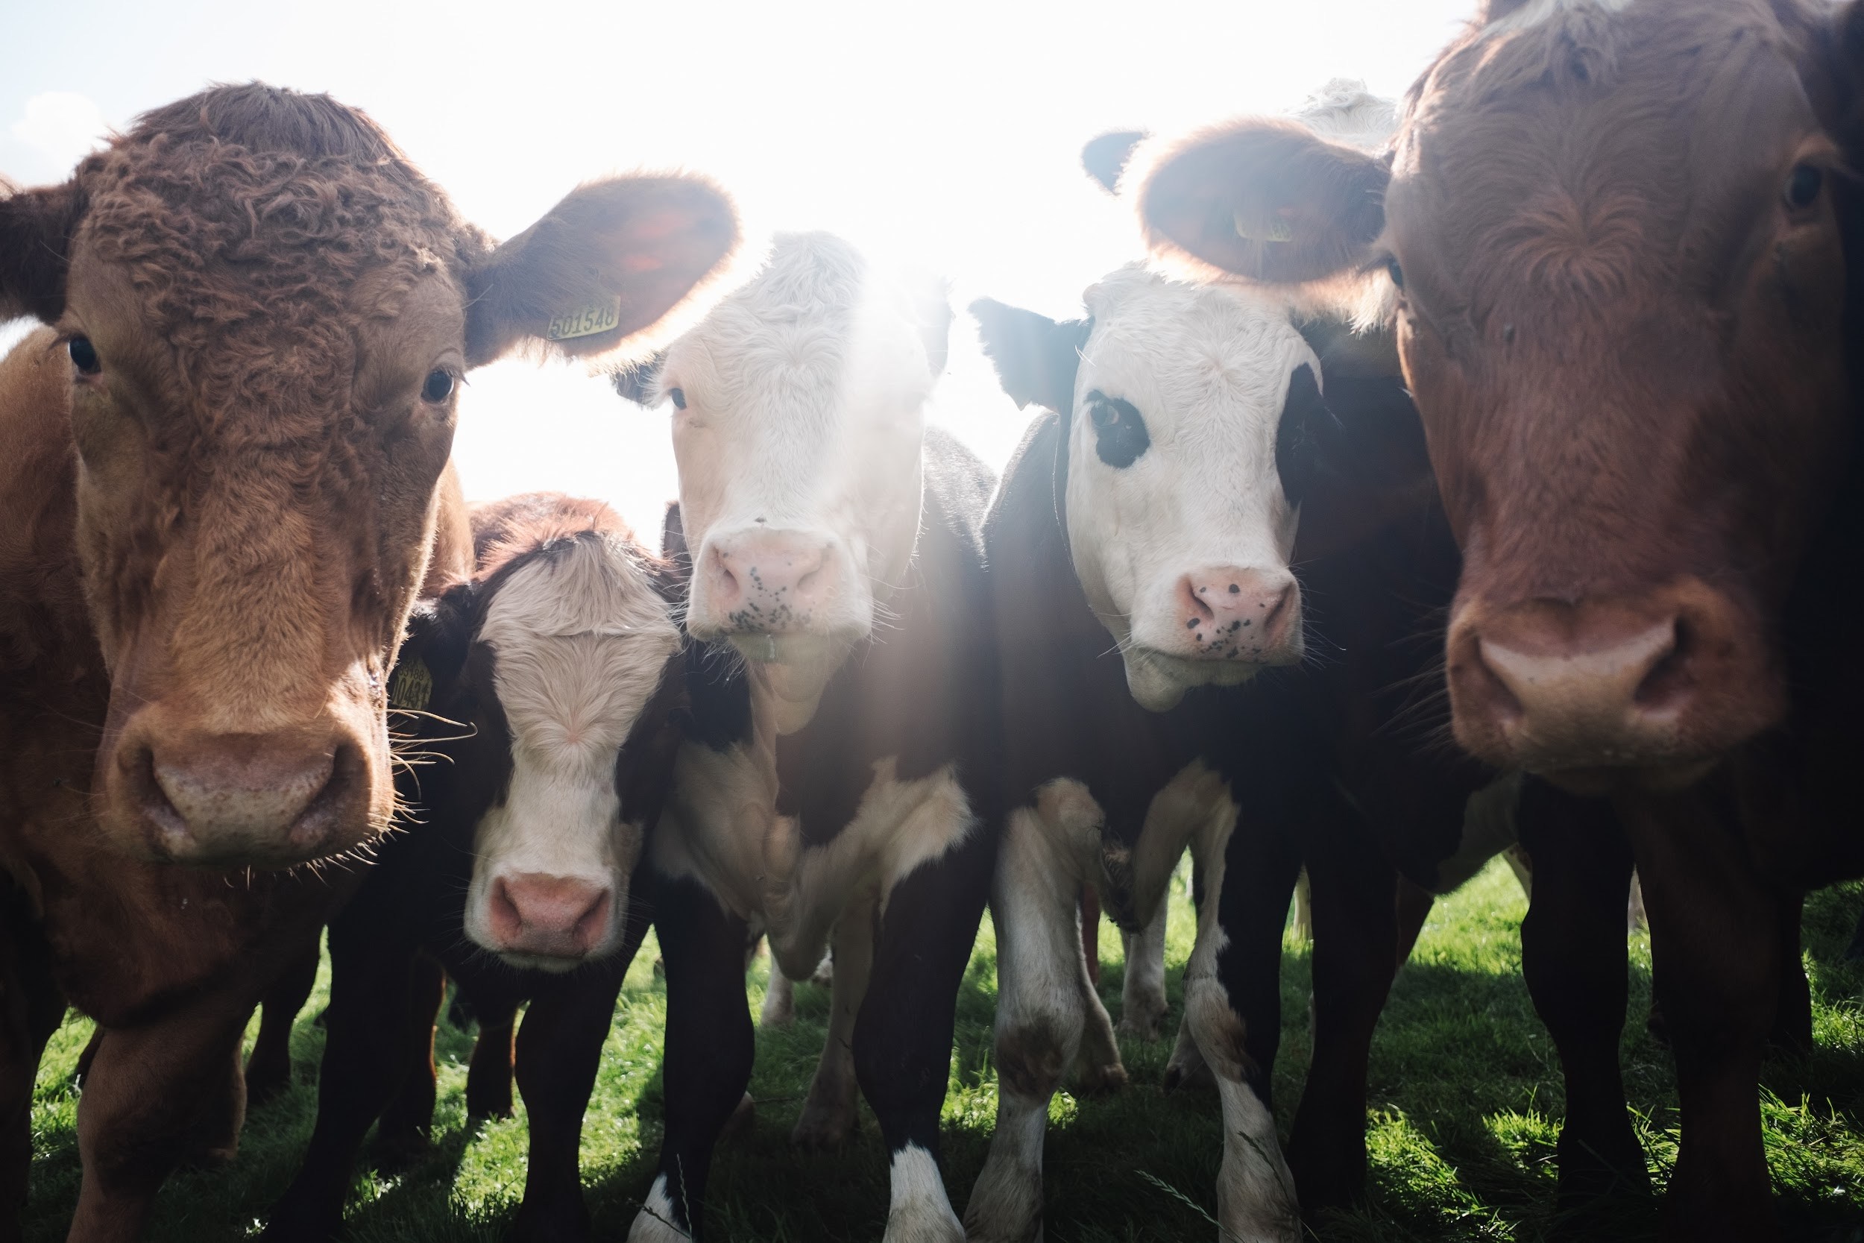
Beef is a big industry
Ranchers need plants to feed their crop…
Australian Pastures
Notes:
Depending upon student background knowledge, teacher may need to lead students to realize a rancher must feed many animals and this costs money. The link shows students the detail of the seed information. Discuss traits listed and why they would be of importance to ranchers. (In slide show mode, the Australian Pastures link goes to this website: https://keys.lucidcentral.org/keys/v3/pastures/Html/Brunswick_grass.htm)

Slide 8
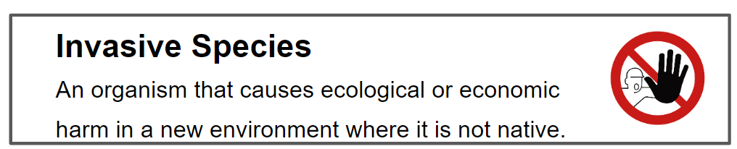
Explore
Scientists have been studying the effects of invasive plant and animal species for years. A major focus of invasive plant science is understanding characteristics of the areas invaded by non-native species and how they differ from non-invaded areas.
Notes:
Introduce students to a study conducted in Saguaro National Park. A major focus of invasive plant science is understanding characteristics of the areas invaded by non-native species and how they differ from non invaded areas. Teacher introduces definition of Invasive Species.

Slide 9
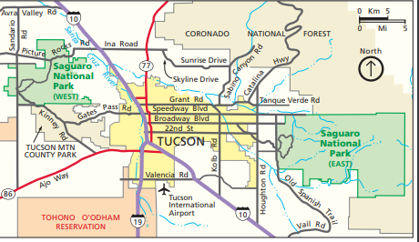
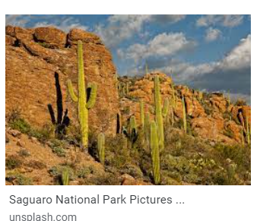
Ever heard of Saguaro National Park?
Notes:
Teacher discusses location of Saguaro National Park

Slide 10
Saguaro National Park
Several scientists in Saguaro National Park compared the soil, vegetation and soil seed bank of patches invaded and not invaded by buffelgrass. You will be studying a table with some of the data from this study, analyzing the data, and drawing conclusions.
Relative Cover % = the number of native plants covering an area of land with buffelgrass COMPARED to the number of native plants covering an area of land without buffelgrass
BG = Buffelgrass patch
NBG= Non-buffelgrass patch
Notes:
Introduce students to a study conducted in Saguaro National Park. A major focus of invasive plant science is understanding characteristics of the areas invaded by exotic species and how they differ from non invaded areas. Several scientists in Saguaro National Park compared the soil, vegetation and soil seed bank of patches invaded and not invaded by buffelgrass. Teacher explains Relative Cover % and BG and NBG.

Slide 11
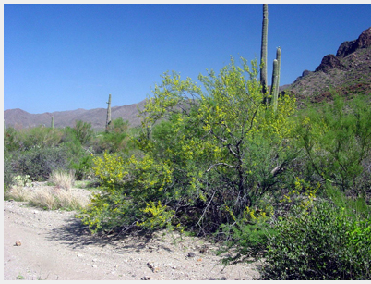
Let’s do a practice round before you work with your group
Species in Saguaro National Park in Areas With and Without Buffelgrass
Plant Species | Relative Cover(%) BG | Relative Cover(%) NBG | Does the plant cover more area with or without buffelgrass?
Whitethorn acacia (Acacia constricta) | 0.0 | 0.4
without
by 0.4%
Notes:
Model a practice round before students work in groups on Student Handout #1. Answer is animated. Students should determine that Whitethorn acacia covered more area in the area without Buffelgrass (NBG) by .4. The students should conclude that the plant covers more area without buffelgrass by 0.4%

Slide 12
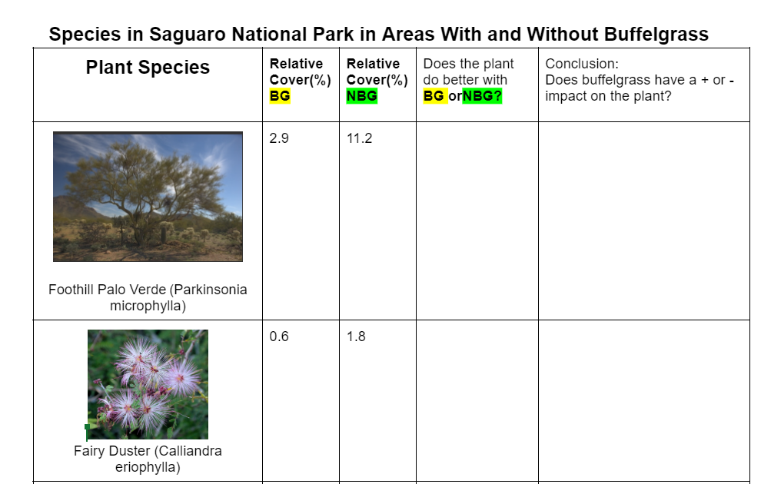
With your group…
Analyze the data displayed in the table on your handout.
Draw a conclusion about the impact of buffelgrass on the plant species given in the table.
Be ready to share your thinking with the class.
Notes:
Go over directions and check for understanding. Then lead students in a class discussion about their findings and conclusions. Students should note that some plant species are much more greatly impacted than others. Bring attention to the very negative impact on saguaros. Scientists know saguaros can survive one season with buffelgrass, but subsequent generations suffer greatly.

Slide 13
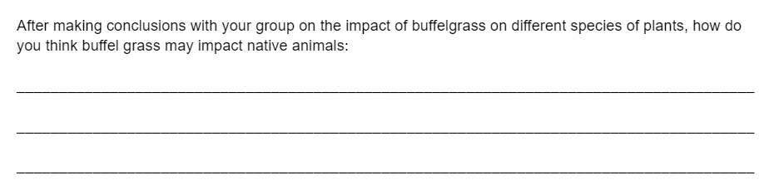
Heads Together…
Record your thinking on your handout
Reflecting on your group’s conclusions on how buffelgrass impacts native plant species,discuss how native animals might be impacted by buffelgrass.
Notes:
Lead a discussion in what conclusions the groups have. Go back and discuss the differences of the impact on different plant species. Students should determine that the native plant species are quite negatively impacted by Buffelgrass. Students may also conclude some species can cope better with Buffelgrass compared to some others. Knowing that only one generation of saguaro can really endure battling buffelgrass, ask students what they think could happen in the future to the saguaro population. Ask students what they think the data would look like over a ten year time span. Tell students that the longer the Buffelgrass grows and takes over, the more native plant species will be eliminated from that area. Then ask students to think about how native animal species might be impacted. Teacher may have to lead students to think about how their diet would be impacted if they rely on native plants. They also should consider how buffel grass turns the desert into grassland and therefore changes the animals’ habitat

Slide 14
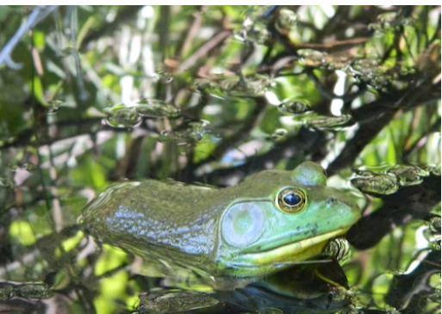
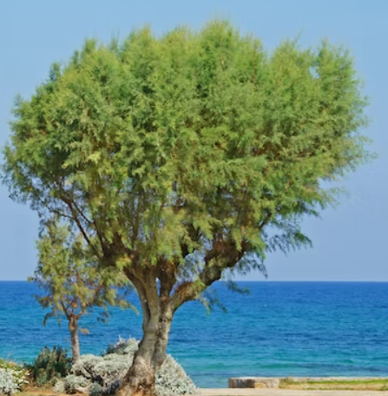
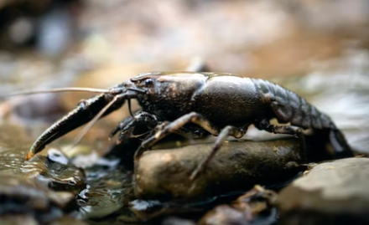
Explain
Do you know the difference?
INVASIVE SPECIES
vs.
NATIVE SPECIES
THINK PAIR SHARE
Notes:
Teacher needs to ensure students are clear on the words native species and invasive species. Have students think of invasive species as invaders. Bullfrogs and crayfish are some examples of animal invasive species. Tamarisk and salt cedar our examples of invasive trees. (Image of salt cedar)

Slide 15
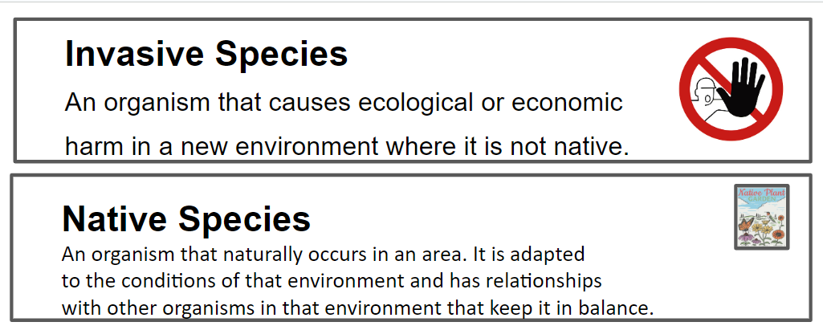
Notes:
Teacher shares definitions.

Slide 16
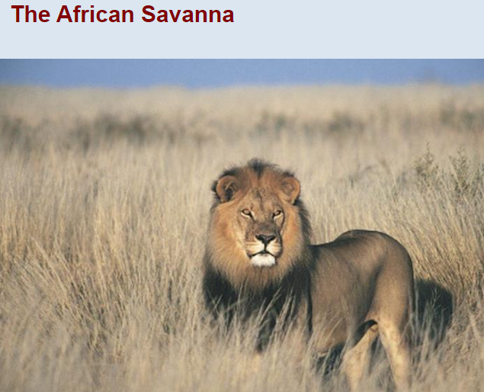
Where did buffelgrass come from?
Buffelgrass is from
the African Savanna
Buffelgrass is native to drier parts of Africa, Asia and the Middle East
Notes:
Teacher explains we brought buffelgrass here from Africa, from semi-arid grasslands. It is also native to drier parts of Asia and the Middle East.

Slide 17
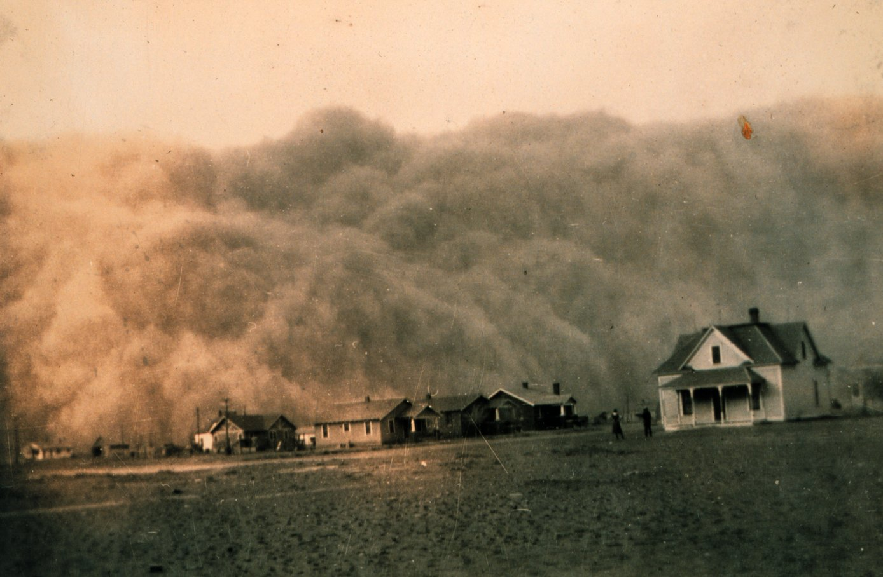
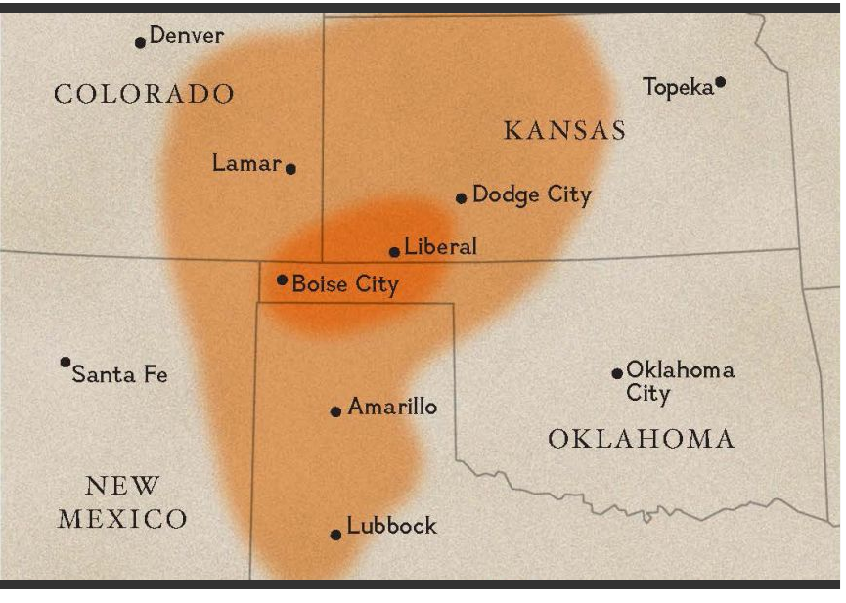
Why did we bring buffelgrass here?
Dust Bowl of 1930s ….
we needed something to stop erosion.
Notes:
Teacher will most likely have to give some background on the Dust Bowl of the 1930s. The Dust Bowl was the name given to the drought-stricken Southern Plains region of the United States, which suffered severe dust storms during a dry period in the 1930s. From Texas to Nebraska, people and livestock were killed and crops failed across the entire region. There were many causes of the Dust Bowl, including but not limited to the Homestead Act, changing climate, the belief that “rain follows the plow”, overall ignorance of proper land management and overgrazing. Winds, drought, and overused soil were other causes as well. While the Dust Bowl did not impact the Sonoran Desert region in quite the same way, there was still a concern about soil erosion in our area due to land use practices exacerbating flood and drought cycles. We needed plants to hold soil in place. Photo source USDA: https://infosys.ars.usda.gov/WindErosion/multimedia/dustbowl/dustbowlpics.html

Slide 18

We brought it here in 1930s
for soil erosion control
feeding cattle
adapted to warm, dry climates
It seemed to be a solution to our soil erosion problems!
Plus, since it spread quickly, it could feed cattle.
Notes:
Teacher reviews why we brought Buffelgrass from Africa. SInce it was adapted to drier, warmer climates, people thought it would do well here.

Slide 19
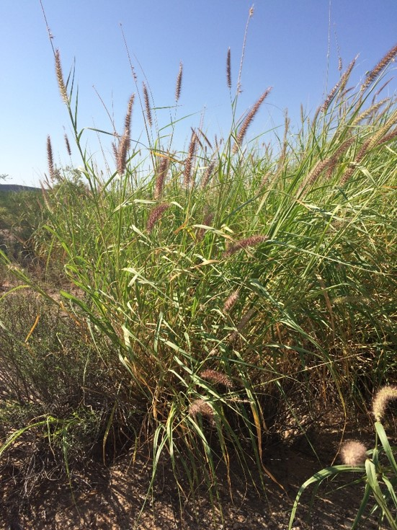

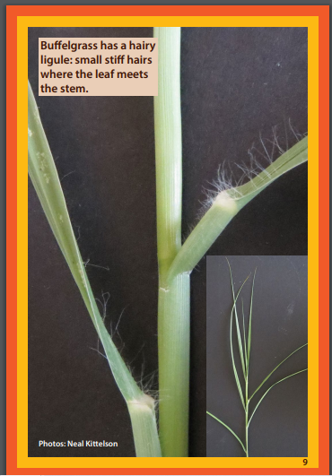
Meet
Buffelgrass
Bunch grass - all stems come from one point to form a large clump
Small, stiff hairs where leaves meet stem
Notes:
Teacher introduces buffelgrass traits and ID.

Slide 20
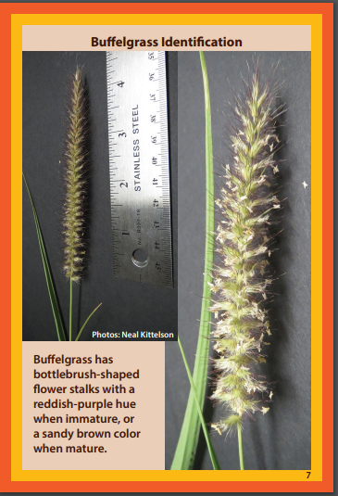
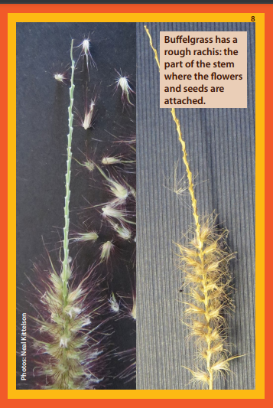
Meet
Buffelgrass
Notes:
Teacher continues to review traits. Flower stalks are reddish-purple and turn sandy brown as they dry. When the seeds fall off, the part to which they were attached is rough to the touch and zig-zaggy looking.

Slide 21
Buffelgrass traits we wanted…
does well in hot, dry climates
spreads quickly from seed
root system holds soil in place
can be eaten by cows
Let's revisit our seed catalogue
Notes:
Teacher continues sharing information on buffelgrass traits. Revisit link from Engage part of lesson and look up Buffel Grass seed under B.

Slide 22
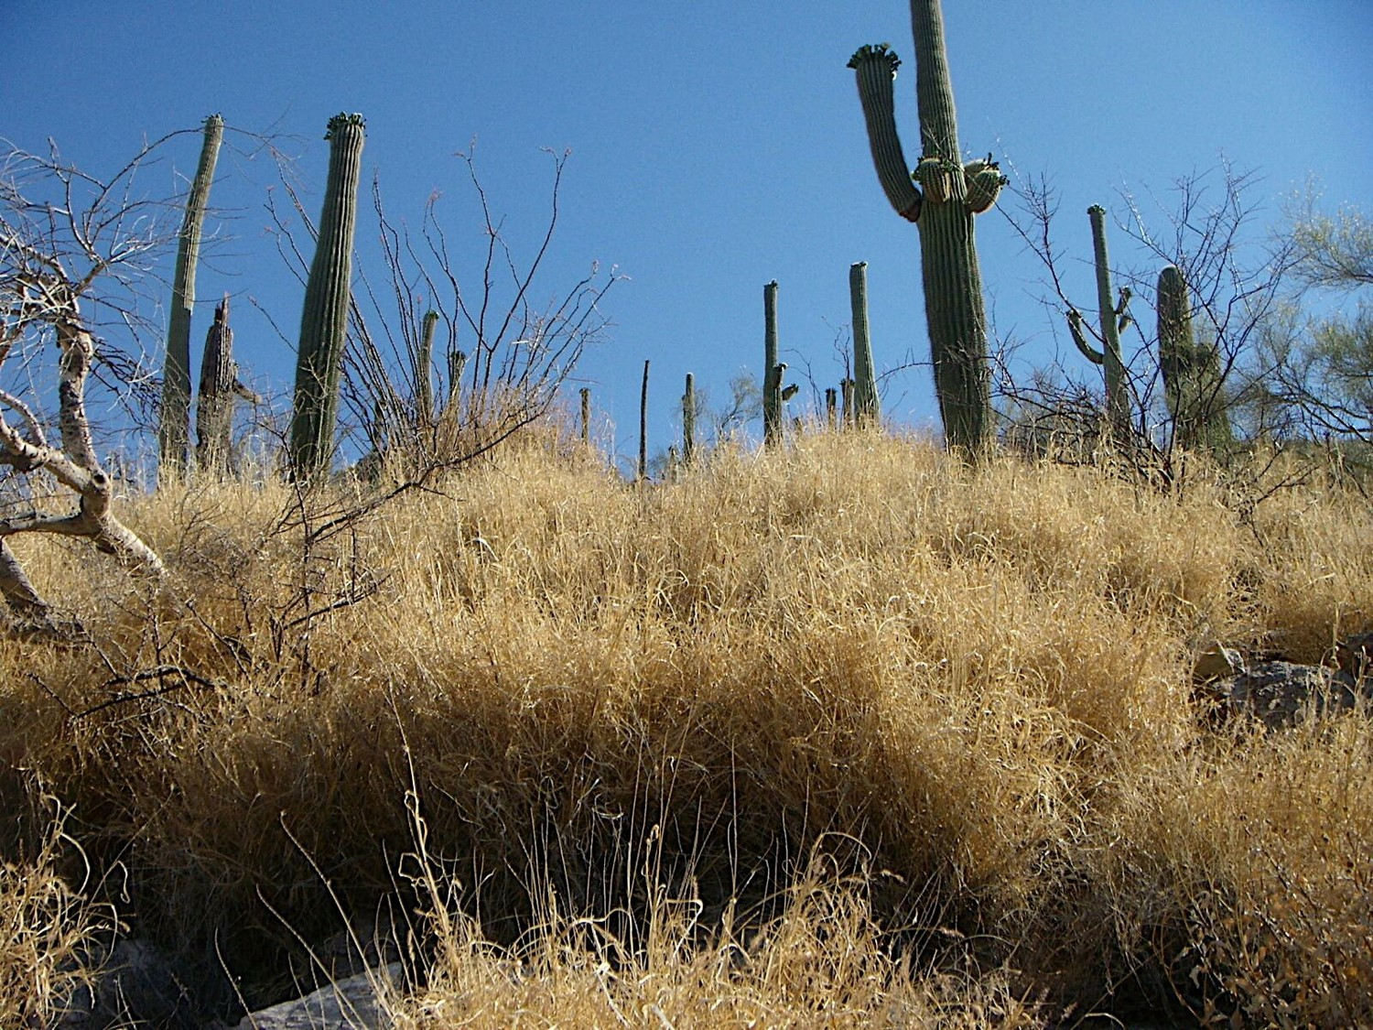
Buffelgrass traits we didn’t know about…
outcompetes the native plants for space, water & nutrients
turns fireproof ecosystems into landscapes rich in fire fuel
Notes:
Teacher then reveals the traits that have caused problems we did not anticipate

Slide 23
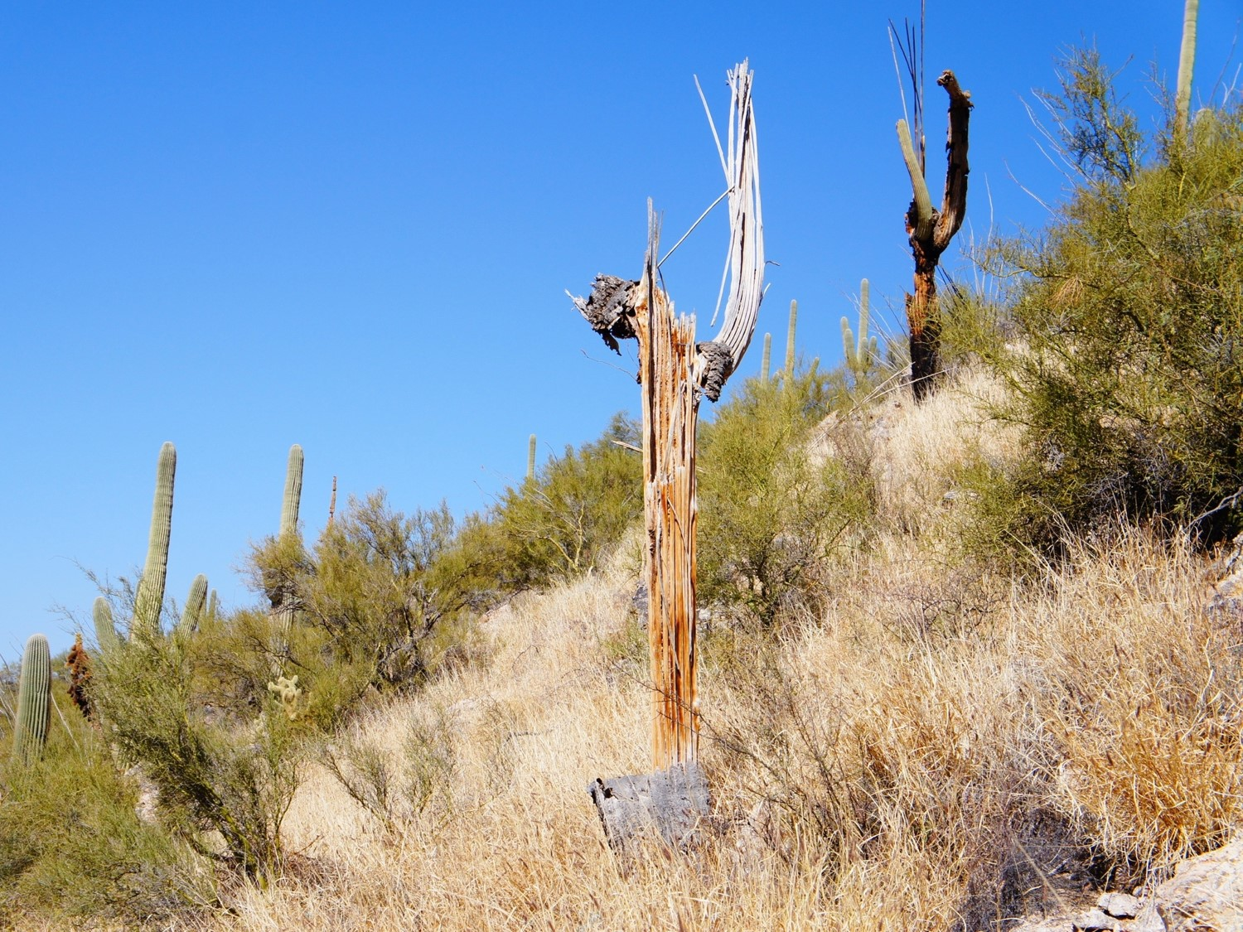
We didn’t realize that these traits would…
turn the Sonoran Desert into a grassland
decrease biodiversity
be the greatest threat to saguaros and our desert
Notes:
Teacher continues to review the Buffelgrass traits that negatively impact the environment and native plants

Slide 24

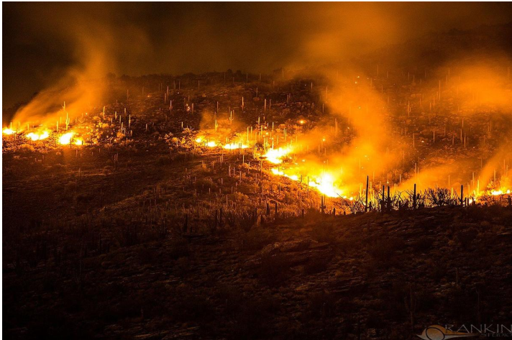
We didn’t realize that these traits would…
burn an area the size of a football field in 3 minutes
fuel extremely hot fires with temperatures up to 1400˙F (fires in native plants burn cooler, 190-750˙F) and flames reaching up 20 feet
Test Burn
Notes:
Teacher continues to review the Buffelgrass traits that negatively impact the environment and native plants, including the damaging effects of the very hot fires fueled by buffelgrass. The link shows a test burn in which Saguaro National Park teamed up with Tucson Water and University of Arizona researcher Chris McDonald to conduct a 160-acre prescribed burn on City of Tucson land in Avra Valley on May 28, 2008. (https://www.youtube.com/watch?v=rBnsTsXwn50) Play the video then ask students if they were a property owner/homeowner/renter, should they have a vested interest in the invasion of buffelgrass?

Slide 25
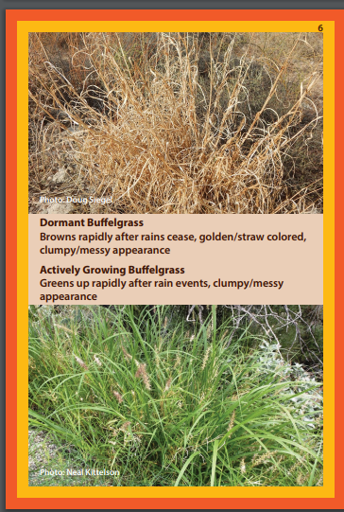
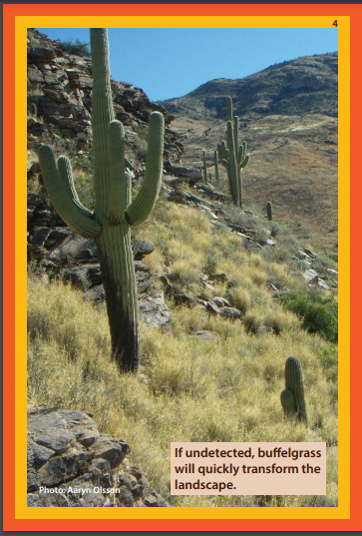
Notes:
Teacher reviews slide info and what happens when buffel grass takes over. Discuss how our unique desert is being transformed into a grassland. The world only has one Sonoran Desert; once it’s gone, it’s lost forever. The saguaro only grows in the Sonoran Desert.

Slide 26
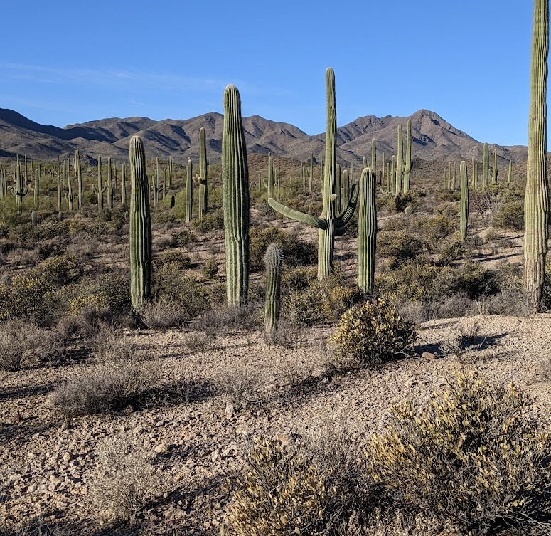
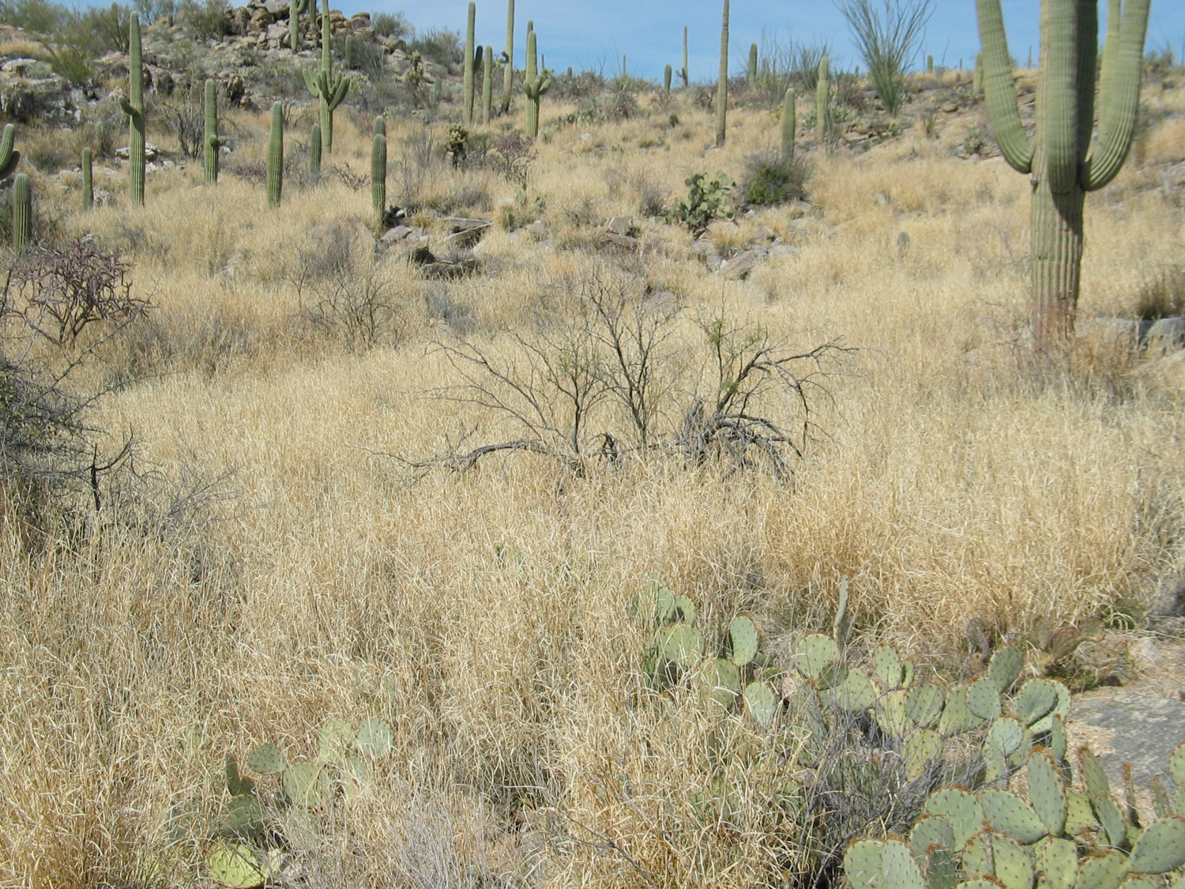
Buffelgrass is turning this into this!
Notes:
Teacher guides students to compare the two photos.

Slide 27
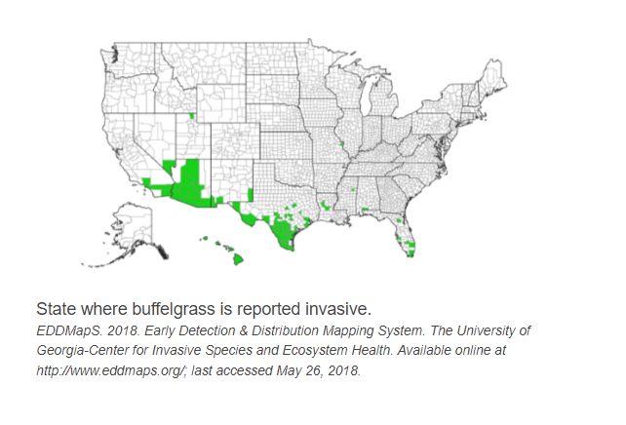
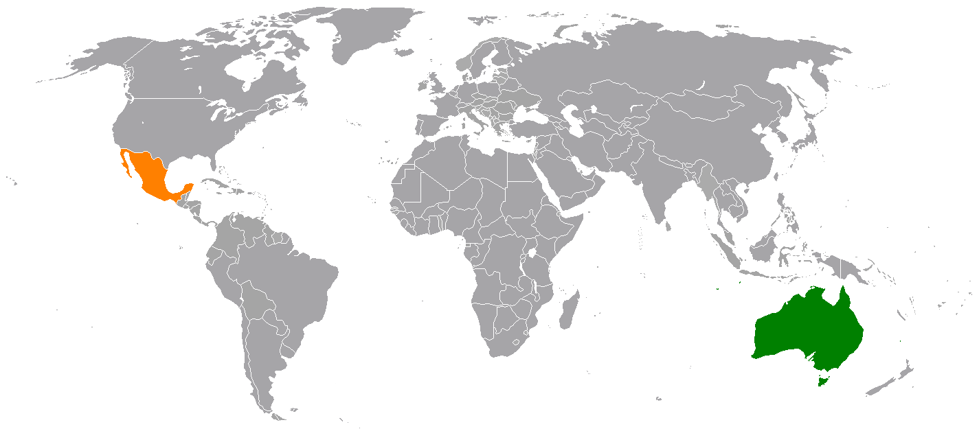
Buffelgrass isn’t just invading North America…
Mexico & Australia
Notes:
Teacher shares how other continents and countries impacted by Buffelgrass. Teacher should point out the borders. Arizona has labeled Buffelgrass as a Noxious Weed, but surrounding states continue to sell it http://buffelgrassseed.com/product-details/ (Teacher may choose to take students to this sight to see where this company is located). Mexico listed Buffelgrass as a Federal Invasive Species in 2016. The South Australian Government declared buffel grass a weed under the Natural Resources Management Act 2004. https://www.pir.sa.gov.au/biosecurity/weeds/controlling-weeds/buffel_grass Teacher should discuss what students have learned already about how seeds travel via wind, water, etc.

Slide 28
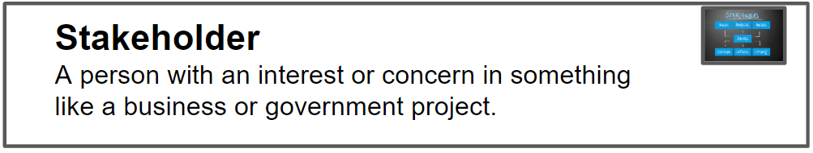
So why do we care? Who are the stakeholders in the buffelgrass invasion?
Notes:
Allow students to discuss in group what they think a stakeholder is and teacher introduces the definition

Slide 29

Heads together…
With your group, discuss who has a stake in knowing about buffelgrass and its impact?
Notes:
Students put heads together and discusses who would have a vested interest in preventing buffel grass from continuing to spread.

Slide 30
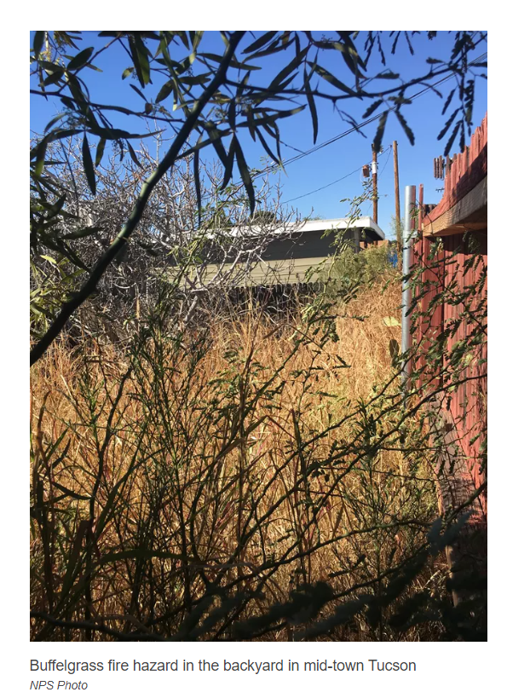
Be ready to share why the following are stakeholders:
Property owners and renters (HOAs too)
Utility companies (electricity, water)
Fire departments
Arizona Department of Transportation
Bureau of Land Management
Forest Service
Game and Fish
City, State, and National Parks
Native American tribes
Ranchers and farmers
Military personnel
Scientists
Fire Management
Notes:
Teacher goes over stakeholders listed on slide and why they are stakeholders. Teacher will most likely need to explain that an Homeowners Association HOA is an organization that makes and enforces rules and guidelines for a subdivision, planned community, or condominium building. HOAs do want buffel grass around or near their communities due to fire risk. Teacher will most likely need to explain that Arizona Department of Transportation agency is responsible for planning, building,operating maintaining highways & is involved with maintaining public transportation and municipal airports. ADOT
does not want buffel grass growing in medians due to fire danger. Ranchers and farmers do not want their land to become infested with buffelgrass for the same reason - greatly increased fire danger. Scientists want to prevent the spread of buffelgrass and study impacts of buffelgrass on native animal species as well.

Slide 31
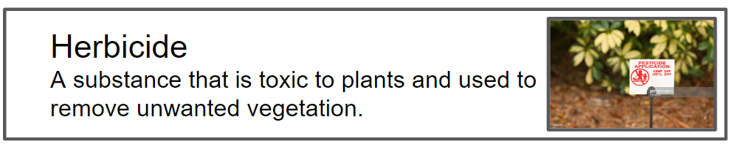

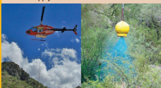
How do you think we could solve the buffelgrass problem?
Dig out - manually remove- pull out roots
Herbicide - people carry spray backpacks, vehicles and helicopters have spray tanks
Notes:
After teacher gets students to share their thinking on how to deal with buffel grass, teacher begins sharing how Buffelgrass must be removed manually or killed with herbicide. Teacher informs students that herbicides (humans spraying, using vehicles to spray herbicide and spraying from airplanes) & manually pulling

Slide 32
Saguaro National Park's Efforts
Notes:
Show this short video summarizing the threat of buffelgrass and Saguaro National Park’s efforts to prevent its spread.

Slide 33
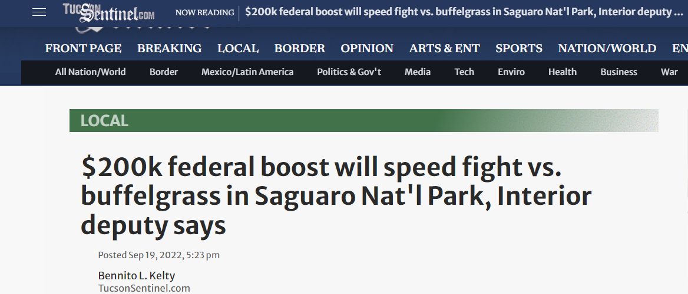
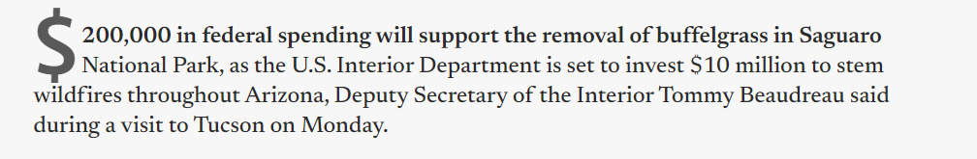
Government $
Federal Funding
Notes:
Teacher talks about how Federal dollars help fight the buffelgrass battle. Teacher can take student to link for more information

Slide 34
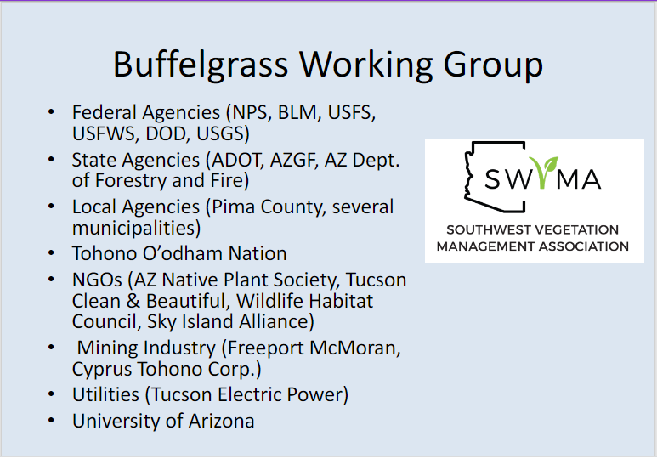
Notes:
Teacher shares some local Stakeholders and stakeholders not discussed earlier and why they are stakeholders. Discuss why these stakeholders have a vested interest in preventing the spread of buffel grass.

Slide 35
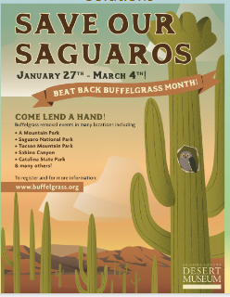
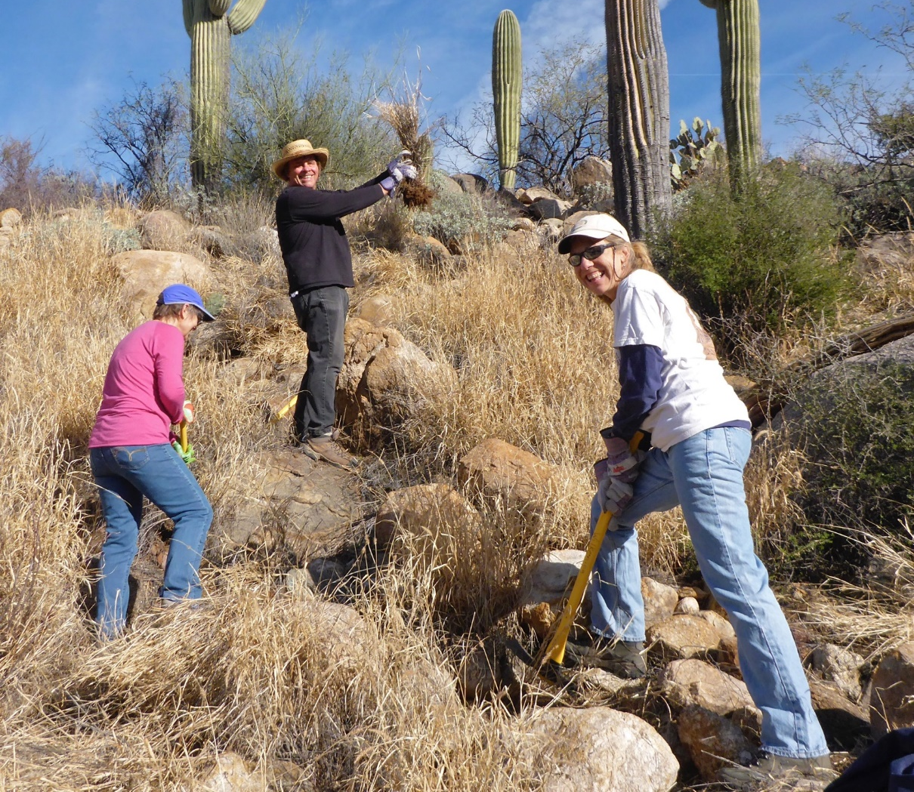
Volunteers - Weed Wackers
Notes:
Teacher shares local groups that actively organize community Buffelgrass pulls. It’s not just governments and companies who care, it’s all of us.

Slide 36

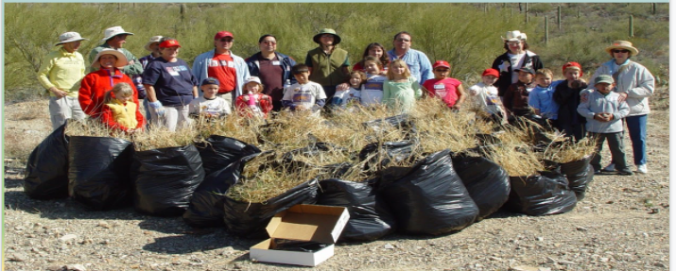
Desert Museum Coati Kids Club
Year 1 - 24 bags
Year 2 - 10 bags
Year 3 - 2 bags
Notes:
Teacher shares information on how kids can make a difference too, like the Desert Museum’s Coati Kids Club and their active role in pulling Buffelgrass on land near the museum. Teacher has students process and discuss what the data on the number of bags collected means.

Slide 37
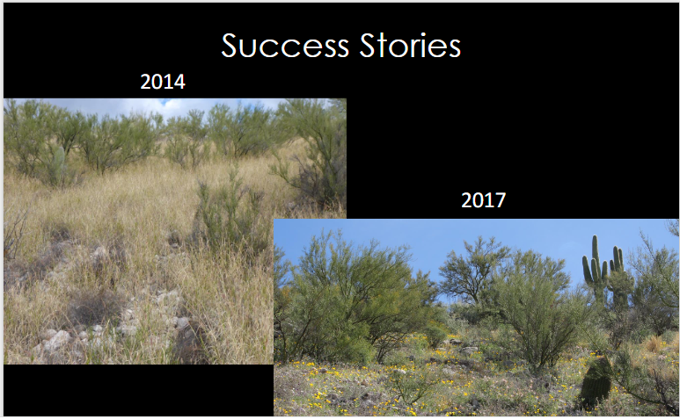
Notes:
Teacher again emphasizes the power of citizens actively working together to get rid of Buffelgrass

Slide 38
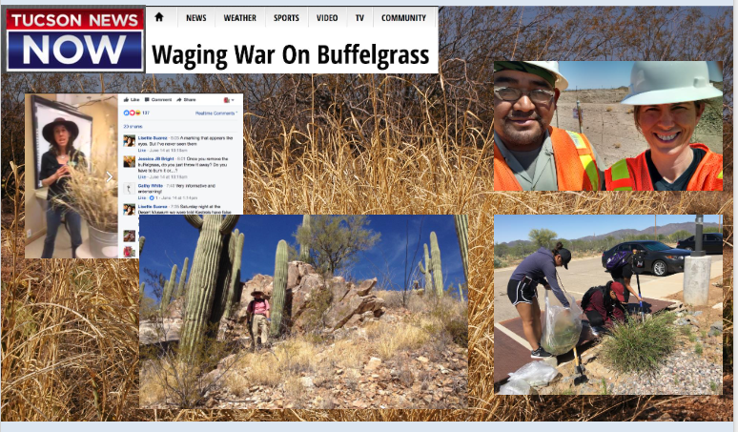
Notes:
Teacher shares how the Buffelgrass Battle is discussed in the local media so as to raise awareness in hopes of getting citizens to become an active participant in battling buffel grass

Slide 39
Elaborate -
Let’s play a board game to explore buffelgrass –how it spreads and its effects.
Warning: You will be recording your learning on your handout!
Notes:
Teacher goes over Directions and Objective of game on the next several slides. Students play game for 20-25 minutes. Students record their learning from playing the game on their handout.

Slide 40
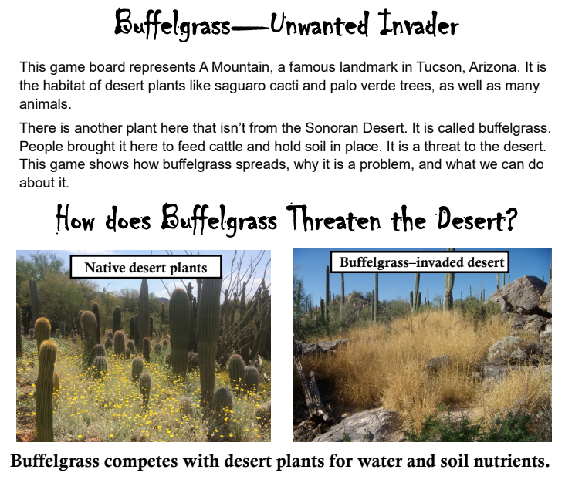
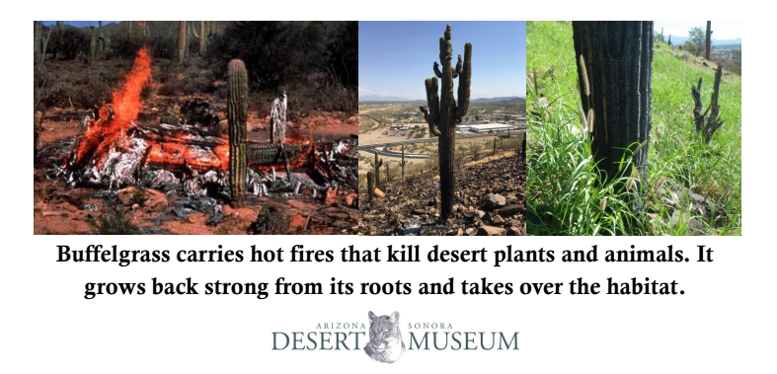
Notes:
Teacher reads info off of slide to class

Slide 41
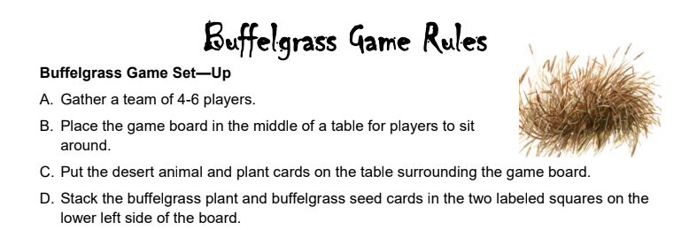
Checking for Understanding:
How many players?
Where do you place the animal and plant cards?
Where do you place the buffelgrass seed and buffelgrass plant cards?
How can you decide as a team together who goes first, second, etc?
Notes:
Teacher goes over directions and checks for understanding

Slide 42
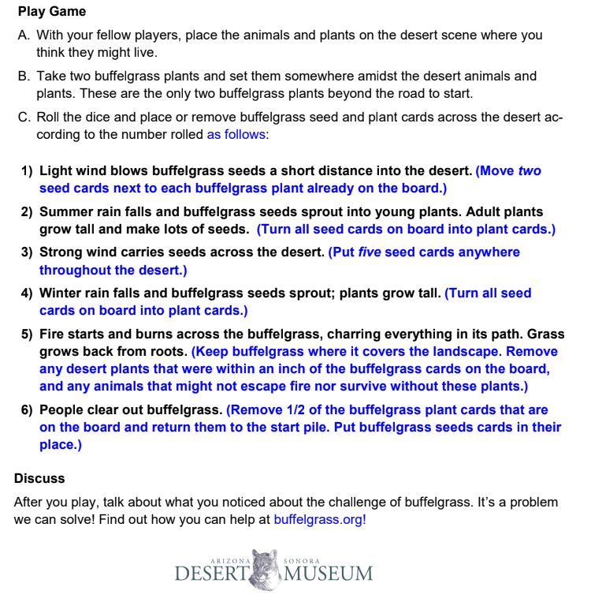
Student Roles
Material Manager: is responsible for getting/returning materials to teacher
Rule Follower: is in charge of the rule sheet and informing group about what to do
Seed Sorter: is in charge of distributing/collecting buffelgrass seed cards
Plant Person: in charge of distributing/collecting buffelgrass plant cards
Notes:
Teacher reviews rules - checking for understanding questions on the next slide. Student roles can be modified to fit your group’s needs. All players should take part in placing initial cards and helping to place/remove buffelgrass cards. The two buffelgrass roles are for keeping the cards neat and sorted. You can use different strategies to assign roles (oldest-youngest, wearing longest socks-shortest socks, etc.) or assign based on need.

Slide 43
As you play, have fun! Record your learnings on your handout:
My biggest learnings from playing the Buffelgrass Game were:
1.______________________________________________________________________________________
________________________________________________________________________________________
2.______________________________________________________________________________________
________________________________________________________________________________________
3.______________________________________________________________________________________
________________________________________________________________________________________
Notes:
Students play game for 20-25 minutes. Students record their learning from playing the game on their handout. Allow students to write their learning as they play the game.Teacher leads class in a discussion about the game, how it went, and what students learned.

Slide 44
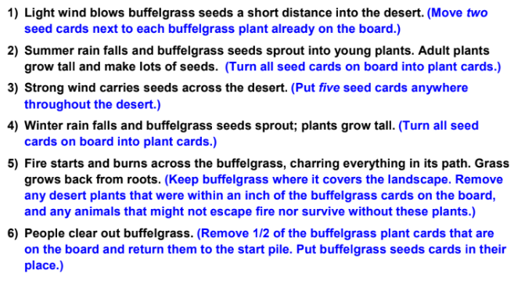
Checking for Understanding
1.Where does the group place animal and plant cards?
Where you think they might live
2. How many buffelgrass plant cards do you begin with? Where do you place them?
Somewhere among the desert animals and plants
3. When you roll the dice, what does the number on the dice tell you?
Look at the Rules sheet to know
Notes:
Check student understanding of how to play the game

Slide 45
Checking for Understanding Continued…
4. Should your group play quietly, or share what they notice and are thinking?
Share your thinking!!
5. Do you need to record anything on your lab worksheet?
Yes - and be ready to share your learnings in class discussion afterwards as well
6. When do you stop playing?
When your teacher gives you the signal - hopefully 20-25 minutes
Notes:
Continue to check for understanding of game

Slide 46
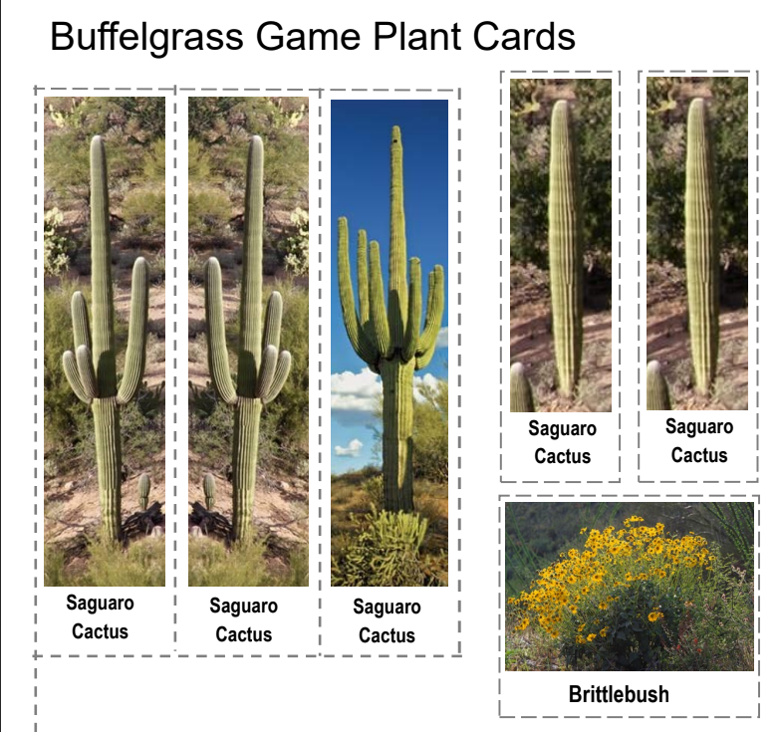



Notes:
Teacher reviews desert plant cards

Slide 47


Notes:
Teacher reviews desert animal cards

Slide 48


Notes:
Teacher reviews plant and seed cards

Slide 49
Did you record your learnings on your handout?
My biggest learnings from playing the Buffelgrass Game were:
1.______________________________________________________________________________________
________________________________________________________________________________________
2.______________________________________________________________________________________
________________________________________________________________________________________
3.______________________________________________________________________________________
________________________________________________________________________________________
Notes:
Give time to Students to record their learning from playing the game on their handout. Allow students to write their learning as they play the game.

Slide 50
Let’s discuss what you learned from the game.
What were your biggest takeaways from the game?
Did the buffelgrass spread quickly and easily?
How were the native plants impacted?
What about the native animals? Was your group correct in their thinking about how buffelgrass could impact animals?
Notes:
Teacher takes students through questions posted on slide and leads class discussion. Students revisit their predictions on how the invasion of bufflegrass could impact native animal species.

Slide 51

Let’s take a look at our native desert tortoise.
Scientists have been studying the desert tortoise and the impact buffelgrass has had on tortoises since they rely on native plants.
Notes:
Teacher shares that any animal that eats or relies on a native plant for its food is negatively impacted as well. Teacher should explain scientists measured the mass (height, weight and length) or male and female tortoises in areas invaded with buffelgrass, and areas not invaded by buffelgrass. Ask students to predict what scientists found. https://ag.arizona.edu/~steidl/files/pdfs/Gray%20and%20Steidl%202015.%20Biological%20Invasions.pdf

Slide 52

What do you notice? What does the graph tell you?
Y Axis:
Tortoises’ body condition
X Axis:
% of area infested with buffelgrass
Notes:
Teacher shares data on desert tortoise. Teacher explains the Y Axis is a measure of the tortoise’s overall health or body condition, basically a measure of the mass (weight) divided by the shell size of each male and female tortoise they measured. The X Axis shows the percentage of area infested with buffelgrass. Students put heads together and discuss. Teacher listens to student thinking. The desert tortoise eats the natural vegetation that is hard to find due to buffelgrass replacing natural plants. Buffelgrass is not nutritious or a part of a desert tortoise’s natural diet. Here is the link to the paper written about the Study. https://ag.arizona.edu/~steidl/files/pdfs/Gray%20and%20Steidl%202015.%20Biological%20Invasions.pdf

Slide 53


Besides diet, how else would the tortoise be impacted?
Notes:
Teacher poses question on slide. Student put Heads Together and may conclude that since the tortoises’ habitat is changing, they may have difficulty finding shelter sites. Not only do tortoises rely on native plants for food, but plants also provide shelter and cover. And buffelgrass may obstruct them from finding the rocky crevices or soil embankments in which to retreat.

Slide 54

Evaluate
Now that you know about buffelgrass, let’s revisit the image and our Wonder Wall from the beginning of the unit…
Does anyone want to add any more post-its?
Have “I Wonders” been answered?
Notes:
Have students revisit their post its on the Wonder Wall from the beginning of the until. Ask students if they want to add anymore post-its and if their I wonders have been answered.

Slide 55
Let’s revisit our Driving ?
How can human-caused changes to habitats impact populations?
What was the change humans caused in this unit?
What populations were impacted by the change humans caused?
Notes:
Teacher revisits the unit’s Driving Question. Teacher then asks students what change in the environment did humans cause in this unit and what populations were impacted. Have students discuss their answers. Then lead a class discussion on the students’ thinking. Discuss that humans brought buffelgrass to North America. Focus on how it has negatively impacted the population of native plant species - particularly saguaros in the Sonoran Desert. This in turn impacts any animal eating native species. Humans have been impacted as well. Revisit stakeholders. Also point out that humans did not anticipate or know about the negative impacts of buffelgrass - they were trying to solve a problem. As humans deal with solving problems they encounter with the environment, they often deal with unintended consequences. Science was behind buffelgrass being a solution, and science was behind fixing the problems our “solution” created. No environmental issue is simple.

Slide 56

Let’s consider the future and buffelgrass…
Image from: Grassification and Fast-Evolving Fire Connectivity and Risk in the Sonoran Desert, United States from Frontiers in Ecology and Evolution, 25th of October, 2021
Notes:
Teacher goes over information in slide and explains that based on many studies and considerable data, this is a graphic of scientists’ conclusions about our future with buffelgrass if we do nothing. Explain the Near Future is roughly 50 years by scientists’ predictions. Bring attention to the size of the flames. Teacher asks students what they think this symbolizes. What do the arrows show?

Slide 57
The PRESENT graphic arrows show that forest fires in the mountains occur in uplands such as grasslands and forests. They are damaging, but they don’t drop down into the desert.
The NEAR FUTURE graphic arrows show that with buffelgrass, mountain forest fires could reach into the desert and burn hotter, causing more damage, and maybe reach into the city.
Notes:
Teacher listens to students’ thinking. Teacher checks for student understanding. Ensure they understand that the future graphic shows buffelgrass will form connectivity between the upland grasslands and woodlands and can carry forest fires from the mountains into the desert, covering more area of land while increasing fire danger, burning off native plants, and replacing native ecosystems with non-native savanna grasslands. Teachers can see entire article here: https://www.frontiersin.org/journals/ecology-and-evolution/articles/10.3389/fevo.2021.655561/full

Slide 58

Notes:
Teacher listens to students ideas and thinking based on what they know what know about buffelgrass. Check student understanding that the fire can spread down the mountain and burn hotter with buffelgrass while turning habitat to non-native grasslands.

Slide 59
The City of Tucson must come up with a plan to prevent the 50 year prediction from becoming a reality.
Notes:
Teacher explains how the size of the graphic shows that the fires are increasing in size and temperature, are moving down the mountain and into the foothills. Discuss what impact this would have on humans, the environment, animals.

Slide 60

Heads together, with your group…
Think about all you learned on the efforts of scientists and citizens to solve the buffelgrass problem. In order to stop the 50-year prediction from becoming a reality for Tucson, talk with your fellow scientists about which method you think is best to prevent the future predicted in the slide. You can have more than one approach. On your Student Handout, record what your group decided and why you think your solution will be effective.
Notes:
Review with students that currently, manual pulling of the buffelgrass, herbicides, legislation, and educating the public are efforts residents and scientists have put forth for solving the buffelgrass problem. Students then record what they believe the most effective solution to be on their student handout.

Slide 61
Following Evaluation…Unit Wrap Up
EPILOGUE

Slide 62

Epilogue: What about our flowers?
Things You Should Know By Now:
Due to trait variation, every individual plant and animal is unique in some way (except identical twins)
Humans have selected for desirable plant traits for hundreds of years
Notes:
To wrap up unit, revisit that due to trait variation, all individual plants and animals are unique (excluding identical twins). Humans have selected for desirable plant traits for years

Slide 63
If we had more time…
If you selected two plants with purple, hairless stems, how would you know if the traits you had selected for actually emerge?
We would have to have our flowers die, collect the seeds, and plant the seeds to see if we were successful.
What if we wanted the flowers to have 6 petals, how would we do that?
Notes:
Ask students how we would ensure that the traits they selected for their next generation actually passed on. Ask how if they wanted flowers to have 6 petals, how would they go about doing that? Students would need to find 2 plants with a 6-petaled flower and cross pollinate those 2 flowers. Wild roses have 4-6 petals. Humans selected traits over the years and the domestic roses now have more like 45 petals.

