Slide 1

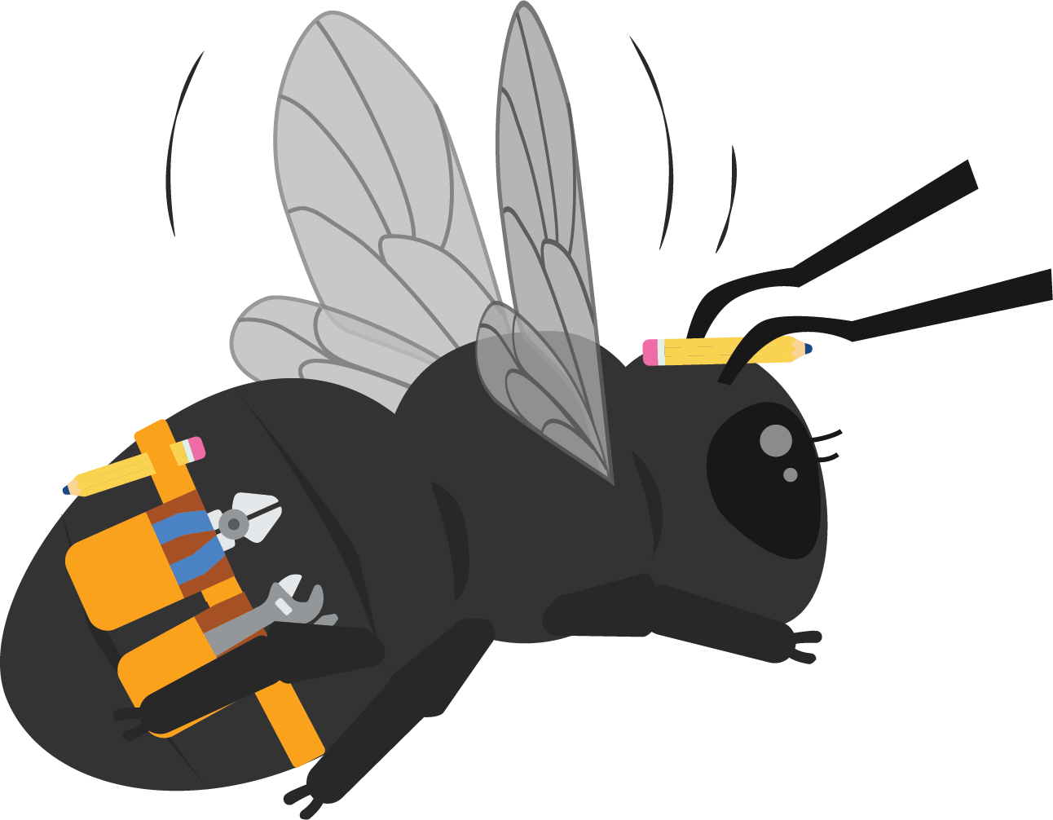
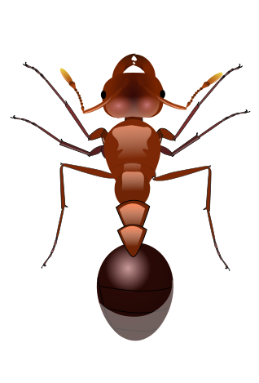

It’s Alive
Unit 1

Slide 2
Driving Question
What is the difference between living and nonliving things?
Notes:
The driving question you pose to students in order to get them to investigate a problem.

Slide 3
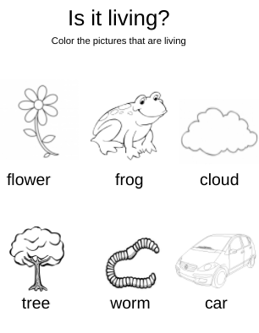
Probe
Color the objects that you think are living.
Why do you think they are living?
Why do you think they are nonliving?
Notes:
Have students color the objects that they think are living. Students will discuss their thinking? (think-pair-share)

Slide 4
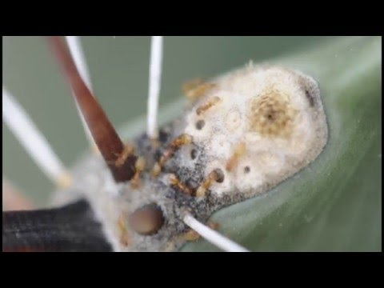
Phenomena
What do you notice?
What do you wonder?
Notes:
Show the video to the students: Ask them what do the notice? What do they wonder? (Wonderwall) Video Link: https://youtu.be/5UGVUiaRFXY

Slide 5
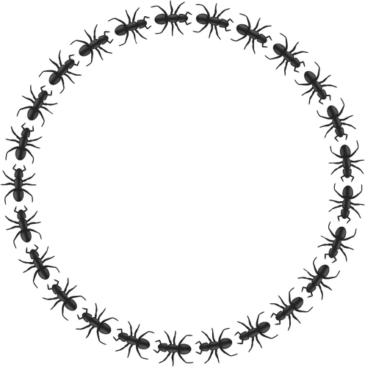
Engage
Let's make a home for our ant:
Think:
What should we feed our ant?
Does our ant need food to live?
Why would our ant not need food?
Notes:
Give each student a plastic ant (or printed picture of an ant). Tell the students to give their ant a name. Tell the students that their ant needs a home and give each student a box. Ask students, “What sort of food should we feed our pet ant?” “Do our ants need food to live?” “Why would our ant not need food”. Guide the students to the idea that the ant is not really alive, it is a plastic (picture) of an ant. (Solo-Pair-Team)

Slide 6

Vocabulary Cards
We will learn some new words that we will hear in this science unit.

Slide 7
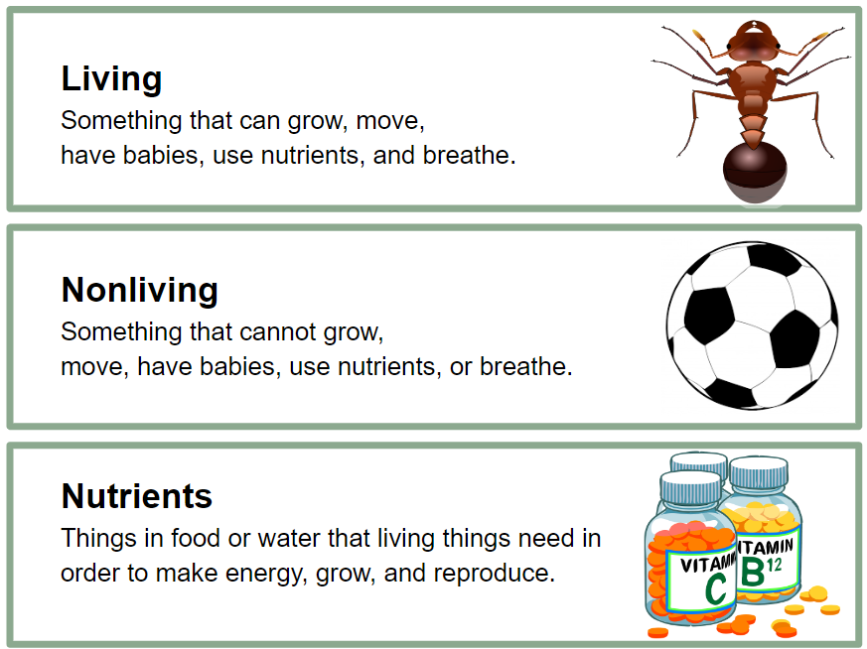
Notes:
Say the word. Have the students repeat the word
Explain the definition
Give an example

Slide 8
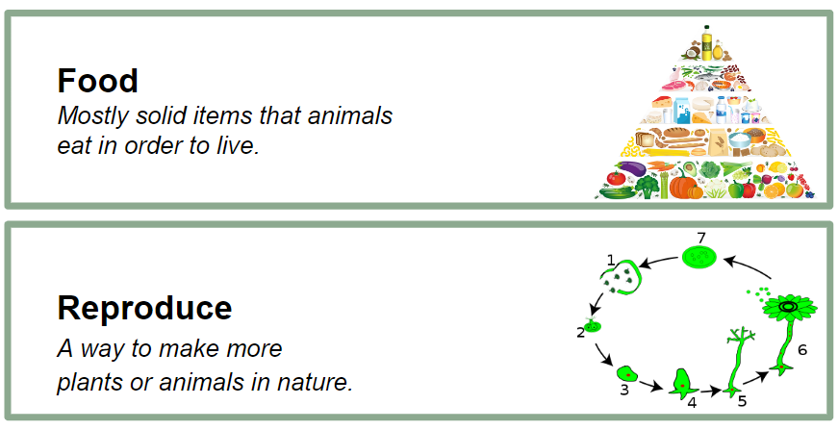
Notes:
Say the word. Have the students repeat the word
Explain the definition
Give and example

Slide 9




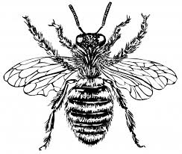
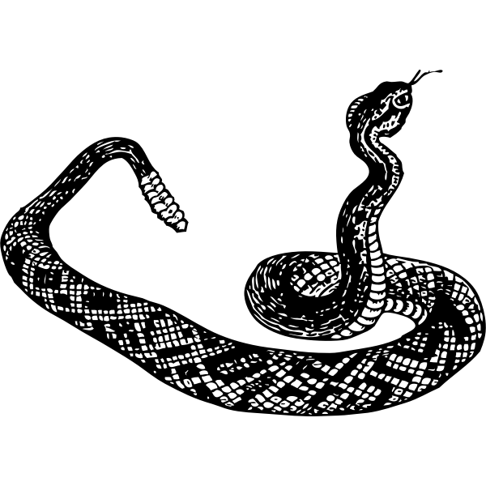
Explore
Think about it: Are these things living or nonliving?
ant
rock
flower
house
bee
snake
Notes:
Give each student a copy of the Living and Nonliving sort.
In small groups have students work together to determine which pictures are “living” and which are “nonliving.”

Slide 10
Explore
Living | Nonliving
Notes:
Use this slide to record each group's answers. As a whole class, ask students if any pictures need to be switched or if the pictures look correct. Have students explain their reasoning. Randomly call on a student on two students to explain why they placed their pictures in the living or the nonliving.

Slide 11
Explore
Living | Nonliving
Notes:
Use this slide to reveal the correct answers. This slide is animated. Each click will reveal a new answer.

Slide 12

Explain
Does it grow?
Notes:
Explain to the students that if something is living or nonliving, we must ask ourselves: Does it grow?

Slide 13
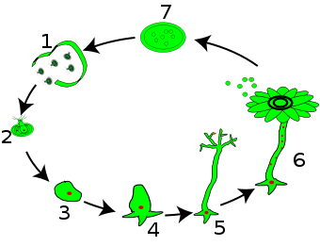
Explain
Does it reproduce?
Notes:
Does it reproduce?

Slide 14

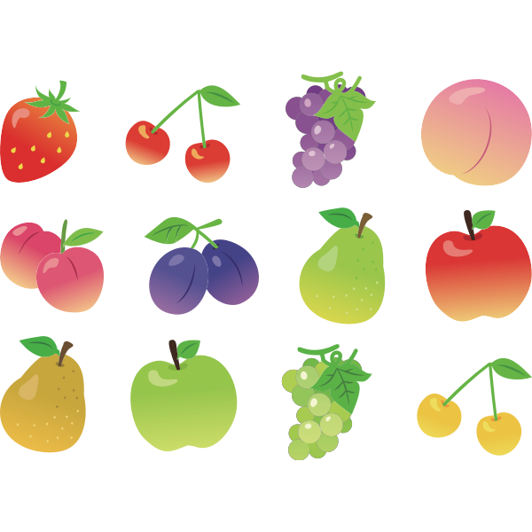
Explain
Does it need nutrients?
Notes:
Does it need nutrients?

Slide 15

Elaborate
Nature Walk
Thinking about everything we learned, we are going to go on a nature walk.
Using your worksheet, you are going to draw or write things that are living and things that are nonliving.

Slide 16
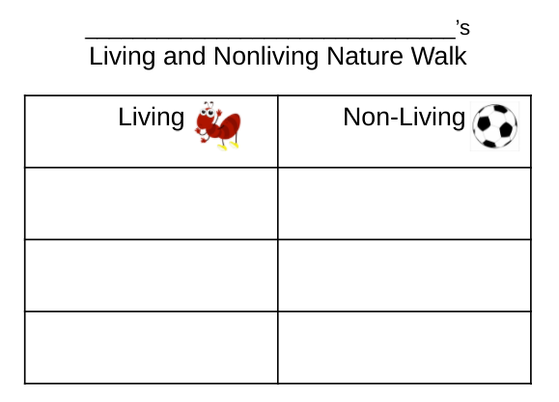
Notes:
Take students on a nature walk around your school. Give each student a clipboard, pencil, and Nature Walk worksheet. Using the knowledge they have learned, have the students identify and record things that are living and nonliving.

Slide 17
Evaluate
Create a class book: one thing that is Living and one Non-Living thing
Ask yourself:
Does it reproduce?
Does it grow?
Does it need nutrients?
Notes:
Remind students that when thinking if something is living or nonliving they can ask themselves: Does it reproduce? Does it grow? Does it need nutrients?

Slide 18
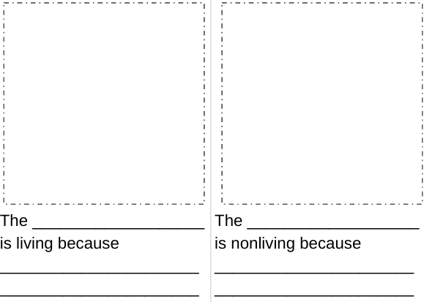
Notes:
Have students select one thing that is Living and one Nonliving thing. Students will draw a picture of each, then write the name of their item and explain why it is living or nonliving. EX: The ant is living because it needs food. The ball is nonliving because it doesn't grow. Students should ask themselves: Does it reproduce? Does it grow? Does it need nutrients? Create a classroom book.

